Slide 1
Week 1 Day 1
Welcome to Revature

Slide 2
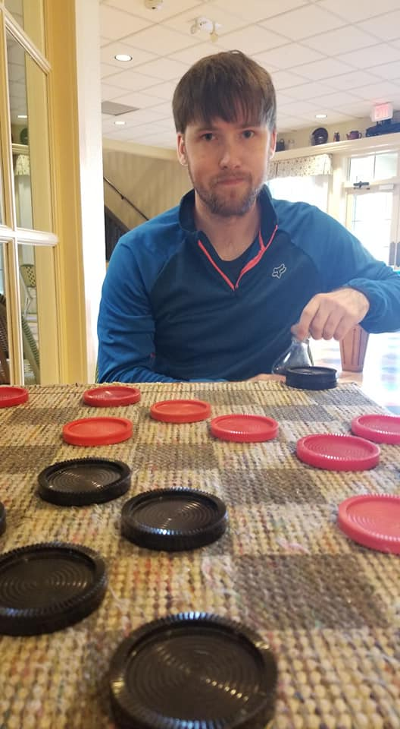
Get to know your trainer
Ethan McGill
Graduated SE from Iowa State University
During my free time
Spend time with my wife and dog
Video Games
Side projects
Wood working

Slide 3
What to expect during training
Training M-F 9AM to 5PM CST
Training will consist of
4 Projects
Weekly Quiz
One on one interview practice
Weekly QC
Content Delivery
Content will be delivered via power points and hands on coding exercises
Comprehensive notes will be provided every afternoon on github
Team based learning strategy

Slide 4
Tentative Schedule
Mondays
Morning:
Quiz
One on one
Personal work
Afternoon
Content
Tuesday – Friday
Morning
Content
Hands on
Afternoon
Personal work
Office Hours
Study/Review

Slide 5
Projects
Four projects with increasing technologies
P0 individual
P1 partner programming
P2 small group
P3 full group capstone

Slide 6
Quality Control
QC will occur on a weekly basis
Meant to be interview practice
More information tomorrow

Slide 7
Expectations
Hard work pays off
Do your best
Ask Questions
Interaction
Cameras on
Use your mic to ask questions
Teamwork
Rely on one another
I should be last line

Slide 8
Git
Version Control System

Slide 9
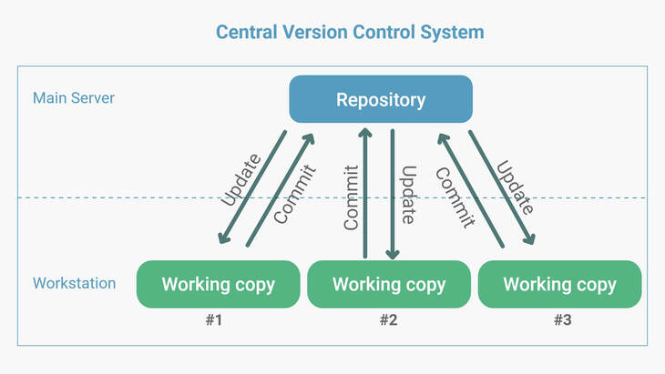
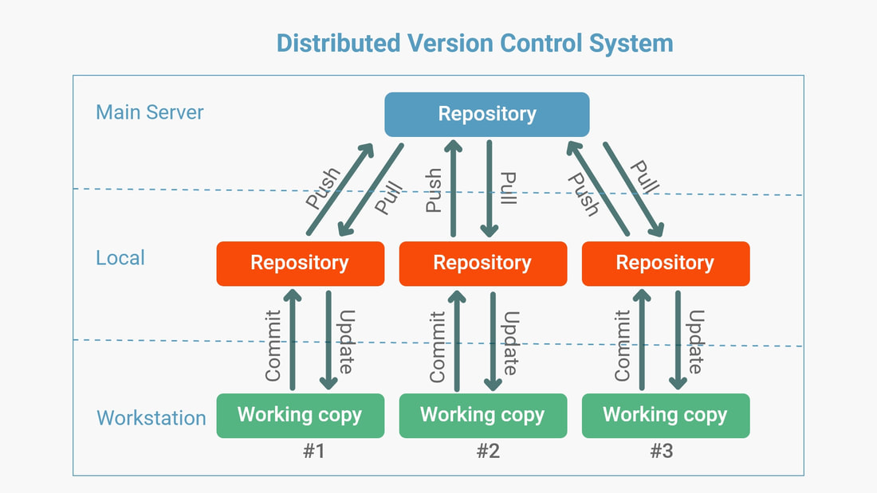
Version Control Systems
Keep track of code changes
Collaboration Tool
Two Types of Version Control Systems
Image source: https://www.htown-tech.com/blogs/centralized-vs-distributed-version-control-system

Slide 10



Repository Hosting Platforms
We must store our decentralized repo somewhere
Many platforms including:
Gitlab.com
Github.com
Bitbucket.org

Slide 11
Creating a Repository DEMO

Slide 12
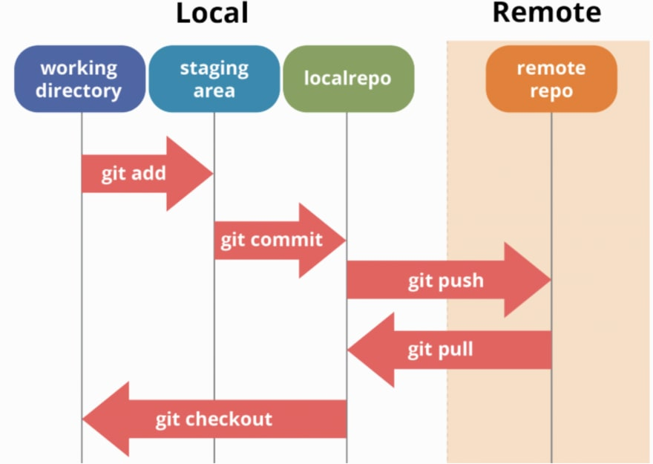
Git Flow and Snapshotting
Image source: https://dev.to/mollynem/git-github--workflow-fundamentals-5496

Slide 13
Creating A Remote Repository (DEMO)

Slide 14
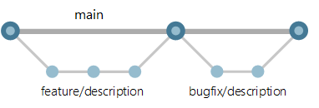
Git Branching
Main branch
Working copy of the code from your project
Create branches off main to test/implement new features
Merge the changes back into main when features/testing is complete
Image source: https://docs.microsoft.com/en-us/azure/devops/repos/git/git-branching-guidance?view=azure-devops

Slide 15
SDLC
Software Development Life Cycle

Slide 16
SDLC Overview
Two types of SDLC
Waterfall
Agile
Both follow these steps:
Requirements Phase
Analysis Phase
Design Phase
Development Phase
Testing Phase
Integration and Deployment Phase
Maintenance Phase

Slide 17

SDLC: Waterfall
Waterfall is the linear approach to SDLC
Image source: https://www.ntaskmanager.com/blog/how-to-use-ntask-for-waterfall-project-management-a-practical-guide-for-first-timers/

Slide 18
Waterfall Project Timeline
Requirements: 2 – 4 weeks
Planning: 2 – 4 weeks
Design: 1 – 4 months
Implementation: 6 – 12+ months
Testing: *6 months
Deployment: 1 – 3 weeks
Maintenance: Lifetime

Slide 19
Waterfall Advantages vs Disadvantages
Advantages
Easy to manage workflow
Good for small teams, short term projects
Generally faster delivery of product
Easily documented process and results
Easy to adapt to shifting teams
Disadvantages
Inflexible and inefficient
Not idea for large projects
Testing is not started until development is complete

Slide 20
SDLC: Agile
Agile is an iterative approach to SDLC
Accomplish all steps in 2 – 4 week sprints
Agile core values:
Individuals and interactions over processes and tools
Working software over comprehensive documentation
Customer collaboration over contract negotiation
Responding to change over following a plan

Slide 21
Agile: Advantages vs Disadvantages
Advantages
Client collaboration is good
More self-organized and motivated
Overall quality of the product is higher due to the iterative approach
Less risk in development if something changes
Disadvantages
Not as great for small teams
Higher costs
Development can bloat if time is mismanaged
Requires more experienced members during planning and management of the project

Slide 22
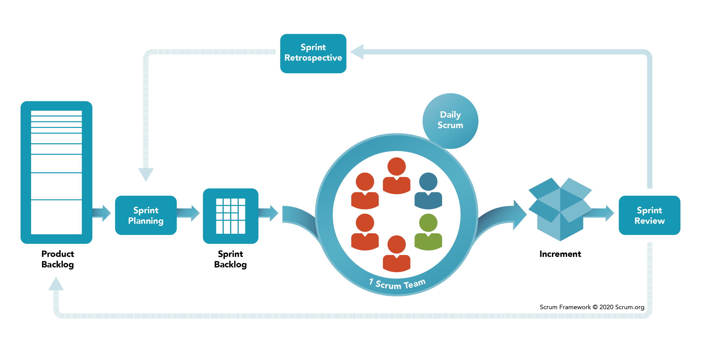
Agile: Scrum Methodology
Scrum is the simplest implementation of the Agile framework
Image source: https://www.scrum.org/resources/what-is-scrum

Slide 23
Scrum: Artifacts
Product Owner
Client/customer
Scrum Master
Team leader
Project Backlog
List of all project requirements
Sprint backlog
List of sprint requirements
User Story
An individual requirement
Sprint
Period in which the team is developing
Velocity
Sum of story points of all user stories complete that week

Slide 24
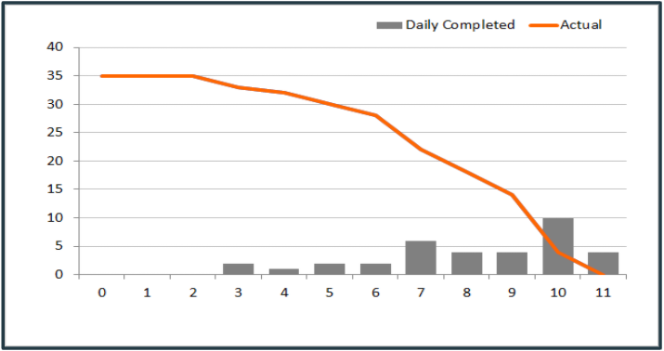
Scrum: Story Pointing
Assigning Points to each user story
Used to create burndown charts which show progress
Assigning points is a team activity
Consider the risk, complexity, and repetition of each user story
Recommended to use Fibonacci sequence when assigning points

Slide 25
Scrum: Ceremonies
Spring Planning
Devs, leaders, owner
Before every sprint
Determine scope, goals, and metrics
Daily Standup
Lead by scrum master everyday
Quick 15 minutes
What you’re working on, stuck on, and goals
Spring Review
Anyone and everyone
Review what the team accomplished
Feedback
Sprint Retrospective
Scrum master reviews metrics, and assesses efficiencies
Make improvements

Slide 26
Java
Installation and Introduction

Slide 27

Java
Java is a programming language that is:
High leveled
Compiled
Strongly/Strictly typed
Object Oriented

Slide 28
Java: Why?
Java has many advantages including:
Platform independent
Very popular, huge developer base
Object Oriented
Simple to learn
Free, and supported by Oracle
Automatic memory management, and garbage collection

Slide 29
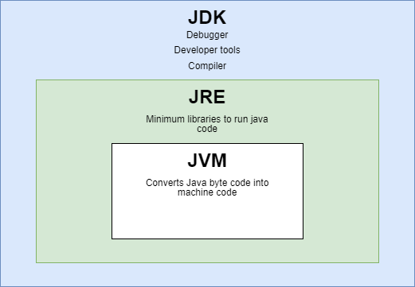
Java: JDK vs JRE vs JDK
JDK: Java Development Kit
JRK: Java Runtime Kit
JVM: Java Virtual Machine

Slide 30
Our First Java Program and installing IDE (DEMO)

Slide 31
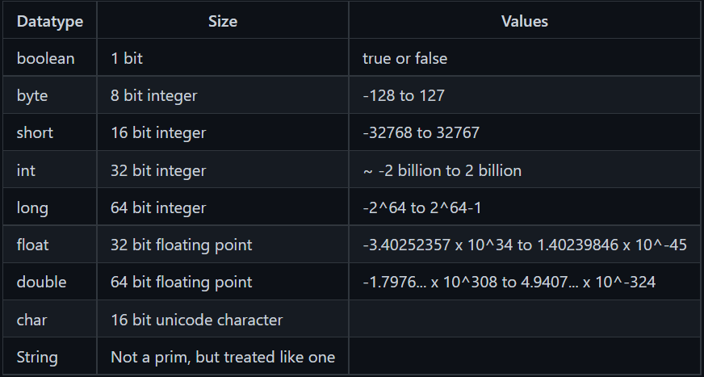
Java: Primitive Data Types
Default values:
boolean: false
char: \u000 (0)
int: 0
float: 0.0f
reference: (objects) null
Datatype Casting:
Widening: occurs automatically, converting smaller to larger
Narrowing: manual, larger to smaller, could cut off data

Slide 32
Java: Classes and Objects
Classes
Blueprints for objects
Objects
Virtualization of real-world objects in code
Consists of:
States (property attributes)
Behaviors (functions)
Identity (name)
Why Objects and Classes?
Modularization

Slide 33
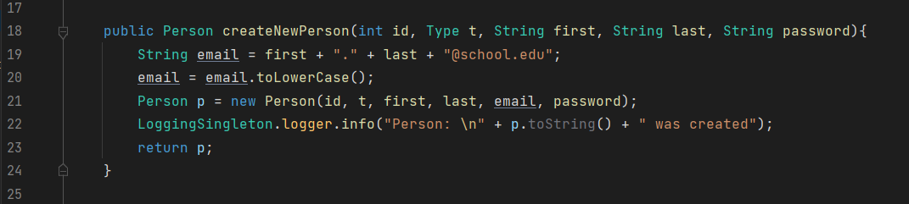
Java: Methods, Parameters, main
Methods
Blocks of code which only run when called
Declared inside of a class, creates the objects behaviors
Parameters
Specified inside of the method parenthesis, you pass these values to your method
main
Special method where the execution of the code occurs

Slide 34
Java Hands on w/Primitives and Methods (DEMO)

Slide 35
Java: Pass by Reference vs Value
Pass by reference takes the literal object from memory and passes it to the method/function
Pass by value, gets the value from the object and passes it to the method/function
Java uses pass by value for its methods

Slide 36
Java: Stack vs Heap Memory
Heap is the total memory for the application
Cannot control the amount
Contains the stack and objects
The new keywords adds new objects to the heap
OutOfMemoryError occurs if you run out of heap space
Stack stores method calls, and local variables
Methods and their local variables get put on the top of the stack
StackOverflowError occurs if you run out of stack space

Slide 37
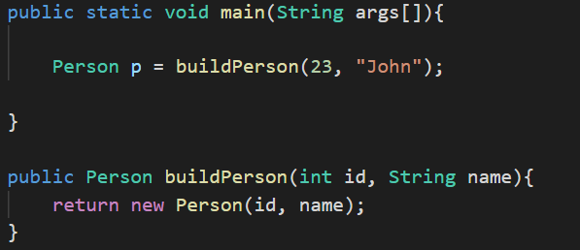
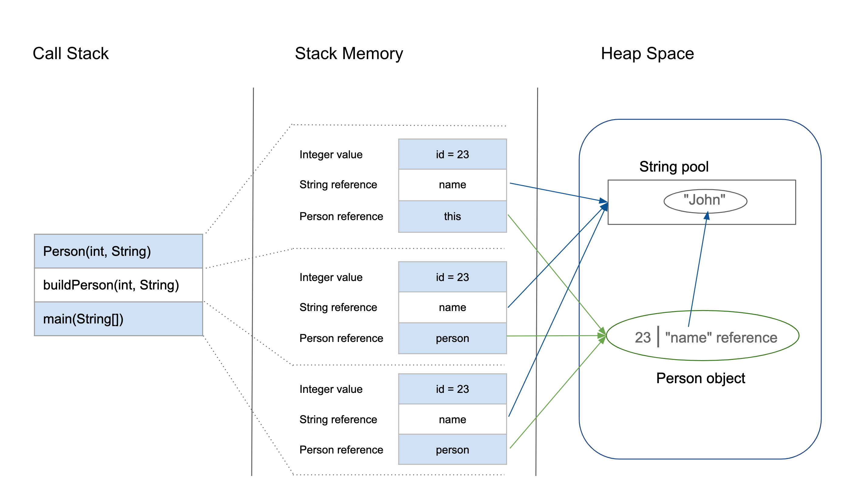
Image source: https://www.baeldung.com/java-stack-heap

