Slide 1
W5D2
Intro to Angular

Slide 2
Single Page Applications
Web applications that render on a single page
All JS, HTML, and CSS is available in one page load
Browser never refreshes in navigation
Advantages:
Fast and responsive
Caching Capabilties
Pleasant user experience across multiple platforms
Disadvantages:
Bad SEO
Less secure vs CXS
Longer initial loading times

Slide 3
Angular: History
Typescript based, open-source framework to develop dynamic web applications
Started as AngularJS
Rewritten to and renamed Angular2
Angular 4 is the most popular version of Angular2+
Incremental changes every ~6 months to Angular2+

Slide 4
AngularJS vs Angular2+
AngularJS
Uses MVC architecture
Written in JS
Different ng directives to do different logic
Doesn’t support mobile
Angular2+
Uses components
Written in TS
Uses () for event binding, [] for property
Supports mobile

Slide 5
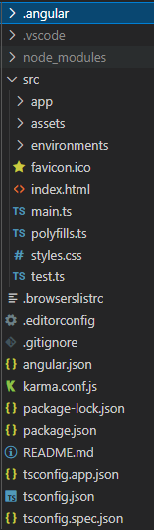
Angular: CLI
Angular Command Line Interface
Helps us create Angular projects
Helps us create components, and other pieces of our application
Install the CLI
npm install –g @angular/cli
Create a project
ng new app=name
Start your application
ng serve --open

Slide 6
Use the CLI to create an app

Slide 7
Angular: Modules
Group of related components, combined with other modules to create an app
Two types
Root
Feature
One single root module (app.module.ts)
Zero or more feature modules

Slide 8
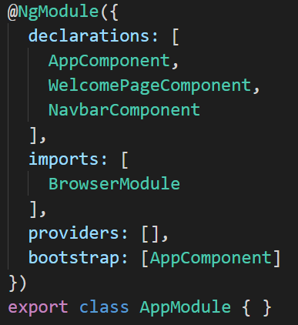
Angular: @NgModule
Marks a class as an angular module
App.module uses it to setup the root of the app
NgModule takes metadata and describes how compile components templates

Slide 9
Angular: Components
Basic building blocks of our apps
Break up our UI logic into components with specific purposes
One root component (AppComponent)
Declare a component in a class with @Component
Imported from @angular/core

Slide 10
Angular: Component Structure
Components also have HTML and CSS files associated with them
The @Component decorator has these properties
Selector
templateUrl
styleUrls
It is possible to use incline templates using {{}}
Create with: ng generate component c-name

Slide 11
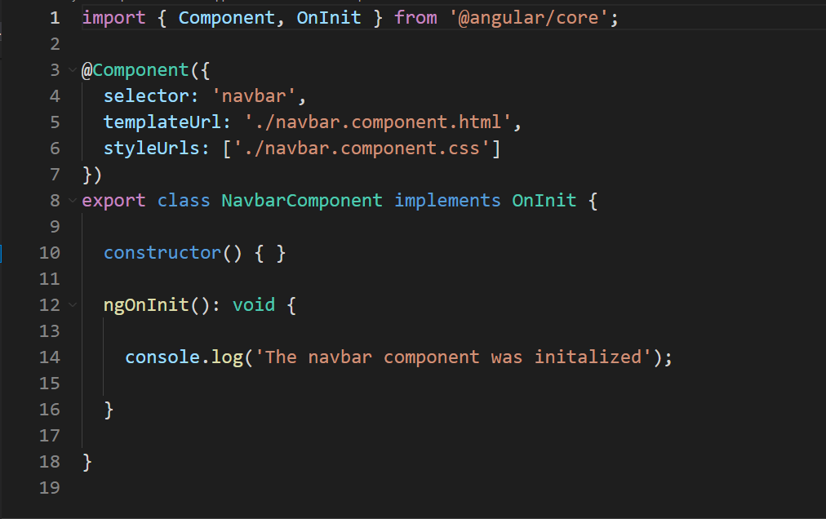
Angular: Component File

Slide 12
Demo: Create our first components

Slide 13
Angular Hands on 1
Create an angular application
Create a “main” component to hold other components
Create a component for each of your team members with
Name
Background
Something Interesting
Display all of those components in the main container component

Slide 14
Angular: Component Lifecycle Methods
Lifecyle of an Angular component is:
Creation
Render
Create/Render Children
Check for Data changes
Destroy before removal from DOM
These are called LifeCycle hooks, and have 8 corresponding methods

Slide 15
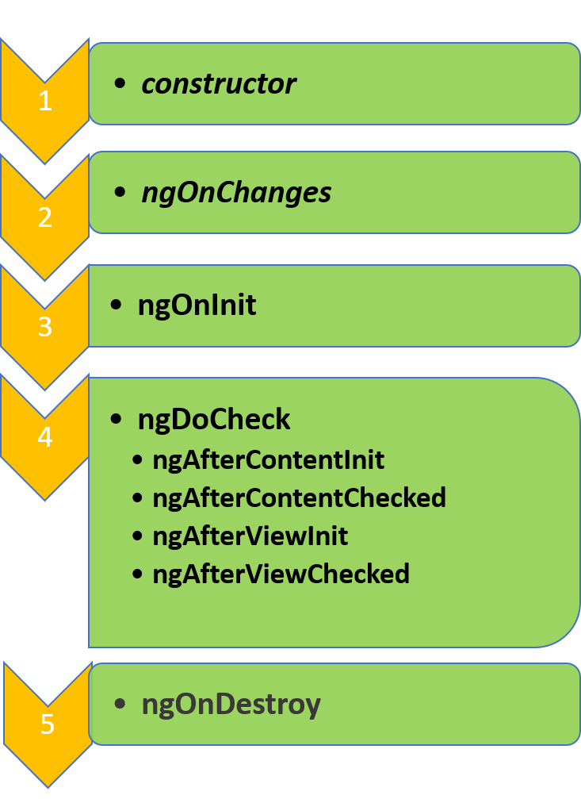
Image Source: https://www.google.com/url?sa=i&url=https%3A%2F%2Fgeeksarray.com%2Fblog%2Fangular-component-lifecycle&psig=AOvVaw2ezRoYJfCuCPzElCeFJaWE&ust=1644617583409000&source=images&cd=vfe&ved=0CAsQjRxqFwoTCLCP34iU9vUCFQAAAAAdAAAAABAW

Slide 16
Demo: Lifecycle methods

