Slide 1
Week 4 Day 2
DevOps

Slide 2
GitFlow
CLI used for apps that need a complex work flow
Developed by Vincent Driessen
Manages large projects via strict branching strategies
To use:
Run git flow in gitbash or install with brew install git-flow on macos

Slide 3
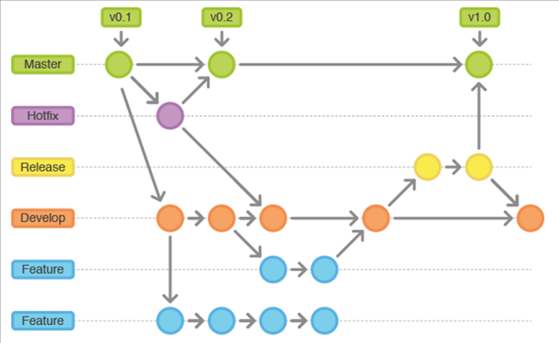
Gitflow: Branches
Gitflow is composed of several branches
Image source: https://dnncommunity.org/blogs/Post/1470/Basic-Git-Flow-For-Making-Open-Source-Contributions-on-GitHub

Slide 4
Gitflow: Best Practices
Create pull requests
Github > Pull Request Tab > New Pull Request
Github UI will walk you through
Be sure to always pull before modifying code
Failure to do so could cause merge conflicts
Some conflicts are fixable on the Github website
Others you will have to look for the conflicts that git marks for you, choose which change you want, and commit again

Slide 5
Unix: Introduction
Open source OS developed in AT&T Bell Lab in the 70’s
Once a small terminal based OS
Now the largest OS family promised of hundreds
Including Linux and MacOS
Original shell was called sh
New shell is called Bourne Again Shell
bash

Slide 6
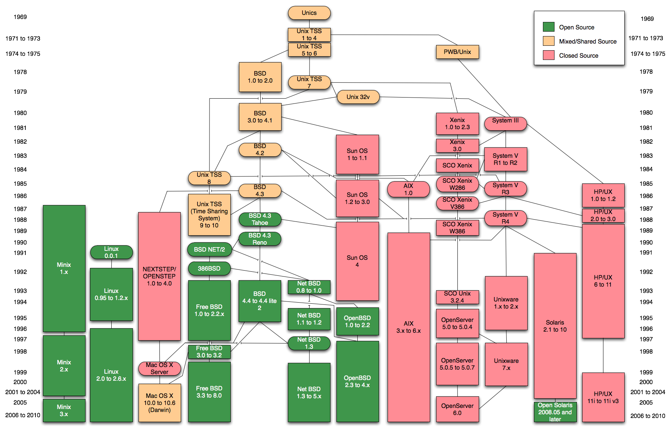
Image source: https://i.stack.imgur.com/G2Xri.png

Slide 7



Unix: Linux
Most well known Unix based OS
Created by Linus Torvalds
Updated by the opensource community
Hundreds of distributions
Ubuntu
Redhat
Arch

Slide 8
Linux: Command Basics
Linux file system is a tree like directory with the root mapping to /
Home directory mapped to ~
Everything is considered a file, even folders
Commands Args and Flags
Commands modified by args and flags
Args are strings that come after the command
Flags are denoted by a single or double dash, special options you can enable for your command

Slide 9
Linux: Navigate and Directory Commands
The most important command: man
Change directory: cd
Root directory: cd /
Home directory: cd ~
Up on directory: cd ..
Into a directory: cd ./dir
Listing files: ls
Contents of current directory: ls
See hidden items: ls –a
Contents of specific directory ls: ./dir
Make a directory: mkdir
mkdir dirname
Print the current directory: pwd

Slide 10
Linux: General Purpose Commands
Super User Do
sudo `command`
Clear Command Line
clear
Print a string
echo string
Redirect Output to a file
>
ex. echo hello > hello.txt
Redirect Output to a file but append
>>
ex. echo hello >> hello.txt
Match patterns in a file
grep

Slide 11
Linux: File Commands
Copy file
cp from to
Copy Directory
cp –r from to
Rename a file
mv old new
Move a file to a new directory
mv file ./dir
Rename a directory
mv –r old new
Create a file
touch filename
Print content of file
cat
Print first or last 10 lines
head
tail

Slide 12
Linux: File Commands Continued
Delete a file
rm file
Delete a directory
rm –r ./dir
Delete your entire existence
rm –rf .
Count words in a file
wc file
-c –bytes btye count
-m –chars char count
-l –lines lines
-w –words word count
Link a file to another
ln

Slide 13
Linux: File Permissions
Three types of permissions
Owner
Group
Other
Assign permissions based on one of the above
Use the chmod command with three binary numbers between 0 and 7 to grant permissions
Or with the less intuitive way with letters and + - symbols

Slide 14
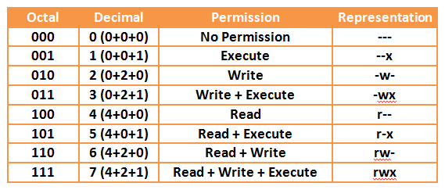
Linux: File Permissions
Example
Chmod 754
7 grants owner all permissions
5 grants group read and execute
4 grants others read only
Image source: http://2.bp.blogspot.com/-V2eWUJugBJ0/Ui4Y1TJ45aI/AAAAAAAAAzQ/gwxcb-GlTGA/s1600/chmod4.png

Slide 15
Linux: Environment Variables
Values accessible by the entire machine
Set them with the export command
export SERVER_PASS=password
Set environments variables each time you open the terminal
Place the export command in a startup file such as ~/.bashrc
Remove a environment variable with
unset

Slide 16
Linux: Package Managers
Allow you to download/install software
RPM: Red Hat Package Manager
APT: Advanced Package Tool
YUM: Yellowdog Updater Modifier
DPKG: Debian Package Manager

Slide 17

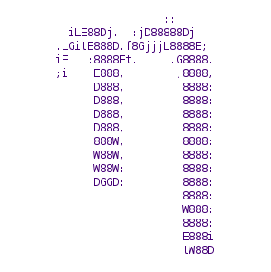
Linux: File Editors
Allow us to write to/edit files in Linux
vi/vim:
nano

Slide 18
Intro to DevOps
Combination of Development and Operations
Combine production, deployment, and maintenance
Expedite app development through automation
Save money
Decrease time between release

Slide 19
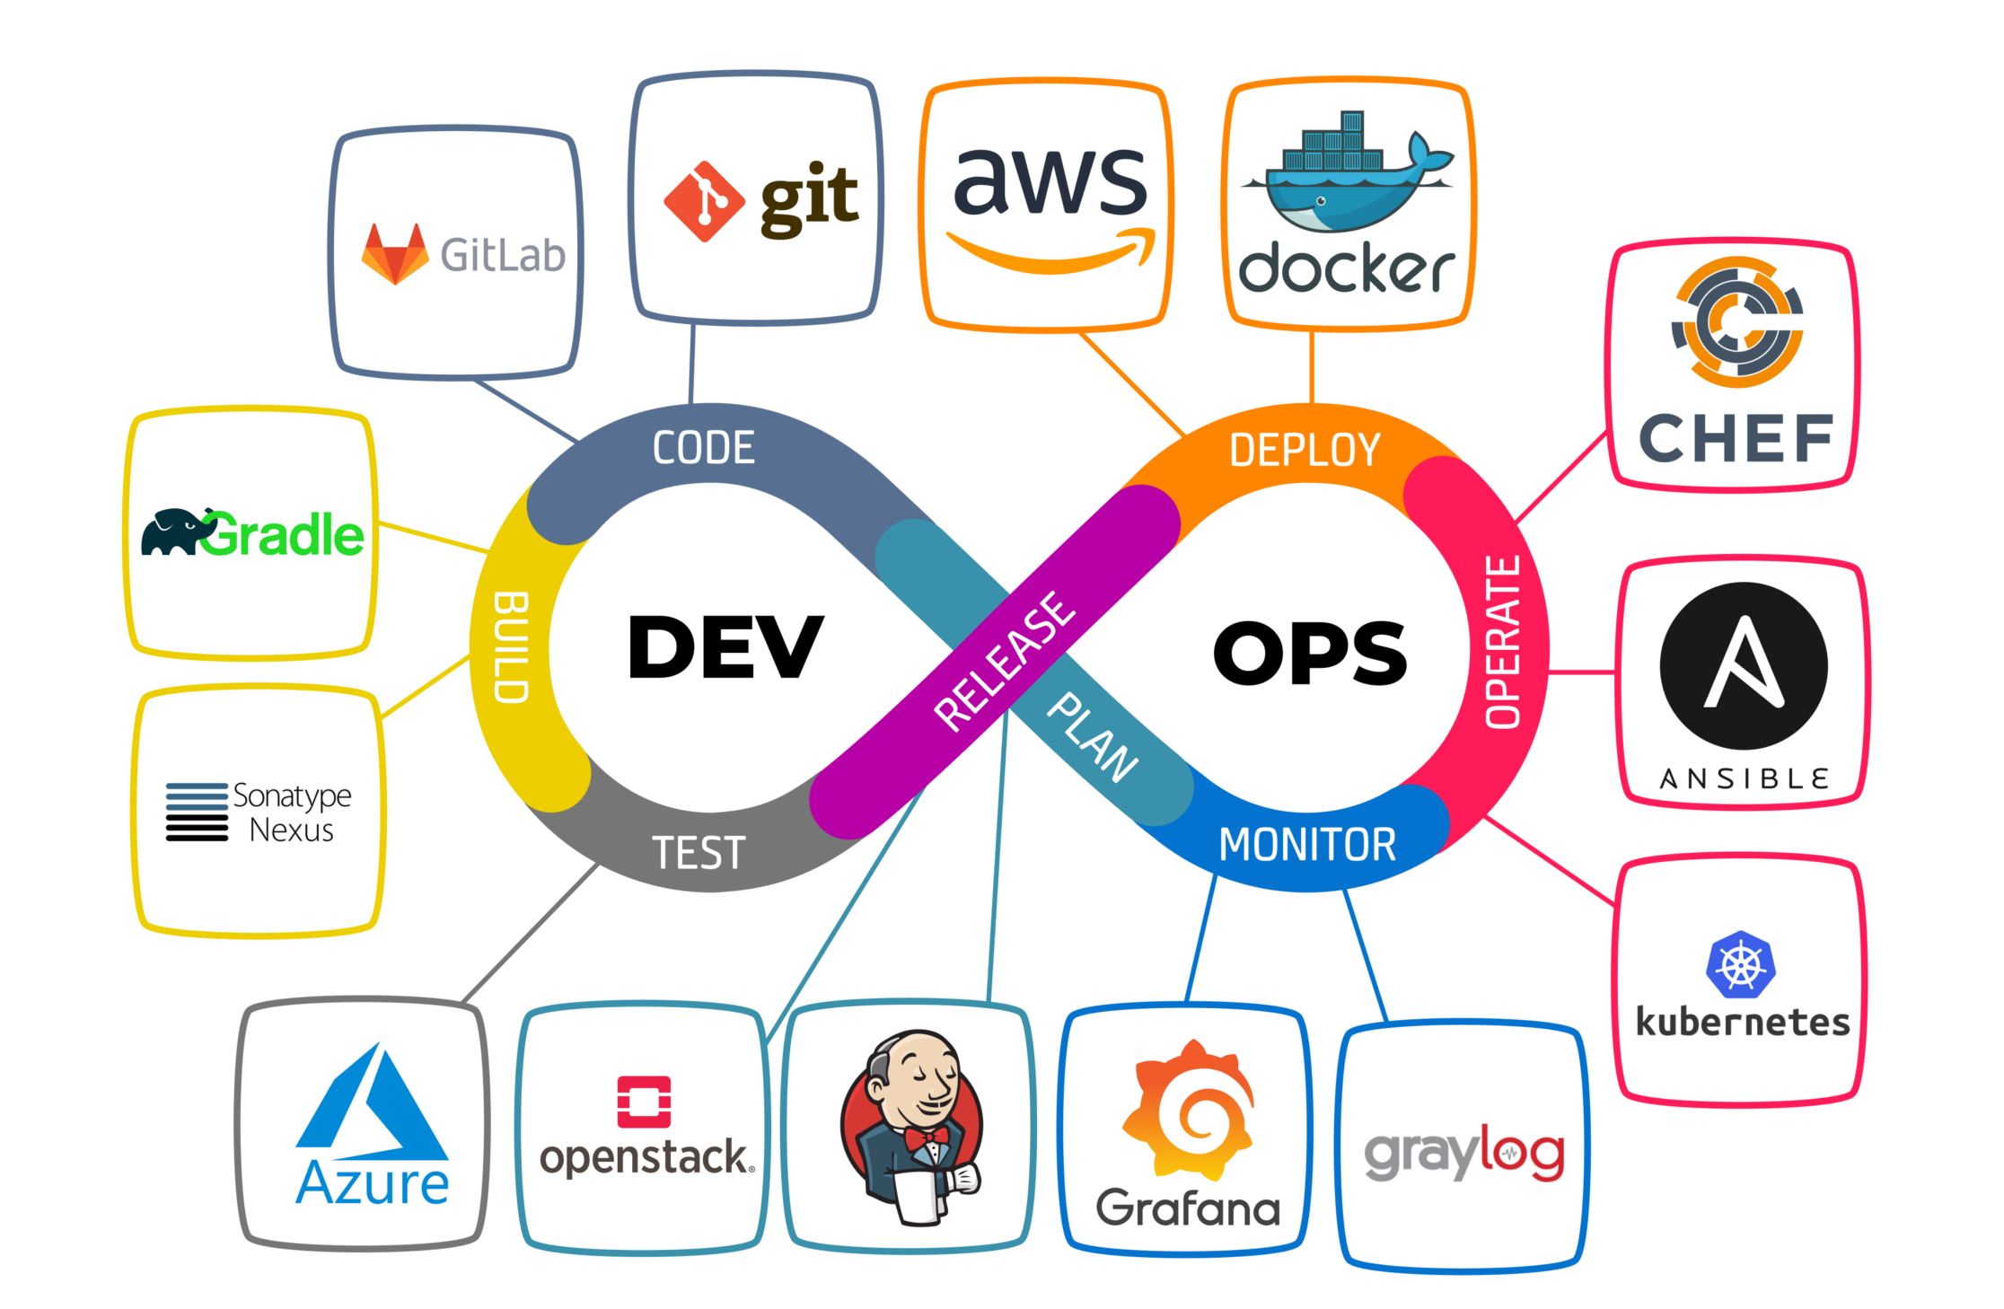
DevOps: Processes
Image source: https://www.shalb.com/wp-content/uploads/2019/11/Devops1.jpeg

Slide 20

DevOps: Continuous Integration
Process of consistently merging code into a central repository
Team mentality
Achieved when all members practice consistent merging
Benefits
Most up to date code
Detect broken builds
Easily tested
Reduces development risk
Reduces overall bugs

Slide 21
DevOps: Continuous Delivery
Automated building, management, and testing of a software
Take the code being pushed and
Build it
Test it
Deploy it to a production like environment
Benefits
Reduced risk in deployment
Predictable progress
Frequent feedback

Slide 22
DevOps: Continuous Deployment
The final stage of completely automated software production
One step farther than Continuous Delivery
Benefits
Even faster development
Releases are less risky
Increased communication is a good thing
Risks
Larger investment in engineering and testing
More documentation
Ongoing maintenance of pipeline
Feature flags are required

Slide 23
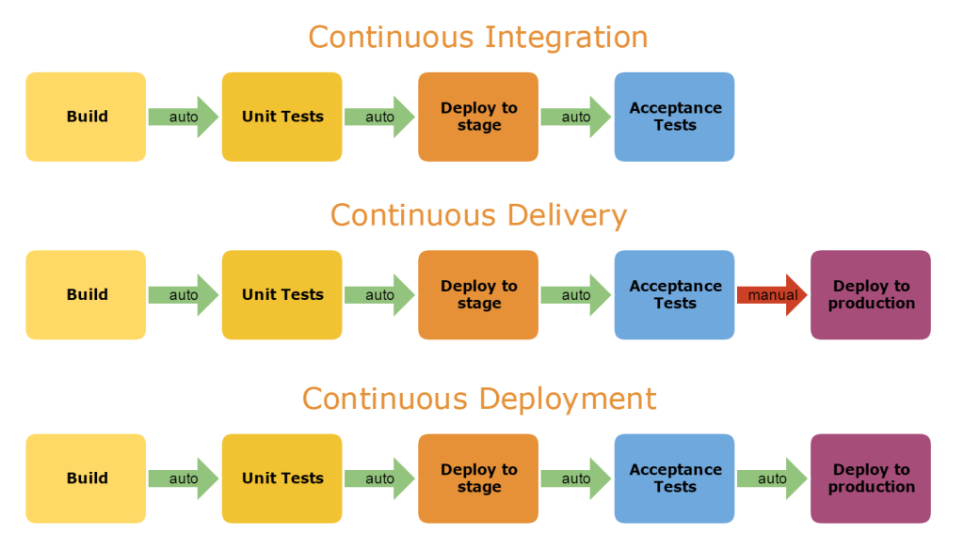
Image source: https://i.stack.imgur.com/yOofB.png

