Slide 1
Week 1 Day 4
Advanced Java: Exceptions, Data Structures, and Threads

Slide 2
Linters: Sonar Lint
Sonar Lint: open source linting tool
Linters provide feedback to developers
Sonar Lint integrates with the IDE
Linters identify code smells
Vulnerabilities
Bugs
Maintainability issues
Install it directly into Intellij with this link:
https://www.sonatlint.org/intellij

Slide 3
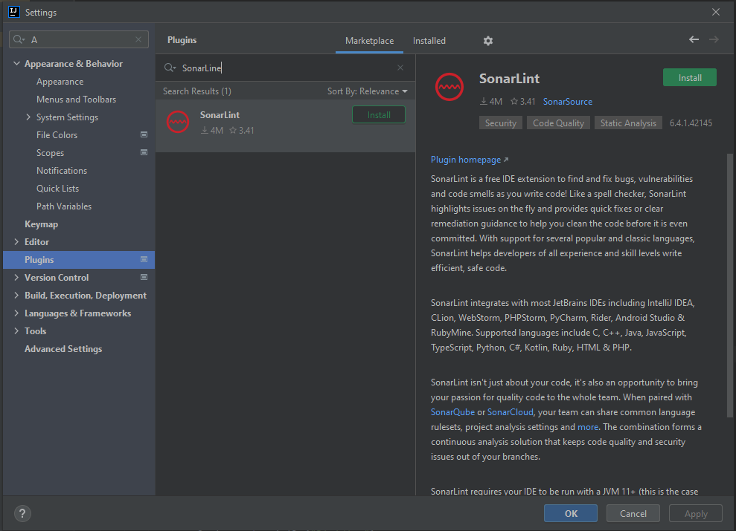
SonarLint Install
In Intellij
File > Settings > Plugins
Search for SonarLint
Install

Slide 4
Installing Sonar Lint DEMO

Slide 5
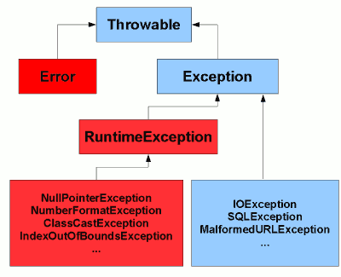
Java: Exceptions
Events that disrupt the normal flow of our java application
Throws an Exception Object
Exceptions form a hierarchy
Two types
Checked
Unchecked
Image Source: https://www.javamex.com/tutorials/exceptions/exceptions_hierarchy.shtml

Slide 6
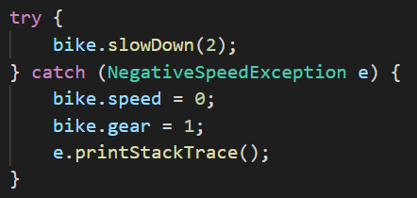
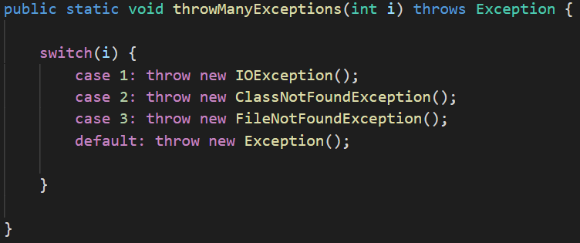
Java: Handling and Declaring Exceptions
Two ways to handle exceptions in java
Using try/catch blocks
Declaring a method can throw an exception
Cause an exception using the throw keyword

Slide 7
Java: Custom Exceptions and Testing
Create custom exceptions by extending Exception or RuntimeException
Extending Exception creates a checked exception
Extending RuntimeExceptoin creates an unchecked Exception
Test for an exception in Junit
@Test(expected=Exception.class)

Slide 8
Java Exceptions DEMO

Slide 9
Java: Generics
Constructs which enforce compile time safety
Placeholder for future datatype to be plugged into
Declared on classes, methods, or return types
Use <> angled brackets when declaring a class or interface to use a generic data type
You will see this used often with Collections

Slide 10
Data Structures
Data organization, management, and storage format that enables efficient access and modification
Linear
Arranged in an orderly manner, each element is attached adjacently
Hierarchical
Elements in sorted order with relationships between them

Slide 11
Java: Collections
Java’s implementation of popular linear data structures
MOST extend the Iterable interface
Iterable allows you to traverse the DS with an iterator
Iterator interface provides methods to do the traversal
Collection Interfaces
List
Sets
Queue
*Map (doesn’t extend Iterable but considered part of collections)

Slide 12
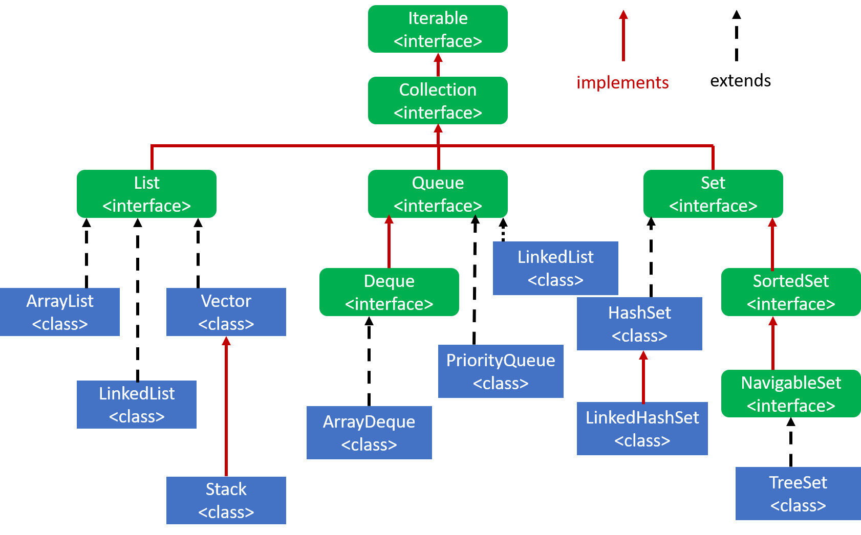
Java: Collections Hierarchy
Image Source: https://bytesofgigabytes.com/java/collection-framework-in-java/

Slide 13
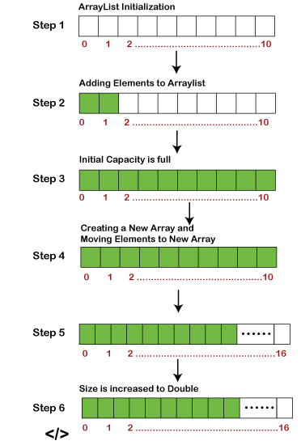
Lists: ArrayList
List which contains an array
Default size of 10
Increases by 50%
Quick traversal and retrieval
Slow insertion and deletion

Slide 14
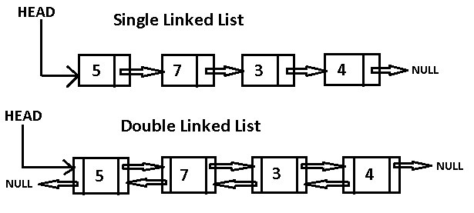
Lists: LinkedList
List of nodes which contain data, and a reference to the next node
Quick insertion and deletion
Slower traversal/retrieval
Image Source: https://medium.com/journey-of-one-thousand-apps/data-structures-in-the-real-world-508f5968545a

Slide 15
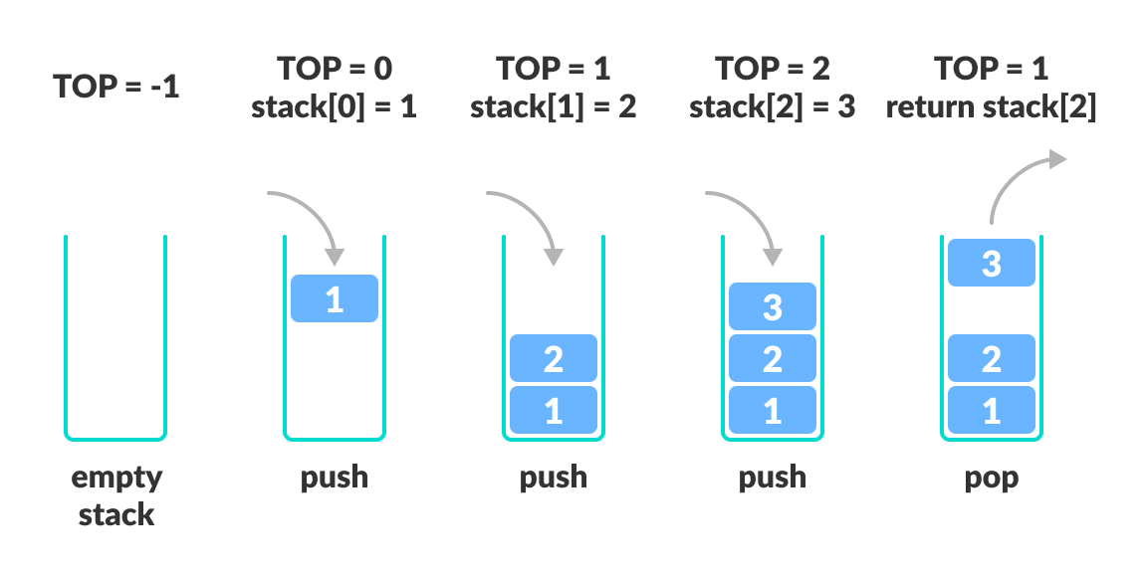
Lists: Vector and Stack
Vector is an older implementation of an arraylist
Doubles in size when the array is resized
Stack is an older implementation of the stack datastructure
First in last out
ArrayDeque is now preferred
Image Source: https://www.programiz.com/dsa/stack

Slide 16
Sets: HashSet and TreeSet
Set that is backed by a Hashmap
No ordering when iterating
One null value allowed
Fast insertion and traversal
Set that is backed by a SortedTree
Sorted order
No null values
Slow insertion and deletion
Faster retrieval

Slide 17
Queues: ArrayDeque and PriorityQueue
ArrayDeque
Double ended queue
Can be used as a queue or stack
Items stored in a resizable array
PriorityQueue
Orders elements by their natural order
Uses a comparator for natural ordering

Slide 18
Maps
Maps store values in key/value pairs
Not technically part of the Collections API because it doesn’t implement Iterable
Can still obtain iterators for its values
.entrySet(), .keySet(), .values()

Slide 19
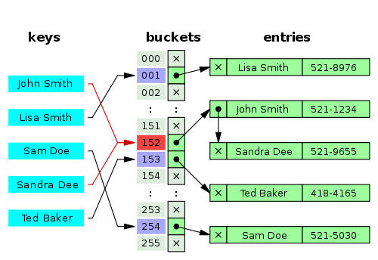
Maps: HashSet
Elements stored as key/value pairs
Insertion and retrieval is fast
Does not maintain insertion order
Null keys and values
Image Source: https://javahungry.blogspot.com/2013/08/hashing-how-hash-map-works-in-java-or.html

Slide 20
Maps: TreeMap and HashTable
TreeMap
Keys stored in a sorted tree
Insertion and retrieval slower
No null keys
Null values allowed
HashTable
Older threadsafe implementation of HashMap
No null keys
No null values

Slide 21
Comparable vs Comparator
Comparable Interface
Defines the natural ordering for the class
Implement Comparable
Override compareTo()
Comparator Interface
Defines total ordering on some collection of objects
Implement Comparator
Override compare()

Slide 22
collections vs Collection vs Collections
A very common and tricky QC question
collections
A collection of entities
Collection
Interface in the Collection API
Collections
Utility class that has static, convenient methods that operate on data structures in the Collections API

Slide 23
Generics and Collections DEMO

Slide 24
Threads and Concurrency
Concurrency, breaking up a task into different parts that can be executed independently
Done with threads in Java
Thread is a subset of a process that is an independent sequence of execution
Each thread of the main execution shares the same heap
Each has it own call stack
Managed by the scheduler
Multithreading leads to parallelism
Create threads through the Thread class and Runnable interface

Slide 25
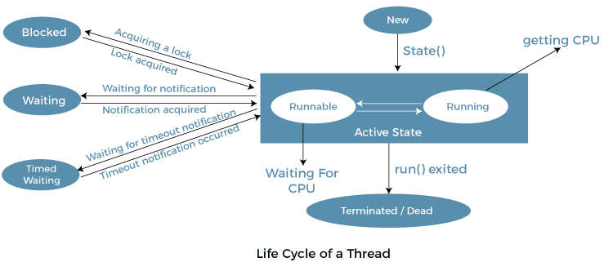
States of Threads
Threads also have priorities
MIN_PRIORITY = 1
NORM_PRIORITY = 5
MAX_PRIORITY = 10
Image Source: https://www.javatpoint.com/life-cycle-of-a-thread

Slide 26
Threads: Creating your own
Thread Class
Gain access to thread methods
Create a class that extends Thread
Implement the .run() method
Use the custom thread with the .start() method
Runnable Interface
Freedom to extend some other class
Create a class that implements Runnable
Implement the .run() method
Create a generic Thread object, and pass your Runnable object in the constructor

Slide 27
Creating Threads DEMO

Slide 28
Threads: Issues
Implementing multithreading yourself can lead to issues
Deadlock
Two threads become blocked indefinitely waiting on one another
Use the keyword synchronized to enforce threads to wait for a resource to become available
Producer Consumer
Producer adds to a buffer
Consumer takes from the buffer
We want the consumer to only consume when the buffer is not empty
We want the producer to only produce if the buffer is not full

Slide 29
Producer Consumer Problem DEMO

