Slide 1
Week 6 Day 4
Web Services

Slide 2
Webservices Review
Software that allows machines to exchange information over a network
REST
SOAP
Advantages
Use the web as a transaction tool
Expose functionality outside of the application
Capitalize on standards
Hardware and OS independent
Loose coupling of programs

Slide 3
Webservices: REST
Representational State Transfer
Style/architecture that outlines communication
Must follow these constraints
Uniform interface
Client-Server
Stateless
Cacheable
Layered
Code on demand

Slide 4
REST Resources
Resource refers to any information
Identify them with URL’s
REST service naming conventions
Nouns to name resources
Use plural for collections of resources
Use path parameters to specify a document
Use path structure to create hierarchy
Identify stores of resources managed by the client
Use query parameters for filtering
BE CONSISTENT!

Slide 5
REST Content Negotiation
The process of selecting the best representation for a given response
Done server-side via media type in request headers
Use Content-Type
Use URL patterns with type extension

Slide 6
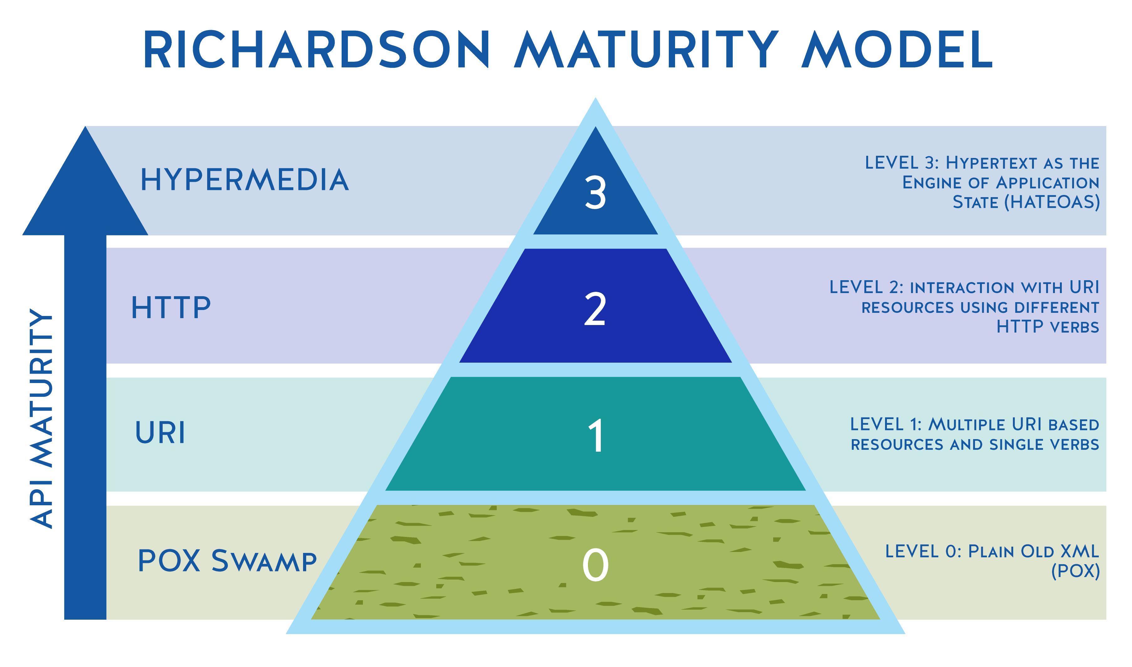
REST Richardson Maturity Model
A model that breaks down the principal elements of a REST approach
Start with HTTP
Introduce Resources
Verbs of HTTP
Hypermedia controls
Image source: https://devopedia.org/images/article/252/1821.1579540894.jpg

Slide 7
Webservices: SOAP
Simple Object Access Protocol
Contract based webservice
Outlines a distributed processing model
Nodes which sent messages
Providers
Provide a service
Requesters
Consume services from providers
Registry
Publish services

Slide 8
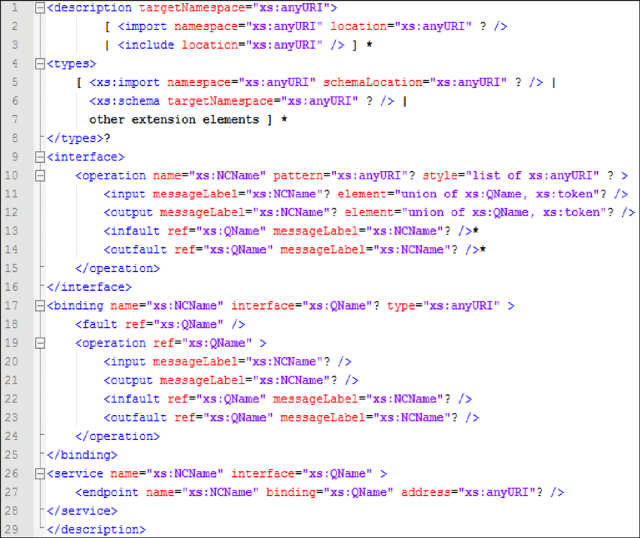
SOAP: WSDL
Web Service Descriptor
Forms the contract for SOAP
Written in an xml
Version 2.0
<description>
<types>
<interface>
<binding>
<service>
Image source: https://www.researchgate.net/profile/Ibrahim-El-Bitar-2/publication/281534319/figure/fig5/AS:669529814335490@1536639755102/Figure-21-Elements-composant-un-document-WSDL-20.png

Slide 9
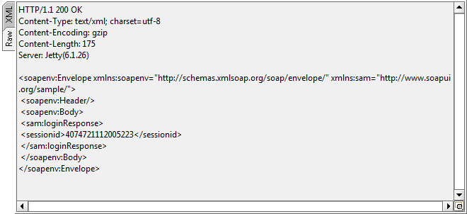
SOAP: Messages
Create a SOAP service
Contract First
Contract Last
Messages are XML document with
<envelope>
<header>
<body>
<fault>
Image source: https://www.soapui.org/soapui/media/images/stories/soapwsdl/response-raw-panel.png

Slide 10
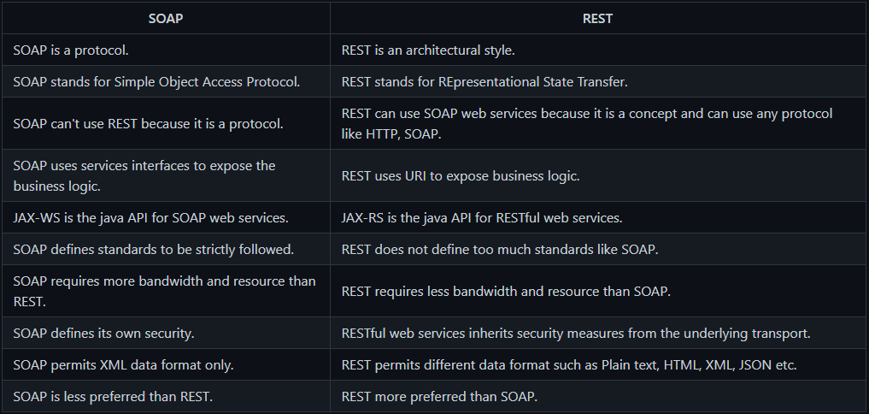
SOAP vs REST

Slide 11
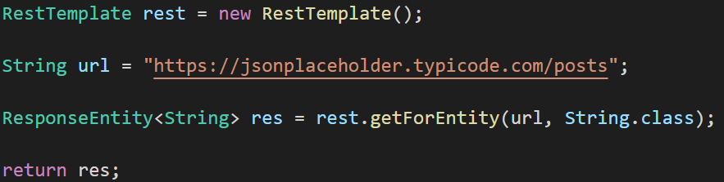
RestTemplates
Used to make Http requests with Java/Spring apps
Acts as a webclient
getForEntity()
getForObject()
exchange()

Slide 12
Spring Boot DevTool
Cache Disabling
Caching can hinder development,
Automatic Restarts
Any time your code changes the server restarts

Slide 13
Spring Boot Actuator
Library that exposes tools for monitoring and gathering metrics about your app
Enable or disable features in the application.properties
/health
/beans
/env
/info
/logfile
/loggers
/mapping
/metrics
/shutdown

Slide 14
Spring Boot Profiles
Allows you to map beans to different profiles
Allows for best practices of separating working environments
Map a bean to specific environment with @Profile(“environmentName”)
Set the active profile in application properties with spring.properties.active=‘environment’
Create separate .properties files for specific setups for profiles

