Slide 1
W6D5
AOP and Messaging

Slide 2
Aspect Oriented Programming (AOP)
Concern ourselves with Aspects
Modularize particular concerns which present themselves across multiple classes
Examples
Database access
Data entities
Error handling
Logging
Help reduce code redundancy

Slide 3
AOP Terminology
Aspect
Representation of a concern
Weaving
Lining aspects with other objects
Join Point
A specific moment during execution
Point Cut
Definition of our join points
Introduction
Declaration of new interfaces and corresponding implementations

Slide 4
@AspectJ
Refers to a style of declaring aspects through the use of Java classes
Spring interprets the same annotations as AspectJ
You must enable support for Spring AOP based AspectJ aspects in your beans.xml
Spring also uses autoproxying of beans which needs to be enabled

Slide 5
Spring AOP
Spring module to help you manage Cross Cutting Concerns
Cross Cutting Concerns
Parts of a program that rely on, or must affect other parts of the system
Manages these with Advice, JoinPoints, and PointCuts

Slide 6
AOP: Advice
Action taken at a Joinpoint
Before: executed before a joinpoint
After Returning: executed after returning from a joinpoint successfully
After Throwing: executed after an exception occured
After: executed after a joinpoint regardless of the outcome
Around: Allows you to run logic before and after the joinpoint

Slide 7
AOP: Pointcut and Joinpoints
Pointcuts determine joinpoints
Comprised of a name, parameters
Determine EXACTLY which methods we are interested in
Joinpoints are specific moments during execution to take advice
“execution(?modifiers-pattern ret-type-pattern ?declaring-type-pattern name-pattern(param-pattern) ?throws-pattern)”

Slide 8
DEMO: AOP

Slide 9
Messaging: Pub/Sub Pattern
Design pattern where:
Service creates messages
Messages get sent through topics
Subscribers consume message from topics
Allows for
One to Many communication
Many to One communication
Many to Many communication

Slide 10
Pub/Sub Use Cases
Real-time event distribution
Replicating data among databases (msa)
Parallel processing and workflows
Enterprise event bus
Data streaming from IoT devices
Refreshing distributed caches
Load balancing

Slide 11
Pub/Sub and Async Programming
Async
Move on from some function/method
Pub/sub allows for this mindset
Subscribers listen for new messages in the queue/topic
Does other logic while its waiting for messages

Slide 12
Messaging Queues
Software component used for passing data between services.
Facilitates async communication
Multiple producers/services adding to the queue
Multiple consumers/services listening to the queue

Slide 13
Messaging Queue Benefits
Resiliency
Failures stay isolated
Consumers can go down without much issue
Scalability
Easily increase the rates at which messages are added or processed
Visibility
Examining the queue can provide valuable insight

Slide 14



Messaging Queue Vendors

Slide 15
DEMO: RabbitMQ

Slide 16

Microservice Architecture Overview
Small, autonomous services that work together
Divide applications into services
Specific purpose and db
Gives us a more decentralized approach
Better scaling
Greater agility
Popularized by netflix

Slide 17
Microservice: Characteristics
Application broken into individually deployable services
Independently replaceable
Independently upgradable
Organized by business logic
Infrastructure automation with cd and automated testing
Failures are isolated

Slide 18
Microservices: Challenges
Finding concrete boundaries
Finding root cause of issue
Version management
Logging between services
Cascading issues

Slide 19
Microservices: Advantages vs Disadvantages
Advantages
Single Responsibility
Fault Isolation
Language/platform independent
Dynamic scaling
Deploy/develop independently
Great with containers
Disadvantages
Complex
Harder to test/monitor
Overall harder to manage and secure

Slide 20
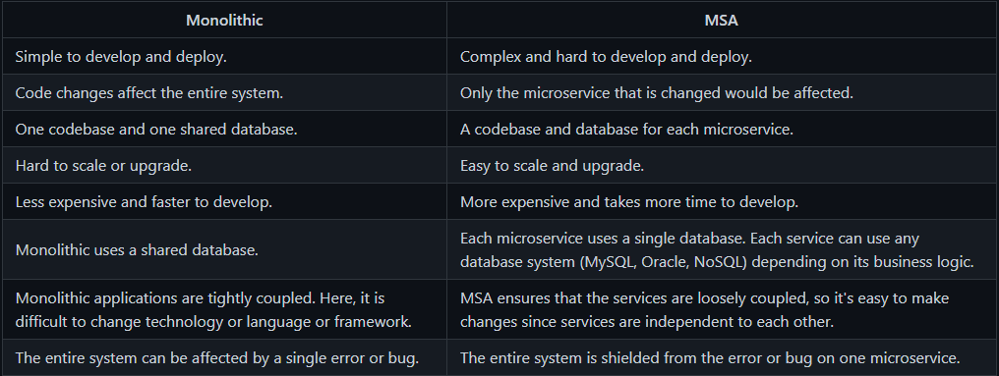
Microservice vs Monolithic

