Slide 1
Week 7 Day 4
Big Data

Slide 2
Big Data Overview
Data in amount so large we had to create new tools
“Big data” is about the tools being used
Data is exponentially expanding
Storage is becoming cheaper
More and more data can be stored

Slide 3
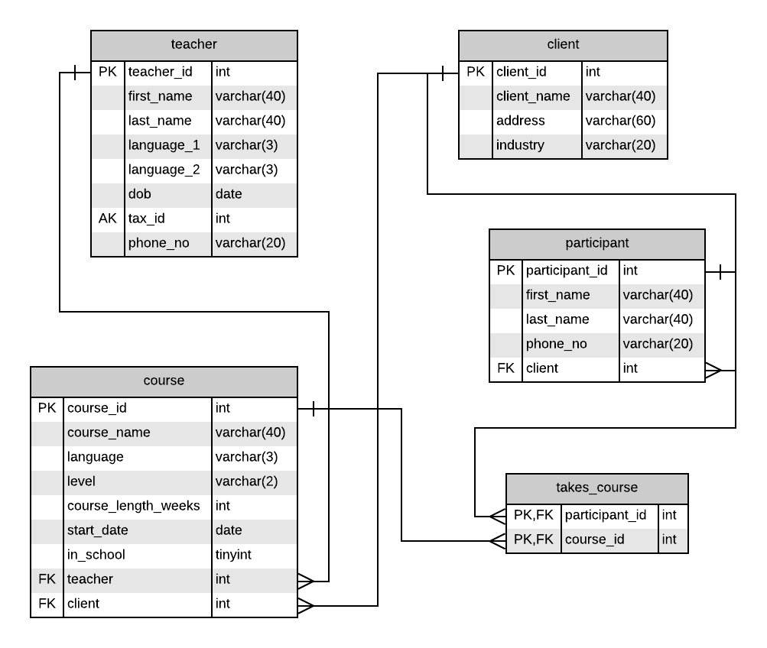
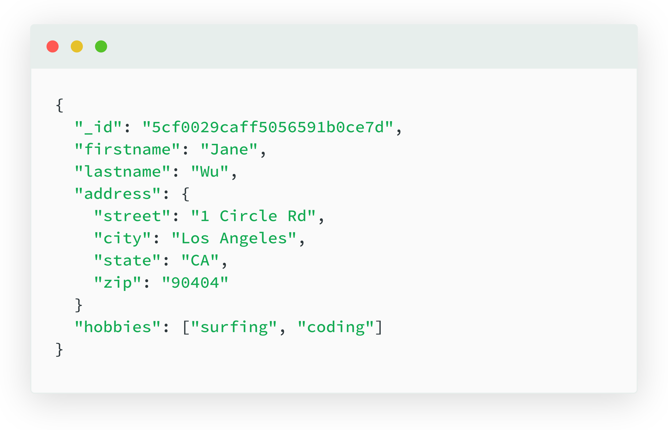
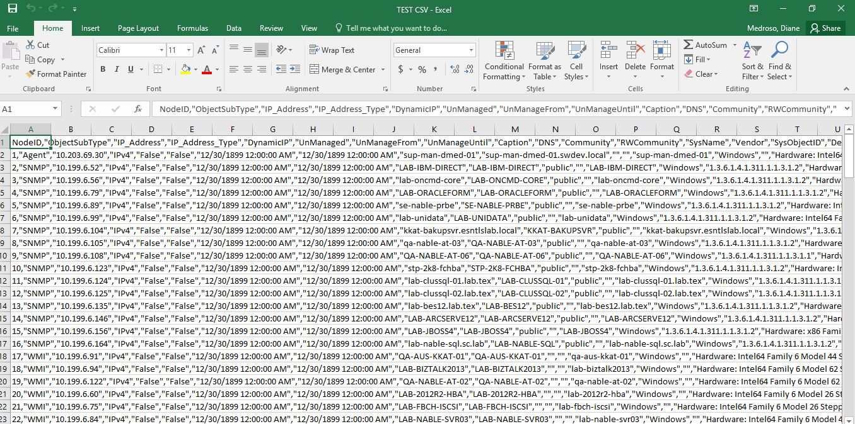
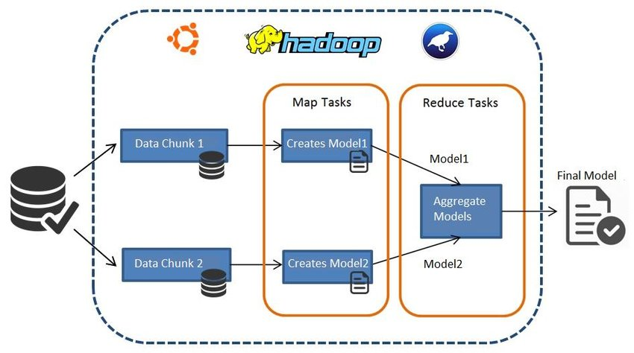
Data Tools
Tools have been limited by the times
Started with glorified spreadsheets
Relational data bases
Unstructured NoSQL databases
Distributed Systems like Hadoop

Slide 4

Hadoop Overview
Collection of tools for distributed data management
Spreads data across multiple machines
Achieve equivalent power of a super-computer
Lower costs
On virtual machines

Slide 5
Hadoop Modules
Hadoop Common
Base libraries and utilities
Hadoop YARN
Platform for managing computing resources
Hadoop MapReduce
Distributed data processing
Hadoop Distributed File System
File system for storing information
Many tools such as Apache Hive and Apache Sqoop use Hadoop behind the scenes

Slide 6
HDFS as Data Source
Hadoop File System
File system from a single machine, distributed across multiple
Massively scalable
Fault tolerant
Creates redundancy/backups of data
Self healing

Slide 7
HDFS Structure
Hadoop runs in a cluster of machines made up of nodes
Name node
Holds metadata for the file structure
Keeps track of where the data notes are
Controls processes
Data Nodes
Stores our data in blocks
Many blocks organized into racks
External processes run to communicate between HDFS and other parts

Slide 8
Hadoop MapReduce
The engine that does the computing on the HDFS
Job Tracker
Orchestrates and schedules tasks
Task Tracker
Get assigned processes to run
Get created close to the data they are working on
Jobs get broken up across many of these
This structure allows for parallel processing
YARN in Hadoop v2 is tasked with provisioning of resources to MapReduce

