Slide 1
Week 7 Day 2
ETL

Slide 2
SQL Overview
Structured Query Language
Language used to query RDBMS
Oracle
Postgres
MySQL
Relational databases have tables with relations to one another
Row based
Used in OLTP

Slide 3
NoSQL Overview
Not Only SQL
Non-tabular
Flexible, and scalable
Three types
Document
Key-value
Wide-column
Graph
Store unstructured data easily

Slide 4
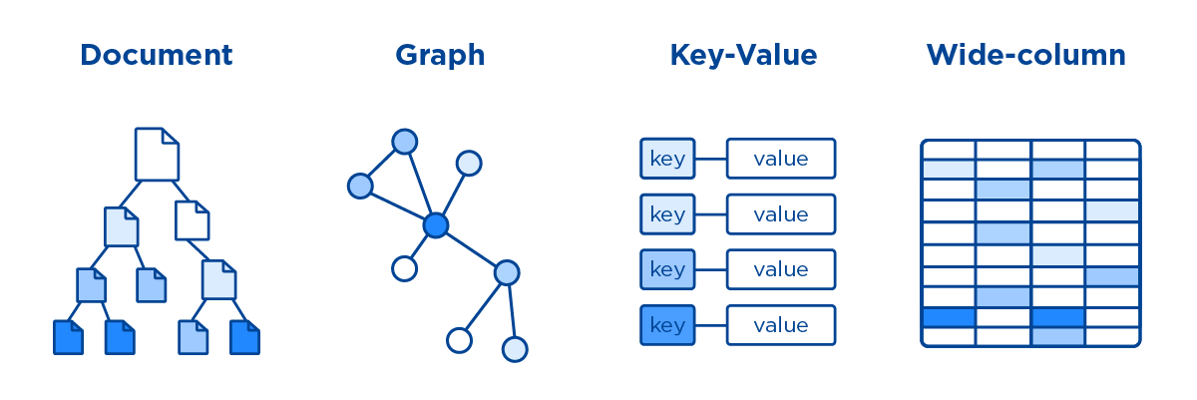
NoSQL Database Types
Document
Store data in documents similar to JSON
Key-value
Simple DB with key value stores
Wide-column
Tables rows and dynamic columns
Graph
Stores data in nodes and edges
Image source: https://abcloudz.com/services/nosql-databases/

Slide 5





NoSQL Vendors
MongoDB
Most widely used document-based db
Cassandra
Wide column db
ElasticSearch
Document based db
Amazon DynamoDB
Key-value pair db
Neo4J
Popular graph based db

Slide 6
DEMO: Querying a NoSQL Database

Slide 7
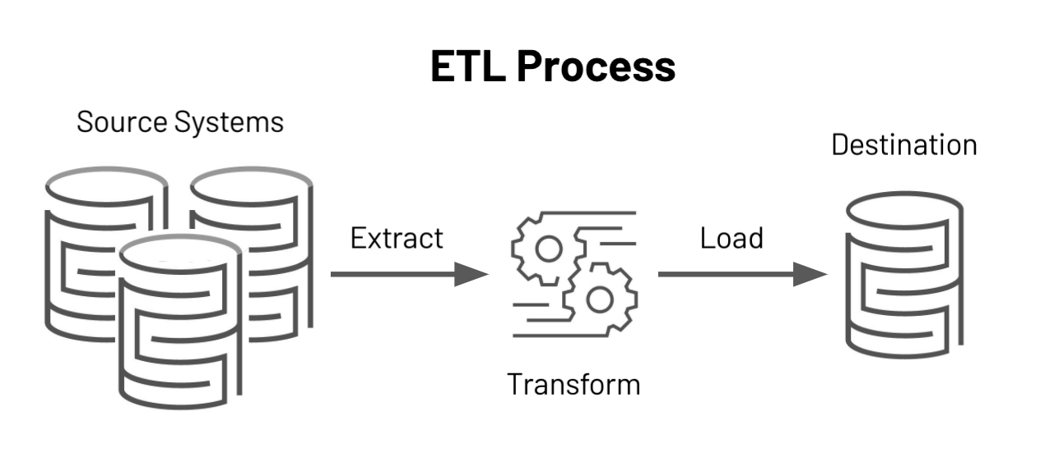
ETL Overview
Extract Transform Load
Copying data from one or more sources into a new location
May be in a different context
Conform data from various sources into one location
Image source: https://databricks.com/glossary/extract-transform-load

Slide 8
ETL Lifecycle: Extract
Taking data from a data source
Full extraction
Taking all the data
Incremental Extraction
Taking only new data from the data source
Often implement using a staging area

Slide 9
ETL Lifecycle: Transform
Converting/Modifying the data we extracted
Cleaning
Converting Null to 0
Converting Male to M
Deduplication
Formatting
Key restructuring

Slide 10
ETL Lifecycle: Advanced Transformation
Derivation
Applying logic to make new derived data
Filtering
Selecting only certain data
Data validation
Make sure it is up to standard

Slide 11
ETL Lifecycle: Load
Adding the data into the target
Typically, into a Data Warehouse
Initial Load
Populating all the tables
Incremental Load
Adding new data periodically
Streaming
Batch
Full refresh
Removing all data, and reloading fresh data

Slide 12
DEMO: ETL Pipeline

