Slide 1
Week 4 Day 3
Docker

Slide 2
IaaS, SaaS, PaaS
SaaS
Software as a service
Google Docs, Zoom
PaaS
Platform as a service
AWS RDS, GCP Cloud SQL
IaaS
Infrastructure as a service
AWS EC2, GCP Compute Engine

Slide 3
Virtual Machines
Simulates a physical machine/server
Virtualize an entire OS
Use hypervisors
Pros
Near total isolation
Virtualization
App runs reliably regardless of host
Cons
Considered bulky
Resource expensive

Slide 4
Containers
Bundle together apps and their dependencies
Share underlying OS kernel
Lighter weight
Provided by an engine running on the host
Pros
Lightweight
Layers of isolation
Virtualized view
Isolated environment
Run reliably regardless of host
Cons
Layers of isolation can cause issues

Slide 5
Containerization
The process of putting our apps in a container
Containers should be completely isolated from the outside world
Linux is the foundation of most containers
Containers are
Built from images
Run on an engine
Stateless
Virtualized and isolated

Slide 6
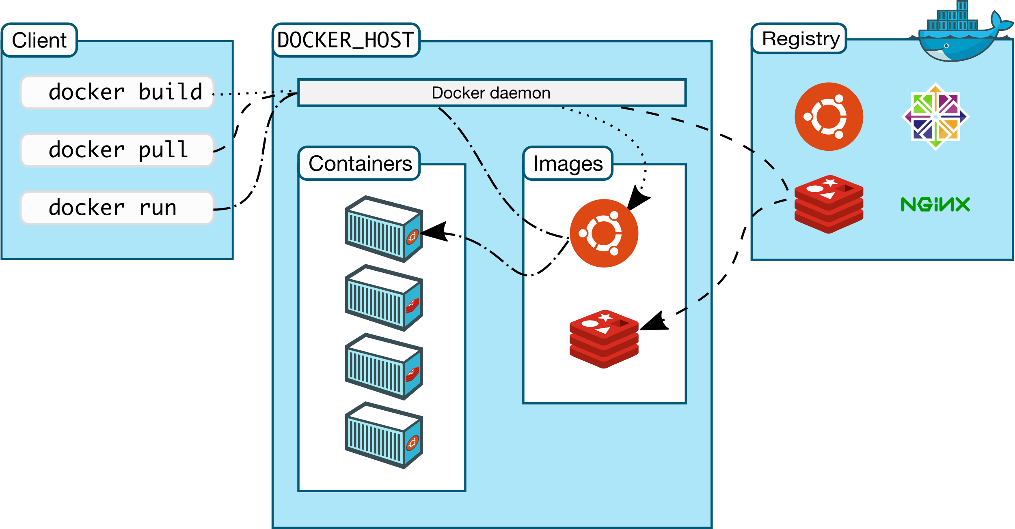
Docker
Open-source platform for developing, shipping, and running applications with containers
Runs on a Client-Server Architecture

Slide 7
Docker: Architecture
CLI
Docker Command Line Interface
Interacts with the Daemon
Uses Rest API
Daemon
Long running process of Docker
Manages objects
Containers
Images
DockerHub
Centralized place to store images

Slide 8
Docker: Objects
Building blocks that are managed by the daemon
Images
Blueprint to construct a container
Created with a Dockerfile
Containers
Runnable isolated instances of a set of processes and their dependencies
Built from an image
Managed by the daemon

Slide 9
Docker: Dockerfile
Defines everything needed for an image
Step by step instructions to create an image
Important Dockerfile keywords
FROM image name
RUN <command>
RUN [“executable”, “param”]
ADD <src> <dest>
COPY <scr> <dest>
EXPOSE
VOLUME [/dirname]
WORKDIR
CMD

Slide 10
Docker: Build an Image
docker build anyflags PATH
Creates an image with a dockerfile
docker commit flags CONTAINER imagename
Committing changes from the container specified to the image specified
Creating an image based off of an existing container

Slide 11
Docker: Build a Container
docker create imagename
Creates a container in created state
Configures it to be ready to run
Needs to run manually
docker run flag imagename
Pull an image from registry if it doesn’t exist locally
Creates and runs the container automatically

Slide 12
Docker: Container Management
docker container ls
docker ps –a
docker container kill id
docker container pause id
docker container start id
docker container rm flags id
docker volume rm volname

Slide 13
Docker Networking
Allows you to connect containers via a network
Docker provides two default network drivers
Bridge
Overlay
Create your own
Use docker run -d –net=bridge –name nameofcontainer

Slide 14
Docker: Best Practices
Ephemeral
Lightweight
Build context
Multi-stage builds
Single Responsibility
Readible docker files
Volumes to persist
Secrets for sensitive data

Slide 15
Docker DEMO

