Slide 1
Week 7 Day 5
OLAP

Slide 2
OLTP Review
Online Transaction Processing
Three tiered systems
User facing application
Business Layer
Data Layer
Fast response times, small amounts of data
Frequent or concurrent database backups
Simple queries to gather small amounts of data

Slide 3
OLAP
Online Analysis Processing
Analytical system used internally
Perform complex queries
Highly resource intensive, slower response times
Data updated in batches
End of the quarter
Data changes slowly

Slide 4
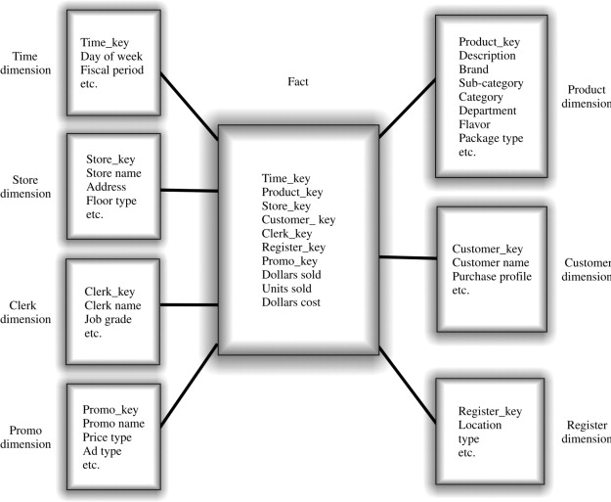
Dimensional Databases
OLAP systems use denormalized dimensional databases
Partly denormalized
Designed of easy queries
Using star or snowflake schema

Slide 5
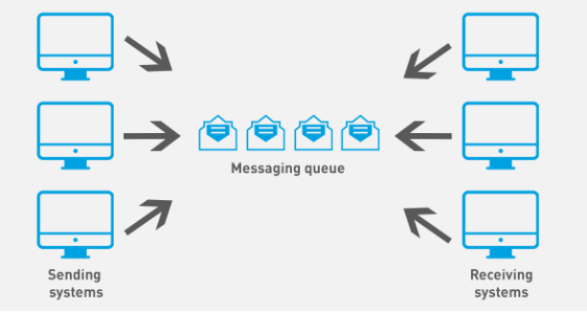
Messaging Review
Messaging queues allow the implementation of pub/sub model
Develop in a more asynchronous way
Messaging services typically use queues

Slide 6
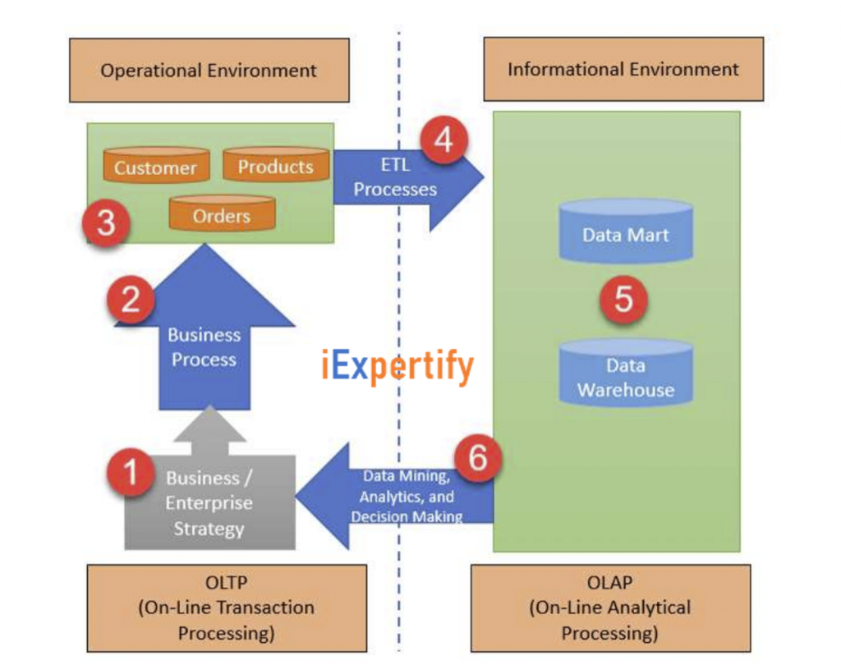
How does all this fit together?

