Slide 1
W4D4
Jenkins

Slide 2

Jenkins
Automation server that is:
Self contained
Open source
Automates
Building
Testing
Deployment
Standalone on a system, or used with tools like docker

Slide 3
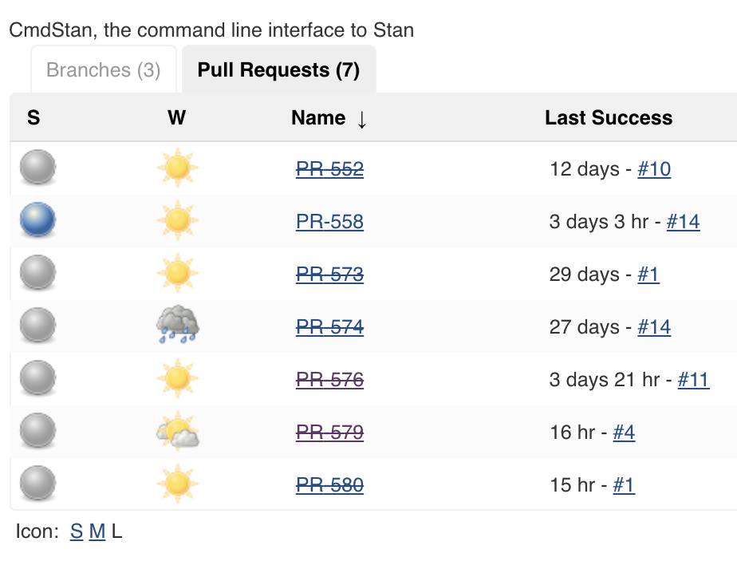
Jenkins: Projects/Jobs
Job is a repeatable set of steps to auto a task
Trigger them manually or automatically
Creates a build
Job Status/Health
Sunny: 81% of more build passed
Partially Sunny: 61 – 80% passed
Cloudy: 41 – 60% passed
Raining: 21 – 40% passed
Stormy: <20% passed
Image source: https://aws1.discourse-cdn.com/standard14/uploads/mc_stan/original/2X/8/80516b619bad31f88cd811a8405e87807abb14cb.jpg

Slide 4
Jenkins: Builds
Created by a Job
Build Status
Blue: Success
Yellow: Unstable
Red: Failure
Gray: No builds/aborted build

Slide 5
Gradle Review
Fast, flexible general purpose build tool
Allows devs to build any software
Scripts written in Groovey or Kotlin
Builds consist of one or more projects
Projects could be anything from building a jar to generating docs, or deployment
Projects are done by tasks
Atomic unit of work, such as compiling classes
The script is written in build.gradle

Slide 6
Building a gradle project with Jenkins DEMO

