Slide 1
Week 5 Day 4
Angular Routing and Http

Slide 2
Angular: Pipes
Provide a way to transform data
Date
Decimal
Currency
Percent
Slice
Lowercase
Uppercase
Titlecase
Json
Async

Slide 3
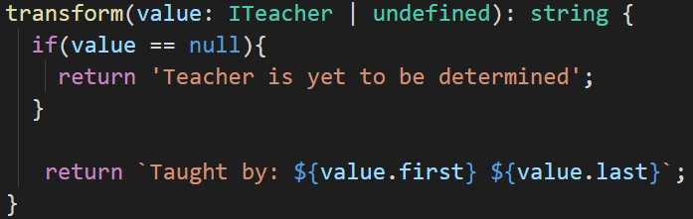
Angular: Custom Pipes
Create with
ng generate pipe pipename
Creates two files
name.pipe.ts
name.pipe.spec.ts
To create the pipe logic implement the transform method in the pipe class

Slide 4
Angular: Routing
Routing allows us to navigate between pages
Must create the RouterModule
Necessary Service Providers
Directives for navigating through views
The router defines navigation of views
Interprets URL links to load components
Routing component imports RouterModule
Does the routing magic

Slide 5
Angular: Route Guards
Used to check if the user should be allowed to access a view
Create with
ng generate guard name
Implement one of four interfaces
CanActivate
CanActivateChild
CanLoad
CanDeactivate

Slide 6
Demo: Pipes and Routing

Slide 7
Angular: HTTP Pub Sub
Describes the flow of messages between applications or services
Message is published to a channel
Message is consumed by a subscriber
Angular uses this model with their HTTP client

Slide 8
Angular: HttpClient
Service used to communicate between the angular app and backend services
HttpClient is available as an injectible class
Included with all angular projects
Must register it in the NgModule
HttpClient return Observables

Slide 9
Angular: RxJS Observables
Reactive Extension for Javascript
Framework for reactive programming
Observables
Passing messages between components
Event handling
Async programming

Slide 10
Angular: Observables and Pub/Sub
Observables define functions for publishing values
Function is only executed when a subscriber consumes the values
Use the .subscribe() to consume, .unsubscribe() to stop
Three callback functions
next(), error(), complete()

Slide 11
Angular: Observable vs Promises
Promise emits only one single value
Observable emits a stream of values

Slide 12
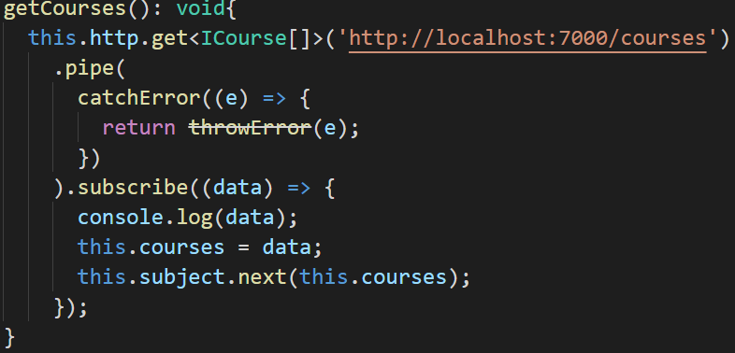
Angular: Handling HttpClient Errors
Use the catchError method from RxJS
Client-side errors return an ErrorEvent
Server-side errors return a HTTP error response
Handle the errors by determining the type
Catch them and pipe them with the catchError operator

Slide 13
Angular: RxJS Subjects
Special type of observable that allows values to be mulitcasted to many Observables
Essentially just an Observable, but when it receives values they get multicasted
Variants of subjects:
Behavior
Replay
Async

Slide 14
Angular: Async Pipes
A pipe that subscribes to an Observable
Returns the latest value emitted
Automatically subscribes and unsubscribes to prevent memory leaks.

Slide 15
Demo: HttpClient

Slide 16
Angular Hands on: The final boss
Create a new angular application
Create a component to take in user input
Take the user input, and send an http request to the pokemon api with a service
This is the same pokeapi from week 3
Display the name and an image of the pokemon queried inside of a component in your application

