Slide 1
Week 5 Day 1
NodeJS and Type Script

Slide 2

Node.JS
Open source, cross-platform, Javascript run-time environment
Not a programming language
Allows us to run JS outside of browser

Slide 3
Node Package Manager
Package manager for JS
Default manager of the node environment
Consists of three components
Website: discovers packages, sets up profiles, and manages access to packages
CLI: runs in the terminal, interacts with npm
Registry: public repo for node packagse

Slide 4
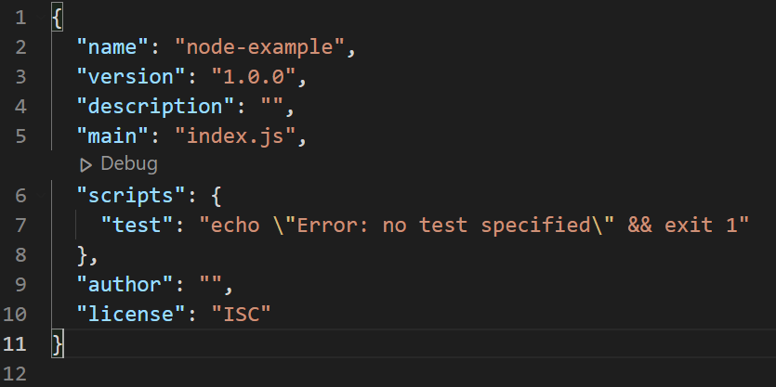
package.json
Information/metadata for the project
Description
Version
License information
Author
Entry point
Scripts
Dependencies

Slide 5
Install NodeJS

Slide 6
OWASP: Using Components with Known Vulnerabilities
When building applications, we may use external libraries to help us
Always inventory your clients and server
Only download components from trusted/official sources
Plan for monitoring and patches

Slide 7

Typescript
Open-source, object-oriented, typed, superset of Javascript by Microsoft
All functionality of Javascript
Additions of classes, interfaces, modules, more
Portable
Strong/static typing

Slide 8
Typescript: Compiling and installing
Install typescript with node package manager
npm install –g typescript
Browser is unable to read typescript directly, we must transpile into javascript
Use the command tsc to output the corresponding javascript

Slide 9
Typescript: Data types
Declare the type when declaring a variable:
let varname: [type] = value
Boolean
Number
String
Undefined
Null
Any
Void
Array
Tuple
Enum
Never

Slide 10
Typescript: Classes and Access Modifiers
Typescript adds extra class functionality to JS
Use of the class and new keywords
Inheritance with extends keyword
Access Modifiers
Public
Private
Protected
readonly modifier
Getters and setters accessed like properties

Slide 11
Typescript: Modules
By default all code is globally scoped
Restrict this with modules
All variables, classes, and functions are not accessible outside of the module
Use the export keyword to create
Use the import keyword to use a module

Slide 12
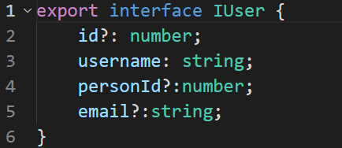
Typescript: Interfaces
Create contracts for classes/objects to implement
Defined with the interface keyword
Optional properties denoted with ?
Not actually compiled

Slide 13
Typescript: Decorators
Similar to Java annotations, used commonly in Angular
Must enable the experimental support in the tsconfig
Types
Class
Method
Property
Parameter
Accessor

Slide 14
Typescript DEMO

Slide 15
Webpack
Static module bundler for JS applications
Packages all modules of our app and serves it to the browser
All JS files and dependencies packaged into a single file, html into a single file, etc
Helps loading times
Uses a dependency graph to accomplish this

