Slide 1
Week 7 Day 3
Data Warehouse

Slide 2
Data Warehouse Overview
Environment/central hub for a dataset
Fed by the etl pipeline
Highly structured, and standardized
Three tiers
Client/frontend
Analytics Server
Database Server
Meant to store 100’s of millions of records

Slide 3
Data warehouse vs Traditional Databases
Data warehouse
Complex, resource intensive analytics
From many data sources
Schedule of activities
Star or Snowflake schema
Columnar storage
Traditional Databases
Transaction processing
From a single datasource
Continuous event driven operations
Normalized schema
Row based storage

Slide 4
Data Lakes
Centralized repositories for all data
Store structured, semi-structured, or unstructured
SQL, NoSQL, or anything else
Input for ETL
Cheaper and slower than data warehouses

Slide 5
Data Warehouse: Vendors
Most of our cloud providers have some data warehouse
Amazon Redshift
Google BigQuery
Azure Synapse Analytics
Db2 Warehouse on the Cloud
Snowflake

Slide 6
Data Warehouse vs Data Marts
Smaller more specialized data warehouses
Focus on a single subject area
Independent and targeted analytics

Slide 7
Star Schema
Unnormalized database schema used in data warehouses
Central fact table
Specific measurable primary data
Dimensional Tables
Simple queries
Simplified analytics
Fast Aggregation
OLAP cube feeding

Slide 8
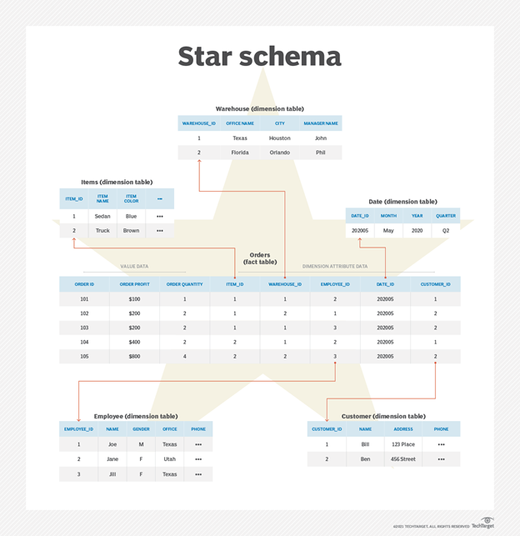
Star Schema
Disadvantages
Data not as flexible
Data integrity can be broken
Many to many not represented
High redundancy

Slide 9
Snowflake Schema
Like star schema, but with more normalized dimension tables
Produces sub-dimensional tables referenced by foreign keys in the primary dimensional tables
Advantages
Less Redundancy
More Flexibility
Disadvantages
Additional complexity in queries

Slide 10
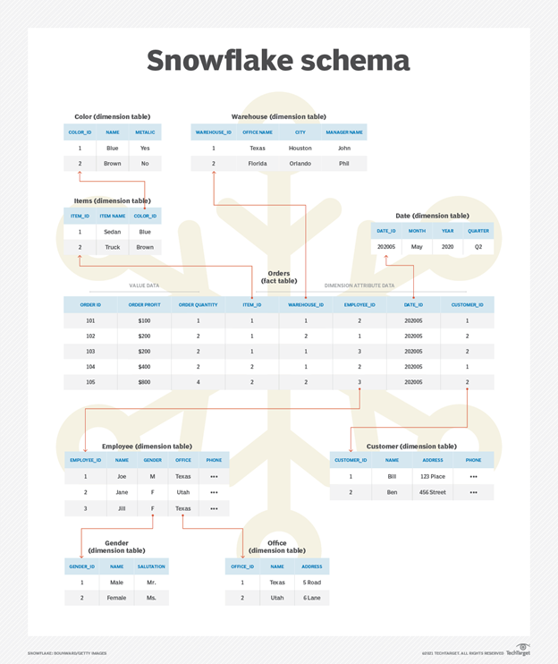
Snowflake Schema

Slide 11
DEMO: A look around Big Query

