Slide 1
Week 7 Day 1
Data Overview

Slide 2
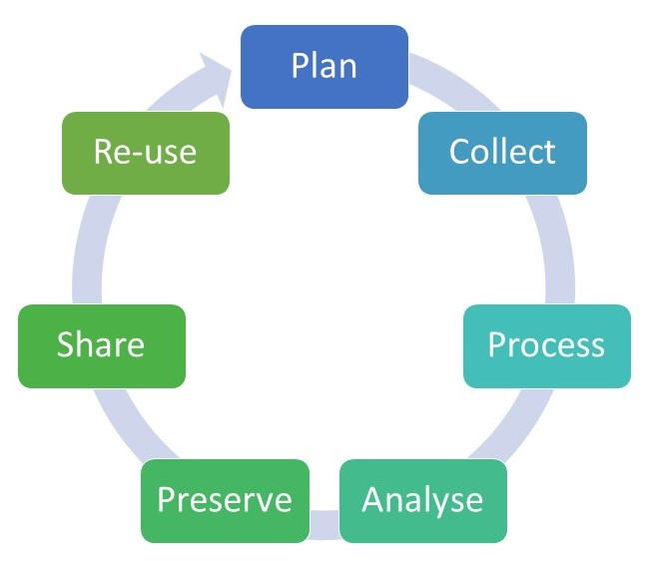
Data Life Cycle
Image source: https://www.reading.ac.uk/research-services/research-data-management/about-research-data-management/the-research-data-lifecycle

Slide 3
Online Transaction Processing
Concurrently processing a number of transactions
Online Banking
Online Shopping
Information about each are typically stored
Typically involves, CRUD operations on small amounts of data

Slide 4
OLTP Features
Real-time execution of many database transactions
Fast response time
Modifying small amounts of data
Indexed data
Frequent or concurrent backups
Little storage space
Simple queries

Slide 5
OLTP System Requirements
Typically follows a layered system with three tiers
Client/presentation layer
Transaction gets created by the human/client interacting with the ui
Backend/business logic
Verify the transaction
Database/data store
Store the data from the transaction

Slide 6
OLTP System Requirements cont.
Must adhere to ACID properties
Handle thousands of users concurrently
Scalable
Available 24/7
High throughput and short response time
Reliable and secure
Recoverable
Typically relational databaes

Slide 7
Data sources
Data is ANYTHING we can quantify
Figures
Numbers
Texts
Pictures
Dates
If it can be stored in a database its data

Slide 8
Data Collection
We can get our data from anywhere
Personal sales, research, projections
Scraped from websites
Queried from pre-existing databases
Files, json, excel, csv

Slide 9
Database Vendors
Relational Database vendors
Oracle
Postgresql
MySQL
NoSQL Database vendors
MongoDB
Cassandra
ElasticSearch

