Slide 1
Week 3 Day 1
HTML and CSS

Slide 2
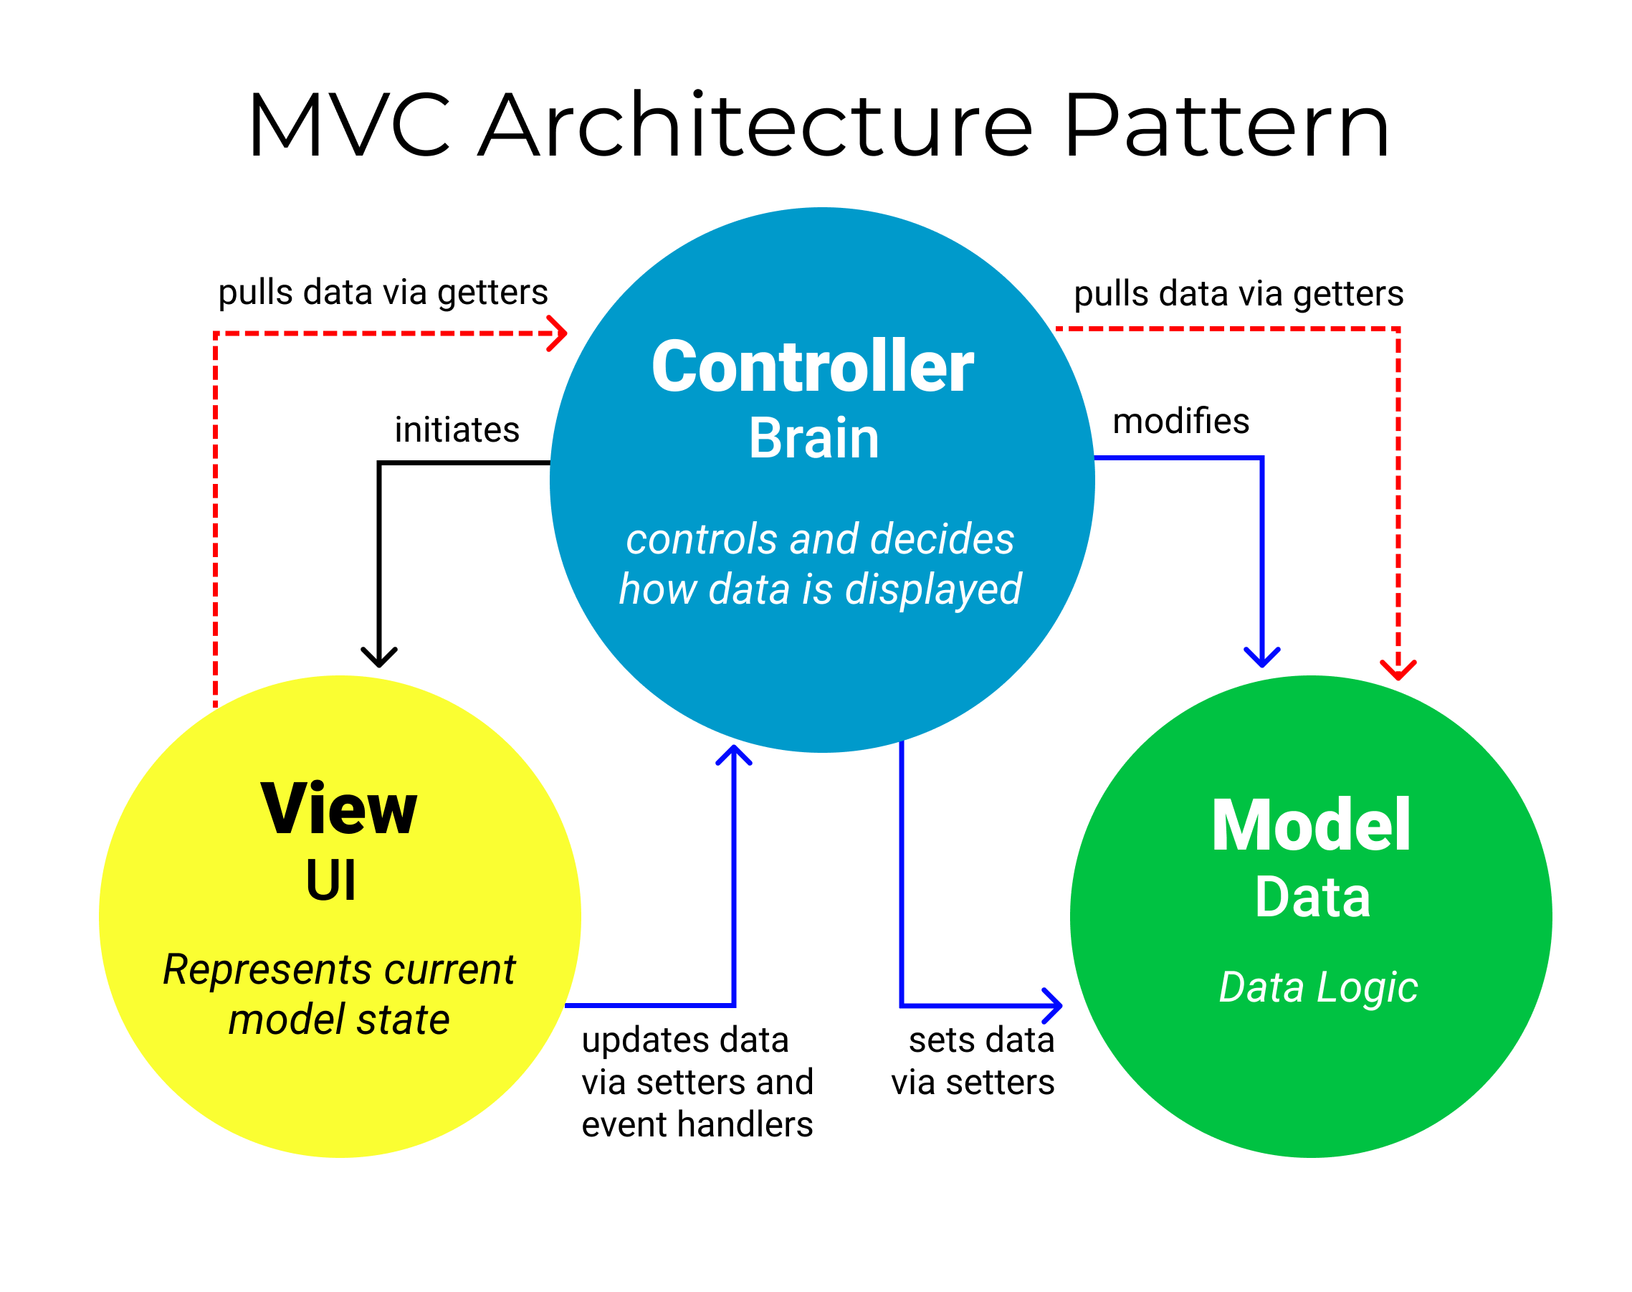
Model View Controller
Image source: https://www.freecodecamp.org/news/the-model-view-controller-pattern-mvc-architecture-and-frameworks-explained/

Slide 3
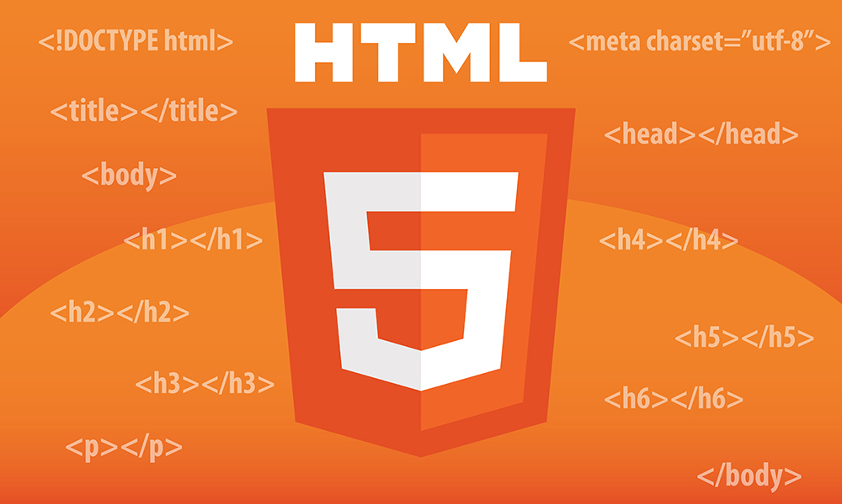
HTML
Hyper Text Markup Language
Hyper Text – Connecting pages
Markup – Describing data
Image source: https://www.oxfordwebstudio.com/user/pages/06.da-li-znate/sta-je-html/sta-je-html.jpg

Slide 4
HTML: Elements and Tags
Elements
Create the structure of the HTML document
Block-level render on new lines
Inline render next to one another on the same line
Tags
Create the physical elements
Enclosed in brackets <>
Most need opening <> and closing </> tags
Some are self closing </img>

Slide 5
HTML: Common Elements
There are over 100 different HTML elements
These are some of the most common:
<div>
<p>
<span>
</br>
</img>
<h1> . . . <h6>
<a>

Slide 6
HTML: Attributes
Key/value pairs which give metadata about the tag
Defined inside of the opening tag
Global attributes
Class
Id
Hidden
Lang
Style
Title
Tag specific
</img> src and alt
<a> href

Slide 7
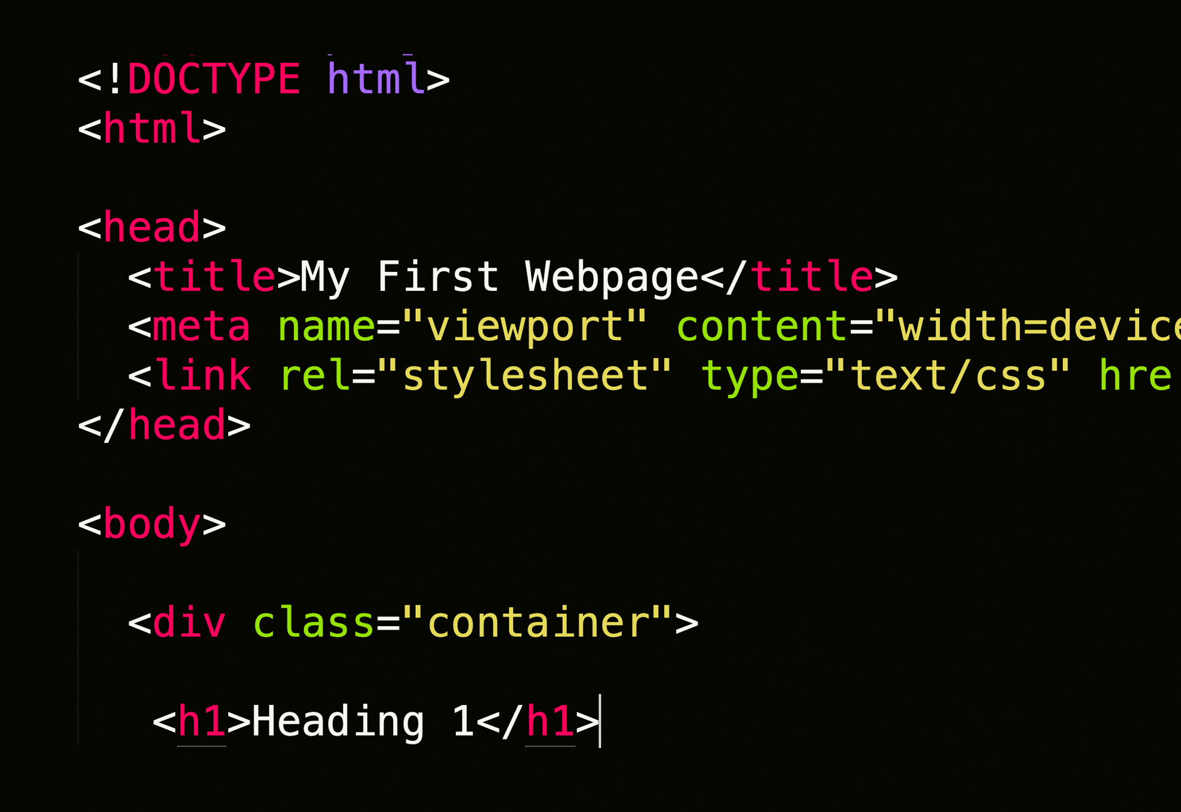
HTML: Document Structure
<!DOCTYPE>
Let’s browser know what type of document its reading
<html>
Root tag of the document
<head>
Inside of html tag, holds metadata about the page
<body>
Inside of html tag, holds the page content
Image source: https://henryegloff.com/media/How-to-Develop-a-Basic-Webpage-Using-HTML-and-CSS-Tutorial-2.jpg

Slide 8
First HTML Page DEMO

Slide 9
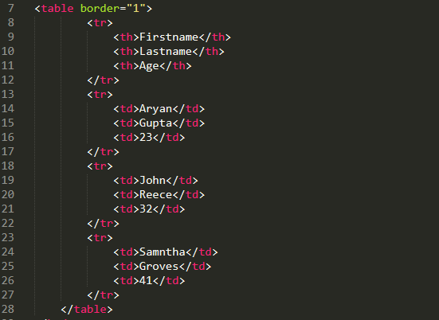
HTML: Tables
Tables are used to structure data
<table>
<thead>
<tr>
<th>
<tbody>
<td>
<tfoot>
Image source: https://www.simplilearn.com/ice9/free_resources_article_thumb/defining_html_tables-html_tables.PNG

Slide 10
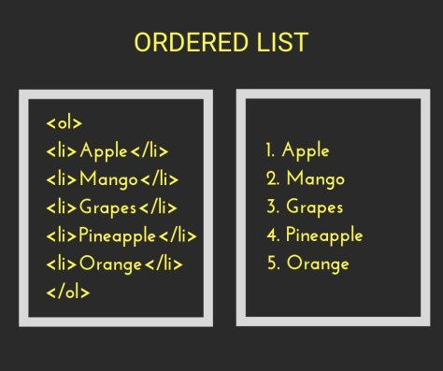
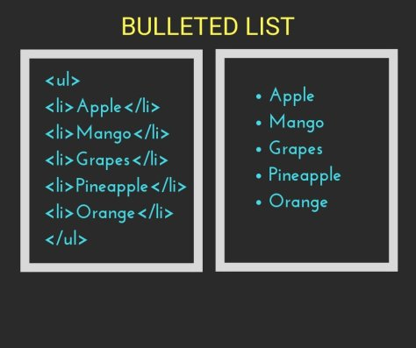
HTML: Lists
Used to display lists of items
<ol> - ordered/numbered list
<ul> - unordered/bulleted list
<li> - list element
Image source: https://www.tutorialbrain.com/html_tutorial/html_lists/

Slide 11
HTML Table and List DEMO

Slide 12
HTML Hands on Number 1
Using different elements in HTML we just spoke about, create a webpage with everyone on your teams:
Name
Background (schooling or whatnot)
Something interesting/fun
Optional a nice profile picture, that we can style later

Slide 13
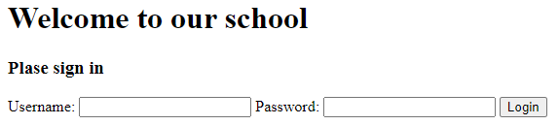
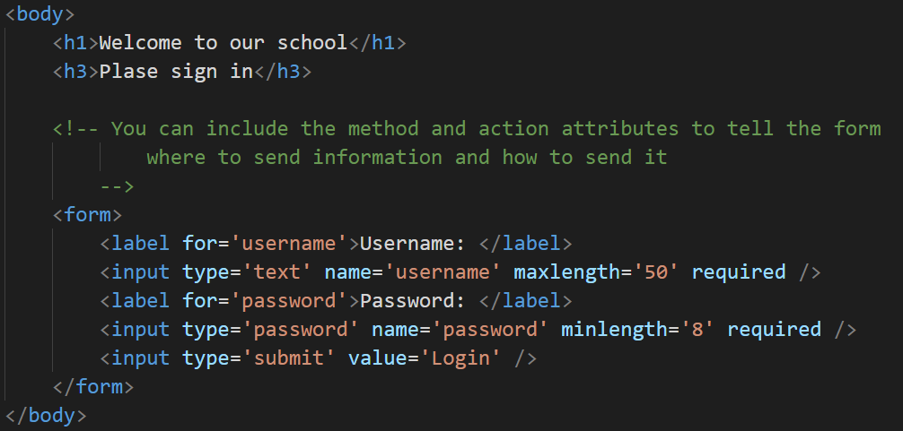
HTML: Forms
Used to collect data from the user
<form>
Attributes
action
target
method
<input>
Attributes
name
value
placeholder
required
min/max

Slide 14
HTML: Input Element and Types
Input element collects the form data
Input types
text
password
radio
check boxes
file select
textarea
select
submit
reset

Slide 15
HTML Forms DEMO

Slide 16
HTML 5
Most recent version of HTML, introduced:
DOCTYPE
Character encoding metadata
Audio and Video embedding
Run JS in background
Semantic tags

Slide 17
HTML 5: Semantic Tags
Tags which describe what they are doing
Non-semantic
<div>, <p>, <span>
Semantic
<table> pre HTML 5
<section>, <article>, <footer>
<footer>, <nav>, <aside>
<figure>, <figcaption>, <details>
<mark>, <summary>, <time>

Slide 18
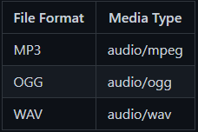
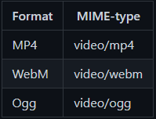
HTML 5: Audio and Video tags
<audio>
Attributes
controls
<source>
Attributes
src
type
<video>
Attributes
width
height
controls
<source>
Attributes
src
type

Slide 19
HTML 5: Validation
Make sure the data is correct on the client side
With javascript, or form validation
HTML5 validation techniques
required
ninlength or maxlength
nin or max
type
pattern

Slide 20
HTML 5 DEMO

Slide 21
CSS
Cascading Style Sheets
Key/value pair of rules that define the styling of the webpage
Composed of selectors and declarations
Selector is an html element or group of elements
Declaration is the styling rules
Linking CSS to an HTML page
Inline – applied directly to the element on the page
Internal/Embedded – declared in a <style> tag in the head
External – declared in an external css file, linked with <link> tag in the head

Slide 22
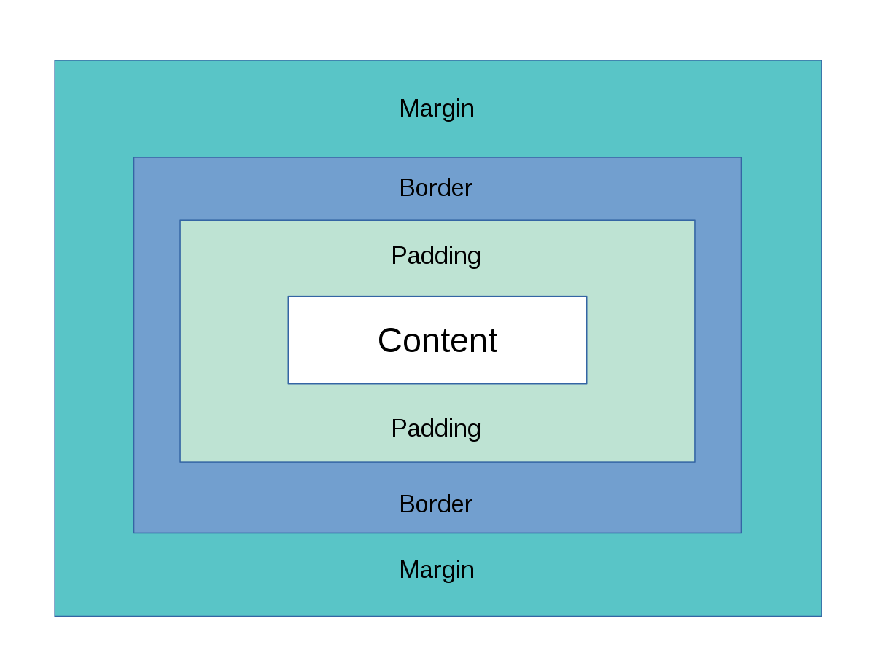
CSS: Box Model
Image source: https://upload.wikimedia.org/wikipedia/commons/thumb/e/ed/Box-model.svg/1200px-Box-model.svg.png

Slide 23
CSS: Properties and Selectors
Properties: used to style the elements
border
padding
margin
display
position
color
text-align
Selectors: used to select elements to style
Element: p {}
Id: #elementId{}
Class: .class{}
Universal: *{}
Attribute: [attribute]{}
Child: div > p {}
Descendent: div p {}

Slide 24
CSS: Specificity
Determines the styling rules for elements that have been selected by multiple selectors
Follows a specific ordering:
Inline CSS
ID selector
Class attribute and Pseudo-class selector
Element and Pseudo-element selector

Slide 25
CSS DEMO

Slide 26
CSS: Responsive Web Design
Approach that allows websites to render on all devices
Done through css selectors
Media queries
Flexible grids
Flex boxes
Flexible images

Slide 27
Responsive Web Design: Media Queries
Allows the CSS to change based on the device
Consists of:
Media feature expressions, and optional media type
Media Types
all, print, screen, speech
Media features
grid, height, width, hover, and more
Logical Operators
not, any, only

Slide 28
Responsive Web Design: Flex Box
One dimensional layout method for arranging elements in row or columns
Create a flex container with css property “display: flex”
And element in the flex container will be responsive to flex box properties
Flex Box Properties
Flex direction
Flex wrap
Flex flow
Justify Content
Align Items
Flex Item Properties
Order
Flex grow
Flex shrink
Flex basis
Flex property
Align self

Slide 29
Responsive Web Design: CSS Grid
Two-dimensional grid-based layout system
Set the grid container with “display: grid”
Set columns with “grid-template-columns”
Set rows with “grid-template-rows”
Used similarly to flex box

