Slide 1
W3D3
Javascript DOM and Events

Slide 2
Javascript: OOP
Inheritance:
Prototypical
Set the __proto__ property of the object to refence it’s parent
Use “newly” implemented classes
Encapsulation:
Closures
Nested function that can access the variables and arguments of its outer function, but can’t change them
Polymorphism:
Type coercion
Abstraction:
Classes from ES6
Creates object templates
Even includes the static keyword and constructors

Slide 3
Javascript OOP DEMO

Slide 4
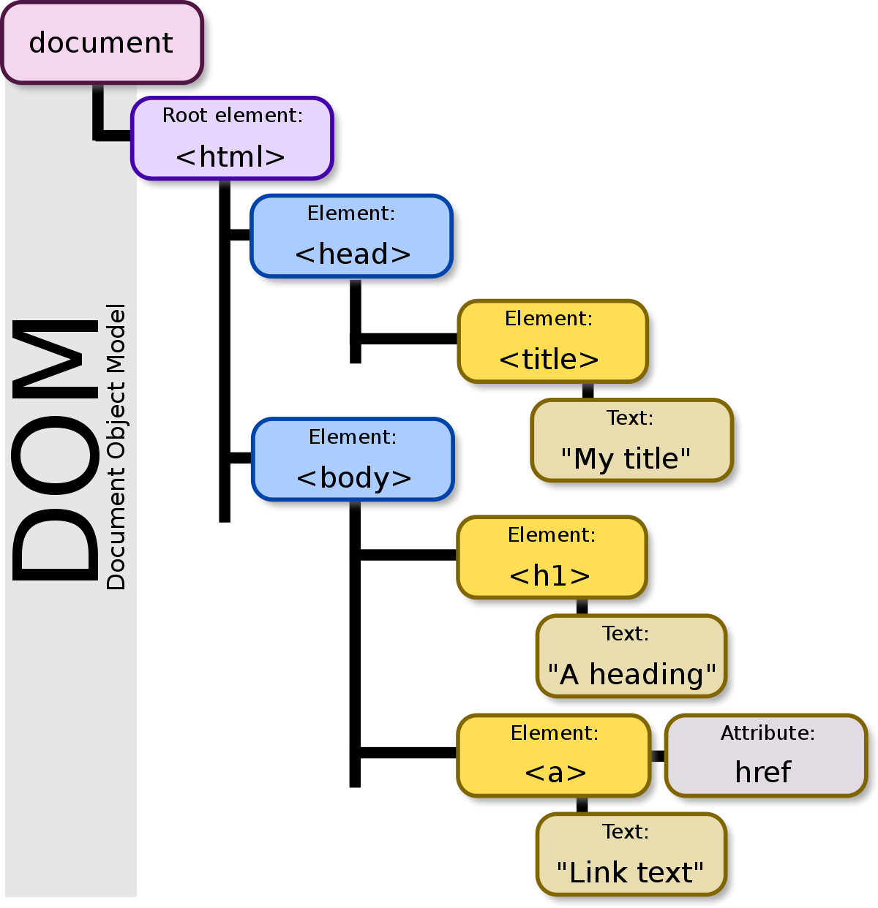
Javascript: Document Object Model
The DOM is a tree like structure representing the HTML document
Root is also the html tag
Access every html element of the page with JS
Use the document keyword to gain access
Image source: https://upload.wikimedia.org/wikipedia/commons/thumb/5/5a/DOM-model.svg/1200px-DOM-model.svg.png

Slide 5
Javascript: Select DOM Elements
All methods/properties are preceded by the document keyword
Selecting Specific Elements
.getElementById(“id”)
.getElementsByClassName(“class”)
.getElementsByTagName(“tag”
.querySelector(“selector)
.querySelectorAll(“selector)
Gain access to top level nodes
.documentElement
.head
.body
Gain access to parent nodes
.parentNode
.parentElement
Gain access to child and sibling nodes
.childNode
.firstChild
.lastChild
.previousElementSibling
.nextElementSibling

Slide 6
Javascript: DOM Manipulation
Create a new DOM element : document.createElement()
To modify elements, precede the methods/properties below with the element keyword
.replaceChild()
.removeChild()
.insertBefore()
.innerText
.textContent
.innerHtml
.cloneNode()
Modify element attributes with the following methods
.getAttribute(“attribute)
.setAttribute(“attribute)
.removeAttribute(“attribute)
.has Attribute(“attribute)

Slide 7
DOM Manipulation DEMO

Slide 8
Javascript: Events and Listeners
Event:
When a user interacts with your webpage
Handle these with Event Listeners/Handlers
Many Types of Events:
onclick
onload
onmouseover
onkeydown
onchange
onsubmit
Many more
Register a handler:
Inline, set the on… attribute of the html elment
Set the event property of the html element to a JS function
Use the element method addEventListener(event, function, useCapture)

Slide 9
Javascript: The Event Object
All Events are represented by an Event object with these properties:
bubbles
currentTarget
preventDefault()
stopPropagation()
target
type

Slide 10
Javascript: Types of Events
There are 16 different subclasses of the Event object, two you will see are:
MouseEvent
onmouseenter, onmouseleave
Special properties
clientX, clientY
movementX, movementY
offsetX, offsetY
screenX, screenY
altKey, ctrlKey, shiftKey
KeyboardEvent
Onkeydown, onkeyup, onkeypress
Special properties
altKey, ctrlKey, shiftKey
key, keycode, which
repeat

Slide 11
Javascript: Bubbling and Capturing
Event propagation:
How the event flows through the components on the page
Bubbling
Default strategy
Bottom up approach
Works with all handlers
Capturing
Must be declared when creating the handler
Top down approach
Only works with handlers registered with .addEventListener()

Slide 12
Event and DOM Hands On
Create an HTML Page with a form
Have the user input their name, and favorite color
On submit, take that users name and favorite color and put it on the screen
Color the users favorite color with the css color associated with it
The page should be appended, do not override older submissions

