Slide 1


Climate Change Modeling
06 oct, 2025

Slide 2



1.Problem Statement
Climate change is a serious global issue that affects the environment, human health, and economies. Increasing greenhouse gas emissions and changing weather patterns make it important to build models that can predict and explain these changes.
The goal of this project is to study climate data, find the main factors that influence CO₂ emissions, and create predictive models that can forecast future climate trends.
Using data analysis and machine learning, the project aims to answer:
What factors in the atmosphere and environment contribute most to CO₂ emissions?
How can predictive models help forecast future climate changes?
How can these insights support governments and organizations in planning effective climate actions?

Slide 3



2. Dataset Description
For this project, we used different datasets related to carbon dioxide (CO₂) levels, temperature records, and sea level rise. These datasets together help us understand how climate change is affecting the planet over time.
CO₂ Dataset
Covers data from 1958 onwards.
Contains monthly carbon dioxide levels (ppm) recorded at Mauna Loa Observatory.
Includes both raw values and seasonally adjusted values to remove seasonal effects.
Useful for studying the rise of greenhouse gases in the atmosphere.
Global Temperature Dataset
Covers data from as early as 1750.
Includes land, ocean, maximum, and minimum temperatures.
Also provides uncertainty values with each measurement.
Helps us track global warming trends over centuries.
Temperature by Location
Data available by city, country, state, and major cities.
Useful for comparing climate change across different regions of the world.
Sea Level Dataset
Covers data from 1880 onwards.
Records global sea level change (in millimeters) relative to a 1993–2008 average.
Important for understanding the impact of melting ice and warming oceans.

Slide 4




3. Data Preprocessing
The climate dataset was prepared by combining three sources: sea level data, global temperature data, and CO2 concentration data. The preprocessing steps included:
Date Handling:
All date columns were converted to datetime format.
New columns year and month were extracted from the dates for aggregation.
Aggregation:
Sea level, temperature, and CO2 data were aggregated to yearly averages to standardize the temporal scale.
Merging:
The three datasets were merged on the year column to create a single consolidated dataset.
Renaming Columns:
Columns were renamed for clarity:
mmfrom1993-2008average → SeaLevel_mm
Seasonally Adjusted CO2 (ppm) → CO2_ppm
LandAverageTemperature → LandTemp_C
LandAndOceanAverageTemperature → LandOceanTemp_C
Missing Values and Duplicates:
The dataset contains no missing values and no duplicate rows.
Final Dataset:
The cleaned dataset has 58 yearly observations and 5 columns: year, SeaLevel_mm, CO2_ppm, LandTemp_C, and LandOceanTemp_C.
All columns are numeric, ready for analysis.

Slide 5


4. Exploratory Data Analysis (EDA)
EDA was carried out to uncover trends and
patterns in employee attrition.
Key Findings:
Sea Level: Increased steadily from around -70 mm (1958) to +50 mm (2015), showing clear long-term rise.
CO₂ Concentration: Rose sharply from ~315 ppm to over 400 ppm, indicating strong greenhouse gas buildup.
Land Temperature: Increased from ~8.5 °C to ~9.8 °C, confirming global land warming.
Land & Ocean Temperature: Climbed from ~15.2 °C to ~16.0 °C, showing consistent warming across Earth’s surface.
Overall Trend: All variables show positive correlation—rising CO₂ levels align with higher global temperatures and sea level rise.

Slide 6
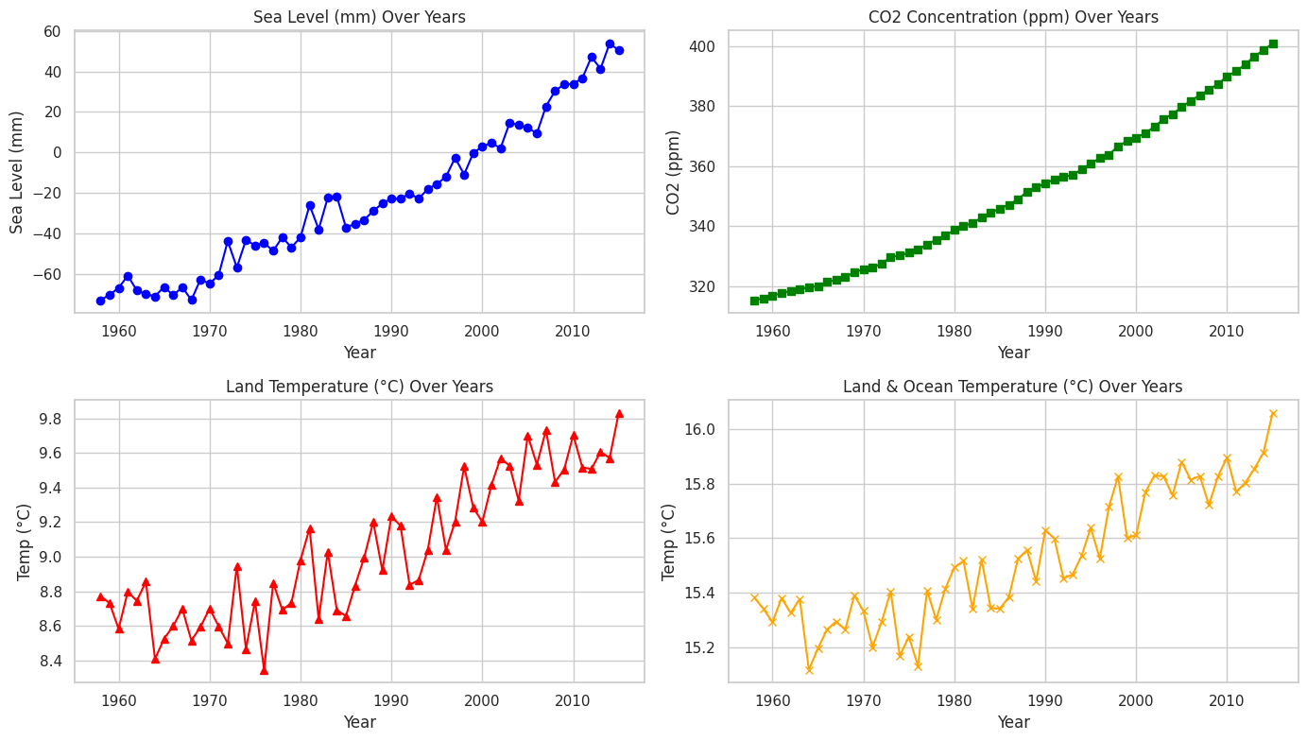

Slide 7
5.Numerical Insights from EDA
🌊 1. Sea Level (mm) Over Years
The plot shows a steady increase in sea level from around -70 mm in 1958 to nearly +50 mm in 2015.
There is a clear upward trend indicating that global sea levels have been rising consistently over the decades.
Minor fluctuations are present, but the overall slope is positive, supporting the hypothesis of climate-driven sea level rise.
This rise correlates with the increase in global temperature and CO₂ concentration, shown in the other plots.
🌫️ 2. CO₂ Concentration (ppm) Over Years
CO₂ concentration has increased from around 315 ppm in 1958 to over 400 ppm by 2015.
The trend is almost perfectly exponential, indicating a continuous rise in atmospheric CO₂.
This increase is primarily attributed to industrial emissions, fossil fuel combustion, and deforestation.
The strong upward trend in CO₂ mirrors the increase in both temperature and sea level, suggesting a causal relationship between greenhouse gas buildup and global warming.

Slide 8
5.Numerical Insights from EDA
🌡️ 3. Land Temperature (°C) Over Years
Land temperatures have shown a gradual upward trend, increasing from around 8.5°C in the 1960s to nearly 9.8°C in recent years.
Despite year-to-year variability, the overall trend confirms global land warming.
Periodic dips in temperature reflect natural climate variability, but the overall warming signal is clear.
This suggests that terrestrial regions are warming at a faster rate than oceans due to lower heat capacity and regional effects.
🌍 4. Land & Ocean Temperature (°C) Over Years
The combined land and ocean temperature has increased from around 15.2°C to 16.0°C over the same period.
The plot indicates a consistent warming pattern, aligning with both land-only and atmospheric CO₂ trends.
The slower but steady increase compared to land temperature alone reflects the moderating effect of oceans.
The upward trajectory further reinforces global climate change evidence across different environmental indicators.

Slide 9

6.Feature Correlation Analysis
Correlation analysis was performed to identify how the key climate indicators relate to each other.
Sea Level shows a very strong positive correlation with CO₂ concentration (0.99), suggesting that rising greenhouse gases are closely linked to sea level rise.
Both Land Temperature (0.89) and Land & Ocean Temperature (0.90) are also highly correlated with sea level, indicating that warming trends contribute to ocean expansion and melting ice.
CO₂ concentration is strongly correlated with Land Temperature (0.90) and Land & Ocean Temperature (0.92), confirming that increased CO₂ drives global warming.
Land Temperature and Land & Ocean Temperature have an almost perfect correlation (0.98), showing that temperature changes are globally consistent across land and sea.
In summary, the analysis highlights a tight interconnection between CO₂ emissions, global temperature rise, and sea level increase, reinforcing the evidence of anthropogenic climate change.

Slide 10
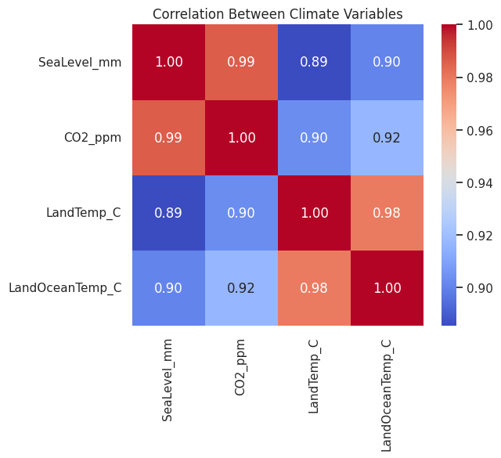
SeaLevel_mm CO2_ppm LandTemp_C LandOceanTemp_C
SeaLevel_mm 1.000000 0.986338 0.885256 0.900339
CO2_ppm 0.986338 1.000000 0.902759 0.917079
LandTemp_C 0.885256 0.902759 1.000000 0.979379
LandOceanTemp_C 0.900339 0.917079 0.979379 1.000000

Slide 11

7.Quadratic Regression – Model A (CO₂ Concentration vs Temperature Anomaly)
The goal of this model was to study the relationship between CO₂ concentration and Land & Ocean Temperature.
A Polynomial Regression (degree 2) model was used to capture the non-linear pattern between these two variables.
The CO₂ values were transformed into polynomial features, allowing the model to fit a curved trend instead of a straight line.
After training the model, key performance metrics were calculated:
MAE (Mean Absolute Error), MSE (Mean Squared Error, R² and Adjusted R²
The results showed high R² and Adjusted R² values, meaning the quadratic model explains the temperature variation very well.
The scatter plot with the red curve shows that the fitted quadratic line closely follows the data points, confirming a strong relationship.
The residual plot indicates that errors are randomly spread around zero, suggesting that the model fits the data properly without major bias.

Slide 12
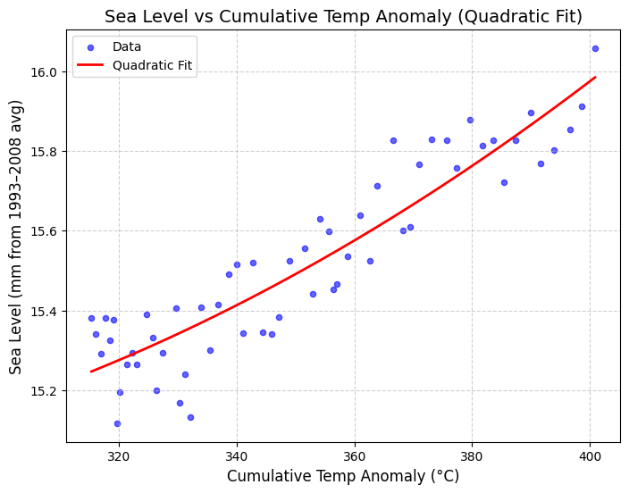
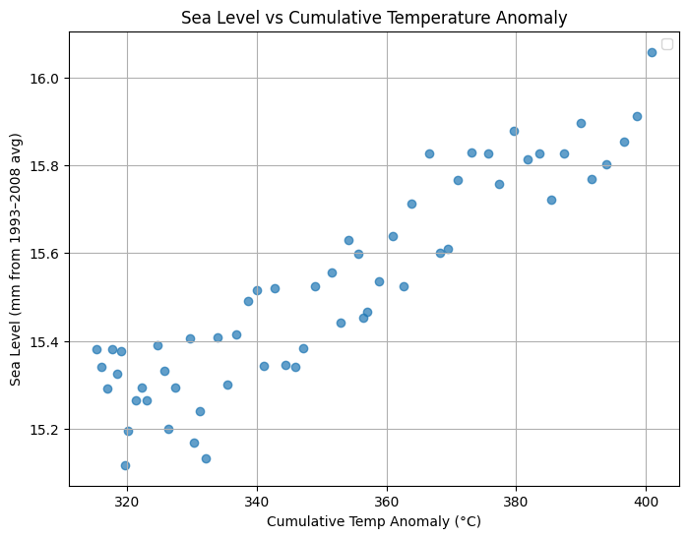
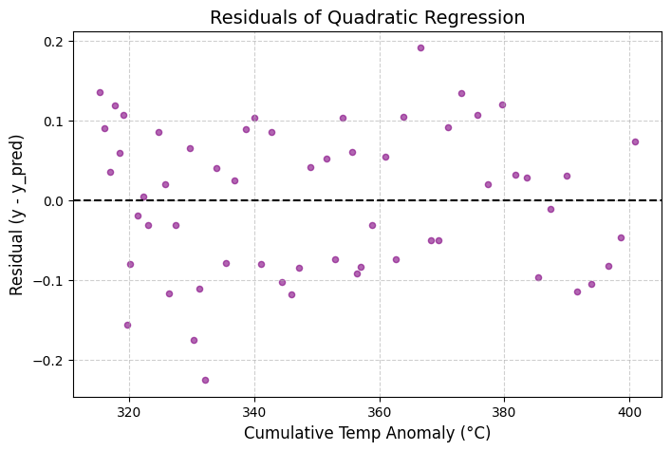
In short: The quadratic regression model shows that temperature increases more rapidly as CO₂ levels rise, capturing the curved, accelerating nature of climate warming.

Slide 13
8.Lag and Cumulative Temperature Features
In the second part, two new features were added to study time-based effects on sea level:
Temp_lag5: Temperature from 5 years earlier — to see delayed (lagged) effects on sea level.
Temp_cumsum: Cumulative temperature anomaly — to observe long-term warming influence.
The models used were Linear Regression, Ridge, Lasso, and ElasticNet, and evaluated using Time Series Cross-Validation (5 splits).
Results were compared for both features:
Models using Temp_cumsum generally gave better R² scores, showing that long-term warming explains sea level rise more accurately than short-term (lagged) temperature changes.
Lagged temperature also showed some predictive power but was less consistent.

Slide 14
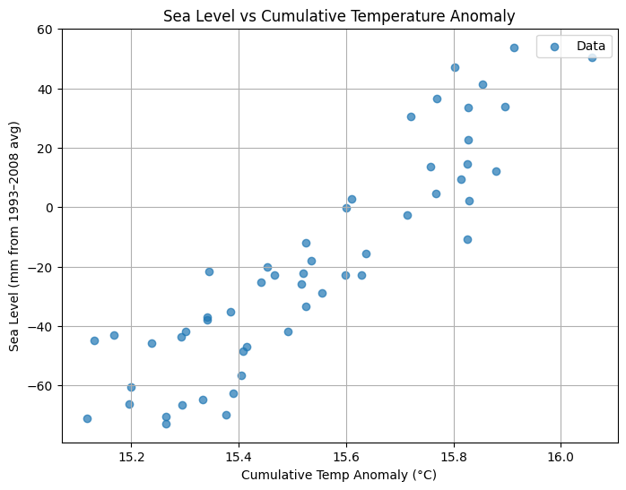
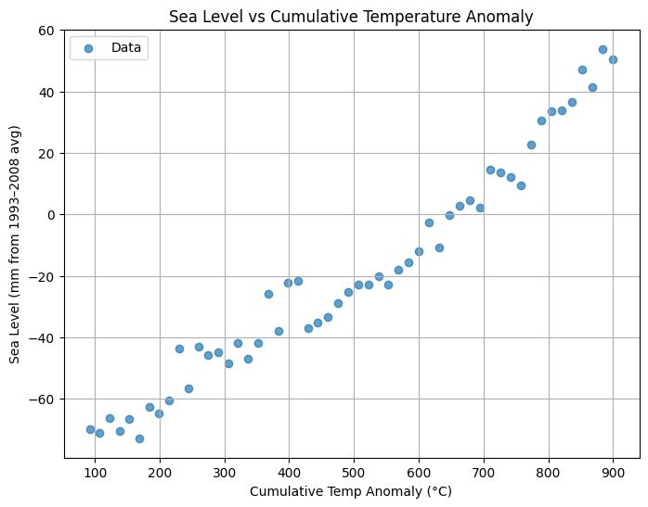
In short: Sea level rise is more closely linked to the accumulated effect of global warming (cumulative temperature) rather than short-term fluctuations.

Slide 15
9.Quadratic Regression – Model B (Cumulative Temperature vs Sea Level)
This model studies how cumulative global temperature increase affects the rise in sea level.
A Quadratic Regression (degree 2) model was used to capture the non-linear relationship between these two variables.
The predictor variable was Cumulative Temperature Anomaly and the target variable was Sea Level (mm).
Polynomial features were created to allow the regression line to bend and better follow the real trend.
The model performance was measured using MAE, MSE, R², and Adjusted R², all showing a strong fit.
The scatter plot shows actual data points (blue) with the red curved line representing the quadratic fit, which closely follows the rising sea level pattern.
The residual plot confirms that errors are small and randomly distributed, meaning the model fits well..

Slide 16
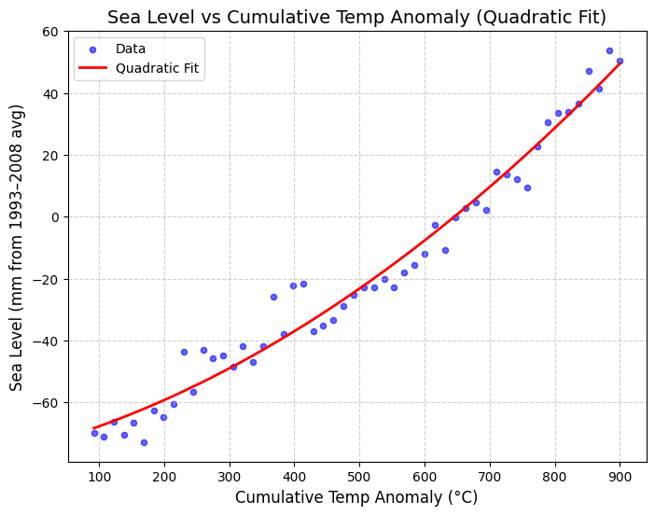
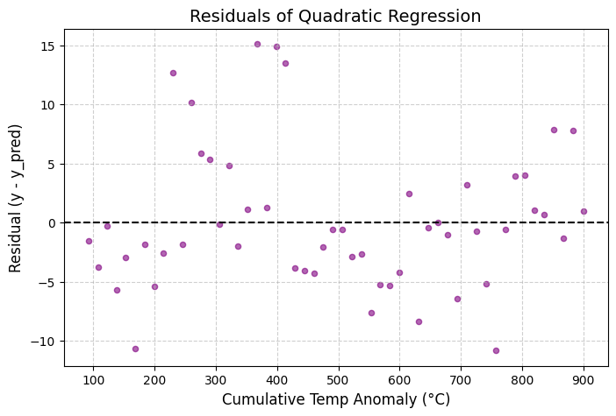
In simple terms: As the Earth’s temperature keeps increasing over time, the sea level also rises — and the relationship is non-linear, meaning sea levels rise faster as global temperatures accumulate

Slide 17


10.Sea Level Prediction from CO₂ Concentration
Overview: We implemented a two-step predictive approach to estimate future sea level rise based on atmospheric CO₂ concentrations. The method combines two regression models:
Model A: Predicts the temperature anomaly (Temp_anomaly) from CO₂ concentration (CO₂_ppm).
Model B: Predicts sea level rise (SeaLevel_mm) from the cumulative temperature anomaly (Temp_cumsum) using a quadratic regression.

Slide 18

11.Methodology:
Predict Temperature Anomaly: Model A estimates the expected temperature increase corresponding to a given CO₂ level.
Update Cumulative Temperature: The predicted temperature anomaly is added to the historical cumulative temperature anomaly to account for accumulated warming.
Predict Sea Level Rise: Model B uses the updated cumulative temperature to predict the corresponding sea level rise.
Output: For a given CO₂ level, the function returns:
Output | Description
CO₂ Level (ppm) | Input CO₂ concentration
Predicted Temperature Anomaly (°C) | Estimated global temperature increase
Cumulative Temperature Anomaly (°C) | Updated total warming including past data
Predicted Sea Level Rise (mm) | Estimated rise relative to baseline
Summary: This approach enables us to translate CO₂ emissions into temperature changes and then into sea level rise. It provides a simple and interpretable chain of predictions, capturing both the immediate impact of CO₂ on temperature and the resulting effect on sea level.

Slide 19
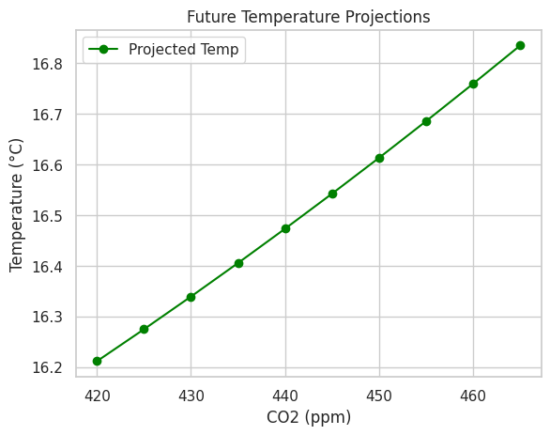
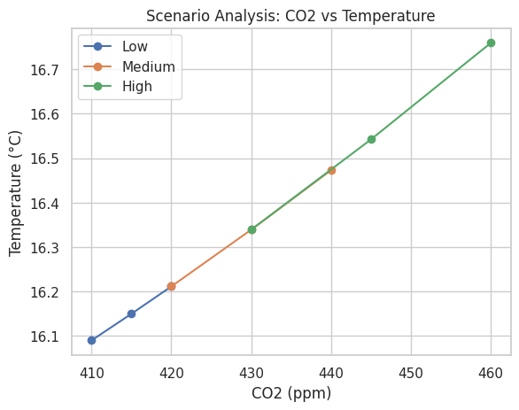
12. Future Projections and Scenario Analysis:

Slide 20
11.Example Prediction:
Using the function predict_sea_level_from_co2, we estimate the sea level rise for a CO₂ concentration of 400 ppm:
result = predict_sea_level_from_co2(400, modelA, polyA, modelB, polyB, df)
print(result)
CO₂ Level (ppm) | Predicted Temp Anomaly (°C) | Cumulative Temp Anomaly (°C) | Predicted Sea Level Rise (mm)
400 | 15.974871783183055 | 916.087371783183 | 52.99705713659479
This demonstrates the workflow: first estimating temperature increase from CO₂, then cumulative warming, and finally the corresponding sea level rise.

