Slide 1


IBM HR Analytics Employee Attrition & Performance
7 Oct, 2025

Slide 2



1.Problem Statement
Employee attrition is a major challenge that directly affects organizational performance, stability, and cost. The goal of this analysis is to identify and understand the key factors that contribute to employee attrition and to develop predictive insights that help HR teams minimize turnover.
By applying data analysis and machine learning techniques, the project aims to answer:
Which employee characteristics are most associated with attrition?
What measures can be implemented to improve retention and engagement?

Slide 3



2. Dataset Description
The dataset used is the IBM HR Analytics Employee Attrition & Performance dataset, a fictional dataset developed by IBM data scientists for workforce analytics.
Source: https://drive.google.com/file/d/1tv2dfgghMKzN_mKmdn0ymCUrkwVvBk3w/view
Number of Records: 1,470 employees
Number of Features: 35 columns including demographics, work experience, satisfaction scores, compensation, and attrition status.
Target Variable: Attrition (Yes/No)

Slide 4




3. Data Preprocessing
To ensure high-quality analysis, several preprocessing steps were performed:
Missing values: None found across all columns.
Duplicates: 0 duplicates detected and removed.
Data type verification: All features correctly formatted as numeric or categorical.
Encoding: Converted categorical variables (e.g., Gender, Job Role, Department) into numeric codes using Label Encoding.
Normalization/Scaling: Applied feature scaling on numerical variables such as MonthlyIncome, Age, and YearsAtCompany to improve model convergence.

Slide 5


4. Exploratory Data Analysis (EDA)
EDA was carried out to uncover trends and
patterns in employee attrition.
Key findings include:
Attrition rate: 16.12% of employees left the company.
Tenure: Average employee tenure is about 7 years.
Age: Most employees are aged 30–35, and younger employees show higher attrition rates.
Gender: Attrition slightly higher among males.
Department: Majority of employees are in Research & Development, followed by Sales.
Overtime & Work-Life Balance: Employees working overtime or reporting lower work-life balance have significantly higher attrition rates

Slide 6
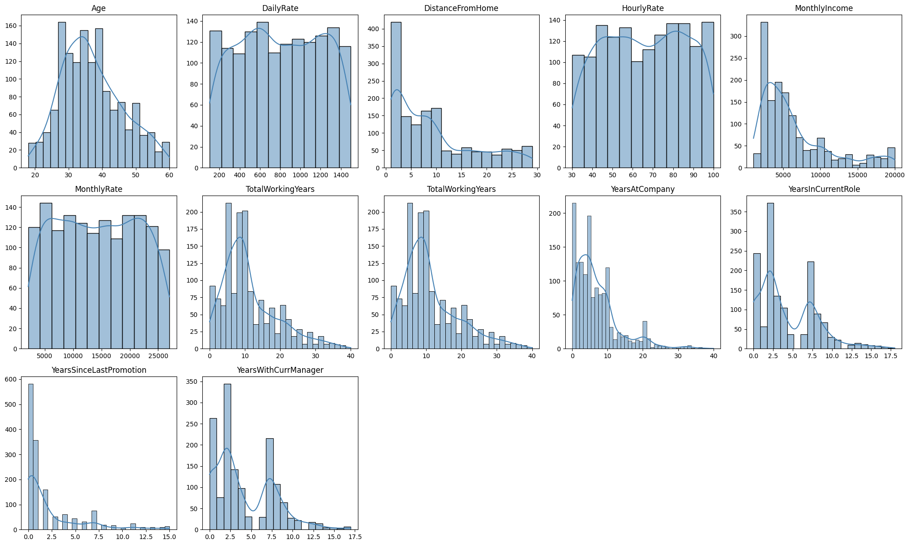

Slide 7
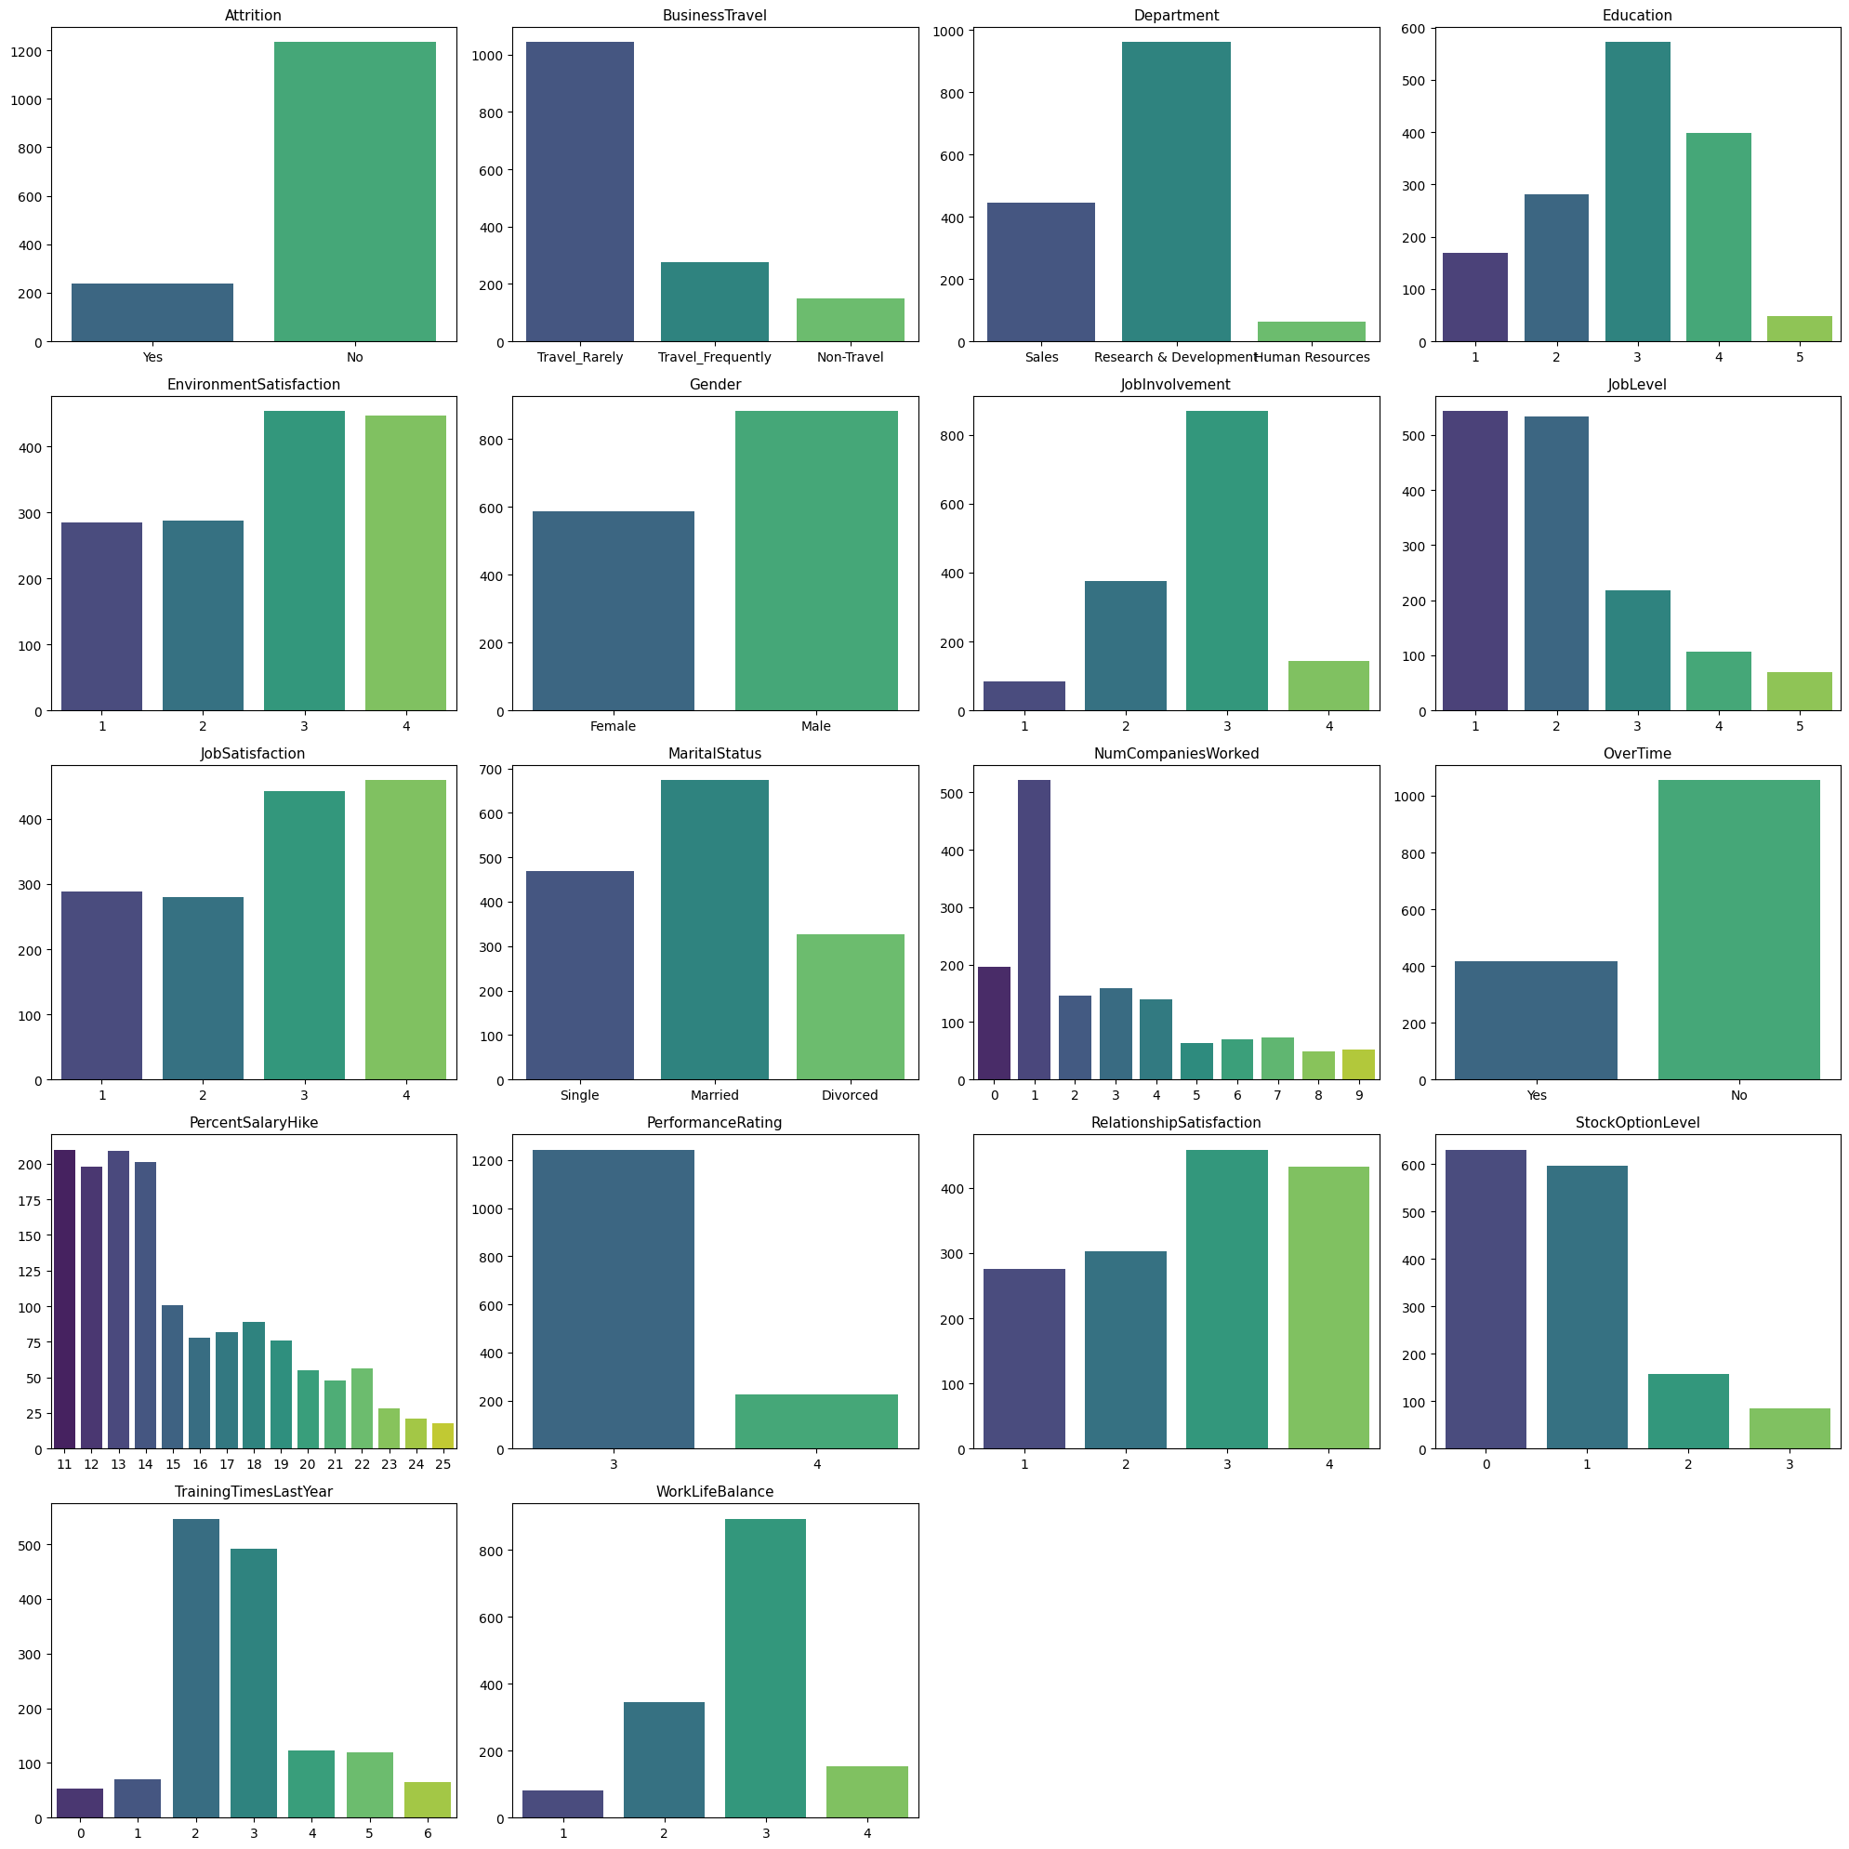

Slide 8
5.Categorical Insights from EDA — Attrition vs Categorical Features
1. Overall Attrition Rate
About 16.1% of employees left the company, while 83.9% stayed.
This confirms a class imbalance, which was later handled using SMOTE.
2. Business Travel
Employees who travel frequently have higher attrition (14.1%) compared to those who travel rarely (10.6%).
Non-traveling employees show the lowest attrition rate (0.8%), suggesting travel workload may affect retention.
3. Department
Most employees work in Research & Development, followed by Sales.
Sales department has a relatively higher attrition rate (6.3%), indicating possible stress or performance pressure in sales roles.
4. Education Field
Employees from Life Sciences and Medical fields dominate the dataset.
Attrition is slightly higher among Life Sciences employees compared to other fields.
5. Gender
Male employees have a slightly higher attrition rate (10.2%) compared to females (5.9%).
This suggests possible gender-related differences in workload or job satisfaction.

Slide 9
Categorical Insights from EDA — Attrition vs Categorical Features
6. Job Role
Sales Executives and Laboratory Technicians show the highest attrition rates.
Roles like Research Director and Manager have low attrition, likely due to seniority and stability.
7. Marital Status
Single employees show higher attrition (8.2%) than married or divorced employees.
Indicates younger or unmarried employees are more likely to leave, possibly for career growth.
8. OverTime
Employees working OverTime have a significantly higher attrition rate (8.6%).
Those who don’t work overtime are more likely to stay, emphasizing the impact of work-life balance on retention.
Summary Insight: Attrition is notably higher among younger, single, and frequently traveling employees, especially those working overtime or in sales-related roles. Work-life balance, role expectations, and travel stress appear to be the key drivers of employee turnover.

Slide 10
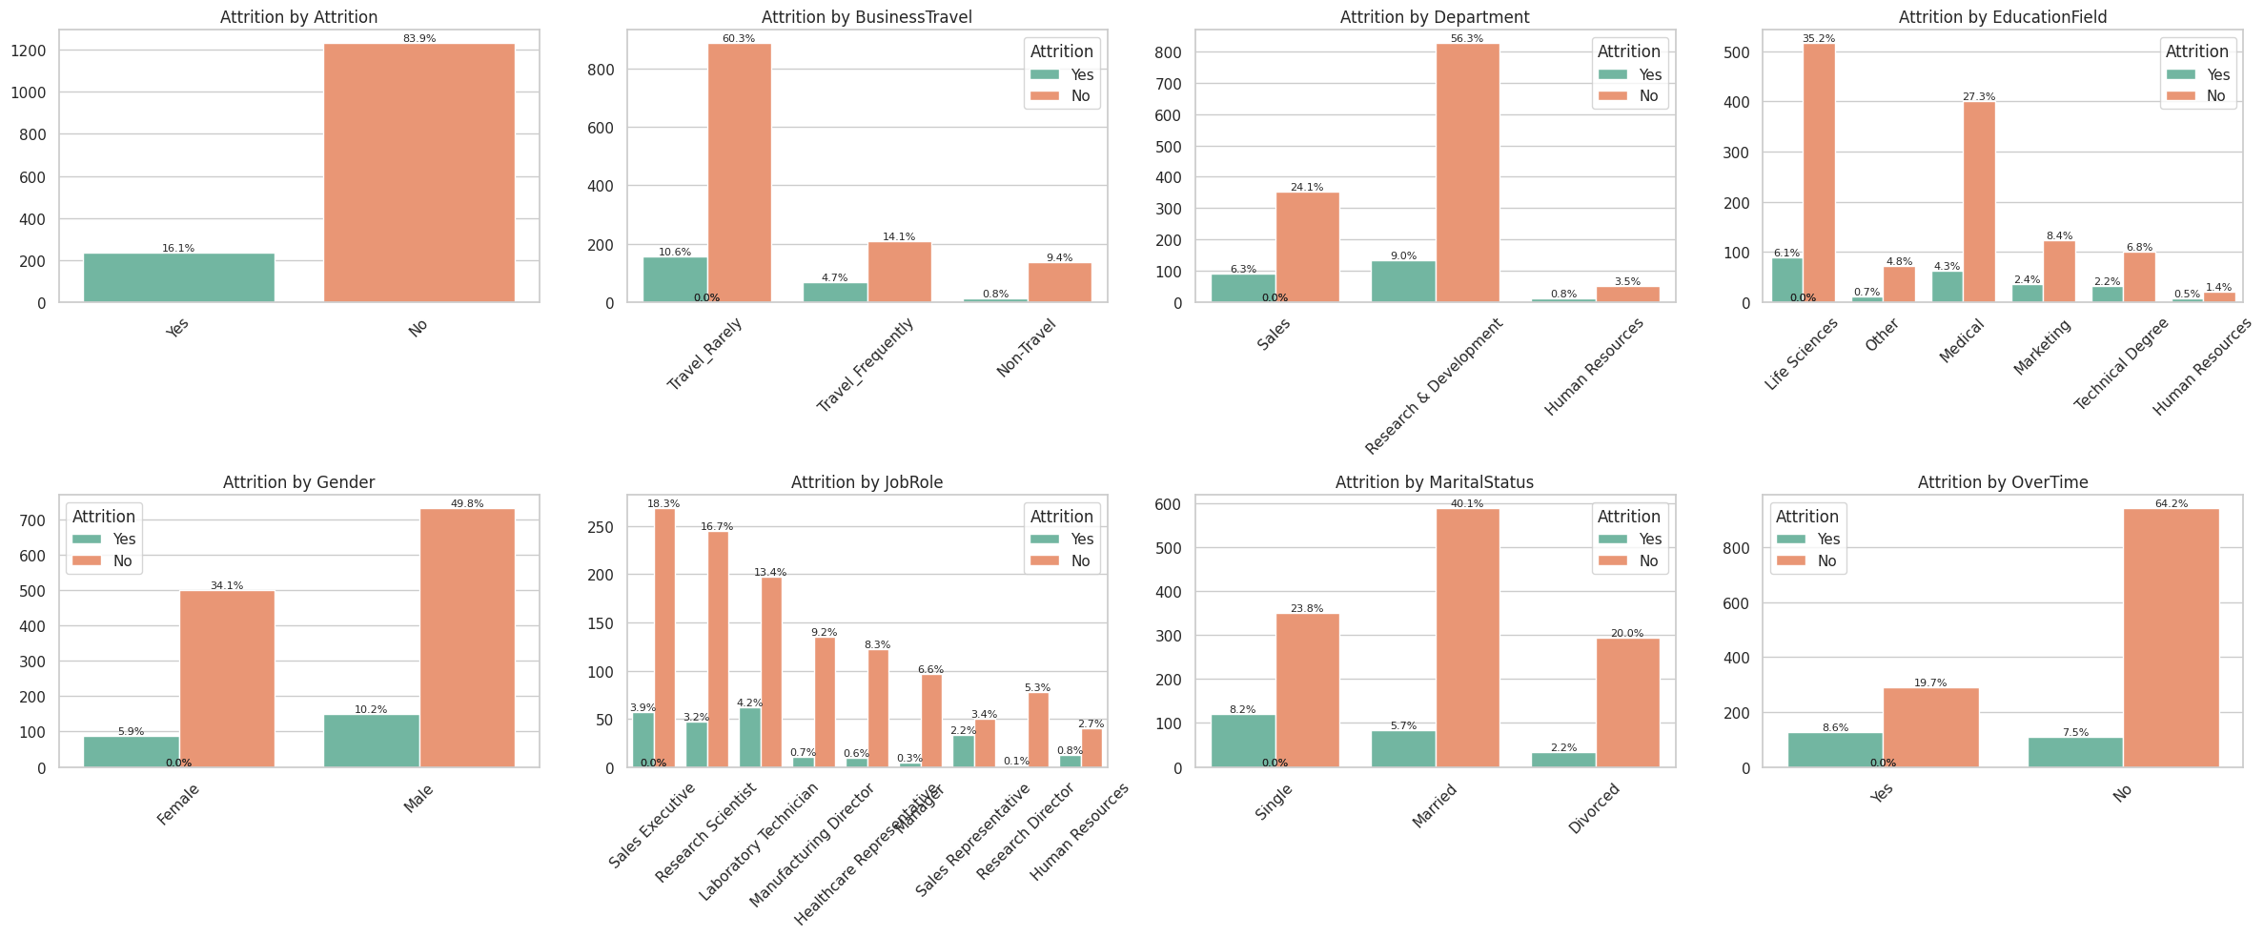

Slide 11
6.Numerical Insights from EDA — Attrition vs Numeric Features
1. Age
Employees who left the company tend to be younger (around 25–35 years).
Older employees (>40) show significantly lower attrition, suggesting higher job stability.
2. MonthlyIncome / MonthlyRate / HourlyRate / DailyRate
Attrition is higher among employees with lower income levels.
The density of “Attrition = Yes” is heavily concentrated at the lower end of salary distribution.
Indicates that compensation dissatisfaction is a key driver of attrition.
3. YearsAtCompany / TotalWorkingYears / YearsInCurrentRole / YearsWithCurrManager
Employees with shorter tenure (<5 years) are more likely to leave.
Attrition sharply declines as tenure increases — long-term employees are much more stable.
Similar trend observed for YearsWithCurrManager and YearsInCurrentRole — frequent role or manager changes may increase attrition risk.
4. Education & EducationField
Education level doesn’t show a strong trend with attrition.
Slightly higher attrition is seen in employees with lower education levels, but not a dominant factor.

Slide 12
Numerical Insights from EDA — Attrition vs Numeric Features
5. JobSatisfaction / EnvironmentSatisfaction / RelationshipSatisfaction
Employees with low satisfaction scores (1 or 2) have a notably higher attrition rate.
Satisfaction scores of 4 (high) are associated with minimal attrition.
Indicates job satisfaction and work environment quality strongly influence retention.
6. PerformanceRating / PercentSalaryHike
Both distributions show minimal difference between attrition and non-attrition groups.
Suggests that performance rating and annual salary hike do not significantly affect attrition in this dataset.
7. WorkLifeBalance
Employees reporting low work-life balance (rating = 1 or 2) show slightly higher attrition.
Reinforces the importance of work-life balance as a retention factor.
8. NumCompaniesWorked / YearsSinceLastPromotion / TrainingTimesLastYear
Higher attrition among employees who have worked in multiple companies before (NumCompaniesWorked > 4). → Indicates that employees with a pattern of job-hopping continue that behavior.
YearsSinceLastPromotion: Employees without promotions for long durations show more attrition — growth opportunities matter.
TrainingTimesLastYear: Little difference observed — may not be a key factor.
9. StockOptionLevel
Attrition is lower among employees with higher stock option levels, implying ownership incentives help retention.

Slide 13

Numerical Insights from EDA — Attrition vs Numeric Features
Overall Numerical Insights Summary
🔺 Higher attrition among:
Younger employees (25–35 years)
Lower-income groups
Low satisfaction levels (Job, Environment, Relationship)
Employees with shorter tenure or fewer years with their manager
Employees lacking promotions or growth opportunities
🔻 Lower attrition among:
Older, experienced, and higher-level employees
Those with higher stock option levels and salaries
Employees with strong satisfaction and work-life balance

Slide 14
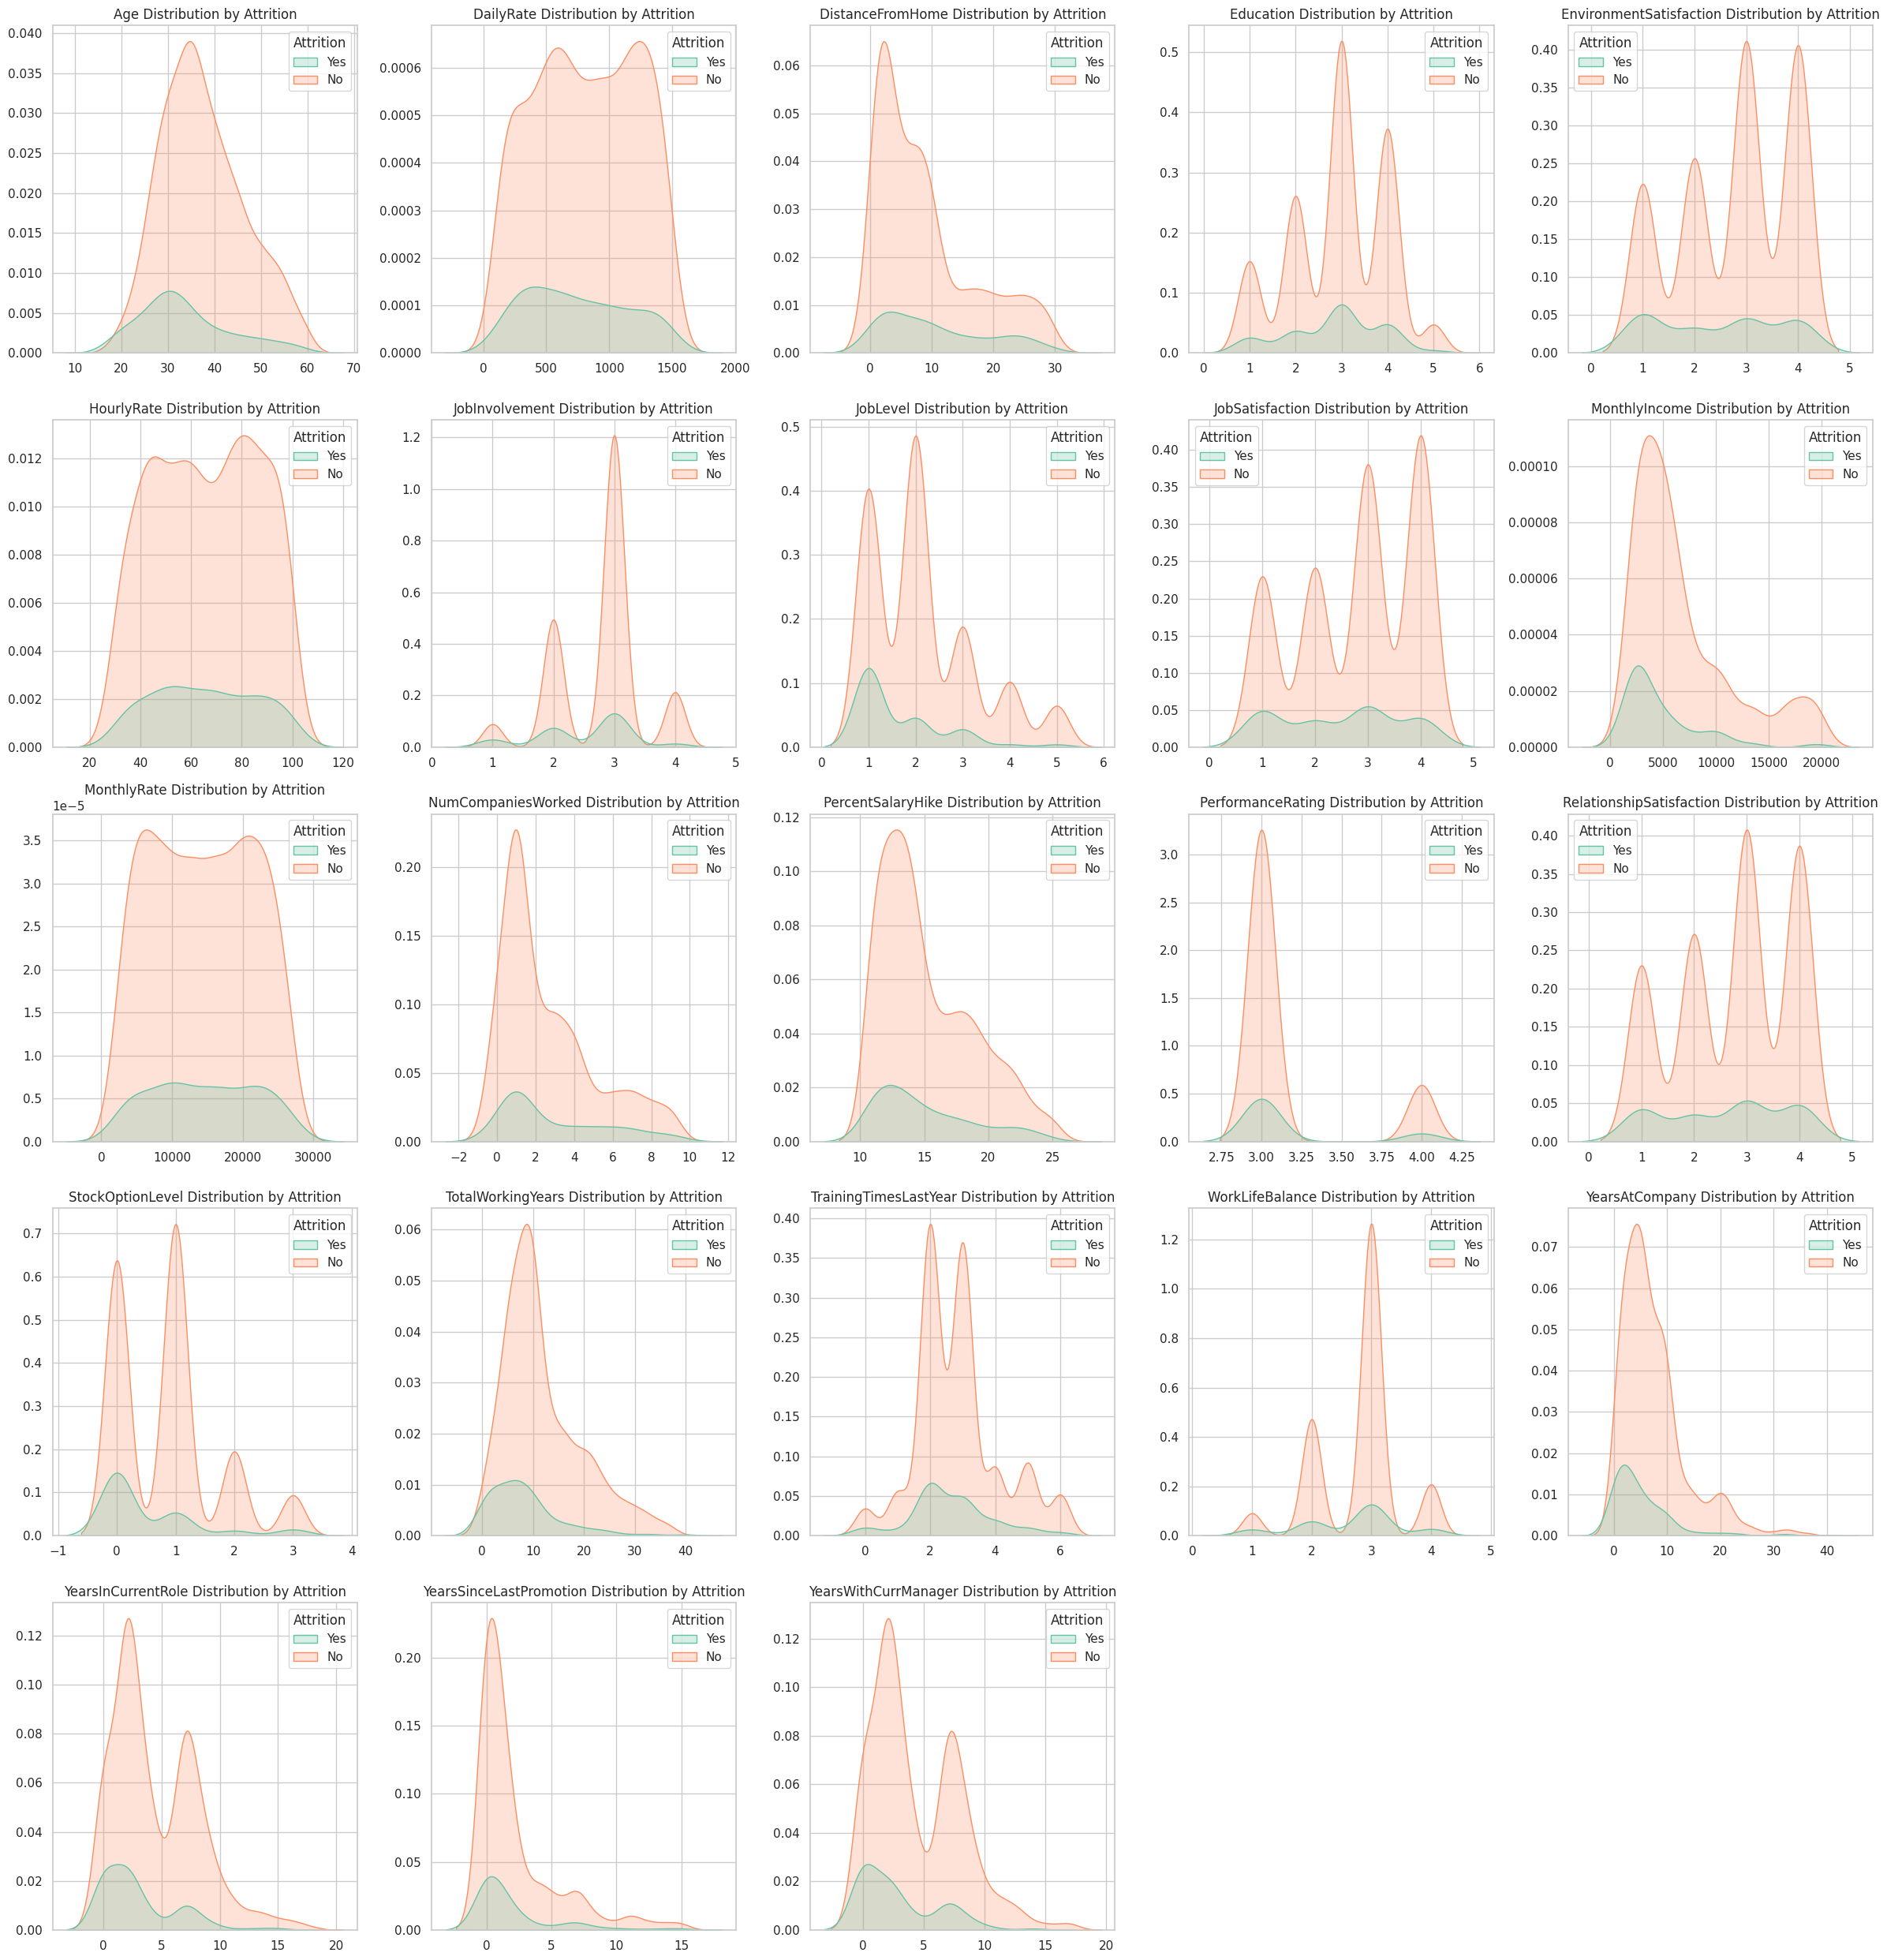

Slide 15

7.Feature Correlation Analysis
Correlation analysis was performed to find which factors most influence employee attrition.
OverTime (0.25) and MaritalStatus (0.16) have the strongest positive correlations, showing that employees who work overtime or are unmarried are more likely to leave.
DistanceFromHome and JobRole also show a slight positive link to attrition.
Factors like MonthlyIncome (-0.16), JobSatisfaction (-0.10), EnvironmentSatisfaction (-0.10), and YearsAtCompany (-0.13) are negatively correlated — employees with higher income, satisfaction, and longer tenure are less likely to leave.
TotalWorkingYears (-0.17) and JobLevel (-0.17) further indicate that experienced and senior employees stay longer.
In summary, workload, personal factors, and early-career stages increase attrition, while experience, satisfaction, and income help reduce it.

Slide 16
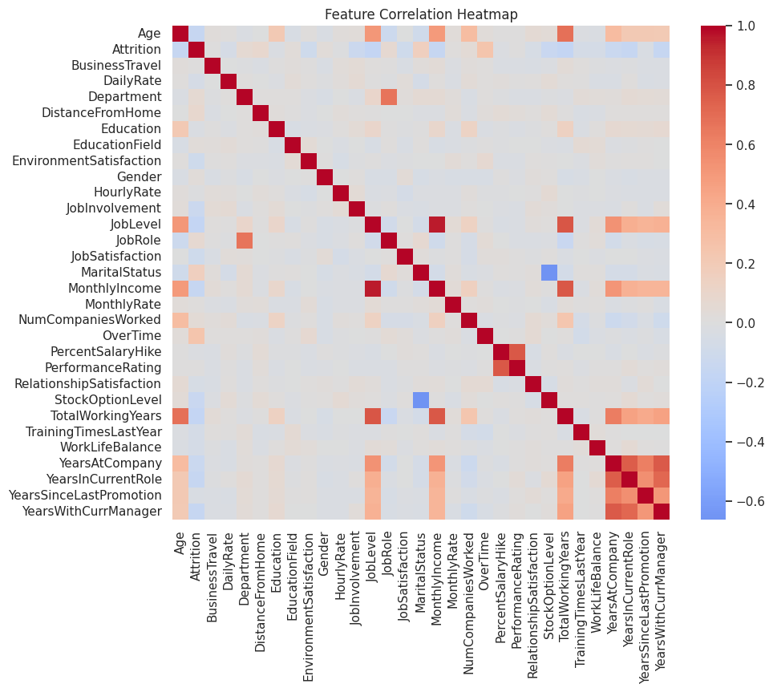
Attrition 1.000000
OverTime 0.246118
MaritalStatus 0.162070
DistanceFromHome 0.077924
JobRole 0.067151
Department 0.063991
NumCompaniesWorked 0.043494
Gender 0.029453
EducationField 0.026846
MonthlyRate 0.015170
PerformanceRating 0.002889
BusinessTravel 0.000074
HourlyRate -0.006846
PercentSalaryHike -0.013478
Education -0.031373
YearsSinceLastPromotion -0.033019
RelationshipSatisfaction -0.045872
DailyRate -0.056652
TrainingTimesLastYear -0.059478
WorkLifeBalance -0.063939
EnvironmentSatisfaction -0.103369
JobSatisfaction -0.103481
JobInvolvement -0.130016
YearsAtCompany -0.134392
StockOptionLevel -0.137145
YearsWithCurrManager -0.156199
Age -0.159205
MonthlyIncome -0.159840
YearsInCurrentRole -0.160545
JobLevel -0.169105
TotalWorkingYears -0.171063

Slide 17

8.Unbalanced Data
The target variable Attrition was highly imbalanced, with:
1,233 employees who stayed (No)
237 employees who left (Yes)
This imbalance can cause models to favor the majority class (employees who stay). To handle this, SMOTE (Synthetic Minority Over-sampling Technique) was applied. SMOTE creates synthetic samples for the minority class, balancing the dataset to 986 records per class and ensuring fair model learning.
Features shape: (1470, 30)
Target distribution before balancing:
Attrition
0 1233
1 237
Name: count, dtype: int64
Used SMOTE.
After resampling: [986 986]

Slide 18
9. Model Building
After preprocessing, all categorical features were converted into numeric form using Label Encoding, resulting in 30 input features.
The dataset was then divided as follows:
Training set: 80%
Testing set: 20%
using stratified sampling to maintain class proportions.
The following machine learning models were built and trained:
Random Forest Classifier
Logistic Regression (with StandardScaler)
K-Nearest Neighbors (K=7)
Support Vector Machine (SVM)
Naive Bayes
XGBoost Classifier
Each model was trained on the balanced dataset, and performance was evaluated using accuracy metrics.

Slide 19


10.Model Evaluation
SVM performed best with 84% test accuracy, showing strong generalization and balanced results.
XGBoost followed with 82.7%, confirming its robustness for complex data patterns.
Random Forest and Logistic Regression gave solid accuracy (~80%) but showed slight overfitting in Random Forest.
KNN and Naive Bayes performed lower, suggesting these simpler methods couldn’t capture deeper relationships.
Model | Train Accuracy | Test Accuracy
SVM | 0.957 | 0.840
XGBoost | 1.000 | 0.827
Logistic Regression | 0.848 | 0.799
Random Forest | 1.000 | 0.799
KNN | 0.881 | 0.626
Naive Bayes | 0.748 | 0.612

Slide 20

11.Best Model: Support Vector Machine
Among all models tested, the Support Vector Machine (SVM) performed the best with a test accuracy of 84.01%, achieving strong balance between accuracy and generalization.
Performance Summary
Metric | Score
Accuracy | 0.84
Precision (Yes class) | 0.50
Recall (Yes class) | 0.47
F1-Score (Yes class) | 0.48
The model performs very well in predicting employees who stay (Class: No) with 91% recall, but has moderate recall (47%) for employees who leave (Class: Yes). This means it identifies most stayers correctly, but occasionally misses some true attrition cases — a common trade-off in HR attrition models.
Confusion Matrix
 | Predicted No | Predicted Yes
Actual No | 225 | 22
Actual Yes | 25 | 22
225 employees were correctly predicted as staying.
22 employees were correctly predicted as leaving.
25 attrition cases were missed (false negatives).

Slide 21
12.Top 10 Influential Features
6.Age – 0.0118
7.EnvironmentSatisfaction – 0.0111
8.TrainingTimesLastYear – 0.0102
9.RelationshipSatisfaction – 0.0095
10.JobRole – 0.0084
OverTime – 0.0329
JobSatisfaction – 0.0288
StockOptionLevel – 0.0259
MaritalStatus – 0.0138
HourlyRate – 0.0125
Interpretation
The SVM model highlights OverTime, JobSatisfaction, and StockOptionLevel as the strongest predictors of attrition. Employees working overtime, showing lower satisfaction, or receiving fewer stock options are more likely to leave. In contrast, higher satisfaction and fair compensation improve retention.
Conclusion
The SVM model provides the best predictive power for employee attrition, balancing accuracy and interpretability. These findings can help HR teams identify at-risk employees early and take proactive actions like improving work-life balance, revising reward policies, and fostering employee engagement.

Slide 22
