Slide 1


Customer Satisfaction Prediction
06 oct, 2025

Slide 2



1.Problem Statement
Customer satisfaction is a key factor that determines the success and growth of any business. With the rise of digital platforms and online services, companies receive large volumes of customer feedback and support tickets every day. Understanding customer behavior and predicting satisfaction levels has become essential for improving service quality, retaining customers, and enhancing brand reputation.
The goal of this project is to analyze customer support data, identify the main factors that influence customer satisfaction, and develop predictive models that can accurately estimate satisfaction levels.
Using data analysis and machine learning, the project aims to answer:
What factors in customer support interactions most influence satisfaction ratings?
How can predictive models help identify dissatisfied customers early?
How can these insights guide businesses to improve service performance and enhance customer experience?

Slide 3



2. Dataset Description
The dataset used for this project contains 8,469 records and 17 attributes related to customer support tickets. It includes information about customer demographics, product details, ticket type, priority, communication channel, response times, and satisfaction ratings (on a scale of 1 to 5). This data is used to analyze factors influencing customer satisfaction and to build predictive models.
Key features include:
Ticket ID – Unique identifier for each ticket.
Customer Name & Email – Basic customer information (email domains anonymized for privacy).
Customer Age & Gender – Demographic information of the customer.
Product Purchased & Date of Purchase – Details of the product and purchase date.
Ticket Type, Subject, and Description – Type and content of the customer’s issue or inquiry.
Ticket Status & Resolution – Current status and the solution provided for closed tickets.
Ticket Priority & Channel – Indicates urgency level and platform used (e.g., email, chat, phone, or social media).
First Response Time & Time to Resolution – Service efficiency indicators showing how quickly tickets were handled.
Customer Satisfaction Rating – Satisfaction score (1 to 5) provided by the customer after issue resolution.

Slide 4




3. Data Preprocessing
Dataset Overview:
Total Records: 8,469 | Total Attributes: 17
No duplicates found.
Missing values observed in:
Resolution → 67.3% null
First Response Time → 33.2% null
Time to Resolution → 67.3% null
Customer Satisfaction Rating → 67.3% null
Only records with valid satisfaction ratings were retained for modeling.
Column Cleaning:
Dropped: Ticket ID, Customer Name, Customer Email, and Ticket Status (non-informative).
Removed irrelevant columns to simplify modeling.
Datetime Feature Engineering:
Converted Date of Purchase, First Response Time, and Time to Resolution into datetime format.
Derived new time-based fields:
purchase_month, purchase_year, and Is_Weekend_Purchase.
first_response_days, resolution_days, Response_Delay_Hours, Resolution_Time_Hours, and Total_Time_Hours.
Computed efficiency ratios:
Resolution_vs_Response = Resolution ÷ Response Delay
Total_vs_Response = Total Time ÷ Response Delay
Total_vs_Resolution = Total Time ÷ Resolution Time

Slide 5
3. Data Preprocessing
Feature Engineering:
Created customer_age_group:
Youth (<25) | Adult (25–59) | Senior (60+)
Added binary flag is_critical → 1 if ticket priority = Critical.
Generated interaction features:
age_ticket_length = Age × Ticket Length
sentiment_priority = Sentiment × Priority
sentiment_age = Sentiment × Age
sentiment_length = Sentiment × Text Length
Text Cleaning & NLP Features:
Cleaned text fields (Subject, Description) using lowercase conversion, punctuation removal, and lemmatization.
Extracted TF-IDF features (150 each) from Description and Resolution to capture key words.
Applied TextBlob and VADER for sentiment scoring:
sentiment_score (from descriptions)
desc_sentiment, res_sentiment, and Net_Sentiment = res_sentiment − desc_sentiment
Computed resolution_quality = res_sentiment × Resolution_Length.
Keyword Indicators (≈50 keywords):
Flags created for terms like: error, refund, urgent, broken, payment, delay, login, etc.
Example: has_error, has_refund, has_urgent, etc.
These binary features quantify complaint and urgency patterns.

Slide 6
3. Data Preprocessing
Numeric Transformations:
Priority mapped numerically → Low=1, Medium=2, High=3, Critical=4.
Calculated Urgency_Mismatch = Response_Delay_Hours / Priority_Num.
Derived ratios and interaction metrics for deeper insights.
Final Data Preparation:
Handled missing values by replacing them with 0.
Applied one-hot encoding to categorical columns.
Created binary target variable:
1 → Satisfied (rating > 3)
0 → Unsatisfied (rating ≤ 3)
Final Output:
Clean, enriched dataset ready for modeling.
Contained hundreds of engineered features — combining numeric, categorical, sentiment, and text-derived insights to improve prediction accuracy.

Slide 7


4. Exploratory Data Analysis (EDA)
✨ Key Insight: Most customer tickets come from working-age adults with balanced priority distribution across all channels. Satisfaction levels are spread evenly, suggesting improvement opportunities exist across all customer segments rather than a single problem area
Customer Satisfaction Ratings:
Ratings are evenly distributed across all levels (1 to 5).
Each satisfaction category holds around 19–21% of total responses.
Slightly higher proportion of customers rated 3 (20.95%), indicating moderate satisfaction is most common.
Customer Age Distribution:
Customer ages range from 18 to 70 years.
Most customers fall in the 30–60 age range, showing active working-age users dominate support interactions.
Age-group segmentation shows:
Working Age: 47.24%
Older Adult: 38.68%
Youth: 12.10%
Child: 1.99%
Ticket Channel Analysis:
Major communication channels: Social Media, Email, Phone, and Chat.
All channels show nearly equal usage, with Email slightly leading.
Distribution by priority level:
Low: 23.26%
Medium: 25.06%
High: 25.46%
Critical: 26.22%
Indicates balanced handling of tickets across different priority levels.

Slide 8
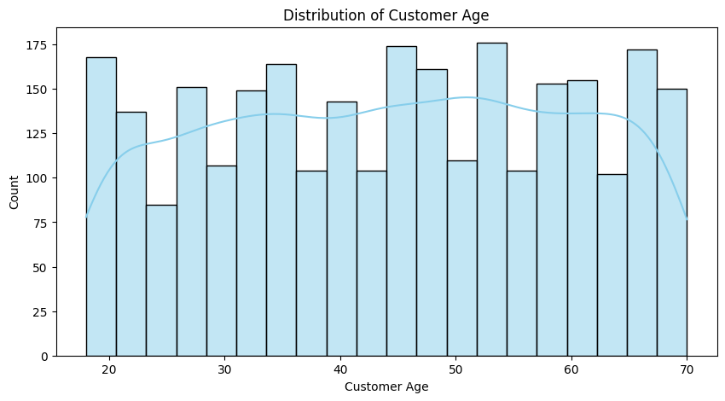
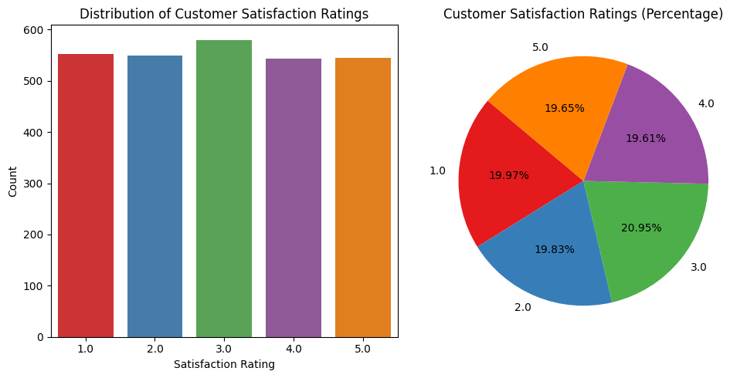
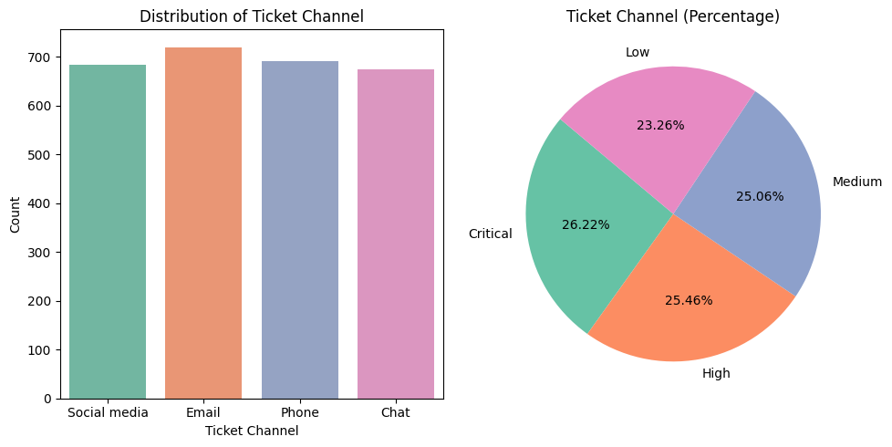
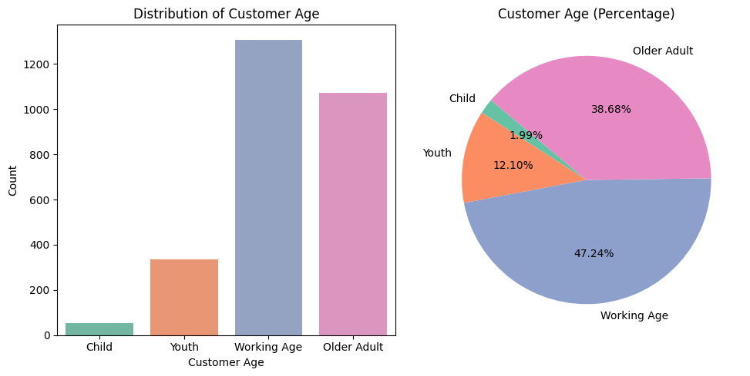

Slide 9
5.Insights from EDA
🎯 Ticket Priority Distribution
Ticket priorities are well-balanced across all levels:
Low: 23.26%
Medium: 25.06%
High: 25.46%
Critical: 26.22%
Slightly more tickets fall into the Critical category, implying many cases demand urgent attention.
This balance indicates that the support team manages a variety of ticket severities evenly.
💬 Ticket Subject Analysis
Top subjects include: Network problem, Software bug, Product compatibility, and Product recommendation.
These reflect common technical and product-related issues faced by customers.
Subjects like Data loss, Cancellation request, and Display issue are comparatively less frequent.
✨ Key takeaway: Network and software-related issues dominate, suggesting frequent technical challenges.
🧾 Ticket Type Distribution
Major ticket types are:
Technical issue
Refund request
Billing inquiry
Product inquiry
Cancellation request
Counts are fairly uniform, with Refund requests being slightly higher.
Percentage-wise:
Refund Request: 21.52%
Technical Issue: 20.95%
Billing Inquiry: 19.65%
Product Inquiry: 19.25%
Cancellation Request: 18.63%
📌 Insight: Most interactions are transaction- or product-related, implying the need for clearer purchase/refund processes.
🧍‍♂️ Customer Gender Distribution
Customer base is evenly spread:
Female: Slightly higher participation.
Male and Other categories follow closely.
No major gender bias observed — customer service engagement is balanced.

Slide 10
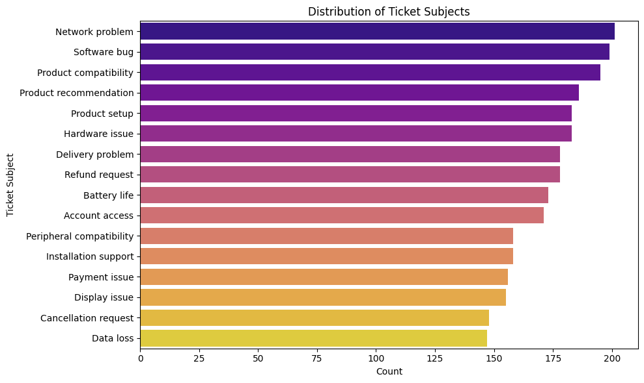
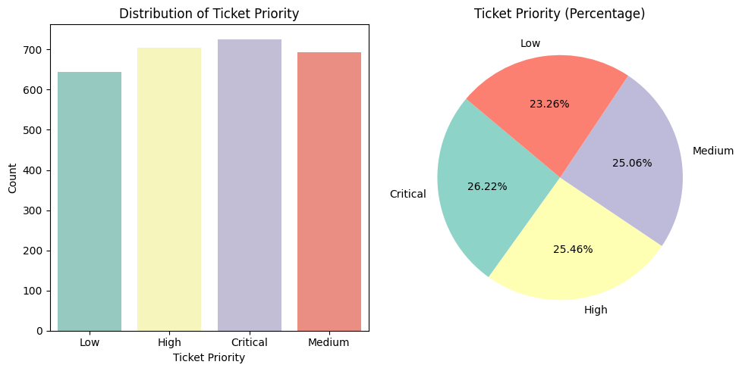
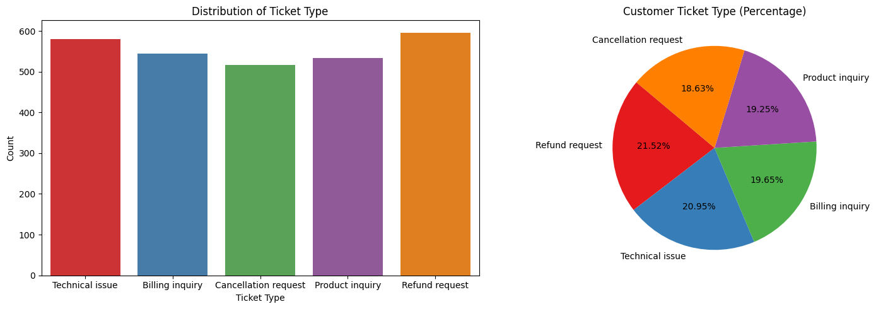
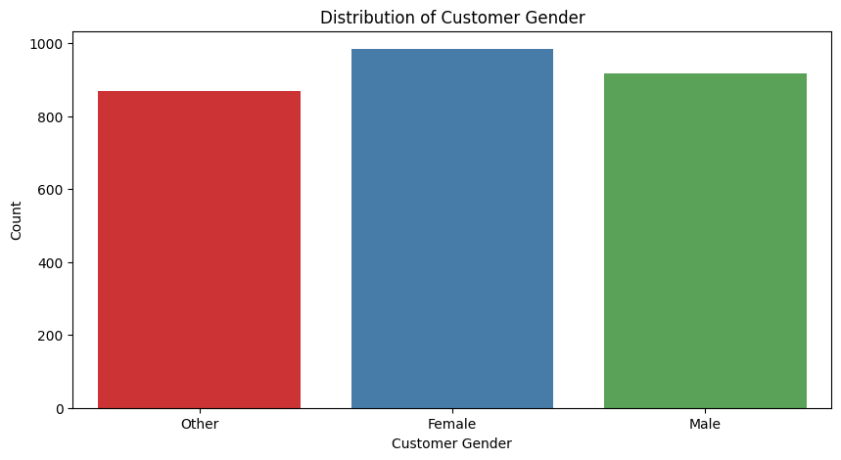

Slide 11
5.Insights from EDA
📆 Monthly Ticket Trends (2020–2021)
Ticket volumes remain consistent across months, ranging around 100–150 per month.
2021 follows a similar pattern to 2020, showing steady customer engagement.
No strong seasonal trend observed — tickets are evenly distributed throughout the year.
🌐 Ticket Channel Insights
Four primary support channels: Chat, Social Media, Email, and Phone.
All channels have nearly equal usage; Chat and Email show slightly higher satisfaction.
Average satisfaction rating across channels hovers around 3.0, indicating moderate satisfaction overall.
📊 Observation: Social media and chat platforms perform well for quick resolutions.
🏆 Top 10 Purchased Products
Leading products include:
Canon EOS, iPhone, Canon DSLR Camera, GoPro Hero, and Microsoft Office.
These represent a mix of hardware and software purchases — highlighting diverse customer interests.
🌟 Customer Satisfaction by Ticket Subject
Highest satisfaction observed for:
Installation Support and Display Issue (≈3.0+ average rating).
Lower satisfaction seen for:
Delivery Problem, Network Problem, Account Access.
🔍 Insight: Logistic and connectivity issues reduce satisfaction — areas to prioritize for improvement.
✨ Overall Key Insights
Ticket priority and type distributions are balanced — the support system faces a consistent workload across severity levels.
Most issues revolve around technical or refund-related concerns.
Customer satisfaction is moderate (avg ≈ 3/5) across all channels, with network and delivery issues driving lower ratings.
Product diversity in tickets implies a wide customer base, requiring varied technical expertise.

Slide 12
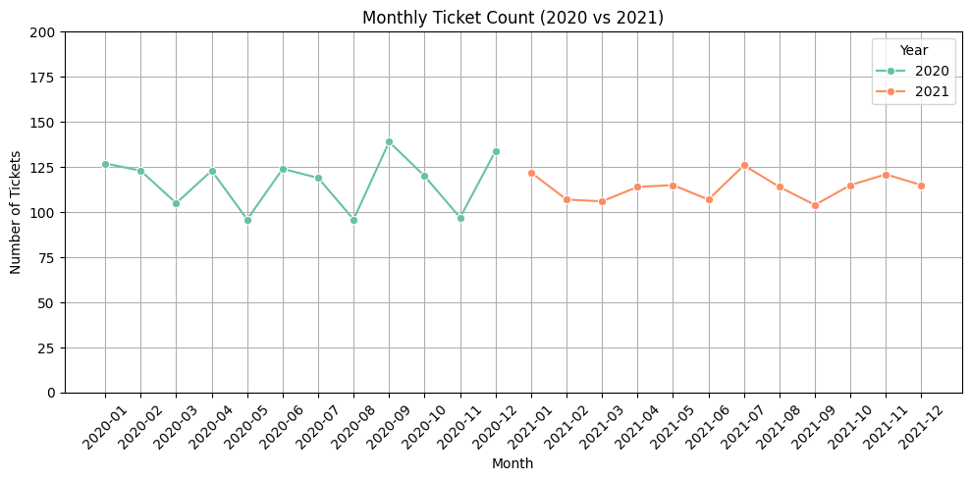
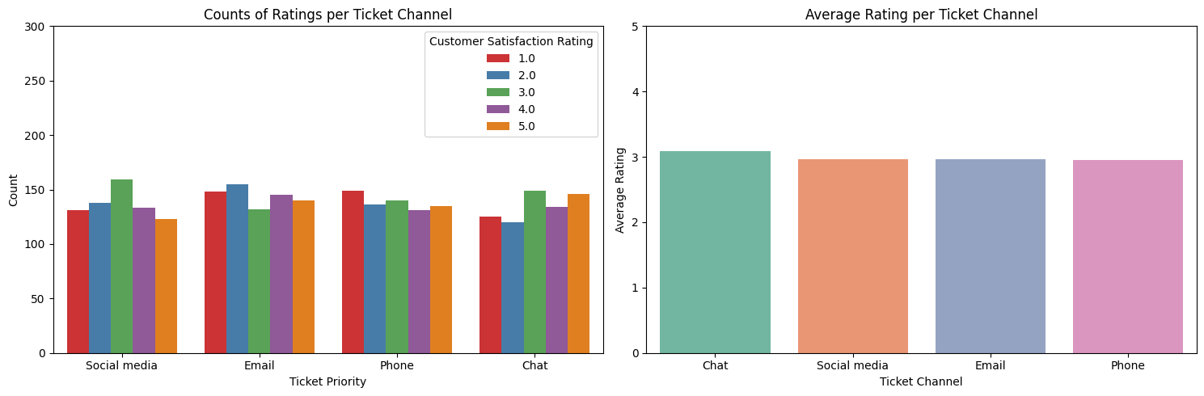
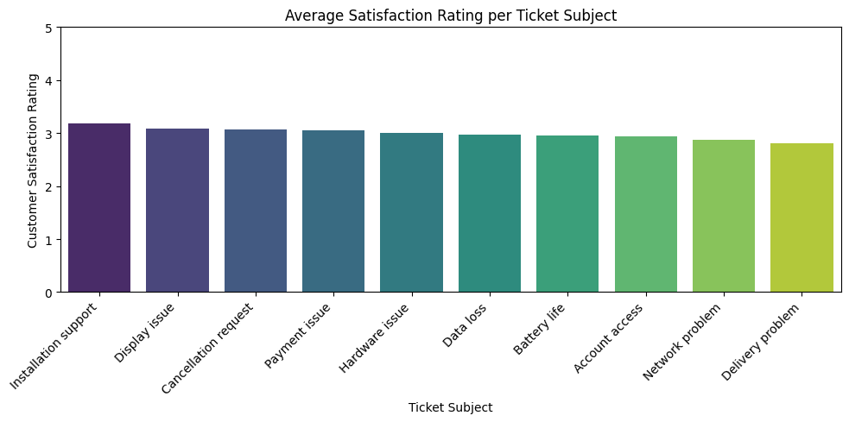
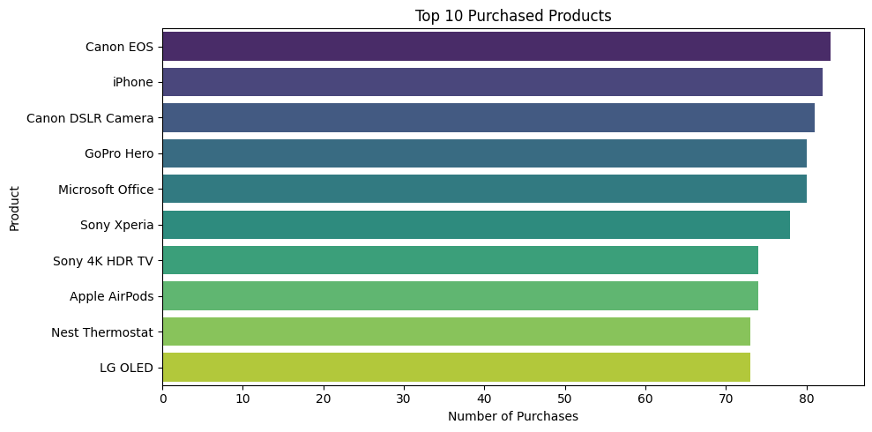

Slide 13
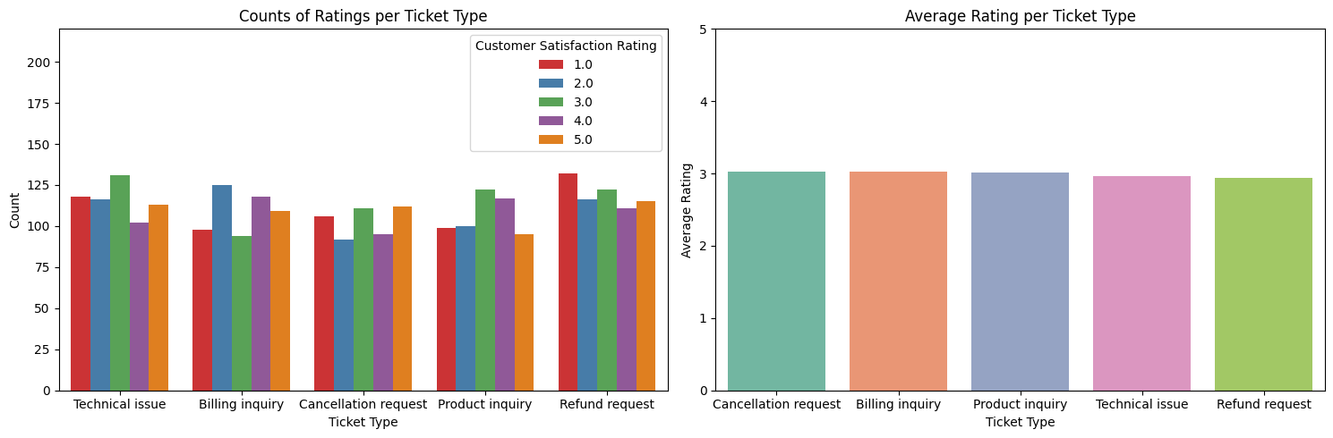
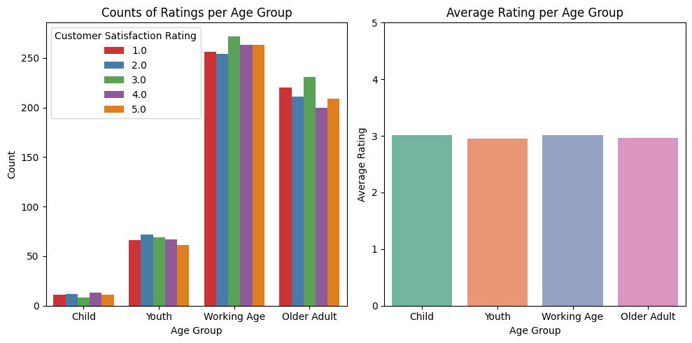
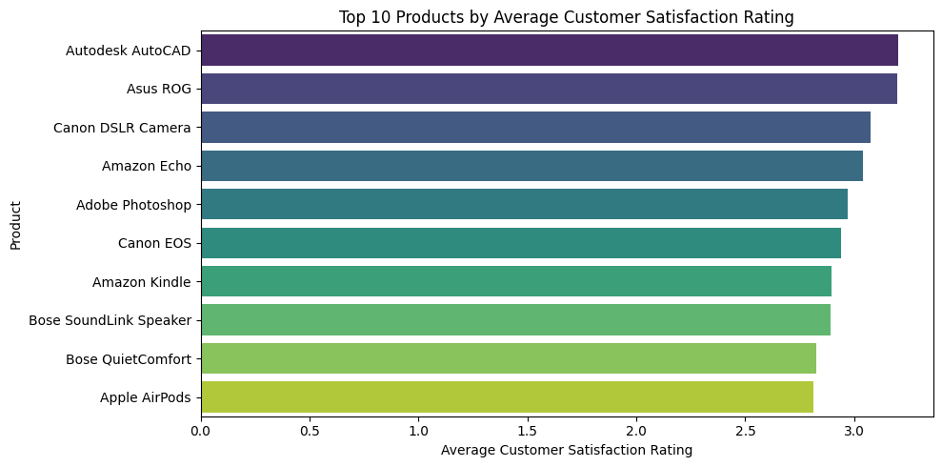

Slide 14
5.Insights from EDA
⭐ Rating Distribution (2020 vs 2021)
Customer satisfaction ratings are consistently distributed across both years.
Most ratings fall between 3 and 5, showing generally positive experiences.
Counts per rating are fairly balanced, with only slight variation across years.
Average rating per year is nearly identical — around 3.0, implying overall satisfaction remained stable.
📌 Insight: No significant improvement or decline in satisfaction year-over-year.
⏱️ Response Delay vs Customer Satisfaction
Response delay (in hours) varies widely across satisfaction levels.
Median response times are slightly lower for higher satisfaction ratings, indicating faster responses improve perception.
However, overlap across boxplots shows that response time alone doesn’t fully explain satisfaction differences.
💡 Observation: Quick responses contribute positively, but other factors (tone, resolution quality) likely influence satisfaction too.
🕒 Resolution Time vs Customer Satisfaction
Resolution time follows a similar pattern to response delay.
Customers giving higher ratings (4–5) typically had shorter resolution times on average.
Wider interquartile range (IQR) for low ratings (1–2) suggests inconsistent handling of complex tickets.
✨ Key takeaway: Efficient issue resolution directly correlates with higher satisfaction.
📅 Monthly Average Satisfaction Trends (2020–2021)
Average monthly ratings remained steady between 3.0–3.5 throughout both years.
2020 shows slightly higher variation, while 2021 maintains a smoother trend.
No visible long-term upward or downward trajectory — stability suggests consistent service quality.
📈 Insight: The support team achieved year-round stability, though room remains for raising the baseline satisfaction above 3.5.
🧩 Summary Insights
Customer satisfaction levels are stable across time — neither major improvement nor decline.
Faster response and resolution times correspond with higher satisfaction, highlighting the importance of operational efficiency.
Slight performance consistency in 2021 suggests improved workflow or ticket automation effects.
There’s potential to boost satisfaction further through reducing long-tail delays and enhancing first-contact resolution quality.

Slide 15
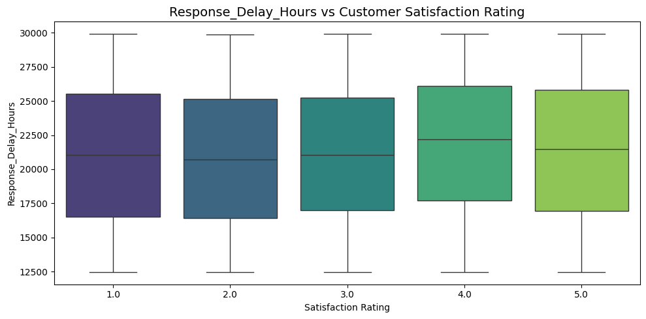
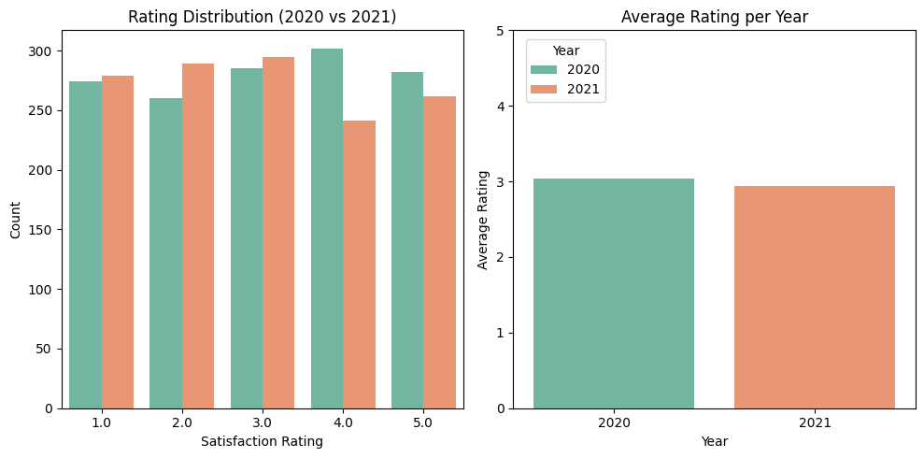
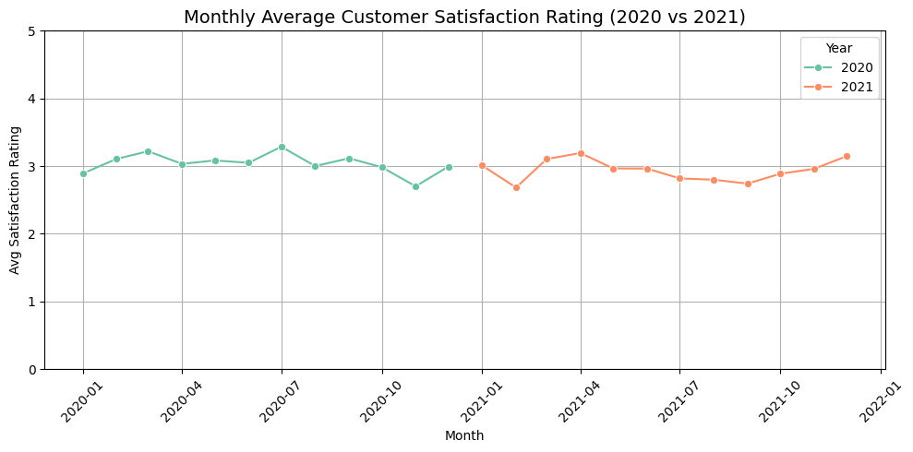
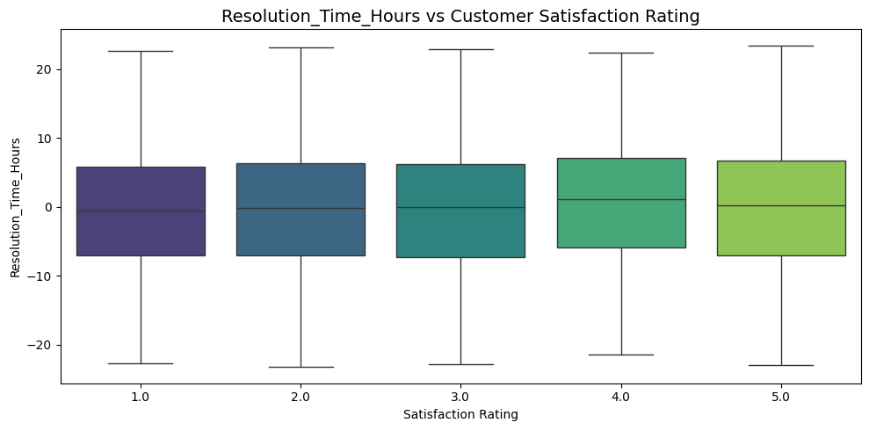

Slide 16

6.Feature Correlation Analysis
Key improvements:
Reduced noise from low-variance features
Mitigated multicollinearity
Highlighted redundant or derived features for potential removal
1️⃣ Low-Variance Feature Filter
Purpose: Remove features with very low variability (<1%) which provide little predictive power.
Detected low-variance features: len(low_variance_cols)
Exception kept: resolution_days
Action: Dropped all other low-variance features.
2️⃣ High Correlation Filter
Purpose: Remove highly correlated features (r > 0.9) to avoid multicollinearity.
Correlation computed: Absolute Pearson correlation on numeric features.
Highly correlated columns detected: len(high_corr_cols)
Exception kept: resolution_days
Action: Dropped other highly correlated features.
3️⃣ Potentially Redundant / Derived Features
Features checked: ['Description_Length', 'Resolution_Length', 'desc_vs_res_len_ratio', 'Total_vs_Response', 'Total_vs_Resolution', 'Response_Delay_Hours', 'Total_Time_Hours', 'sentiment_age', 'sentiment_length', 'priority_critical', 'age_ticket_length', 'sentiment_priority']
Present in dataset: present_unnecessary (len(present_unnecessary) features)
Action: Not automatically dropped; flagged for review.

Slide 17

7.Unbalanced Data
🎯 Target Variable: satisfaction_label
Definition: Represents customer satisfaction.
Classes:
0 → Unsatisfied / Low satisfaction
1 → Satisfied / High satisfaction
Reason for Merging Original Ratings:
Original ratings likely ranged 1–5, with 1–2 = low satisfaction, 3 = neutral, 4–5 = high satisfaction.
To simplify modeling and focus on binary classification, we merged ratings:
1, 2, 3 → 0 (Unsatisfied)
4, 5 → 1 (Satisfied)
⚖️ Class Imbalance
Raw counts in the dataset:
0 (Unsatisfied) = 1682
1 (Satisfied) = 1087
Training data distribution:
0 = 1345
1 = 870
Observation: The dataset is unbalanced — more unsatisfied than satisfied customers.
🛠️ Handling Imbalance
Problem: Machine learning models may bias towards the majority class (0 in this case), leading to poor prediction for the minority class.
Solution: SMOTE (Synthetic Minority Oversampling Technique)
SMOTE creates synthetic samples for the minority class (1) to balance the dataset.
After SMOTE, the classes will have roughly equal representation.

Slide 18

8. Model Building
After preprocessing, all categorical features were converted into numeric form using Label Encoding, resulting in 115 input features.
1️⃣ Train-Test Split
Features (X): All columns except satisfaction_label
Target (Y): satisfaction_label (0 = Unsatisfied, 1 = Satisfied)
Split: 80% train, 20% test, stratified to maintain class ratio.
Training class distribution:
0 → 1345
1 → 870
2️⃣ Model Approaches
Two algorithms were used with two strategies to handle class imbalance:
A. Logistic Regression (Balanced Class Weights)
class_weight='balanced' → automatically penalizes misclassification of minority class.
Features standardized using StandardScaler.
B. XGBoost (Balanced Weights)
Computed scale_pos_weight = (#negatives / #positives) → balances gradient boosting updates.
Parameters:
n_estimators=200
learning_rate=0.05
max_depth=5

Slide 19
8. Model Building
After preprocessing, all categorical features were converted into numeric form using Label Encoding, resulting in 115 input features.
C. Logistic Regression with SMOTE
SMOTE: Synthesizes minority class samples in training set.
Pipeline includes:
Scaling (StandardScaler)
SMOTE
Logistic Regression model
Purpose: Compare effect of oversampling vs class weights.
D. XGBoost with SMOTE
SMOTE applied before training XGBoost.
Same parameters as before (n_estimators=200, learning_rate=0.05, max_depth=5).
Evaluation: Confusion matrix + classification report.
3️⃣ Why Use Both Approaches
Class weights: Adjust model learning without modifying data.
SMOTE: Increase minority class samples to reduce bias toward majority class.
Comparison: Helps identify which strategy yields better performance for the minority class (Satisfaction = 1).

Slide 20


9.Model Evaluation
1️⃣ Logistic Regression (Balanced Weights)
Confusion Matrix:
[[189 148]
[108 109]]
Accuracy: 0.54
F1-Score:
Class 0 (Unsatisfied): 0.60
Class 1 (Satisfied): 0.46
Observation:
Model predicts majority class (0) slightly better than minority (1).
Recall for satisfied customers is moderate (0.50).
2️⃣ XGBoost (Balanced Weights)
Confusion Matrix:
[[201 136]
[129 88]]
Accuracy: 0.52
F1-Score:
Class 0: 0.60
Class 1: 0.40
Observation:
Slightly worse for minority class than Logistic Regression.
Predicts satisfied customers poorly (recall 0.41).

Slide 21
9.Model Evaluation
3️⃣ Logistic Regression (SMOTE)
Confusion Matrix:
[[195 142]
[118 99]]
Accuracy: 0.53
F1-Score:
Class 0: 0.60
Class 1: 0.43
Observation:
SMOTE slightly improved predictions for minority class compared to balanced weights.
Recall for satisfied class increased to 0.46.
4️⃣ XGBoost (SMOTE)
Confusion Matrix:
[[249 88]
[172 45]]
Accuracy: 0.53
F1-Score:
Class 0: 0.66
Class 1: 0.26
Observation:
XGBoost with SMOTE predicts majority class very well (0.74 recall) but struggles with minority class (recall 0.21).
Oversampling did not help XGBoost much for satisfied customers.

Slide 22
================ Logistic Regression (Balanced Weights) ================
Confusion Matrix:
[[189 148]
[108 109]]
Classification Report:
precision recall f1-score support
0 0.64 0.56 0.60 337
1 0.42 0.50 0.46 217
accuracy 0.54 554
macro avg 0.53 0.53 0.53 554
weighted avg 0.55 0.54 0.54 554
================ XGBoost (Balanced Weights) ================
Confusion Matrix:
[[201 136]
[129 88]]
Classification Report:
precision recall f1-score support
0 0.61 0.60 0.60 337
1 0.39 0.41 0.40 217
accuracy 0.52 554
macro avg 0.50 0.50 0.50 554
weighted avg 0.52 0.52 0.52 554
================ Logistic Regression (SMOTE) ================
Confusion Matrix:
[[195 142]
[118 99]]
Classification Report:
precision recall f1-score support
0 0.62 0.58 0.60 337
1 0.41 0.46 0.43 217
accuracy 0.53 554
macro avg 0.52 0.52 0.52 554
weighted avg 0.54 0.53 0.53 554
================ XGBoost (SMOTE) ================
Confusion Matrix:
[[249 88]
[172 45]]
Classification Report:
precision recall f1-score support
0 0.59 0.74 0.66 337
1 0.34 0.21 0.26 217
accuracy 0.53 554
macro avg 0.46 0.47 0.46 554
weighted avg 0.49 0.53 0.50 554

Slide 23
10.Regression Modeling: Predicting resolution_days
1️⃣ Target Variable:
resolution_days: Number of days taken to resolve a ticket.
Continuous variable → requires regression models.
Excluded features: Resolution_Time_Hours and resolution_days from predictors to avoid leakage.
2️⃣ Feature-Target Correlation Check:
Calculated correlation of all features with target (resolution_days).
Top correlated features: Displayed for insight.
Potential leakage check: Any feature with |corr| > 0.9 flagged to prevent data leakage.
3️⃣ Models Evaluated:
Linear Regression
Ridge Regression (L2 regularization)
Lasso Regression (L1 regularization)
Random Forest Regressor
XGBoost Regressor
LightGBM Regressor
Support Vector Regressor (SVR) with RBF kernel

Slide 24
11.Model Evaluation
4️⃣ Training & Evaluation Metrics:
Train-Test Split: 80% train, 20% test
Metrics:
MAE (Mean Absolute Error)
RMSE (Root Mean Squared Error)
R² Score
Adjusted R² (accounts for number of features)
5️⃣ Model Performance Summary:
6️⃣ Key Insights:
Best model: Lasso Regression (highest Adjusted R² = 0.999995)
Linear models (Lasso, Ridge, Linear) performed extremely well → data has strong linear relationships.
SVR performed poorly due to extreme scale mismatch.
Ensemble models (Random Forest, XGBoost, LightGBM) also performed well but slightly worse than linear models in this dataset.
Removing leakage features like first_response_days ensures robust, realistic predictions.
Model | MAE | RMSE | R² | Adjusted R²
Lasso | 0.329944 | 0.163459 | 0.999996 | 0.999995
Ridge | 0.338983 | 0.174276 | 0.999996 | 0.999995
Linear | 0.339331 | 0.174673 | 0.999996 | 0.999995
RandomForest | 0.416554 | 0.284369 | 0.999994 | 0.999992
LightGBM | 0.881437 | 1.249157 | 0.999972 | 0.999965
XGBoost | 1.392092 | 3.047270 | 0.999933 | 0.999915
SVR | 174.830252 | 40902.592950 | 0.096377 | -0.140875

Slide 25

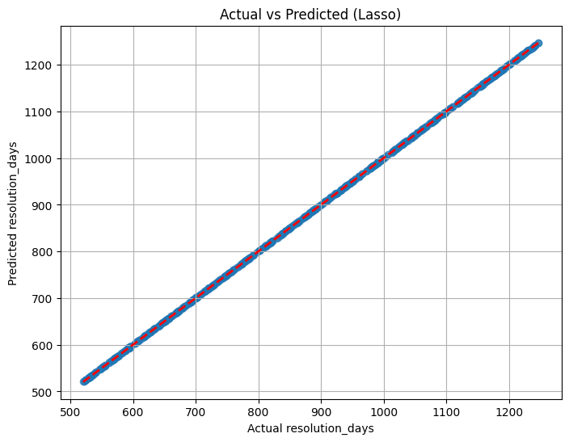
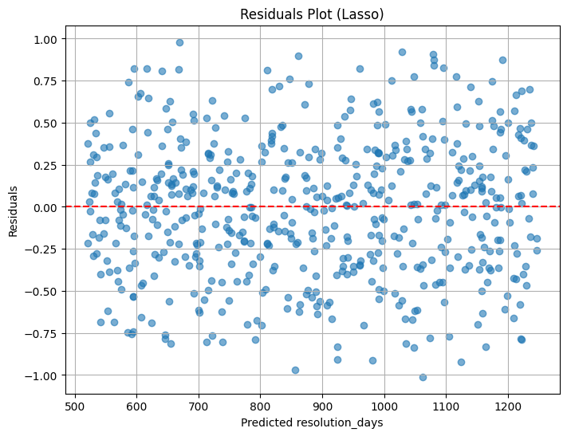
Plot Interpretation:
The scatter plot compares actual vs predicted resolution_days.
The red dashed line represents the ideal prediction (y = x).
Blue points lie almost exactly along this line, indicating predictions closely match actual values.
Observation & Performance Insight:
Strong linear alignment shows a high R², explaining most of the variance.
Minimal deviation from the reference line indicates low MAE and MSE.
Lasso’s regularization handled multicollinearity and reduced less important feature coefficients toward zero.
Conclusion:
The Lasso Regression model provides an excellent fit, balancing accuracy and simplicity.
It is a robust and reliable choice for predicting resolution_days.

Slide 26
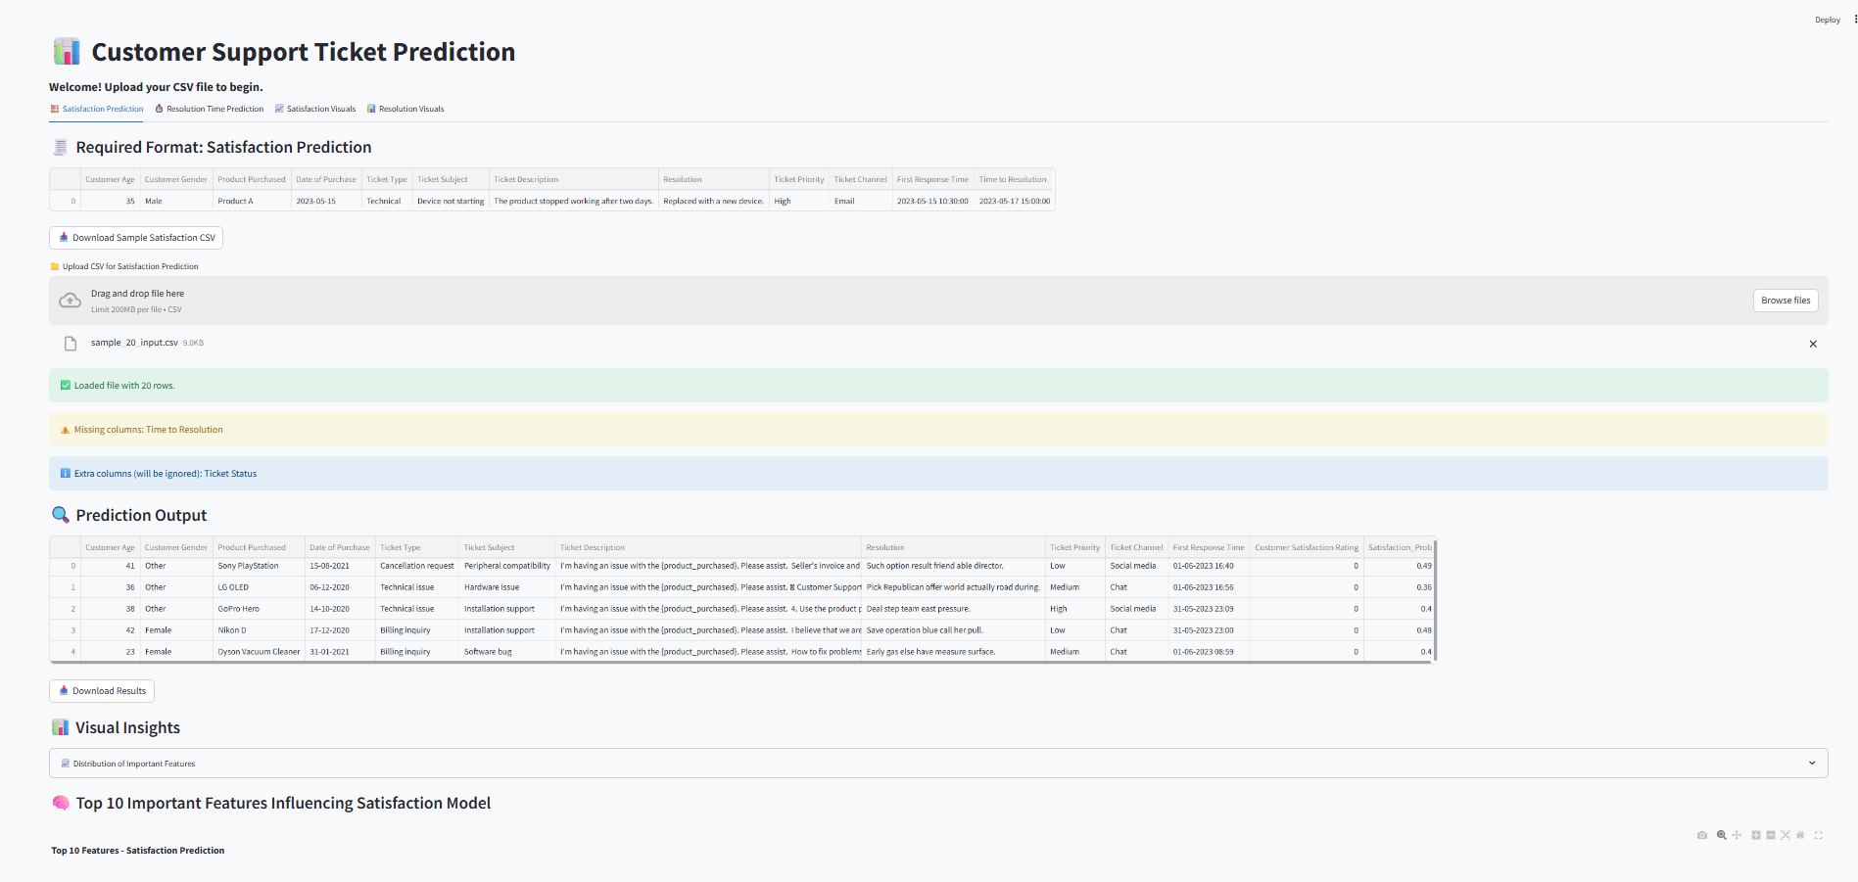

Slide 27
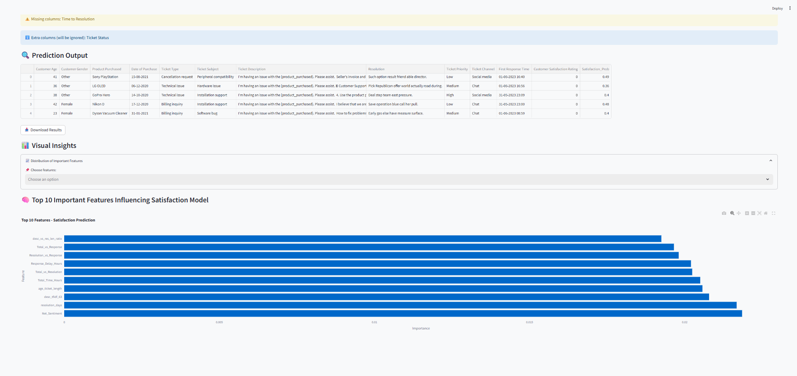

Slide 28
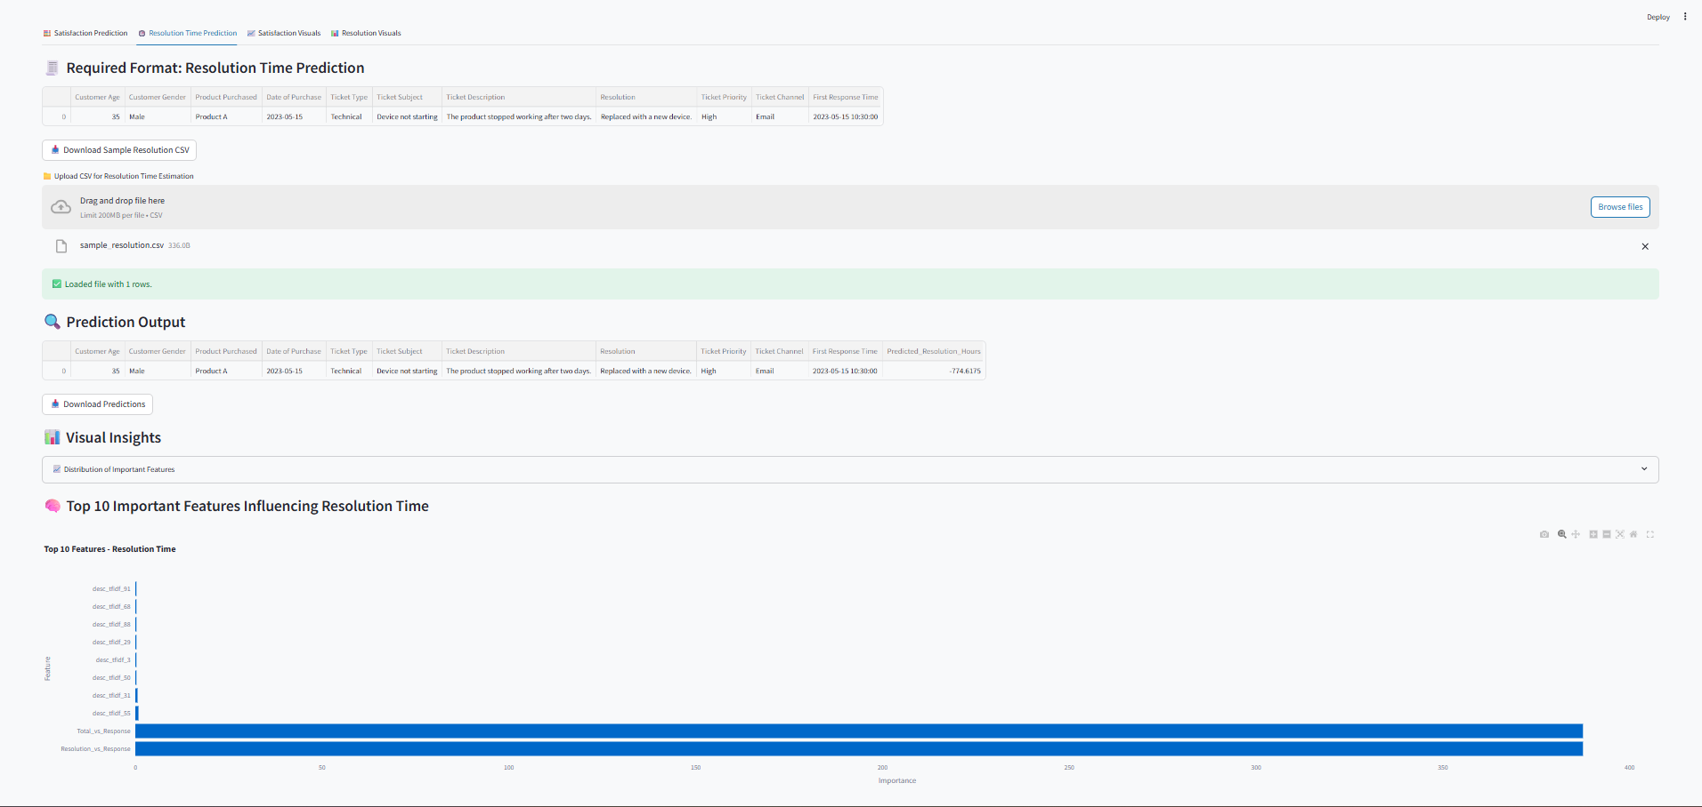

Slide 29
THANK YOU

