Slide 1

Welcome to Java!

Slide 2
Topics
Why Java? An Introduction
JDK, JRE, JVM
Classes and Objects
“Hello World” Application
Primitives
Control flow + Operators
Exploring the Stack and Heap
Arrays, varargs
String, StringBuilder, and StringBuffer
Packages & Imports
Constructors, methods, & parameters
Type Conversion and Casting
Variable scopes
Access modifiers, non-access modifiers
Wrapper classes
Object class methods
Annotations
Javadocs, code comments, and documentation

Slide 3
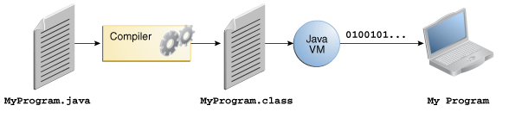
Why Java?
Platform independent, portable – write once, run anywhere (WORA)
Simple syntax
Based on C
Rich API
Java is FREE
Support from Oracle Corporation
Automatic memory management
No pointers!
Garbage collector

Slide 4
JDK, JRE, JVM
JDK – Java Developer Kit
Needed to create a Java program
javac (compiler)
javadoc
JRE – Java Runtime Environment
Needed to run a Java program
Debugger
JVM – Java Virtual Machine
jar, war
Java class libraries
Translates byte code (.class files)
to machine code, runs the program
jvisualvm

Slide 5


Classes and Objects
Class is a blueprint that defines:
State (variables)
Car has wheels.
Behavior (methods)
Car can drive.
State and behavior are called “class members”
Object is an instance of a class
Objects are created from class blueprints
2005 Honda Civic is a Car
Car hondaCivic = new Car();
Notes:
State involves NOUNs
Behavior involves VERBs

Slide 6
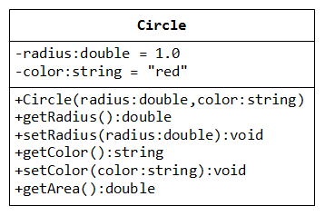
Class
class MyClass{
// instance variables
int variable;
// methods
void myMethod(){
}
}

Slide 7
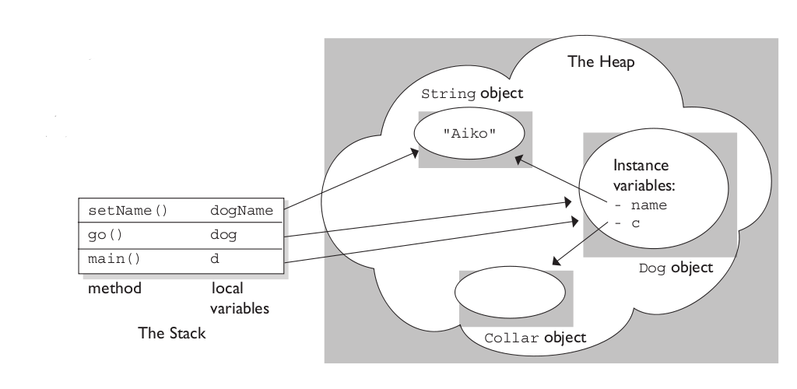
Objects and Methods
Create an object of a class:
MyClass ref = new MyClass( );
Objects let you call methods
ref.myMethod( );
Every method has a return type
String
int
An Object
If not, return type is void
void myMethod( ){
}

Slide 8
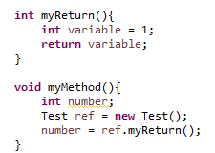
Return
In a method use:
return someVariable;
Return Statement will:
Terminate the local method
Pass the value to where the method was called
Example:
You can use return multiple times
The first one that is reached is used

Slide 9


Parameterized Methods
Methods may take parameters of any data type
Methods may take any number of parameters
Values passed into parameters are called arguments

Slide 10

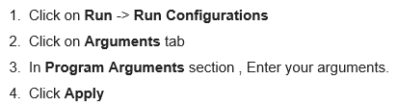
Command Line Arguments
Command line arguments
Pass as arguments into main( ) method
Values are passed as Strings
Entered through the command line:
Windows Command Prompt
Linux/UNIX shell
Macintosh Terminal
Entered through an IDE:
Type a space between each argument

Slide 11
Hello World!
// this is a code comment
// here we've declared and defined a class called "HelloWorld"
// important to note: the public class name must match the name of the file
public class HelloWorld {
// this is the "main" method - the JVM looks for this method to start up a program
public static void main(String[] args) {
System.out.println("Hello World!");
}
}
Command line / terminal
> javac HelloWorld.java
> java HelloWorld
> Hello World!
Compiling our Java source code, generates “HelloWorld.class” file
Invoking the JVM to run our byte code from the compiled .class file
JVM executes the byte code and prints the message to standard output

Slide 12
Primitive Data Types
boolean N/A True or False
byte 1 byte -128 to 127
char 2 bytes 0 to 65536
double 8 bytes 1.7e-308 to 1.7e+308
int 4 bytes -2,147,483,648 to 2,147,483,647
long 8 bytes -9,223,372,036,854,775,808 to 9,223,372,036,854,775,807
float 4 bytes 3.4e-308 to3.4e+308
short 2 bytes -32,768 to 32,767

Slide 13
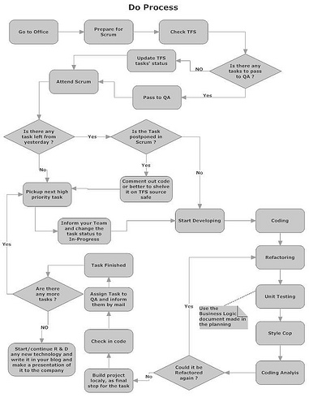
Control Statements
if
switch-case
for
while
do-while
break
continue

Slide 14
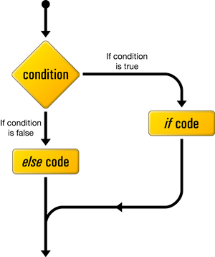
If/Else
int a = 0;
if (a > 5){
System.out.println(“greater than 5”);
}
else{
System.out.println(“less than 5”);
}

Slide 15
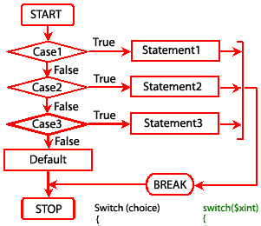
Switch/Case
int i = 2;
switch(i) {
case 0:
System.out.println(“Zero”);
break;
case 1:
System.out.println(“One”);
break;
case 2:
System.out.println(“Two”);
break;
default:
System.out.println(“greater than 2”);
}

Slide 16
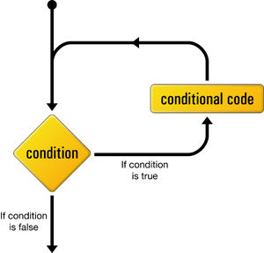
While Loop
int num = 1;
while (num < 10) {
System.out.println(num);
num++;
}

Slide 17
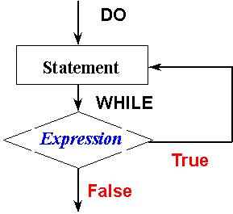
Do/While Loop
int num = 1;
do {
System.out.println(num);
num++;
} while(num < 10);

Slide 18
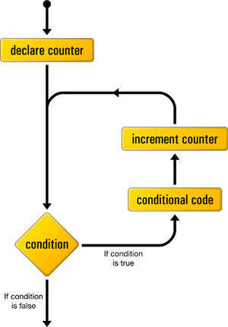
For Loop
for (int num = 0; num < 10 ; num++)
{
System.out.println(num);
}

Slide 19
Enhanced For Loop
int[ ] items = {1, 2, 3, 4, 5};
for (int element : items)
{
System.out.println(element);
}
“int element” declares a local variable
At the end of the block:
Loop moves to the next element in the array
For each element in “items”

Slide 20
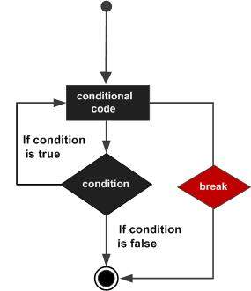
Break
for (int a = 0; a<10; a++){
if (a == 5) break;
System.out.println(a);
}
System.out.println(“Loop complete!”);

Slide 21
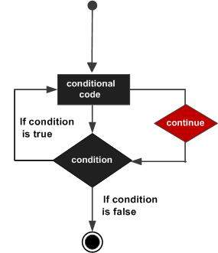
Continue
for (int i = 0; i< 10; i++){
if (i == 5) continue;
System.out.println(i);
}

Slide 22
Operators
+ ADDITION
- SUBTRACTION
* MULTIPLICATION
/ DIVISION
% MODULUS
++ INCREMENT
-- DECREMENT
+= ADDITIONASSIGNMENT
-= SUBTRACTION ASSIGNMENT
%= MODULUSASSIGNMENT

Slide 23
Relational Operators
== EQUALTO
!= NOT EQUAL TO
> GREATER THAN
< LESS THAN
>= GREATER THAN OR EQUALTO
<= LESS THAN OR EQUAL TO

Slide 24
Boolean Logical Operators
& LOGICAL AND
| LOGICALOR
&& SHORT-CIRCUITAND
|| SHORT-CIRCUITOR
! LOGICALUNARY NOT

Slide 25
Ternary Operator
? TERNARY OPERATOR
A quick “if-else” expression
int k = 10;
int m = k > 6 ? 1 : 0;
k greater than 6? Then m = 1. Else m = 0.

Slide 26
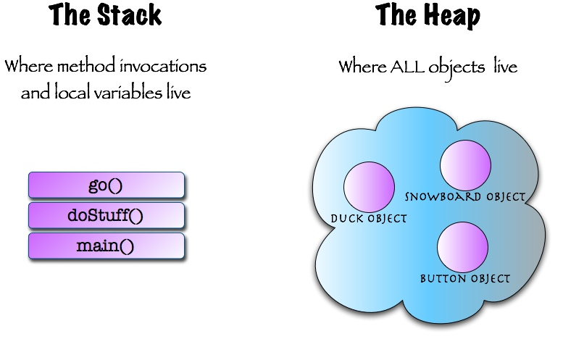
Stack VS Heap

Slide 27
Arrays
Array is a contiguous block of memory
Elements of an array must be the same type
variable = new int[5];
OR
int[ ] items = {1, 2, 3, 4, 5};
Elements are accessed by an index
items[0] = 1;
items[3] = 4;
Find an array’s size with arrayName.length
items.length

Slide 28
2-D Arrays
int variable[][] = new int[2][3];
Index Locations in a 2-D Array
variable[0][2] = 5;
variable[1][1] = 10;
[0][0] | [0][1] | [0][2]
[1][0] | [1][1] | [1][2]
 |  | 5
 | 10

Slide 29
Varargs
Varargs is a construct to allow passing in a variable number of arguments to a method
Arguments passed in become an array, and are accessed the same way
Syntax: methodName(Type… argName) or methodName(Type …argName)
public class HelloWorld {
// instead of an explicit array, we use varargs here
public static void main(String… args) {
System.out.println("Hello World!");
}
}

Slide 30
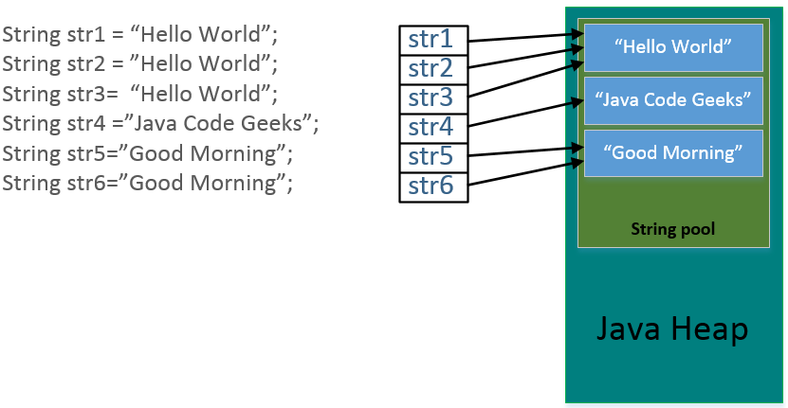

String
String is a special Java class
String words = new String(“Hello World”);
OR
String words = “Hello World”;
Strings are immutable
Strings go to the String Pool

Slide 31
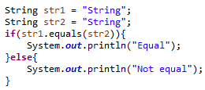
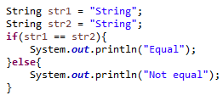
More on String
Strings are immutable objects
Once created they cannot be changed
Compare Strings using the equals( ) method
Using == will compare reference variable memory locations
First output is “Equal”
Second output is “Not equal”

Slide 32
String API
toUpperCase() -Converts all the characters of a string to upper case.
toLowerCase()-Converts all the characters of a string to lower case
charAt(int index) -This returns the indexed character of a string, where the index of the initial character is 0
concat(String s) -This returns a new string consisting which has the old string + s
equals(String s) -Checks if two strings are equal
equaIsIgnoreCase(String s) -This is like equals(), but it ignores the case(Ex: ‘Hello’ and ‘hello’ are equal)
length( ) -Returns the number of characters in the current string.
replace(char old, char new) -This returns a new string, generated by replacing every occurrence of old with new.
trim() -Returns the string that results from removing white space characters from the beginning and ending of the current string.

Slide 33


StringBuffer / StringBuilder API
Allows dynamic modification of Strings
Easy to create
Has several String manipulation methods
append
insert
deleteCharAt
setCharAt
Substring
StringBuffer is a synchronized version of StringBuilder (we’ll cover what this means later)

Slide 34
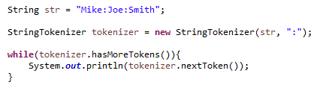

StringTokenizer
Parses a String
Splits into tokens based on delimiter
Second parameter is the delimiter
Delimiter can be any character, or:
Space
\t (tab)
\n (new line)
\r (carriage-return)
\f (form-feed)

Slide 35

Packages
A package is a folder to organize Java class files
The package statement declares where your class resides
The package statement is Line 1 of every class
A best practice is to use “reverse domain naming”

Slide 36
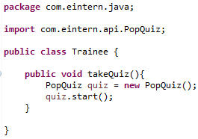

Imports
Used when code is outside the current package
Imports utilities from the Java API
Imports classes from various frameworks
Necessary step to using tools in your arsenal

Slide 37
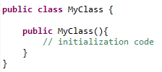
Constructors
The constructor is called using the new keyword
A constructor initializes an object immediately
It has the same name as the class
It looks like a method
It has no return type
It can accept parameters
The JVM creates a “default constructor” if you do not provide one

Slide 38
Type Conversion and Casting
Convert a variable from one type to another (explicit or implicit)
Explicit conversion (must be done with casting):
int variable = 10;
byte item = (byte) variable;
Implicit conversion:
byte item = 10;
int variable = item;
You can cast objects, too!
Dog dog = new Dog( );
dog = (Animal) dog;

Slide 39
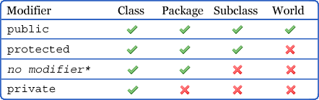
Access Modifiers
public
protected
default (no modifier)
private

Slide 40
Applying Access Modifiers
public class MyClass {
String password;
}
private myMethod(int arg) {
}
protected anotherMethod(int arg) {
}
Class:
Method:
Variable (default):
Constructor:
public class MyClass {
String password;
}
public MyClass() {
}

Slide 41
Non-Access Modifiers
static
Static fields and methods belong to the class or interface on which they are declared
Do not require an instance of the class to call the field / method
abstract
Classes declared abstract cannot be instantiated
Abstract classes can have abstract or concrete (non-abstract) methods
Methods can be declared abstract, meaning subclasses must implement
If a method is abstract, the entire class must be abstract
final
Final classes cannot be extended, final variables cannot be reassigned, and final methods cannot be overriden
synchronized
synchronized methods or blocks help with thread safety – they can only be accessed by a single thread at a time
transient
prevents the serialization of the field
volatile, strictfp
less common and less useful

Slide 42
Static Members
Static variables
Shared by all instances of that class
Changing value in one object is seen by all others
Static methods
Method calls do not require an object
MyClass.myStaticMethod( );
Static block
Also known as the “static initializer”
Block of code run by the JVM at Class Loading
Used to initialize static variables
Non-static variables cannot be referenced from a static context
int b=2
Object 1
int a=1
Object 2 int a=2

Slide 43
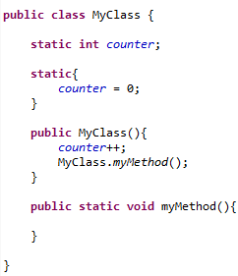
Static Examples
1
2
3
4

Slide 44

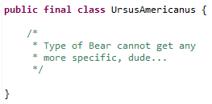

Final
Final variables
Cannot be changed once initialized
Constant value
Typically written in all uppercase
Final methods
Cannot be overridden
Final classes
Cannot be extended
The last leaf on the “Animal”
Inheritance tree
Who… me?

Slide 45
Wrapper Classes
Let you treat primitive data types as objects
Each data type has a Wrapper class
Primitive Data Type | Wrapper class
boolean | Boolean
byte | Byte
char | Character
short | Short
int | Integer
long | Long
float | Float
double | Double

Slide 46


Using Wrapper Classes
Simply pass a primitive value into the Wrapper constructor
Primitive to Wrapper is called “wrapping”
Wrapper to primitive is called “unwrapping”
Since Java 5, the JRE can perform “auto-boxing”
Wrappers can be directly assigned to primitive variables
And vice versa

Slide 47
Object Class
Object class is the root class from which all other objects in Java extend
API overview:
https://docs.oracle.com/javase/8/docs/api/java/lang/Object.html
clone()
equals()
finalize()
hashCode()
toString()
wait()
notify()
getClass()

Slide 48
Annotations
Constructs used to provide metadata about the entity
Must import it like any other type
Used extensively by modern frameworks
Use “@” to specify an annotation
Examples:
@Override
@Deprecated
public class Person extends AbstractPerson {
String firstName;
String lastName;
@Override
printName() {
System.out.println(firstName + lastName);
}
}

Slide 49
Javadocs & code comments
/** This is a Javadoc comment
* Written by @author YourNameHere
* This class represents a person’s
* <ul>
* <li>first name</li>
* <li>last name</li>
* <li>date of birth</li>
* </ul>
*/
public class Person {
String firstName;
String lastName;
// this is an inline comment
// using Java 8's LocalDate here
LocalDate dob;
/* here's a
* multi-line comment
*/
printName() {
System.out.println(firstName + lastName);
}
}
3 types of comments:
Inline comment
Multi-line comment
Javadoc comment
For code documentation
Can contain metadata about the file, class, fields, methods, etc
Use annotations to markup metadata
Can use HTML tags which will render when documentation is generated

Slide 50
Assignment
Write a program to add, subtract, multiply and divide two numbers using methods with parameters using only one class.
In one project, create two classes. One class should contain only methods (add, subtract, multiply and divide). The other class should contain only the main() method which calls each of the methods from the previous class.
Create an example for each control statement.

Slide 51
Assignment
Write a program to add, subtract, multiply and divide two non zero hard-coded numbers.
Write a program to search for the greatest of three numbers using Short-circuit Operators and print the result.
Write a program –declare two variables a and b and initialize them to true and false respectively. Get the output of the following computations:
!a
a | b
(!a & b) | (a & !b)
Never delete your practice projects. You never know when you need to reference that code!

Slide 52
Assignment
Write a program that prints all Strings passed through the command line.
(Hint: loop through main(String[ ] args))
Create a new Java project
Create a Customer class with:
At least 2 constructors
At least 2 overloaded methods
At least 1 static variable
At least 1 final variable
Create a main method in a new class that:
Creates 2 customers
Uses each of the Customer class members

