Slide 1
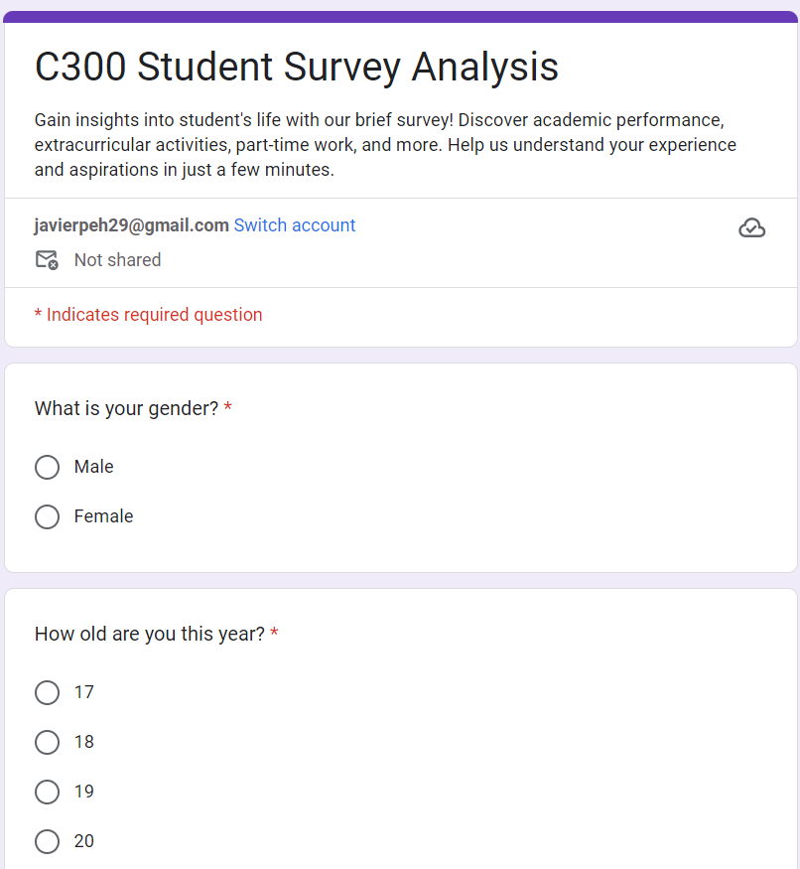
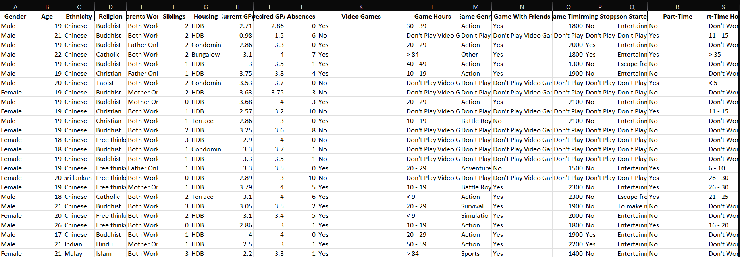
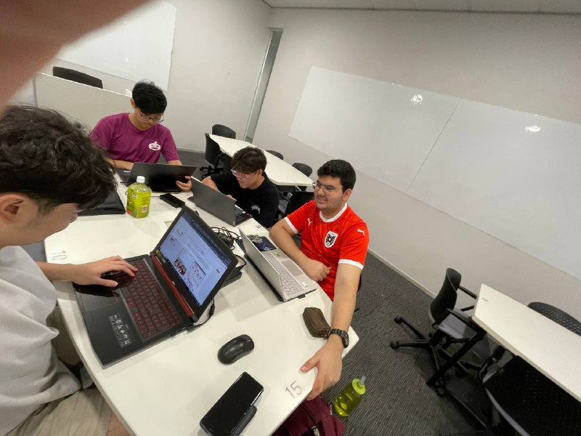
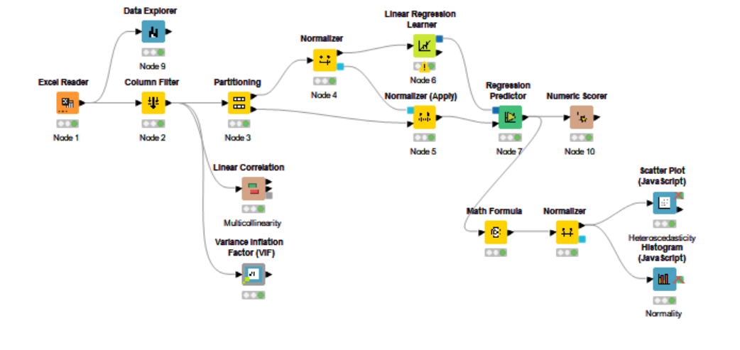
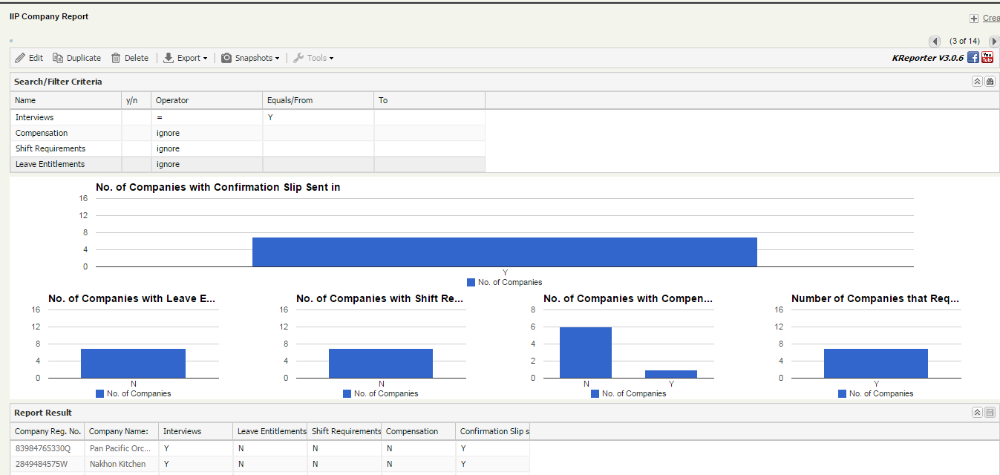
Student Survey Analysis
Project Overview
Problem: The objective of the Students Survey Analysis Project is to understand the demographic and behavioural profiles of students across various educational institutions. By analysing data related to demographics, school performance, gaming habits, part-time work, co-curricular activities (CCA), satisfaction levels, and career aspirations, the project aims to gain insights into students' lifestyles, challenges, and future goals. This understanding can help in designing better educational programs, support services, and career guidance.
Requirements: For the project, a comprehensive survey encompassing demographics, academic performance, gaming habits, part-time employment, CCA involvement, satisfaction levels, career aspirations, and necessary skills will be created. To extract important insights, the data will be cleaned, displayed, clustered, and subjected to text analytics analysis based on student's career options and Skills requirements.
Solution: The creation of the survey and data collecting, data cleansing and visualization, clustering analysis, and text analytics are the stages in which the project will be carried out. The outcomes will be combined into a report and shown through an intuitive dashboard, offering practical insights into the requirements and actions of the students.
Technologies: The project utilizes Tableau for data visualization, and Knime for data cleansing, predictive models, We also used Python as an alternative throughout our process, using libraries like pandas, scikit-learn, matplotlib, seaborn, and nltk. Excel will assist with preliminary data tasks.
Survey Questionaire
Results of the data we have collected
Team Members
Peh Yi Feng Javier, Liaw Hong Da
Tan Hong Bin, Daniel Sanjay Sadhnani
Supervisor
Ms Nimmy Varghese
Predictive Model
Notes:
NOTES
Refer to write ups in ‘Past Projects for Reference’ Booklet for Project overview write ups - Student Academic - Project (sharepoint.com)
ENGLISH – British. E.g. organisation VS organization
Font: RP approved font - Arial family only.
Header: Arial Bold
Copy text: Arial regular or Arial Bold. Use Emphasis of SOI’s orange colour in moderation.
Picture frame – Give a 4.5 or 6pt orange outline.

