Slide 1
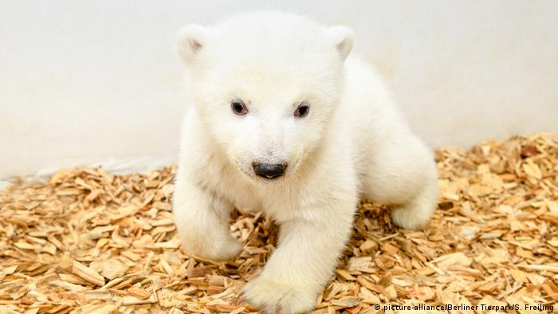
Future…
Function
Integrate Map Services
Realtime communication
Make your pets NFTs
Infrastructure
Microservices
Easy to deploy
Elastic/Easy to scale
Self-healing
Performance
Refactoring database

