Slide 1
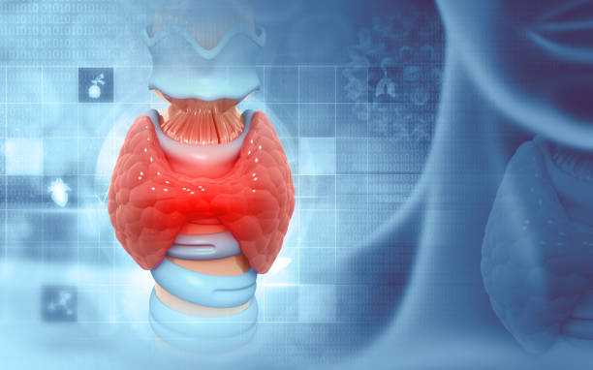
HYPOTHYROID PREDICTION
USING
STATISTICAL MACHINE LEARNING

Slide 2
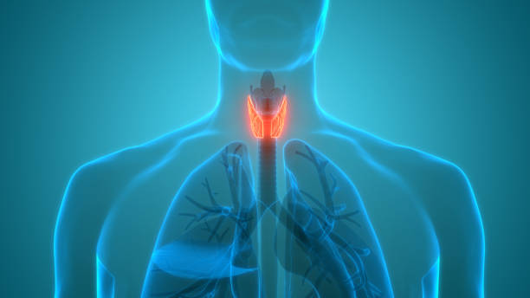
B. HARI KRISHNA
2203A52006
by: B. HARI KRISHNA 2203A52006
TRAINER
MR. D. RAMESH
ASST. PROFESSOR
CS and AI&ML

Slide 3
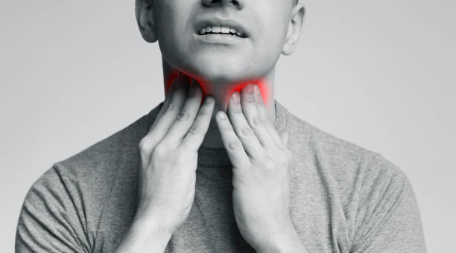
INTRODUCTION
The machine learning model I am working is “HYPOTHYROID PREDICTION”
Hypothyroidism is a common thyroid disorder characterized by an underactive thyroid
gland, which fails to produce sufficient thyroid hormones. These hormones are crucial
for regulating metabolism and overall body functions. Hypothyroidism can manifest with
symptoms like fatigue, weight gain, cold intolerance, and cognitive impairment. It
affects individuals of all ages but is more prevalent in women and older adults. Early
diagnosis and proper management, typically through thyroid hormone replacement
therapy, are essential to alleviate symptoms and prevent complications associated with
this condition.

Slide 4
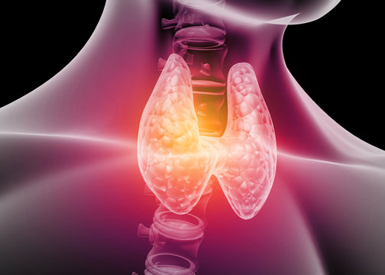
INTRODUCTION
Hypothyroid prediction using machine learning is a cutting-edge application that leverages advanced algorithms
to diagnose and forecast hypothyroidism, a common thyroid disorder. By analyzing patient data, including thyroid
hormone levels, symptoms, and medical history, machine learning models can accurately identify individuals at
risk of hypothyroidism. This innovative approach holds immense potential in improving early detection,
personalized treatment, and overall healthcare outcomes, ultimately enhancing the quality of life for affected
individuals.

Slide 5

INTRODUCTION
The main agenda of our project is to predict the hypothyroid based on few features like
'age', 'sex', ‘on thyroxine', 'query on thyroxine', ‘on antithyroid medication', 'sick', 'pregnant', 'thyroid
surgery', 'I131_treatment', 'query hypothyroid', 'query hyperthyroid', 'lithium', 'goitre', 'tumor’,
'hypopituitary', 'psych', ‘TSH measured', 'TSH', 'T3_measured', 'T3', 'TT4_measured', 'TT4’,
'T4U_measured', 'T4U', ‘FTI measured', 'FTI’ and these are independent variables (x – values) and
dependent variable (y – value) positive or negative.

Slide 6
DATA COLLECTION AND PREPROCESSING
STEPS TO BE FOLLOWED
DATA CLEANING
DATA TRANSFORMATION
FEATURE SELECTION
DATA SPLITTING
HANDLING IMBALANCED DATA
OUTLIER DIRECTION
NORMALIASATION AND STANDARDIZATION
TIME – BASED FEATURES
DIMENSIONLITY REDUCTION
DATA VALIDATION

Slide 7
DATA INSIGHTS
Age
Sex
On thyroxine
Query on thyroxine
Antithyroid Medication
Sick
Pregnant
Thyroid surgery
I131_Treatment
Query hypothyroid

Slide 8
DATA INSIGHTS
Query hyperthyroid
Lithium
Goitre
Tumor
Hypopituitary
Psych
TSH_measured
TSH
T3_measured
T3

Slide 9
TT4 measured
TT4
T4U measured
T4U
FTI measured
FTI

Slide 10
UNCLEANED DATASET
age | sex | on_thyroxine | query_on_thyroxine | on_antithyroid_medication | sick | pregnant | thyroid_surgery | I131_treatment | query_hypothyroid | query_hyperthyroid | lithium | goitre | tumor | hypopituitary | psych | TSH_measured | TSH
41 | F | f | f | f | f | f | f | f | f | f | f | f | f | f | f | t | 1.3
23 | F | f | f | f | f | f | f | f | f | f | f | f | f | f | f | t | 4.1
46 | M | f | f | f | f | f | f | f | f | f | f | f | f | f | f | t | 0.98
70 | F | t | f | f | f | f | f | f | f | f | f | f | f | f | f | t | 0.16
70 | F | f | f | f | f | f | f | f | f | f | f | f | f | f | f | t | 0.72
18 | F | t | f | f | f | f | f | f | f | f | f | f | f | f | f | t | 0.03
59 | F | f | f | f | f | f | f | f | f | f | f | f | f | f | f | f | ?
80 | F | f | f | f | f | f | f | f | f | f | f | f | f | f | f | t | 2.2
66 | F | f | f | f | f | f | f | f | f | f | f | f | t | f | f | t | 0.6
68 | M | f | f | f | f | f | f | f | f | f | f | f | f | f | f | t | 2.4
84 | F | f | f | f | f | f | f | f | f | f | f | f | t | f | f | t | 1.1
67 | F | t | f | f | f | f | f | f | f | f | f | f | f | f | f | t | 0.03
71 | F | f | f | f | t | f | f | f | f | t | f | f | f | f | f | t | 0.03
59 | F | f | f | f | f | f | f | f | f | f | f | f | f | f | f | t | 2.8
28 | M | f | f | f | f | f | f | f | f | f | f | f | f | f | f | t | 3.3
65 | F | f | f | f | f | f | f | f | t | f | f | f | f | f | f | t | 12
42 | ? | f | f | f | f | f | f | f | f | f | f | f | f | f | f | t | 1.2
63 | F | f | f | f | f | f | f | f | f | f | f | f | f | f | f | t | 1.5
80 | F | f | f | f | f | f | f | f | f | f | f | f | f | f | t | t | 6
28 | M | f | f | f | f | f | f | f | f | f | f | f | f | f | t | t | 2.1
51 | F | t | f | f | f | f | f | f | f | f | f | f | f | f | f | t | 0.1
46 | M | f | f | f | f | f | f | f | f | f | f | f | f | f | f | t | 0.8
81 | M | f | f | f | f | f | f | f | f | f | f | f | f | f | f | t | 1.9
54 | F | f | f | f | f | f | f | f | f | f | f | f | f | f | f | t | 3.1

Slide 11
UNCLEANED DATASET
T3 measured | T3 | TT4 measured | TT4 | T4U measured | T4U | FTI measured | FTI | TBG measured | TBG | Referral source | binaryClass
t | 2.5 | t | 125 | t | 1.14 | t | 109 | f | ? | SVHC | P
t | 2 | t | 102 | f | ? | f | ? | f | ? | other | P
f | ? | t | 109 | t | 0.91 | t | 120 | f | ? | other | P
t | 1.9 | t | 175 | f | ? | f | ? | f | ? | other | P
t | 1.2 | t | 61 | t | 0.87 | t | 70 | f | ? | SVI | P
f | ? | t | 183 | t | 1.3 | t | 141 | f | ? | other | P
f | ? | t | 72 | t | 0.92 | t | 78 | f | ? | other | P
t | 0.6 | t | 80 | t | 0.7 | t | 115 | f | ? | SVI | P
t | 2.2 | t | 123 | t | 0.93 | t | 132 | f | ? | SVI | P
t | 1.6 | t | 83 | t | 0.89 | t | 93 | f | ? | SVI | P
t | 2.2 | t | 115 | t | 0.95 | t | 121 | f | ? | SVI | P
f | ? | t | 152 | t | 0.99 | t | 153 | f | ? | other | P
t | 3.8 | t | 171 | t | 1.13 | t | 151 | f | ? | other | P
t | 1.7 | t | 97 | t | 0.91 | t | 107 | f | ? | SVI | P
t | 1.8 | t | 109 | t | 0.91 | t | 119 | f | ? | SVHC | P
f | ? | t | 99 | t | 1.14 | t | 87 | f | ? | other | N
t | 1.8 | t | 70 | t | 0.86 | t | 81 | f | ? | other | P
t | 1.2 | t | 117 | t | 0.96 | t | 121 | f | ? | SVI | P
t | 1.6 | t | 99 | t | 0.95 | t | 104 | f | ? | SVI | P
t | 2.6 | t | 121 | t | 0.94 | t | 130 | f | ? | SVHC | P
f | ? | t | 130 | t | 0.86 | t | 151 | f | ? | other | P
t | 2.1 | t | 108 | t | 0.91 | t | 119 | f | ? | other | P
t | 0.3 | t | 102 | t | 0.96 | t | 106 | f | ? | SVI | P
f | ? | t | 104 | t | 0.9 | t | 116 | f | ? | other | P

Slide 12
CLEANED DATA SET
age | sex | on thyroxin | Query on thyroxine | Antithyroidmedication | sick | Pregnant | Thyroid surgery | I131 treatment | Query hypothyroid | query_hyperthyroid | lithium | goitre | tumor | Hypo Pituitary | psych | TSH measured | TSH
41 | 2 | 0 | 0 | 0 | 0 | 0 | 0 | 0 | 0 | 0 | 0 | 0 | 0 | 0 | 0 | 1 | 1.3
23 | 2 | 0 | 0 | 0 | 0 | 0 | 0 | 0 | 0 | 0 | 0 | 0 | 0 | 0 | 0 | 1 | 4.1
46 | 1 | 0 | 0 | 0 | 0 | 0 | 0 | 0 | 0 | 0 | 0 | 0 | 0 | 0 | 0 | 1 | 0.98
70 | 2 | 1 | 0 | 0 | 0 | 0 | 0 | 0 | 0 | 0 | 0 | 0 | 0 | 0 | 0 | 1 | 0.16
70 | 2 | 0 | 0 | 0 | 0 | 0 | 0 | 0 | 0 | 0 | 0 | 0 | 0 | 0 | 0 | 1 | 0.72
18 | 2 | 1 | 0 | 0 | 0 | 0 | 0 | 0 | 0 | 0 | 0 | 0 | 0 | 0 | 0 | 1 | 0.03
59 | 2 | 0 | 0 | 0 | 0 | 0 | 0 | 0 | 0 | 0 | 0 | 0 | 0 | 0 | 0 | 0 | 78
80 | 2 | 0 | 0 | 0 | 0 | 0 | 0 | 0 | 0 | 0 | 0 | 0 | 0 | 0 | 0 | 1 | 2.2
66 | 2 | 0 | 0 | 0 | 0 | 0 | 0 | 0 | 0 | 0 | 0 | 0 | 1 | 0 | 0 | 1 | 0.6
68 | 1 | 0 | 0 | 0 | 0 | 0 | 0 | 0 | 0 | 0 | 0 | 0 | 0 | 0 | 0 | 1 | 2.4
84 | 2 | 0 | 0 | 0 | 0 | 0 | 0 | 0 | 0 | 0 | 0 | 0 | 1 | 0 | 0 | 1 | 1.1
67 | 2 | 1 | 0 | 0 | 0 | 0 | 0 | 0 | 0 | 0 | 0 | 0 | 0 | 0 | 0 | 1 | 0.03
71 | 2 | 0 | 0 | 0 | 1 | 0 | 0 | 0 | 0 | 1 | 0 | 0 | 0 | 0 | 0 | 1 | 0.03
59 | 2 | 0 | 0 | 0 | 0 | 0 | 0 | 0 | 0 | 0 | 0 | 0 | 0 | 0 | 0 | 1 | 2.8
28 | 1 | 0 | 0 | 0 | 0 | 0 | 0 | 0 | 0 | 0 | 0 | 0 | 0 | 0 | 0 | 1 | 3.3
65 | 2 | 0 | 0 | 0 | 0 | 0 | 0 | 0 | 1 | 0 | 0 | 0 | 0 | 0 | 0 | 1 | 12
42 | 2 | 0 | 0 | 0 | 0 | 0 | 0 | 0 | 0 | 0 | 0 | 0 | 0 | 0 | 0 | 1 | 1.2
63 | 2 | 0 | 0 | 0 | 0 | 0 | 0 | 0 | 0 | 0 | 0 | 0 | 0 | 0 | 0 | 1 | 1.5
80 | 2 | 0 | 0 | 0 | 0 | 0 | 0 | 0 | 0 | 0 | 0 | 0 | 0 | 0 | 1 | 1 | 6
28 | 1 | 0 | 0 | 0 | 0 | 0 | 0 | 0 | 0 | 0 | 0 | 0 | 0 | 0 | 1 | 1 | 2.1
51 | 2 | 1 | 0 | 0 | 0 | 0 | 0 | 0 | 0 | 0 | 0 | 0 | 0 | 0 | 0 | 1 | 0.1
46 | 1 | 0 | 0 | 0 | 0 | 0 | 0 | 0 | 0 | 0 | 0 | 0 | 0 | 0 | 0 | 1 | 0.8
81 | 1 | 0 | 0 | 0 | 0 | 0 | 0 | 0 | 0 | 0 | 0 | 0 | 0 | 0 | 0 | 1 | 1.9
54 | 2 | 0 | 0 | 0 | 0 | 0 | 0 | 0 | 0 | 0 | 0 | 0 | 0 | 0 | 0 | 1 | 3.1

Slide 13
CLEANED DATASET
T3_measured | T3 | TT4_measured | TT4 | T4U_measured | T4U | FTI_measured | FTI | binaryClass
1 | 2.5 | 1 | 125 | 1 | 1.14 | 1 | 109 | 1
1 | 2 | 1 | 102 | 0 | 1.25 | 0 | 100 | 1
0 | 25 | 1 | 109 | 1 | 0.91 | 1 | 120 | 1
1 | 1.9 | 1 | 175 | 0 | 1.23 | 0 | 120 | 1
1 | 1.2 | 1 | 61 | 1 | 0.87 | 1 | 70 | 1
0 | 12 | 1 | 183 | 1 | 1.3 | 1 | 141 | 1
0 | 25 | 1 | 72 | 1 | 0.92 | 1 | 78 | 1
1 | 0.6 | 1 | 80 | 1 | 0.7 | 1 | 115 | 1
1 | 2.2 | 1 | 123 | 1 | 0.93 | 1 | 132 | 1
1 | 1.6 | 1 | 83 | 1 | 0.89 | 1 | 93 | 1
1 | 2.2 | 1 | 115 | 1 | 0.95 | 1 | 121 | 1
0 | 25 | 1 | 152 | 1 | 0.99 | 1 | 153 | 1
1 | 3.8 | 1 | 171 | 1 | 1.13 | 1 | 151 | 1
1 | 1.7 | 1 | 97 | 1 | 0.91 | 1 | 107 | 1
1 | 1.8 | 1 | 109 | 1 | 0.91 | 1 | 119 | 1
0 | 1 | 1 | 99 | 1 | 1.14 | 1 | 87 | 0
1 | 1.8 | 1 | 70 | 1 | 0.86 | 1 | 81 | 1
1 | 1.2 | 1 | 117 | 1 | 0.96 | 1 | 121 | 1
1 | 1.6 | 1 | 99 | 1 | 0.95 | 1 | 104 | 1
1 | 2.6 | 1 | 121 | 1 | 0.94 | 1 | 130 | 1
0 | 2 | 1 | 130 | 1 | 0.86 | 1 | 151 | 1
1 | 2.1 | 1 | 108 | 1 | 0.91 | 1 | 119 | 1
1 | 0.3 | 1 | 102 | 1 | 0.96 | 1 | 106 | 1
0 | 1.3 | 1 | 104 | 1 | 0.9 | 1 | 116 | 1

Slide 14
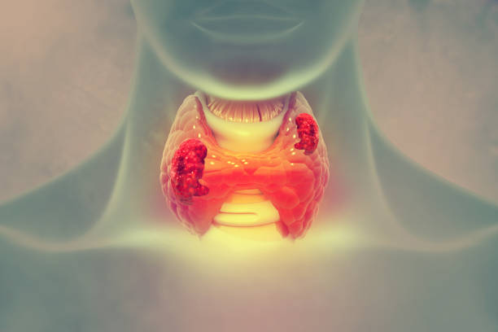
MACHINE LEARNING MODEL
SUPERVISED LEARNING
Supervised learning is defined as it is a type of machine which is used for labelled data i.e where there are predicted vales (y-values) exist in a data. Supervised learning infers a function from labelled training data consisting of a set of training examples.
This is used for prediction and has a feedback mechanism
The dataset of “Hypo thyroid prediction” is being trained and tested using
PERCEPTRON LEARNING
LOGISTIC REGRESSION
SUPPORT VECTOR MACHINE
KNN

Slide 15
BOOT STRAPPING
Bootstrapping is a resampling method where you create multiple random subsamples,
called "bootstraps," from your original dataset by selecting data points with replacement.
Each bootstrap is of the same size as the original dataset, but it contains repeated
instances and may have some instances omitted.
Bootstrapping is used to estimate the distribution of a statistic or to assess the variability
of a model's performance.
In classification, bootstrapping is often used to estimate the model's accuracy, precision,
recall, and other performance metrics.

Slide 16
PERCEPTRON LEARNING
The perceptron is a fundamental concept in machine learning and artificial intelligence. It's a type of binary
linear classifier that's used for supervised learning tasks. The perceptron takes multiple input values, assign
weights to them, and computes their sum. If the sum is above a certain threshold, it outputs one class;
otherwise, it outputs another. It’s a building block for more complex neural networks and played a pivotal
role in the development of machine learning algorithms, although it has limitations when dealing with non
-linearly separable data.

Slide 17
LOGISTIC REGRESSION
Logistic regression is a statistical model used for binary classification tasks. It's particularly valuable in predicting
outcomes with two possible categories, such as yes/no or true/false. Unlike linear regression, which predicts
continuous values, logistic regression calculates the probability of an observation belonging to one of the two classes.
It uses the logistic function to transform a linear combination of input features into a value between 0 and 1,
representing the probability of the positive class. It's widely used in various fields, including medicine, finance, and
machine learning, for its simplicity and interpretability.

Slide 18
SUPPORT VECTOR MACHINE
A Support Vector Machine (SVM) is a powerful supervised machine learning algorithm used for classification and
regression tasks. SVMs are particularly effective in finding a hyperplane that best separates data into different
classes in a high-dimensional space. They aim to maximize the margin between data points of different classes,
making them robust and capable of handling complex datasets. SVMs can also use kernel functions to transform
data, making them versatile for various applications, including image classification, text analysis, and
bioinformatics.

Slide 19
KNN(K Nearest Neighbours)
K-Nearest Neighbors (KNN) with bootstrap is a classification technique that combines KNN with
resampling. In this method, the dataset is repeatedly sampled with replacement to create multiple
subsets.
KNN is then applied to each subset, and the results are aggregated to make predictions.
This approach helps reduce the impact of outliers and enhances the model's robustness.
By leveraging bootstrap resampling, KNN classification becomes more stable and accurate for
various data distributions.

Slide 20
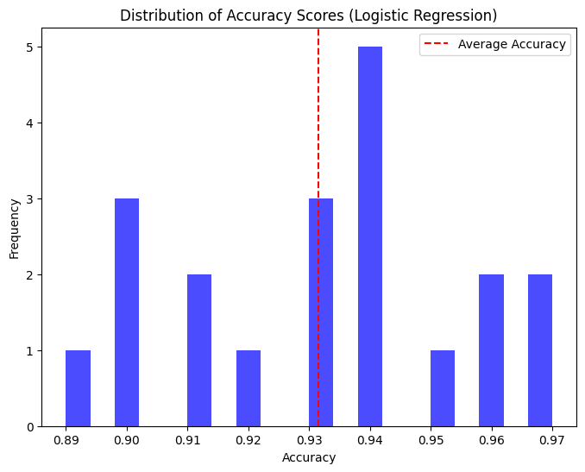
THE MACHINE LEARNING MODEL USED
LOGISTIC REGRESSION:
Accuracy : 95.5026455026455%
Confusion Matrix:
[[ 18 7]
[ 2 351]]

Slide 21

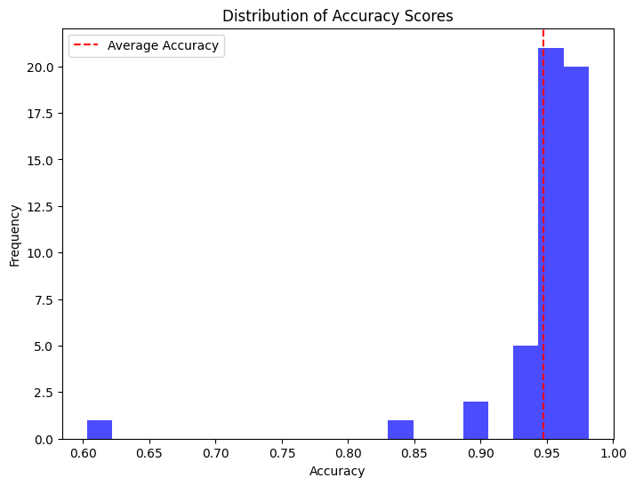
PERCEPTRON LEARNING(BOOT STRAP):
Accuracy: 93.65%
Confusion Matrix:
[[ 14 11]
[ 2 351]]

Slide 22
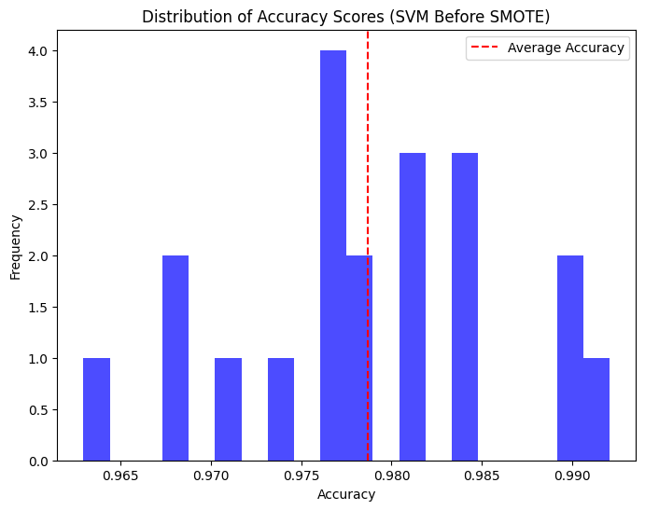
SUPPORT VECTOR MACHINE:
(BEFORE SMOTE):
Accuracy: 96.29%
Confusion Matrix:
[[ 17 11]
[ 3 347]]

Slide 23
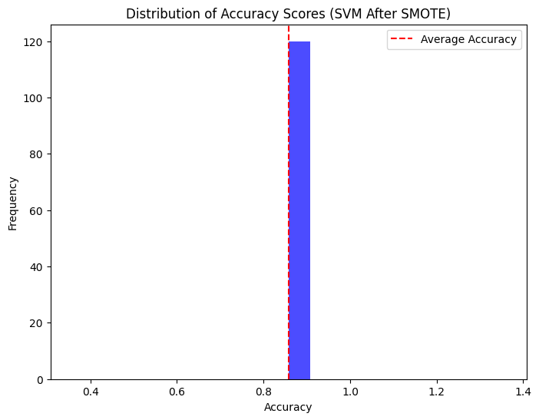
AFTER SMOTE:
Accuracy: 85.75418994413405%
CONFUSION MATRIX:
[[160 21]
[ 30 147]]

Slide 24
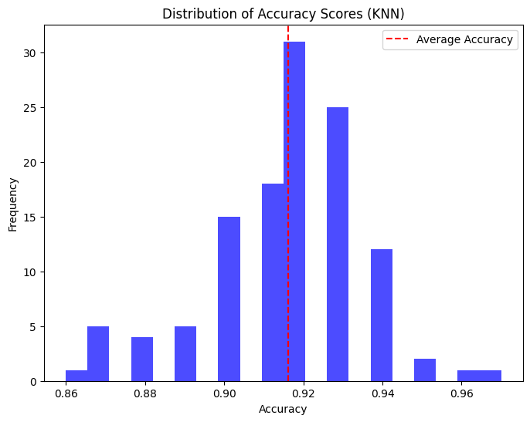
KNN (BOOTSTRAP):
Accuracy : 91.61666666666667%

Slide 25
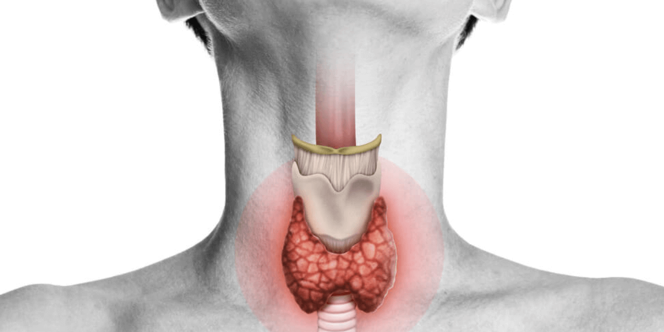
MODEL SELECTION:
MODEL USED(with BOOT STRAP) | ACCURACY(%)
LOGISTIC REGRESSION | 95.50
2. PERCEPTRON LEARNING | 93.65
3. SUPPORT VECTOR MACHINE(before SMOTE) | 96.29
4. SUPPORT VECTOR MACHINE(after SMOTE) | 85.75
5. KNN | 91.61

Slide 26

CONCLUSION:
So from the accuracy, we can predict that the Support Vector Machine shows
the best possible accuracy result ranging from 96.29% which is highest
accordingly .
FUTURE SCOPE:
By developing this model we may predict the scope of “hypo thyroid” more
accurately and precisely. By providing more number of specifications.

Slide 27
THANK YOU

