Slide 1
Income Classification

Slide 2
By: Zuhayr Zia 2203A52065
Under the guidance and training of:
Mr. D.Ramesh
asst. professor
CSE(ai & ml)

Slide 3
Problem Statement
The core problem is to predict income levels, categorized as either "<=50K" or ">50K," based on a set of attributes.
Accurate predictions have wide-ranging real-world applications, such as in financial planning, credit approval, and marketing targeting.

Slide 4
Importance:
Socioeconomic Analysis: Understanding income levels in a population can provide valuable insights into socioeconomic disparities, which can inform policy and decision-making.
Marketing and Advertising: Businesses can use income predictions to target their products and services more effectively.
Financial Planning: Individuals can benefit from personalized financial advice based on their predicted income level.
To address this problem, we will explore the Adult Census Income dataset, preprocess the data, select appropriate machine learning algorithms, and train a model to make predictions. We will evaluate the model's performance using relevant metrics.

Slide 5
Introduction:
Dataset Overview: The Adult Census Income dataset, available on Kaggle, provides a rich source of information collected from the U.S. Census Bureau. It encompasses a diverse range of attributes related to individuals' demographics and economic status.
Significance: The Census Income dataset holds great significance due to its potential applications in predicting income levels and addressing socioeconomic questions. It challenges us to explore how data-driven insights can shape our understanding of income disparities.
Dataset Composition: With thousands of records and a variety of features, including age, education, occupation, marital status, and more, this dataset offers a comprehensive view of the factors that may influence income.
Objective: Our primary goal today is to extract meaningful insights from this dataset and harness the power of machine learning to predict income levels accurately

Slide 6
Understanding the Dataset
Dataset Overview: Now, let's take a closer look at the Census Income dataset to understand its composition and characteristics.
Dataset Size: The dataset consists of 32,563 individual records, each representing a person, and 15 attributes that describe various aspects of their lives.
Data Types: The dataset contains a mix of data types, including both categorical and numerical features. These features provide a rich source of information for analysis.
Target Variable: At the heart of our analysis is the target variable, which is 'income.' This variable categorizes individuals into two classes: those whose income is above a certain threshold (usually $50,000) and those below it.
Features: Some of the key features in the dataset include 'age,' 'education,' 'occupation,' 'marital status,' 'relationship,' 'hours per week worked,' and more. These features will play a crucial role in our analysis and prediction.
Missing Values: It's important to note that the dataset may contain missing values, which we will need to handle during the preprocessing stage to ensure the quality of our analysis.
Data Preprocessing: To prepare the data for machine learning, we will perform data preprocessing tasks such as encoding categorical variables, scaling numerical features, and handling any missing data.

Slide 7
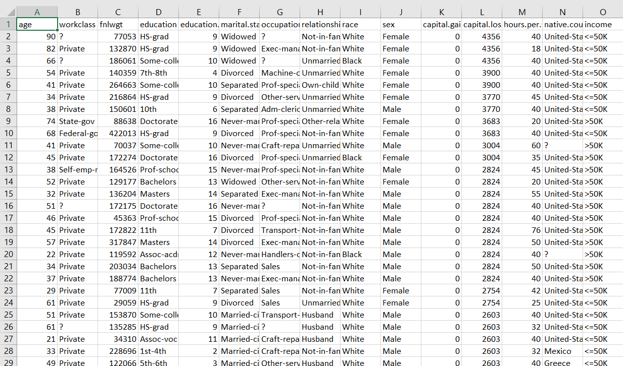

Slide 8
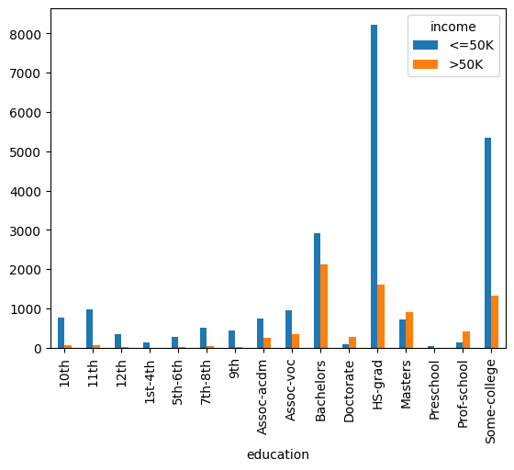
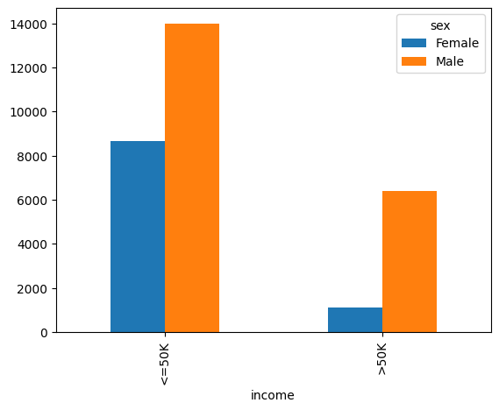
Data Visualization

Slide 9
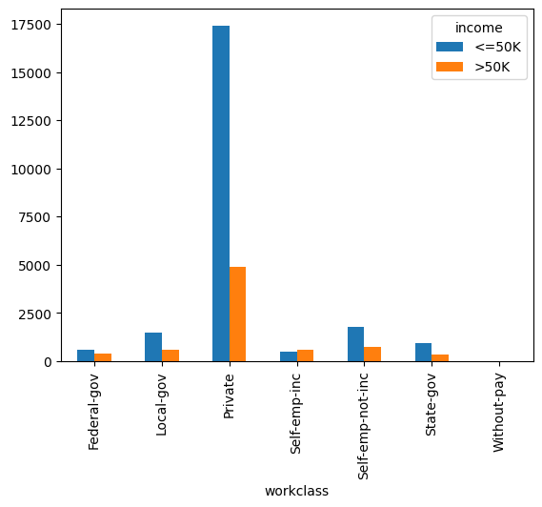
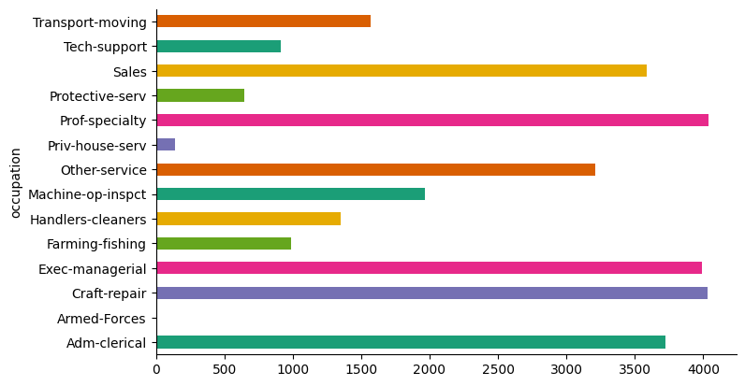

Slide 10
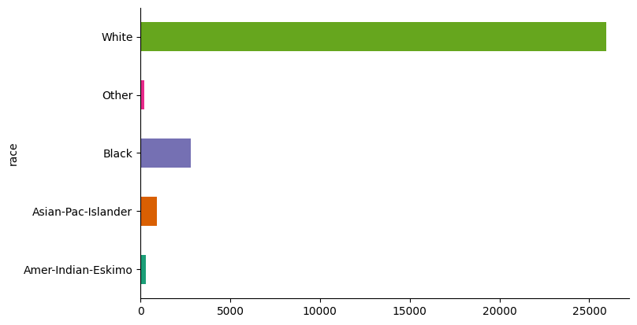

Slide 11
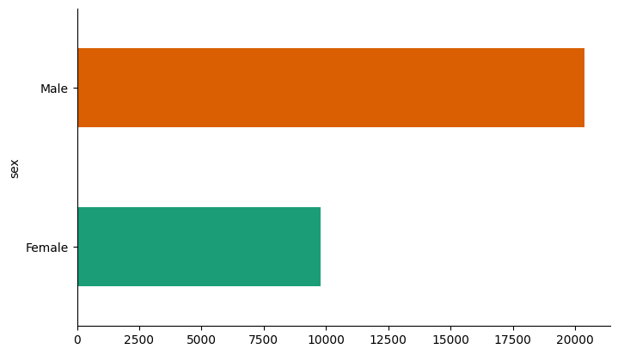

Slide 12
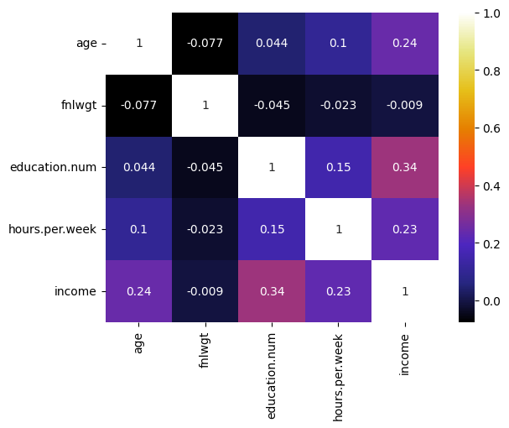

Slide 13
Machine Learning and AI Implementation
Approach: In this project, we employ machine learning and AI techniques to address a specific question: Can we accurately classify income levels into categories ('<50K' or '>50K') based on demographic and economic attributes?
Our approach involves the following steps:
Data Preprocessing: We clean and prepare the data to ensure it's suitable for machine learning algorithms.
Model Selection: We carefully choose machine learning algorithms that are best suited for our classification task.
Model Training: We train our selected model on a portion of the data and fine-tune its parameters for optimal performance.
Model Evaluation: We rigorously assess the model's performance using various evaluation metrics to ensure its accuracy and reliability.

Slide 14
Continuation:
Why Machine Learning? Machine learning allows us to extract patterns and insights from large datasets that may not be apparent through traditional statistical analysis. It enables us to make data-driven predictions and decisions.
Key Goals: Our key goals in this section are to select the appropriate machine learning algorithm, train the model, and evaluate its predictive capabilities. The insights we gain will shed light on the factors that influence income levels.

Slide 15
Classification?
Classification is a fundamental task in machine learning and data analysis. It involves the process of categorizing or labeling data into predefined classes or categories based on the characteristics or features of the data. The main goal of classification is to assign data points to one of several discrete classes or categories, making it a supervised learning technique.
Key uses of classification:
Supervised Learning
Categorization
Binary or Multiclass
Classification Algorithms
Decision Boundary
Performance Metrics
Real-World Applications

Slide 16
Utilizing Classification to determine annual Income range (<=/>=50k$)
Why Classification? Classification is a fundamental and interpretable technique that we use to categorize people into different income levels based on their attributes.
How It Works:
Classification models, unlike regression models that predict continuous values, work by assigning each individual to a specific category or class.
In our case, classification estimates the category to which an individual's income level belongs, such as "<=50K" or ">50K."
Model Training:
We trained our classification model, such as Logistic Regression, Perceptron, Support Vector Machine (SVM), or k-Nearest Neighbors (k-NN), on our preprocessed training dataset.
During training, the model learns the patterns and relationships between the input features and the corresponding income categories.
It identifies the decision boundaries that best separate individuals into the correct income categories.

Slide 17
Preparing the Data for Analysis
Data Preprocessing Overview: Before we dive into the modeling phase, it's essential to ensure that our dataset is clean, well-organized, and suitable for machine learning. This process is known as data preprocessing.
Why Data Preprocessing Matters: Data preprocessing is a critical step in the machine learning pipeline because it can significantly impact the performance of our models. It involves tasks that improve the quality of our data and make it more conducive to modeling.
Handling Missing Values
Encoding Categorical Variables
Scaling Features
Data Splitting
Data Quality Assurance

Slide 18
The Model:
Logistic Regression:
Logistic Regression is a classification algorithm used to predict binary outcomes.
It estimates the probability of an instance belonging to a particular class.
In our project, it helps categorize individuals into income categories ("<50K" or ">50K") based on their attributes.
Output:
Logistic Regression Accuracy: 0.7932634929054502

Slide 19
Perceptron:
The Perceptron is a simple linear classification algorithm.
It's used for binary classification tasks by finding a decision boundary to separate two classes.
In our analysis, the Perceptron model helps predict income categories.
Output:
Perceptron Accuracy: 0.7582548733589709

Slide 20
Support Vector Machine (SVM):
SVM is a versatile classification technique that finds optimal decision boundaries to separate different classes.
In our project, SVM is employed to accurately classify individuals into income categories by maximizing the margin between the classes.
Output:
SVM Accuracy: 0.8140830128630155

Slide 21
k-Nearest Neighbors (k-NN) with Bootstrap:
k-NN is a method that assigns a class label based on the majority class among its k-nearest neighbors.
In our analysis, k-NN is combined with bootstrapping, a resampling technique, to assess model performance and robustness.
We calculate the mean accuracy of multiple k-NN models to understand its predictive power.
Output:
k-NN with Bootstrap Mean Accuracy: 0.7962538124917125

Slide 22
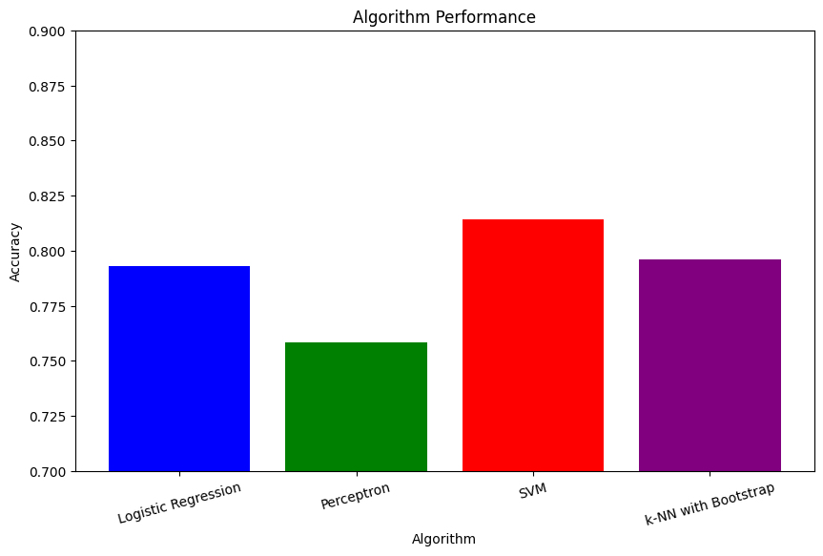
Overall Performance:

Slide 23
Conclusions
Our project successfully utilized classification techniques, including Logistic Regression, Perceptron, and Support Vector Machine (SVM), to predict income levels.
We accurately categorized individuals into income groups ("<50K" or ">50K") and gained valuable insights into income disparities.
The models were rigorously evaluated using metrics such as accuracy and precision. This project showcases the importance of classification in making precise income predictions with real-world applications.

Slide 24
References:
Dataset: https://www.kaggle.com/datasets/uciml/adult-census-income/data
Github link: https://github.com/2203A52065/Project-Stat-ML

Slide 25
Thank You

