Slide 1

Student Dropout And
Academic Success Prediction
BY
B.Gopikrishna
2203A52076
Under the guidance of
Mr.D.Ramesh

Slide 2
INTRODUCTION
Education is a fundamental aspect of human development, offering individuals the opportunity to acquire knowledge, skills, and opportunities for personal and professional growth. However, the educational journey is not without its challenges, and one of the most pressing issues in the realm of education is student dropout. Dropout rates in schools, colleges, and universities have significant implications for individuals, institutions, and society as a whole. On the flip side, predicting and promoting academic success is equally crucial for ensuring that students achieve their full potential and contribute positively to society.

Slide 3
Student Dropout:
Student dropout refers to the phenomenon where students discontinue their education before completing a particular academic program or degree. This can occur at various stages of the educational journey, from primary school to higher education. Dropout rates can vary widely based on factors such as socioeconomic background, personal circumstances, and the quality of education provided. High dropout rates can result in negative consequences, including limited career opportunities, reduced earning potential, and a potential burden on social welfare systems.Understanding the reasons behind student dropout and developing effective strategies to prevent it are critical goals for educators, policymakers, and researchers. Identifying at-risk students and intervening early to provide support and resources can make a substantial difference in reducing dropout rates.

Slide 4
Academic Success :
Student academic success is the culmination of effective learning strategies, dedication, and goal-oriented efforts. It involves achieving academic excellence, personal growth, and overall well-being while pursuing educational objectives. Success is not solely measured by grades but also by critical thinking, problem-solving, and adaptability. It requires time management, effective study habits, and a supportive learning environment. Ultimately, student academic success empowers individuals to unlock their full potential and create a promising future

Slide 5
DATA SET
4425 INSTANCES and 35-attributes
Marital status | Application mode | Application order | Course | Daytime/evening attendance | Previous qualification | Nacionality | Mother's qualification | Father's qualification | Mother's occupation | Father's occupation | Displaced | Educational special needs | Debtor | Tuition fees up to date | Gender | Scholarship holder | Age at enrollment | International | Curricular units 1st sem (credited) | Curricular units 1st sem (enrolled) | Curricular units 1st sem (evaluations) | Curricular units 1st sem (approved) | Curricular units 1st sem (grade) | Curricular units 1st sem (without evaluations) | Curricular units 2nd sem (credited) | Curricular units 2nd sem (enrolled) | Curricular units 2nd sem (evaluations) | Curricular units 2nd sem (approved) | Curricular units 2nd sem (grade) | Curricular units 2nd sem (without evaluations) | Unemployment rate | Inflation rate | GDP | Target
1 | 8 | 5 | 2 | 1 | 1 | 1 | 13 | 10 | 6 | 10 | 1 | 0 | 0 | 1 | 1 | 0 | 20 | 0 | 0 | 0 | 0 | 0 | 0 | 0 | 0 | 0 | 0 | 0 | 0 | 0 | 10.8 | 1.4 | 1.74 | Dropout
1 | 6 | 1 | 11 | 1 | 1 | 1 | 1 | 3 | 4 | 4 | 1 | 0 | 0 | 0 | 1 | 0 | 19 | 0 | 0 | 6 | 6 | 6 | 14 | 0 | 0 | 6 | 6 | 6 | 13.66667 | 0 | 13.9 | -0.3 | 0.79 | Graduate
1 | 1 | 5 | 5 | 1 | 1 | 1 | 22 | 27 | 10 | 10 | 1 | 0 | 0 | 0 | 1 | 0 | 19 | 0 | 0 | 6 | 0 | 0 | 0 | 0 | 0 | 6 | 0 | 0 | 0 | 0 | 10.8 | 1.4 | 1.74 | Dropout
1 | 8 | 2 | 15 | 1 | 1 | 1 | 23 | 27 | 6 | 4 | 1 | 0 | 0 | 1 | 0 | 0 | 20 | 0 | 0 | 6 | 8 | 6 | 13.42857 | 0 | 0 | 6 | 10 | 5 | 12.4 | 0 | 9.4 | -0.8 | -3.12 | Graduate
2 | 12 | 1 | 3 | 0 | 1 | 1 | 22 | 28 | 10 | 10 | 0 | 0 | 0 | 1 | 0 | 0 | 45 | 0 | 0 | 6 | 9 | 5 | 12.33333 | 0 | 0 | 6 | 6 | 6 | 13 | 0 | 13.9 | -0.3 | 0.79 | Graduate
2 | 12 | 1 | 17 | 0 | 12 | 1 | 22 | 27 | 10 | 8 | 0 | 0 | 1 | 1 | 1 | 0 | 50 | 0 | 0 | 5 | 10 | 5 | 11.85714 | 0 | 0 | 5 | 17 | 5 | 11.5 | 5 | 16.2 | 0.3 | -0.92 | Graduate
1 | 1 | 1 | 12 | 1 | 1 | 1 | 13 | 28 | 8 | 11 | 1 | 0 | 0 | 1 | 0 | 1 | 18 | 0 | 0 | 7 | 9 | 7 | 13.3 | 0 | 0 | 8 | 8 | 8 | 14.345 | 0 | 15.5 | 2.8 | -4.06 | Graduate
1 | 9 | 4 | 11 | 1 | 1 | 1 | 22 | 27 | 10 | 10 | 1 | 0 | 0 | 0 | 1 | 0 | 22 | 0 | 0 | 5 | 5 | 0 | 0 | 0 | 0 | 5 | 5 | 0 | 0 | 0 | 15.5 | 2.8 | -4.06 | Dropout
1 | 1 | 6 | 15 | 1 | 1 | 1 | 1 | 1 | 6 | 5 | 0 | 0 | 0 | 1 | 1 | 0 | 19 | 0 | 0 | 6 | 7 | 5 | 13.6 | 0 | 0 | 6 | 8 | 5 | 12.66667 | 0 | 15.5 | 2.8 | -4.06 | Graduate
1 | 1 | 2 | 15 | 1 | 1 | 19 | 1 | 1 | 10 | 10 | 1 | 0 | 1 | 0 | 0 | 0 | 18 | 1 | 0 | 6 | 6 | 6 | 12 | 0 | 0 | 6 | 6 | 2 | 11 | 0 | 11.1 | 0.6 | 2.02 | Dropout
1 | 1 | 1 | 12 | 1 | 1 | 1 | 22 | 27 | 10 | 10 | 1 | 0 | 0 | 1 | 0 | 1 | 30 | 0 | 0 | 7 | 8 | 7 | 14.9125 | 0 | 0 | 8 | 9 | 1 | 13.5 | 0 | 13.9 | -0.3 | 0.79 | Dropout
1 | 1 | 1 | 9 | 1 | 1 | 1 | 22 | 27 | 8 | 5 | 1 | 0 | 0 | 1 | 0 | 1 | 20 | 0 | 0 | 5 | 5 | 5 | 13.8 | 0 | 0 | 5 | 6 | 5 | 12 | 0 | 9.4 | -0.8 | -3.12 | Graduate
1 | 5 | 1 | 15 | 1 | 1 | 9 | 23 | 27 | 6 | 10 | 1 | 0 | 0 | 1 | 0 | 0 | 22 | 1 | 0 | 6 | 8 | 6 | 11.66667 | 0 | 0 | 6 | 6 | 6 | 13 | 0 | 12.7 | 3.7 | -1.7 | Graduate

Slide 6
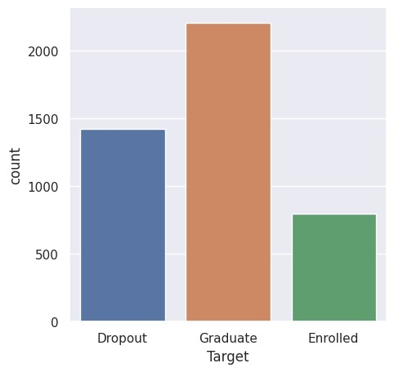
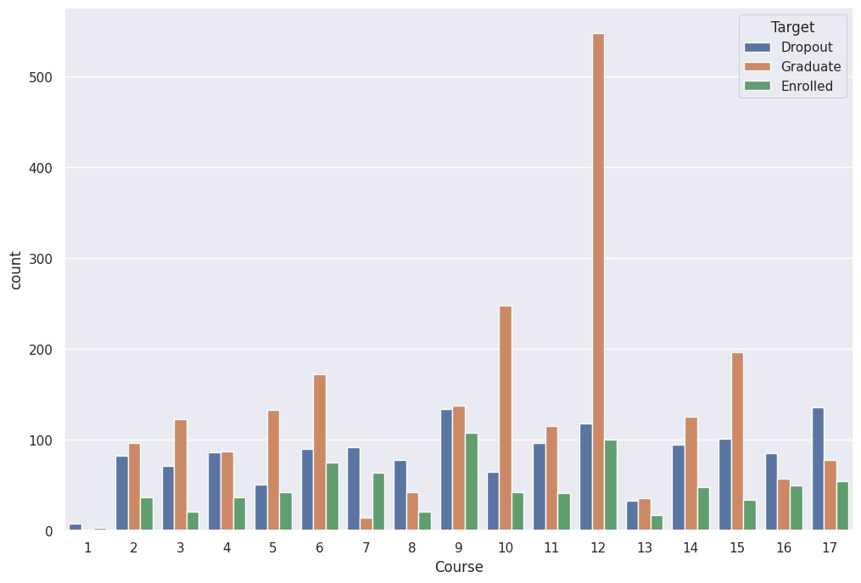
Graphs
Graph of total number of students dropout, graduate and enrolled w.r.t Course
graph of total number of students dropout,graduate and enrolled

Slide 7
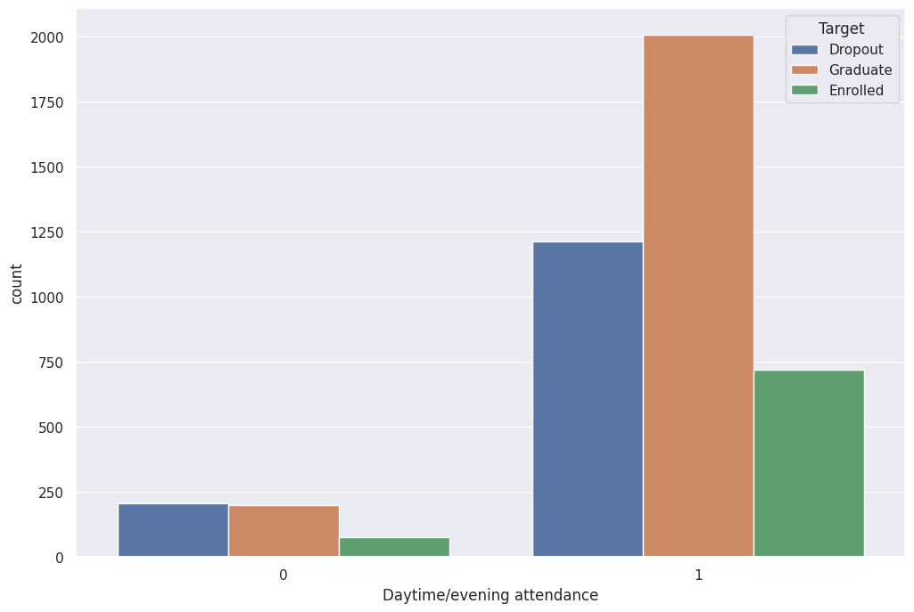
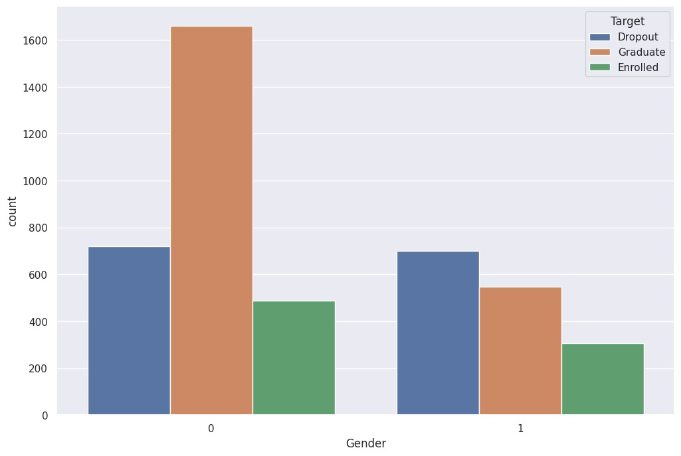
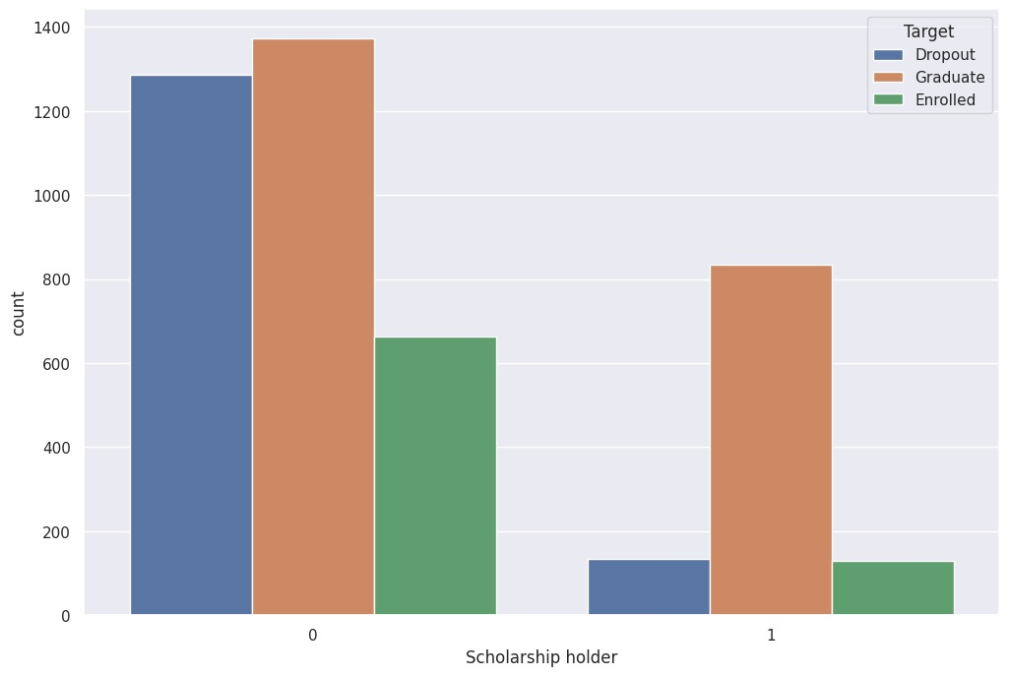
Graph of total number of students dropout, graduate and enrolled w.r.t Gender
Graph of total number of students dropout, graduate and enrolled w.r.t Scholarship Holder
Graph of total number of students dropout, graduate and enrolled w.r.t attendance

Slide 8
Machine Learning Model
The Machine learning models used in this project are:
1)Logistic Regression
2)Perceptron learning
3)Support vector machine
4)K-Nearest neighbour

Slide 9
Logistic Regression
Logistic regression is a binary classification algorithm in machine learning. It models the relationship between a set of input features and a binary output, typically representing two classes. It uses a logistic function to predict the probability of an input belonging to the positive class. If this probability exceeds a threshold (usually 0.5), the input is classified as the positive class; otherwise, it's classified as the negative class. The model is trained by adjusting its parameters to minimize the difference between predicted probabilities and actual class labels in the training data, making it a fundamental tool for classification tasks.

Slide 10
Perceptron learning
Perceptron learning is a binary linear classification algorithm in machine learning. It aims to separate two classes by finding a hyperplane in feature space. It iteratively updates weights based on misclassified examples, moving the hyperplane closer to correct classification. This continues until all examples are correctly classified or a predefined limit is reached. While simple and effective for linearly separable data, perceptrons have limitations for more complex patterns. Multi-layer perceptrons (neural networks) address these limitations by stacking perceptrons in layers, enabling them to learn complex relationships in data.

Slide 11
Support Vector Machine (SVM)
A Support Vector Machine (SVM) is a powerful machine learning model used for classification and regression tasks. It works by finding the optimal hyperplane that best separates different classes of data points, maximizing the margin between them. SVMs are known for their versatility and ability to handle both linear and non-linear datasets through various kernel functions. This model is widely used in applications like image classification, text categorization, and bioinformatics due to its ability to make accurate predictions while minimizing overfitting. SVMs are favored for their robust performance and interpretability, making them a valuable tool in the field of machine learning.

Slide 12
Ridge Regression
Ridge Regression is an adaptation of the popular and widely used linear regression algorithm. It enhances regular linear regression by slightly changing its cost function, which results in less overfit models.

Slide 13
Lasso Regression
LASSO regression, also known as L1 regularization, is a popular technique used in statistical modeling and machine learning to estimate the relationships between variables and make predictions.

Slide 14
KNN
KNN is a simple, supervised machine learning (ML) algorithm that can be used for classification or regression tasks - and is also frequently used in missing value imputation. It is based on the idea that the observations closest to a given data point are the most "similar" observations in a data set, and we can therefore classify unforeseen points based on the values of the closest existing points. By choosing K, the user can select the number of nearby observations to use in the algorithm.

Slide 15
Conclusion
The student dropout and academic success prediction dataset holds significant potential for improving educational outcomes and reducing dropout rates. By leveraging machine learning models and data-driven insights, we can identify at-risk students early, enabling timely interventions and tailored support systems. This dataset not only aids in understanding the complex factors influencing student success but also empowers educators and policymakers to implement proactive measures. With the right strategies and predictive tools, we can strive towards fostering a more inclusive, equitable, and successful educational environment for all students, ultimately contributing to their brighter futures and the overall betterment of society.

Slide 16
GITHUB LINK:
https://github.com/2203A52076/2203A52076-Student-dropout-and-academic-success-prediction-review-2-.git

Slide 17

THANK

