Slide 1
superconductivity data
Presented By:
GUNDELLI ABHICHANDAN
2203A52089
To:
Ramesh Dadi
Faculty of STATML

Slide 2
INTRODUCTION
Problem statement:
By using these data set we can predict the critical temperature based on the features extracted.
This data set contains 81 features extracted from 21263 superconductors along with the critical temperature in the 82nd column The goal here is to predict the critical temperature based on the features extracted.

Slide 3
DATA OVERVIEW
Material Information:
Material Composition: The chemical composition of each material, including the type and proportion of elements or compounds present.
Crystal Structure: Details about the crystalline structure of the material, which can include information about the unit cell, lattice parameters, and space group.
Material Properties:
Physical Properties: Various physical properties of the material, such as density, melting point, thermal conductivity, and specific heat capacity.
Electrical Properties: Electrical characteristics, including resistivity, electrical conductivity, and electron mobility.

Slide 4
Superconductivity-related Data:
Critical Temperature (Tc): The critical temperature at which the material exhibits superconducting behavior.
Critical Magnetic Field (Hc): The critical magnetic field strength at which superconductivity is suppressed.
Superconducting Transition: Information about the transition from a normal state to a superconducting state, including transition width.
Experimental Observations:
Experimental Conditions: Details about the experimental conditions under which superconductivity was observed, such as temperature, pressure, and magnetic field strength.
Measurement Techniques: Information on the methods and instruments used to measure superconducting properties.

Slide 5
Labels or Target Variables:
Superconductivity Labels: Binary labels indicating whether each material is a superconductor (1) or not (0) based on experimental observations.
Machine Learning and Analysis Metadata:
Splitting and Partitioning: Information on how the dataset is split into training, validation, and test sets for machine learning.
Feature Importance: Results of feature importance analysis, indicating which features are most relevant for predicting superconductivity.
Model Performance Metrics: Metrics such as accuracy, precision, recall, F1-score, and ROC curves for evaluating machine learning models.

Slide 6
IMPLEMENTATION
Linear Regression
Support Vector Machine

Slide 7
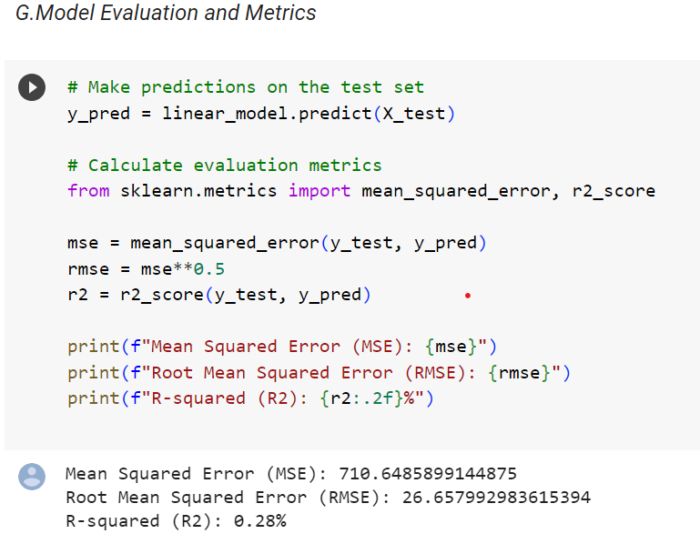
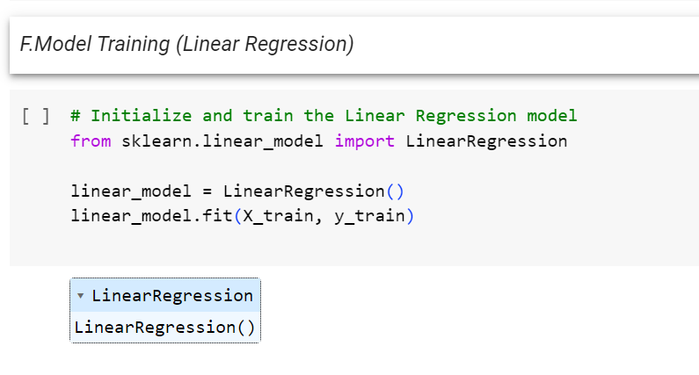
LINEAR REGRESSION

Slide 8
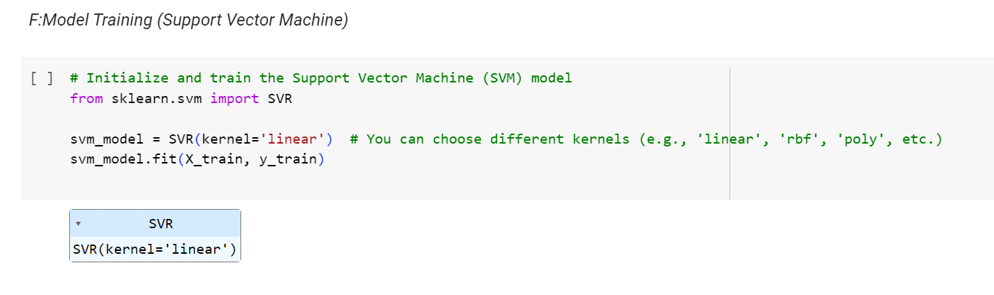
SUPPORT VECTOR MACHINE

Slide 9
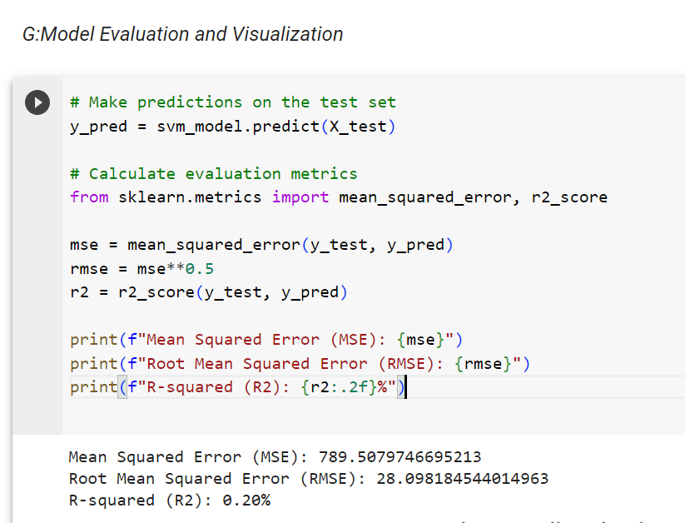
SVM Model Evaluation

Slide 10
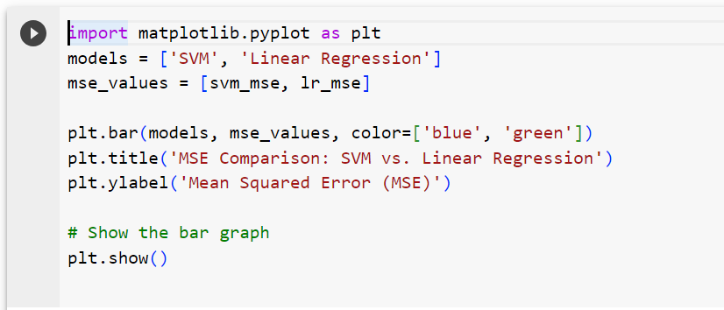
PERFORMANCE COMPARISON

Slide 11
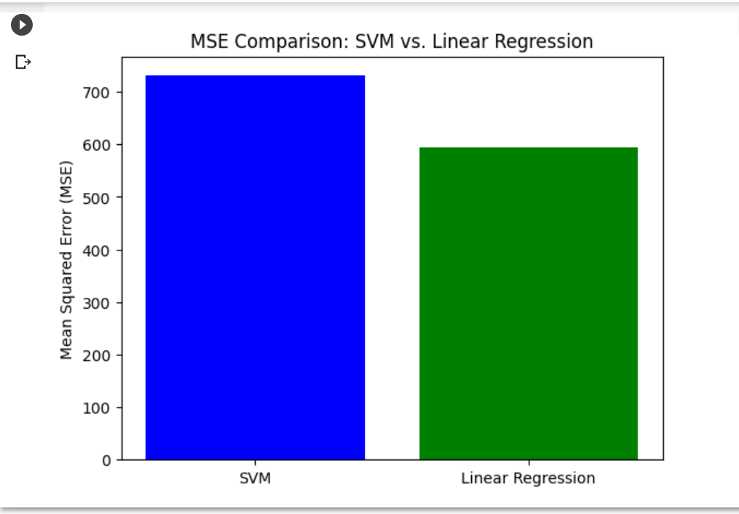
PERFORMANCE VISUALISATION
Masadi Swetha

Slide 12
GitHub Link:
CONCLUSION
https://github.com/2203A52089/2203A52089_capstone.git

Slide 13
THANK YOU

