Slide 1
OBESITY LEVEL PREDICTION
NAME:V.LASYA
HT.NO:2203A52204

Slide 2
INTRODUCTION:
WHAT IS OBESITY?
Obesity is a complex disease involving having too much body fat. Obesity isn't just a cosmetic concern. It's a medical problem that increases the risk of many other diseases and health problems. These can include heart disease, diabetes, high blood pressure, high cholesterol, liver disease, sleep apnea and certain cancers.
Often, obesity results from inherited, physiological and environmental factors, combined with diet, physical activity and exercise choices.

Slide 3
What are the causes of obesity?
Although there are genetic, behavioral, metabolic and hormonal influences on body weight, obesity occurs when you take in more calories than you burn through typical daily activities and exercise. Your body stores these excess calories as fat.
People with obesity might eat more calories before feeling full, feel hungry sooner, or eat more due to stress or anxiety.
Many people who live in Western countries now have jobs that are much less physically demanding, so they don't tend to burn as many calories at work. Even daily activities use fewer calories, courtesy of conveniences such as remote controls, escalators, online shopping, and drive-through restaurants and banks.

Slide 4
Data set explanation:
This dataset contains information about the obesity classification of individuals. The data was collected from a variety of sources, including medical records, surveys, and self-reported data.
Source:Kaggle
It contains the below columns:
ID: A unique identifier for each individual
Age: The age of the individual
Gender: The gender of the individual
Height: The height of the individual in centimeters
Weight: The weight of the individual in kilograms
BMI: The body mass index of the individual, calculated as weight divided by height squared
Label: The obesity classification of the individual, which can be one of the following:Normal Weight,Overweight,underweight,obese.

Slide 5
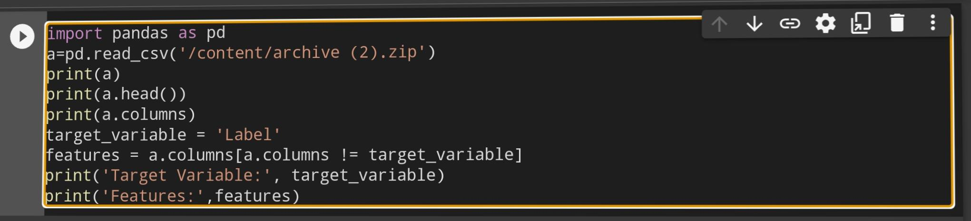
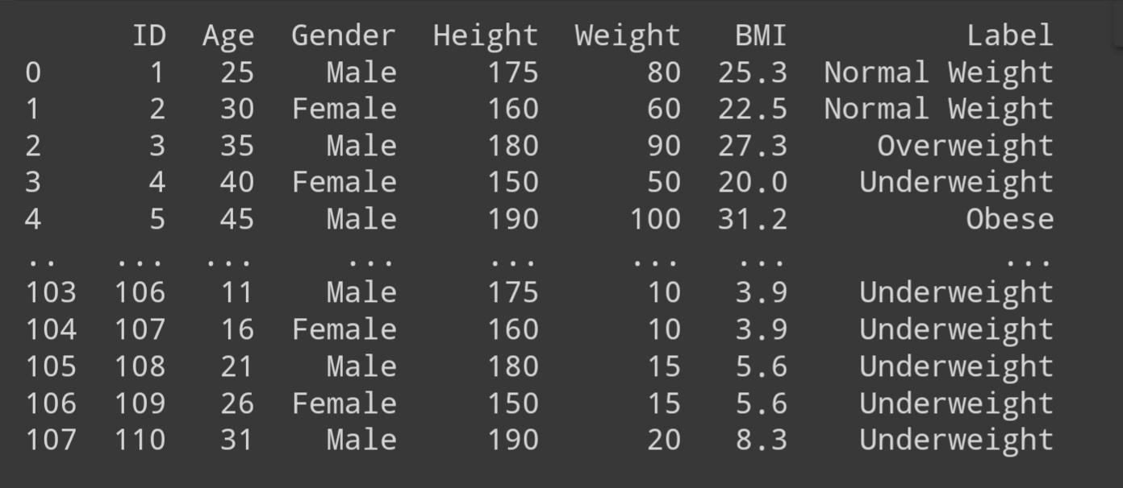

Slide 6
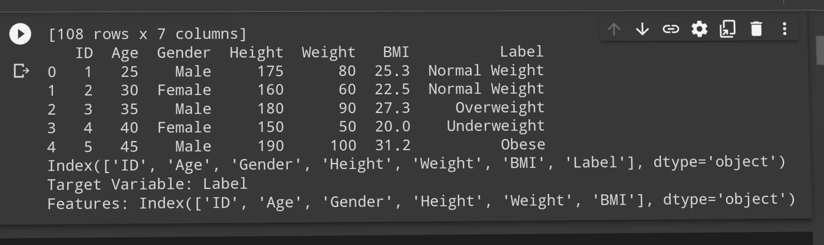
Here the dataset is loaded using pandas library.
We can see that the dataset have features and a target variable.
Features:ID,Age,Gender,Height,Weight,BMI
Target Variable:Label
From the dataset we can see that it is parametric method approach.
The dataset contains categorical values.
So,this is classification.

Slide 7
IMPLEMENTATION:
There are three methods to find the accuracy for the classification dataset.They are:
●Logistic Regression
●Support Vector Machine
●Perception Learning
●K Nearest Neighbour’s
Lastly we apply bootstrapping for these 4 models.

Slide 8
LOGISTIC REGRESSION:
Logistic regression is a classification algorithm, used when the value of the target variable is categorical in nature. It follows parametric method approach.It can be applied for supervised data. Logistic regression is most commonly used when the data in question has binary output, so when it belongs to one class or another, or is either a 0 or 1.
Mathematically, a logistic regression model predicts P(Y=1) as a function of X.
It is one of the simplest ML algorithms that can be used for various classification problems .

Slide 9
SUPPORT VECTOR MACHINE:
Support Vector Machine (SVM) is a powerful and versatile machine learning algorithm primarily used for classification and regression tasks. It's particularly well-suited for both linear and nonlinear classification problems and is known for its ability to find an optimal hyperplane or decision boundary that maximizes the margin between different classes. Here are the key concepts and characteristics of SVM:
Hyperplane: In SVM, the goal in classification is to find a hyperplane that best separates the data points of different classes. This hyperplane is chosen to maximize the margin, which is the distance between the hyperplane and the nearest data points (support vectors) of each class.

Slide 10
Support Vectors: Support vectors are the data points that are closest to the hyperplane and have the smallest margin. They play a critical role in defining the position and orientation of the hyperplane.
Linear and Nonlinear Separation: SVM is effective for linearly separable data, where a straight line (or hyperplane in higher dimensions) can separate the classes. However, SVM can also handle nonlinear data by using techniques like the kernel trick. Kernels allow SVM to transform the original feature space into a higher-dimensional space, where the data becomes linearly separable.

Slide 11
Classification and Regression: SVM is primarily used for classification, where it assigns data points to different classes. However, it can also be used for regression tasks, referred to as Support Vector Regression (SVR), where it finds a hyperplane that best fits the data while minimizing errors.
SVMs are widely used in applications like image classification, text classification, bioinformatics, and many others. They are favored for their ability to handle high-dimensional data, robustness against overfitting, and adaptability to both linear and nonlinear problems. However, tuning SVM hyperparameters, especially for non-linear kernels, can be a complex task.

Slide 12
PERCEPTRON LEARNING:
●Perceptron is a building block of an Artificial Neural Network.
●Perceptron is a linear Machine Learning algorithm used for supervised learning for various binary classifiers.
●This algorithm enables neurons to learn elements and processes them one by one during preparation.
●The perceptron consists of 4 parts.
•Input values or One input layer
Weights and Bias
Net sum
•Activation function

Slide 13
Activation Function: A neuron can be activated or not, is determined by an activation function. The activation function calculates a weighted sum and further adding bias with it to give the result.
The default activation function in perception learning is
Sigmoid function.

Slide 14
K Nearest Neighbours
K-Nearest Neighbors (K-NN) is a simple and intuitive machine learning algorithm used for both classification and regression tasks. It's a type of instance-based learning where the prediction for a data point is based on the majority class (in classification) or the average value (in regression) of its K nearest neighbors in the training dataset.
Here's how it works:
●Choose a value for K, which represents the number of nearest neighbors to consider.
●For a given data point you want to classify or predict, calculate the distance (e.g., Euclidean distance) to all data points in the training set.

Slide 15
●Select the K data points with the shortest distances.
●For classification, assign the class label that is most common among the K nearest neighbors to the data point.
●For regression, calculate the average value of the target variable for the K nearest neighbors and use this as the prediction.
K-NN is a non-parametric and lazy learning algorithm, meaning it doesn't make any assumptions about the underlying data distribution and doesn't build an explicit model during training. Instead, it uses the entire training dataset for prediction.

Slide 16
Boot strapping
Bootstrapping in machine learning refers to a resampling technique that involves creating multiple datasets by randomly sampling the data with replacement from the original dataset. These new datasets, called bootstrap samples, are typically of the same size as the original dataset but may contain duplicate instances and omit some original instances.
The purposes are:
●Bagging(bootstrap Aggregating)
●Random forests
●Estimating uncertainty
●Feature importance

Slide 17
Libraries used:
PANDAS: to load the dataset
MATPLOTLIB.PYPLOT:to implement graphs
SKLEARN.MODEL_SELECECTION:for test and train split
SKLEARN.SVM:for logistic regression in classification
SKLEARN.METRICS:
Accuracy score
Classification report
Confusion matrix
SKLEARN:svm
SKLEARN.LINEAR_MODEL:Perceptron
SKLEARN.NEIGHBORS:knn
SKLEARN.UTILS:resample

Slide 18
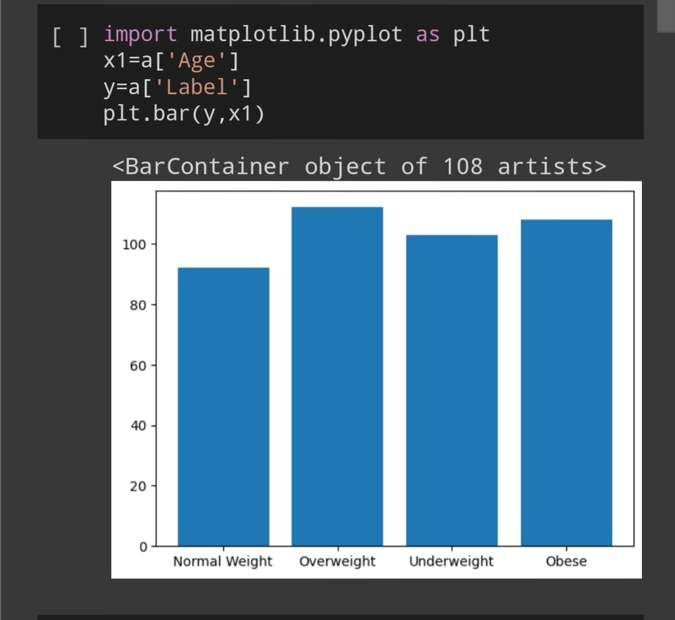

Slide 19
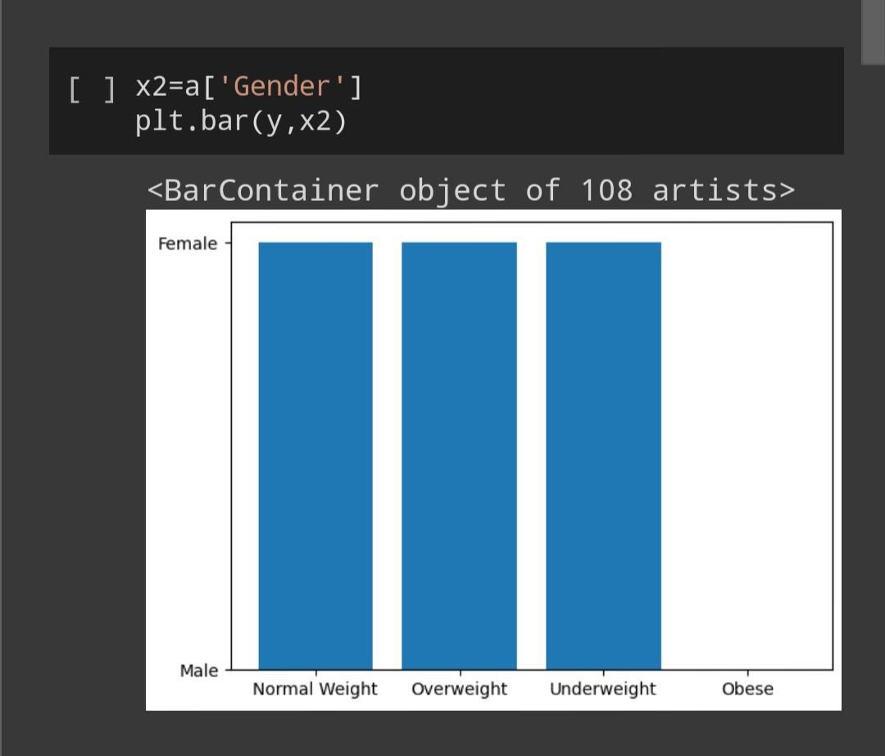

Slide 20
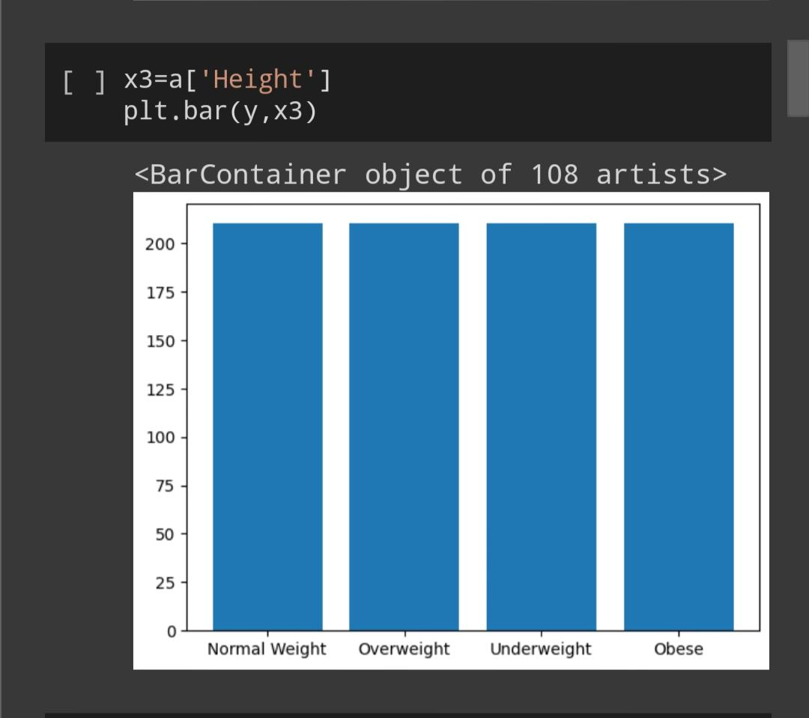

Slide 21
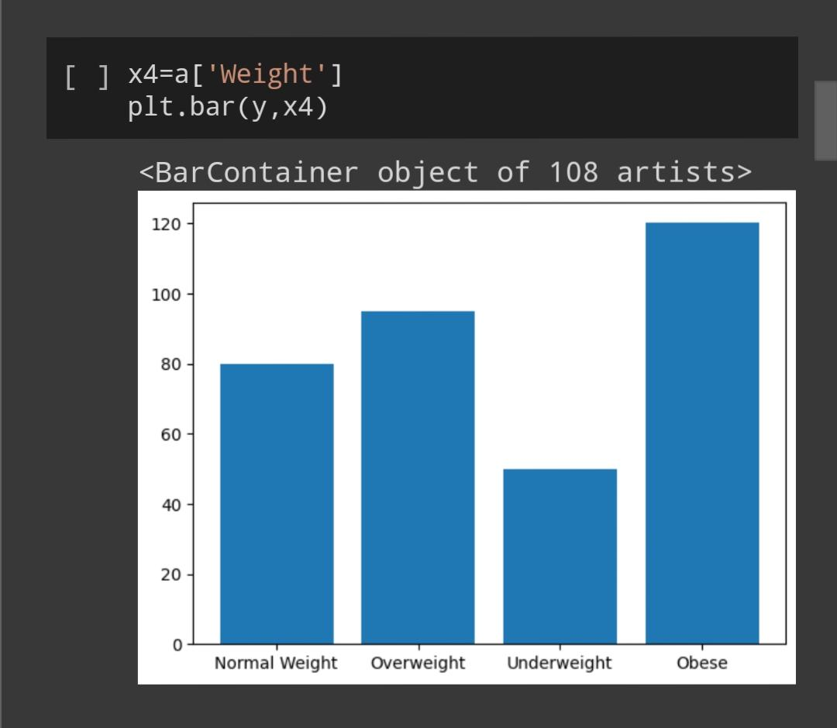

Slide 22
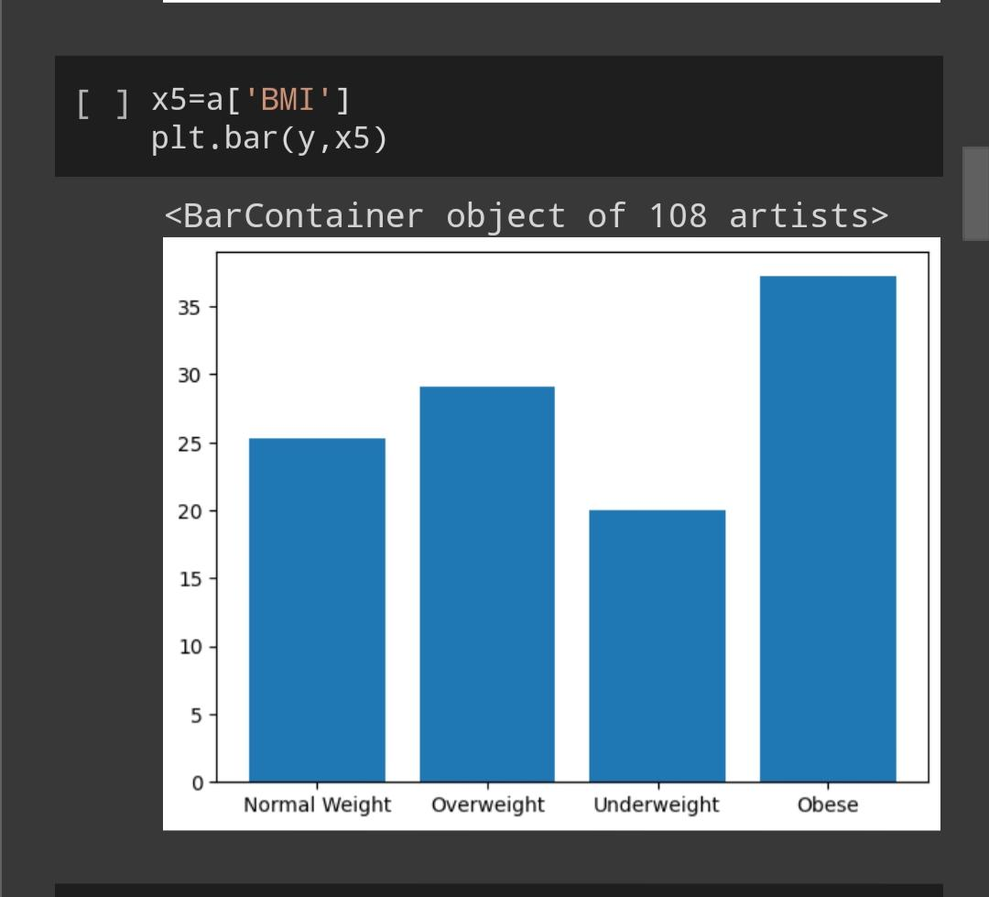

Slide 23
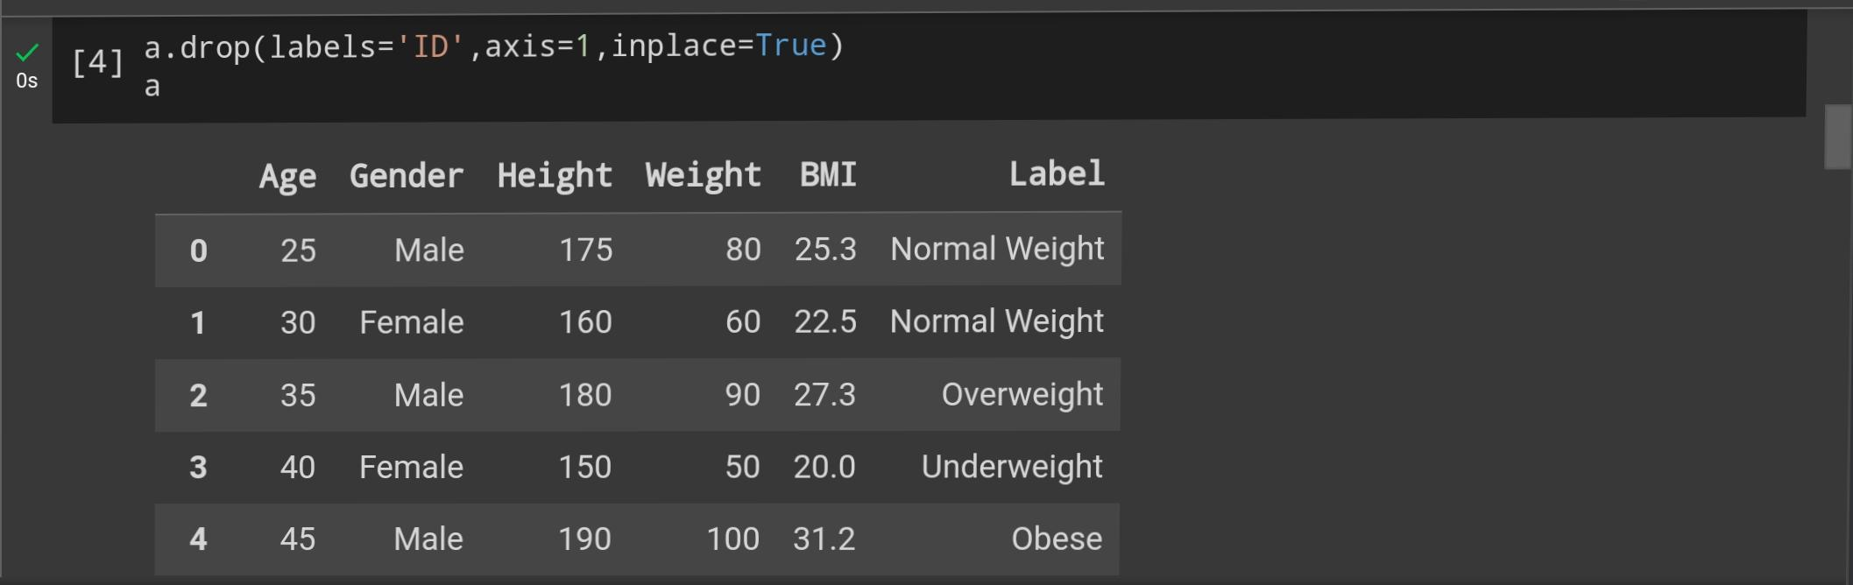
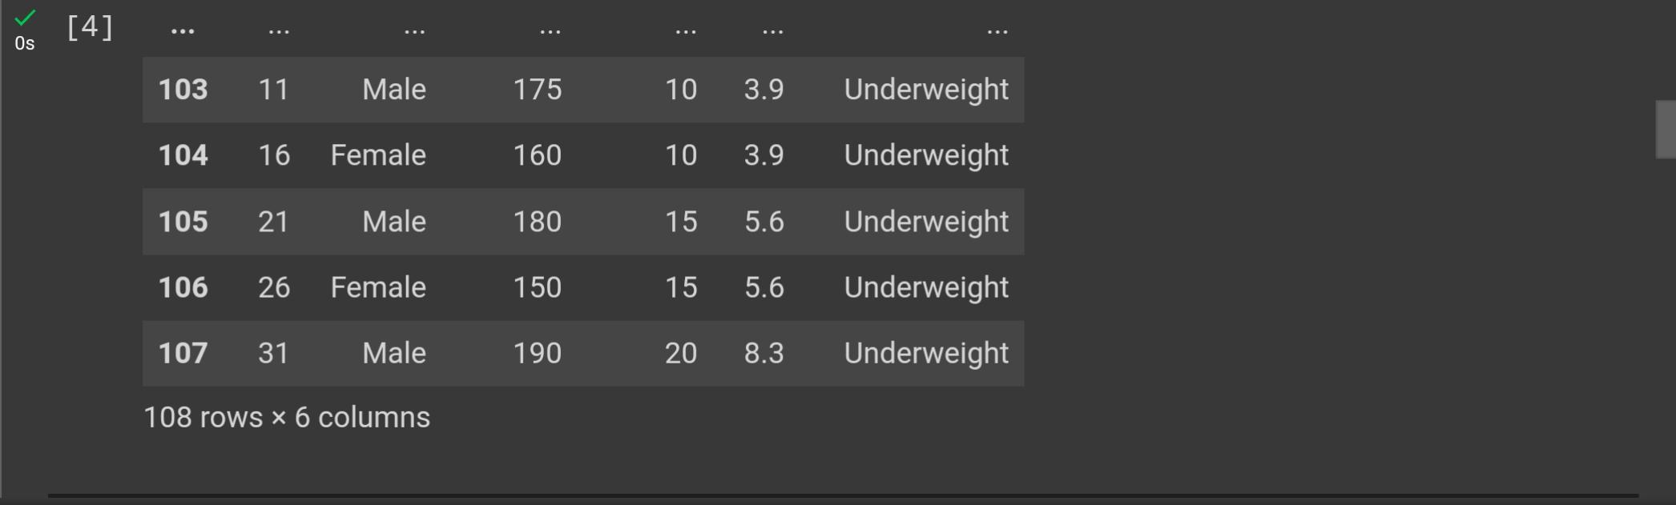

Slide 24
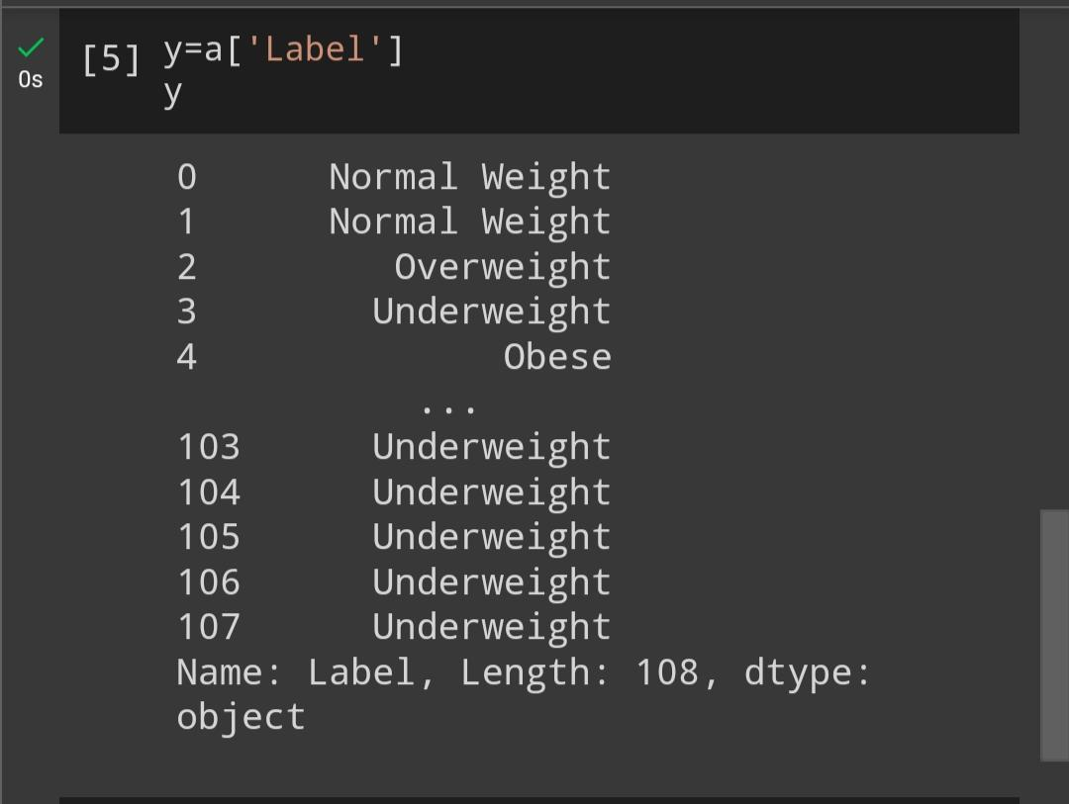

Slide 25
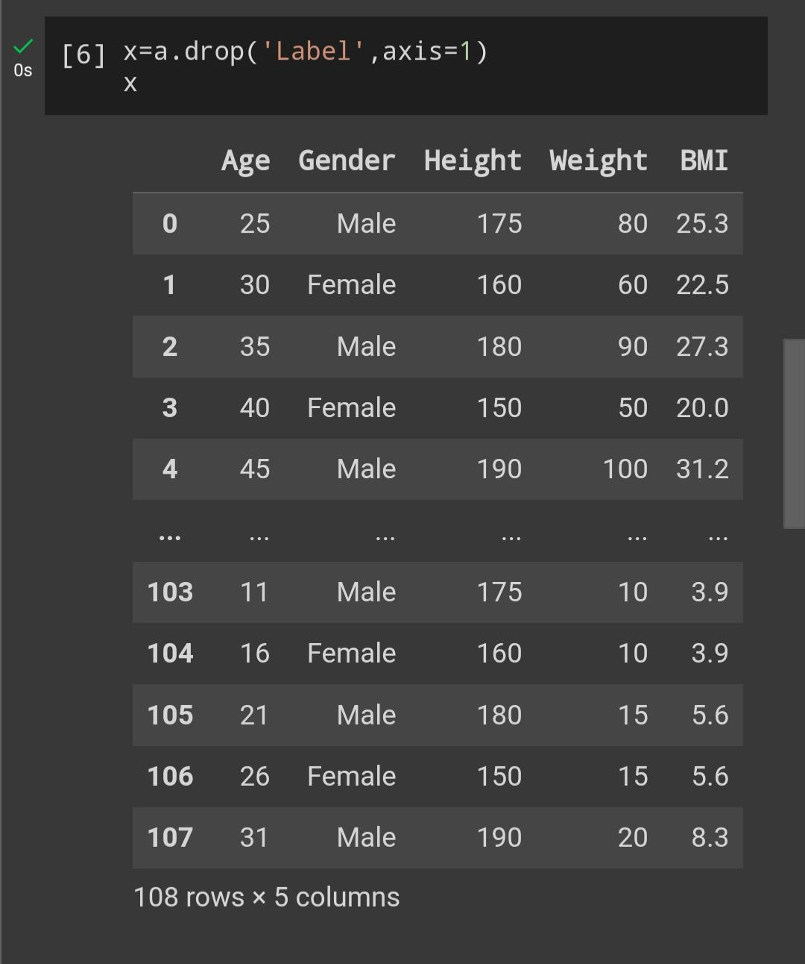

Slide 26
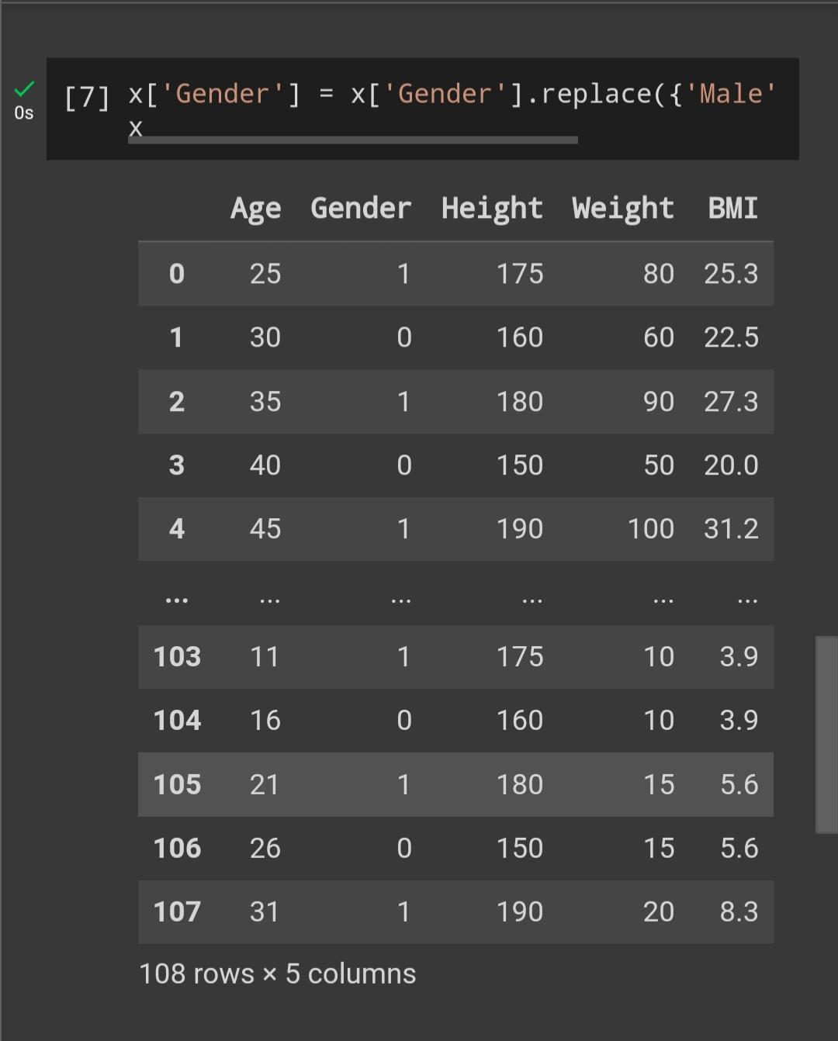

Slide 27
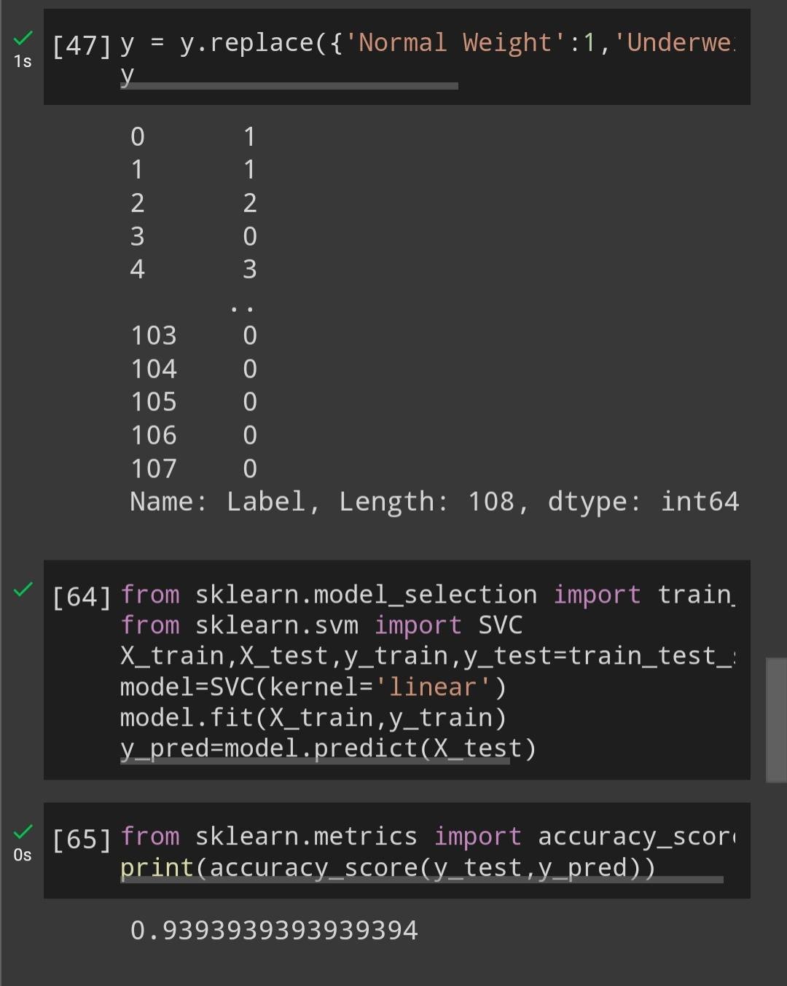

Slide 28
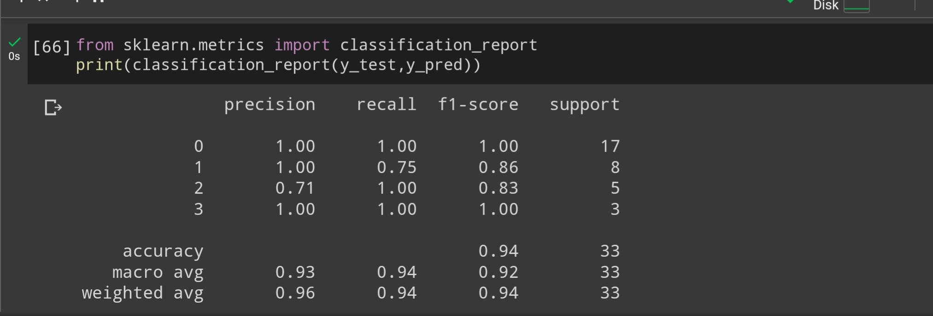

Slide 29
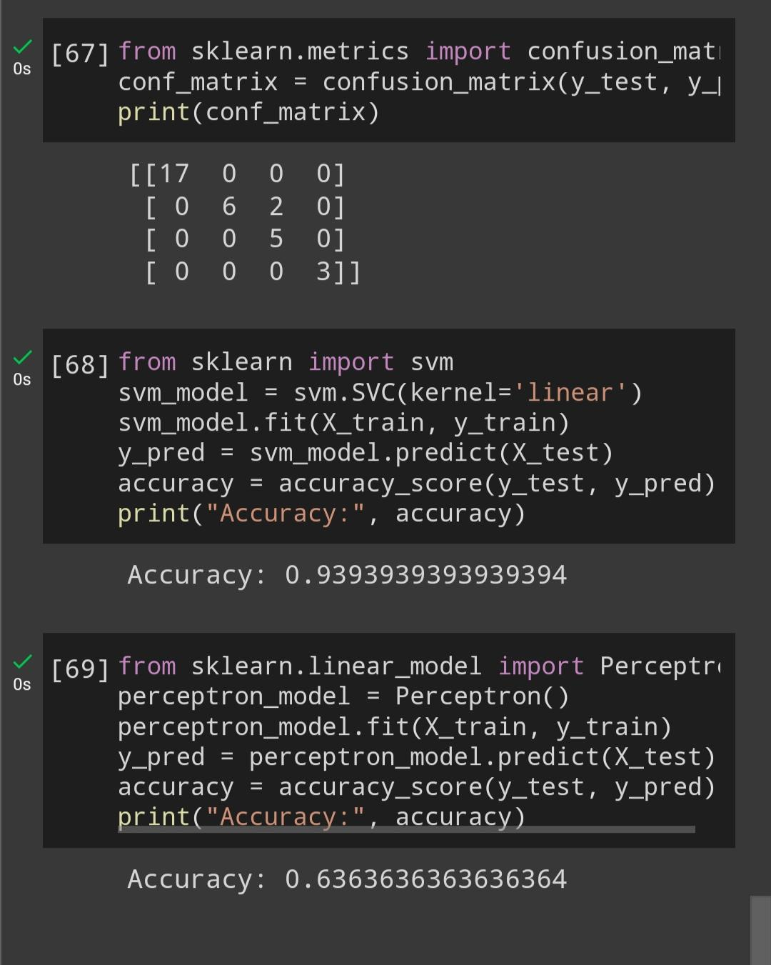

Slide 30
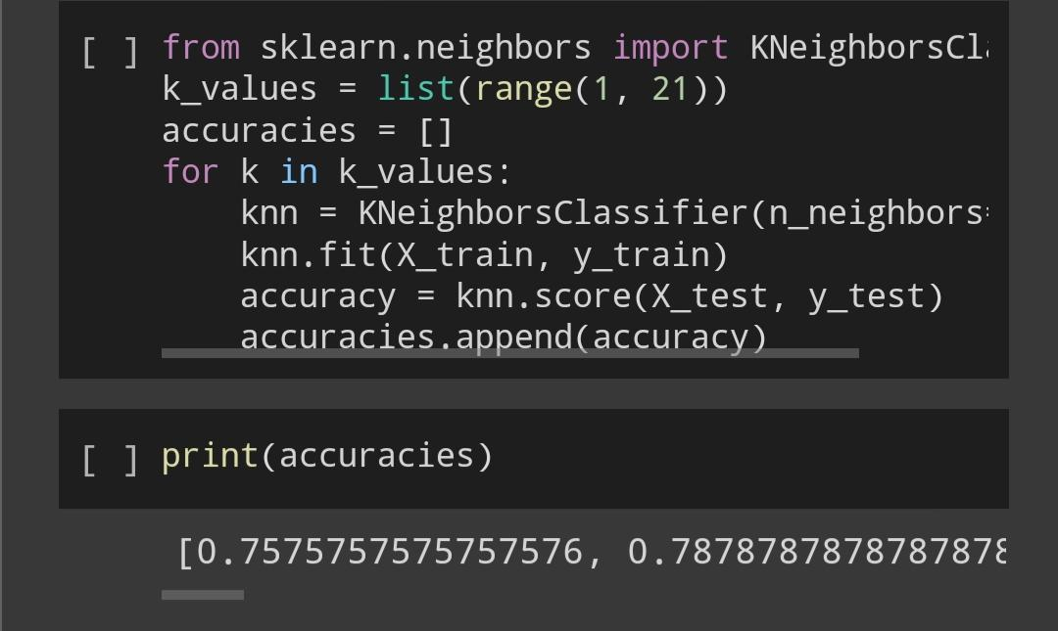
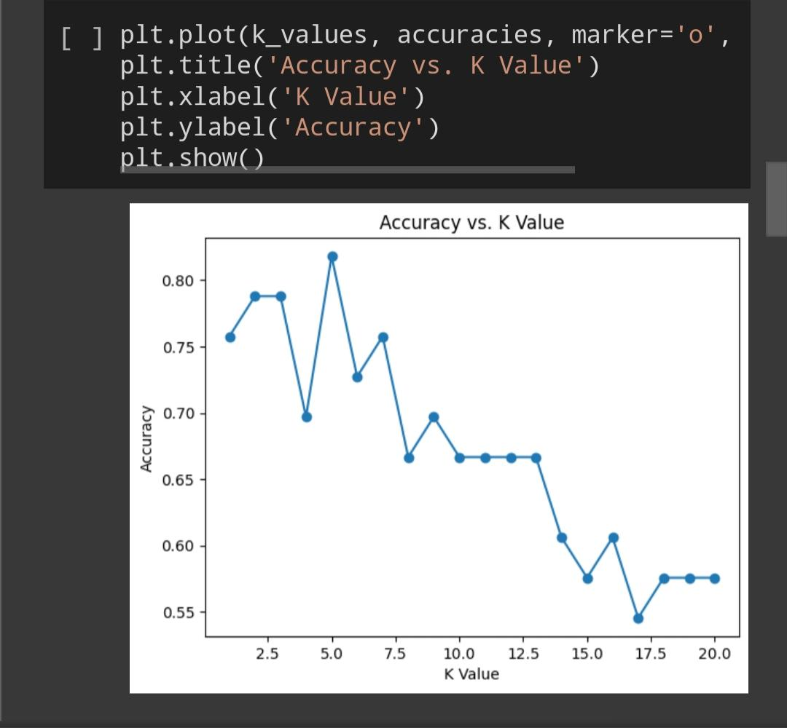

Slide 31
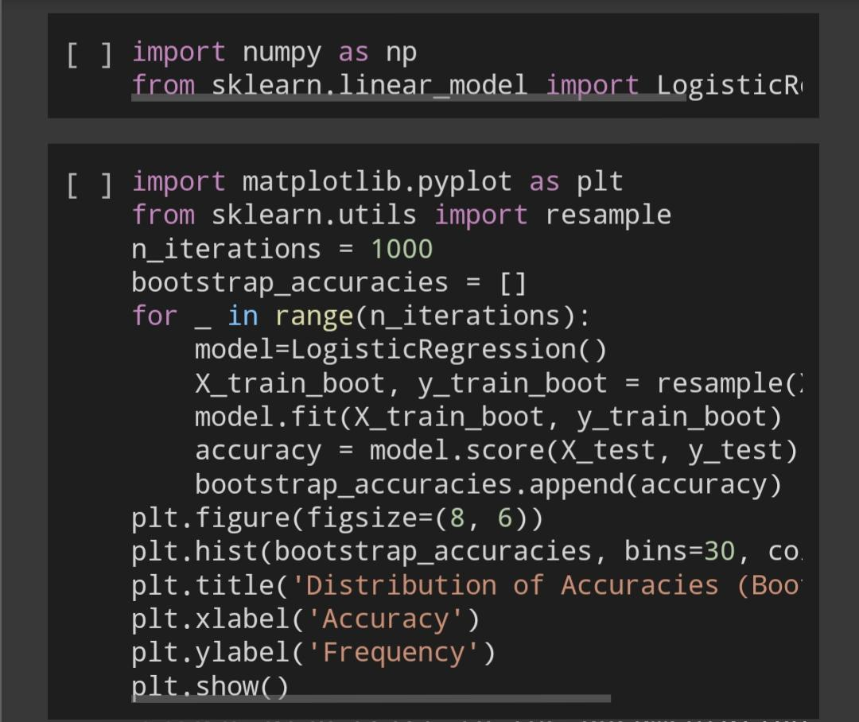
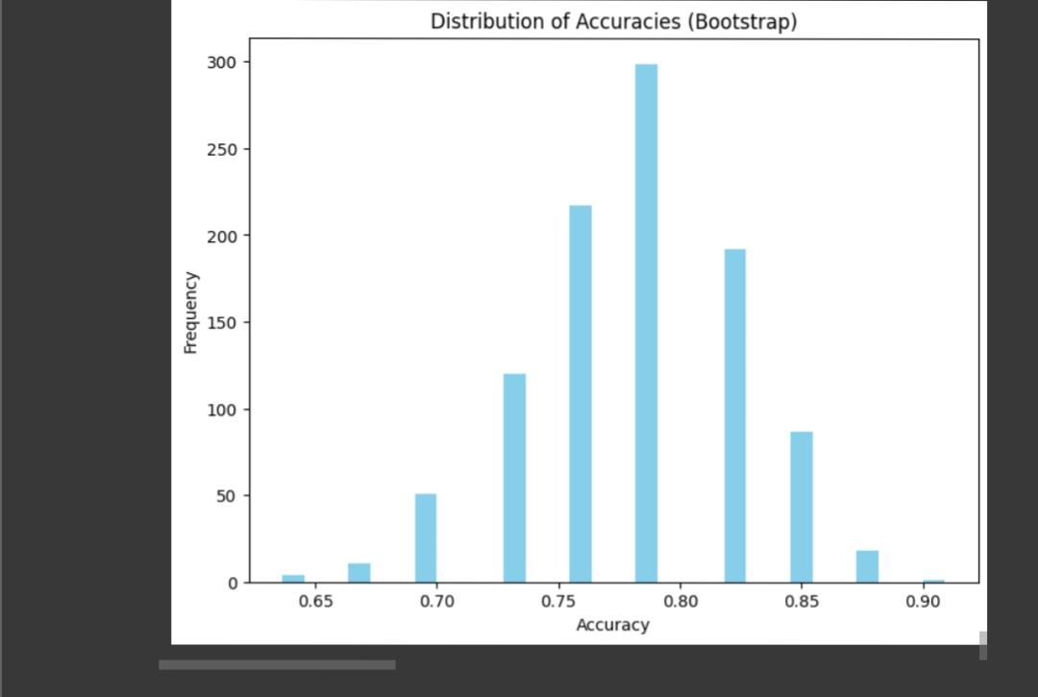

Slide 32
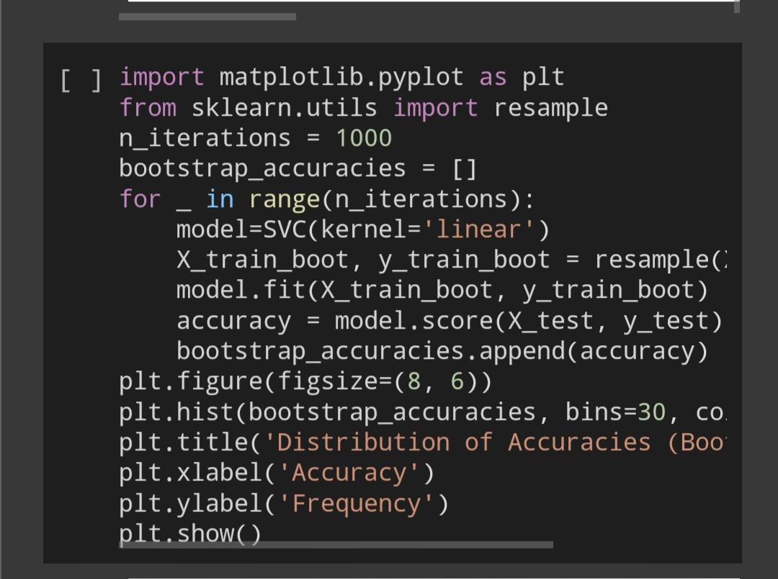
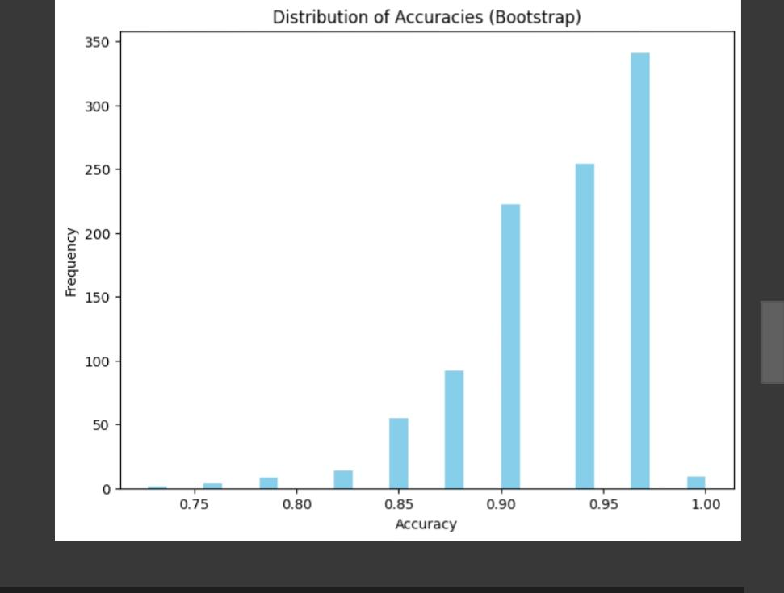

Slide 33
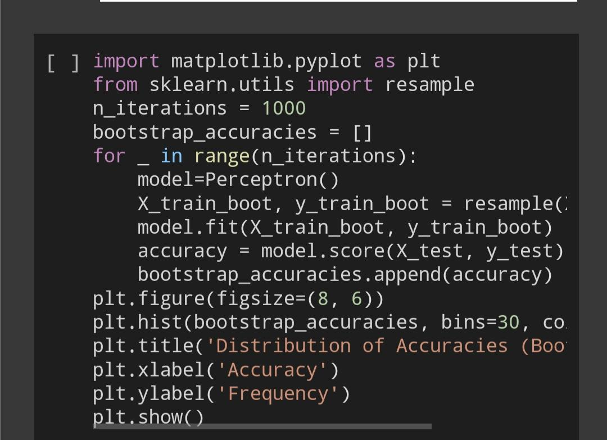
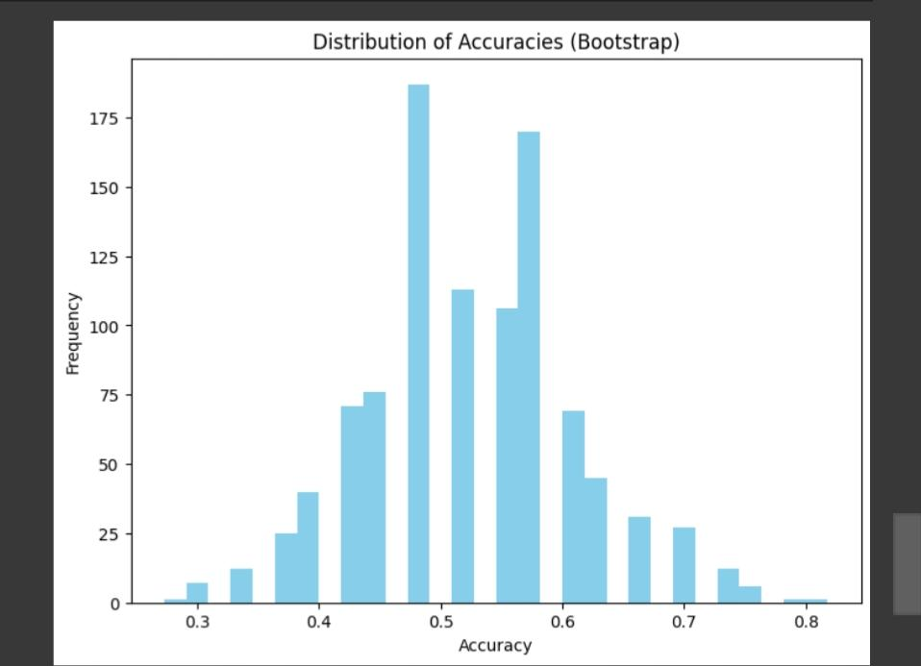

Slide 34
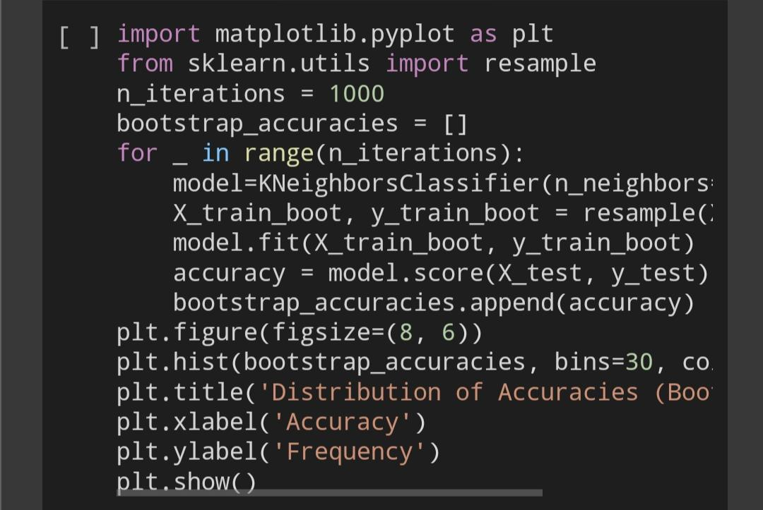
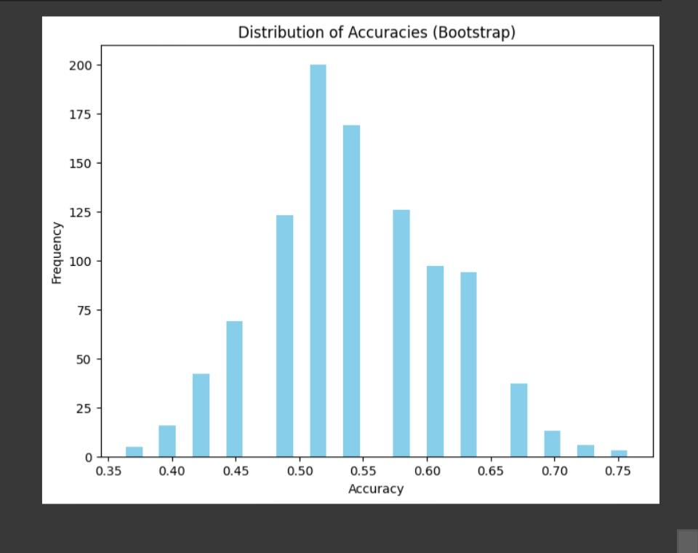

Slide 35
RESULT ANALYSIS:
Comparison of the results from different sources:
My results:
LOGISTIC REGRESSION:0.9393939393939394
SUPPORT VECTOR MACHINE:0.9393939393939394
PERVEPTRON LEARNING:0.6363636363636364
SOURCE1:
LOGISTIC REGRESSION:0.9696969696969697
SUPPORT VECTOR MACHINE:0.9696969696969697
PERVEPTRON LEARNING:0.66666666666666

Slide 36
SOURCE2:
LOGISTIC REGRESSION:0.9696969696969697
SUPPORT VECTOR MACHINE:0.9696969696969697
PERVEPTRON LEARNING:0.6363636363636364
SOURCE3:
LOGISTIC REGRESSION:0.764705882329411
SUPPORT VECTOR MACHINE:0.8235294117647058
PERVEPTRON LEARNING:0.4117647058823529

Slide 37
SOURCE4:
LOGISTIC REGRESSION:0.912281
SUPPORT VECTOR MACHINE:0.905261
PERVEPTRON LEARNING:0.434344
SOURCE5:
LOGISTIC REGRESSION:0.9090909090909091
SUPPORT VECTOR MACHINE:0.9090909090909091
PERVEPTRON LEARNING:0.5353535353535354

Slide 38
CONCLUSION:
The Accuracies obtained are:
LOGISTIC REGRESSION:0.9393939393939394
SUPPORT VECTOR MACHINE:0.9393939393939394
PERVEPTRON LEARNING:0.6363636363636364
K-NEAREST NEIGHBOUR:k=5 is the most accurate value for this dataset.

Slide 39
GITHUB LINK:
https://github.com/2203A52204/statml_poject

