Slide 1
Machine Learning Project
Heart attack analysis & prediction
V. Shashidhar| CSE(AI&ML) | 2203A52063
Under the Guidance of
~Ramesh sir

Slide 2
Agenda :
What is Machine learning?
Introduction
Procedure
Perceptron & SVM
KNN
Applying Bootstrapping method
conclusion
Summary

Slide 3
INTRODUCTION :
Heart attack prediction using machine learning is a groundbreaking application that leverages artificial intelligence to enhance early detection and prevention of cardiovascular events.
With heart disease being a leading cause of mortality worldwide, the development of predictive models is of paramount importance. Machine learning algorithms can analyze a multitude of patient data, including medical history, vital signs, and lifestyle factors, to identify individuals at high risk of experiencing a heart attack.
Impact By providing timely insights, these predictive models empower healthcare professionals to take proactive measures, thus potentially saving lives and reducing the burden of cardiovascular diseases on healthcare systems and individuals alike. This emerging field holds great promise in revolutionizing cardiac care and promoting better health outcomes.

Slide 4
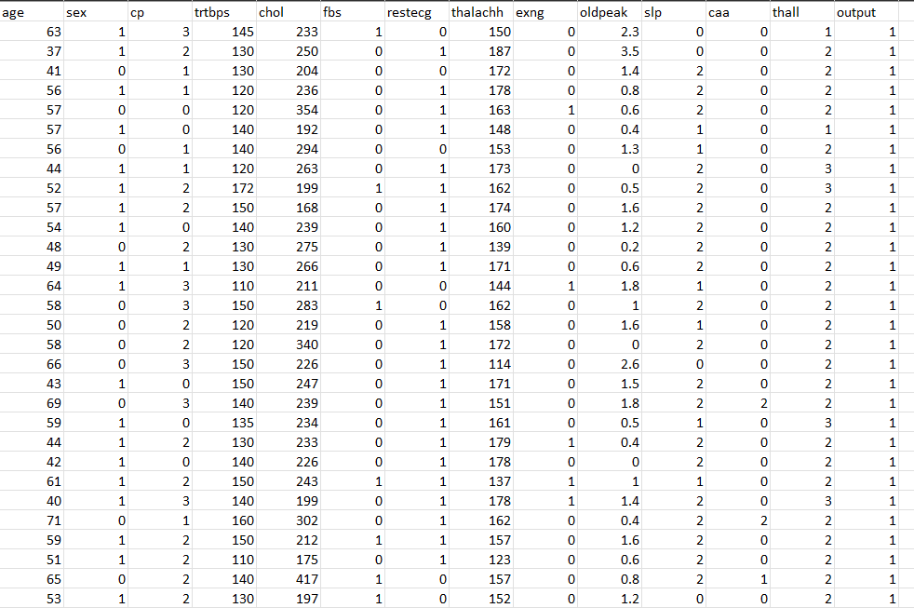
DATASET:

Slide 5
Procedure:
Preprocessing
Identify Features and target variables
Training and Testing
Accuracy

Slide 6
Logistic Regression :
Logistic regression is a statistical technique used for binary classification, where the goal is to predict one of two possible outcomes. It models the probability of one of the outcomes using a logistic (sigmoid) function, with learned coefficients based on input features, and then classifies new data points by comparing this probability to a threshold. It's widely applied in various fields, such as spam detection and medical diagnosis, due to its simplicity and effectiveness in solving binary decision problems.

Slide 7
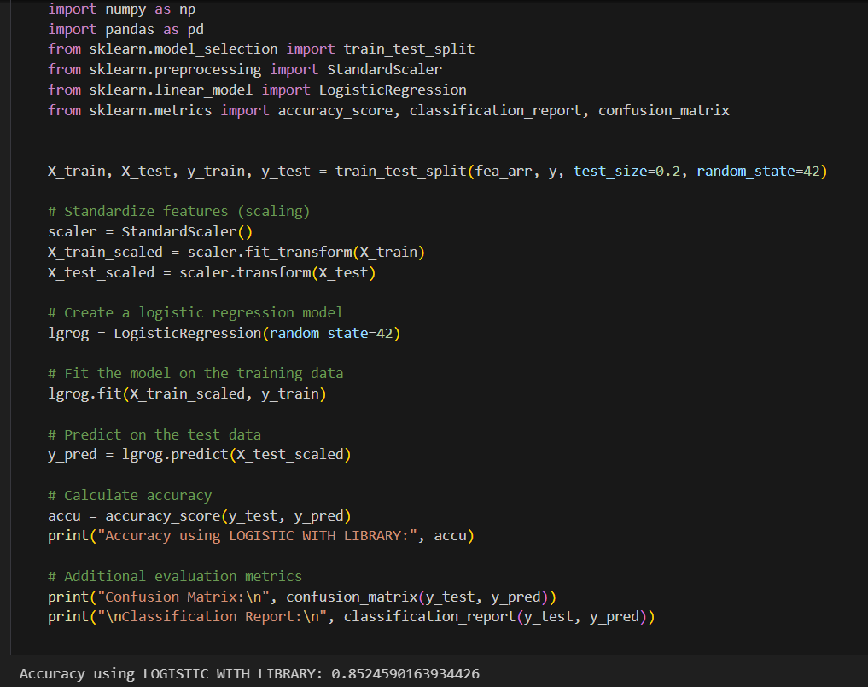
Accuracy
Logistic Regression

Slide 8
Support Vector Machine :
A Support Vector Machine (SVM) is a powerful machine learning algorithm used for both classification and regression tasks. SVM's primary goal in classification is to find a hyperplane that maximally separates data points from different classes while also maintaining the largest possible margin, essentially acting as a decision boundary. It aims to identify the support vectors, which are the data points closest to this boundary. SVM can handle both linear and nonlinear datasets by using different kernel functions, making it versatile in solving complex classification problems. Its ability to find robust decision boundaries and handle high-dimensional data has made it popular in applications such as image recognition, text classification, and bioinformatics.

Slide 9
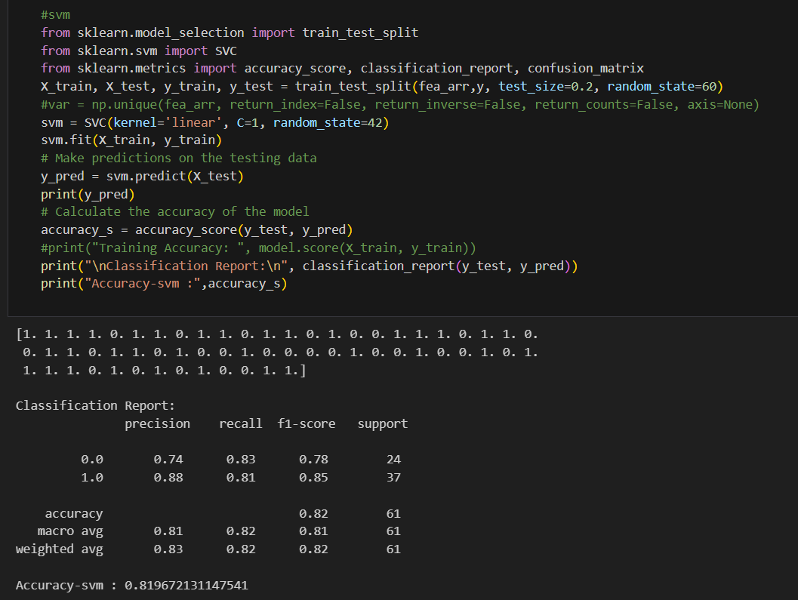
SVM

Slide 10
Perceptron Learning :
The perceptron learning algorithm is one of the simplest forms of supervised machine learning algorithms used for binary classification. It is a type of linear classifier that finds a linear decision boundary to separate two classes in feature space. The perceptron takes a set of input features, assigns weights to them, and computes a weighted sum. If the sum exceeds a certain threshold, the perceptron predicts one class; otherwise, it predicts the other class. During training, the algorithm adjusts the weights based on misclassified data points to iteratively improve the decision boundary. While the perceptron is straightforward and efficient, it has limitations and cannot handle problems that are not linearly separable. More advanced techniques like support vector machines and neural networks are often preferred for complex tasks.

Slide 11
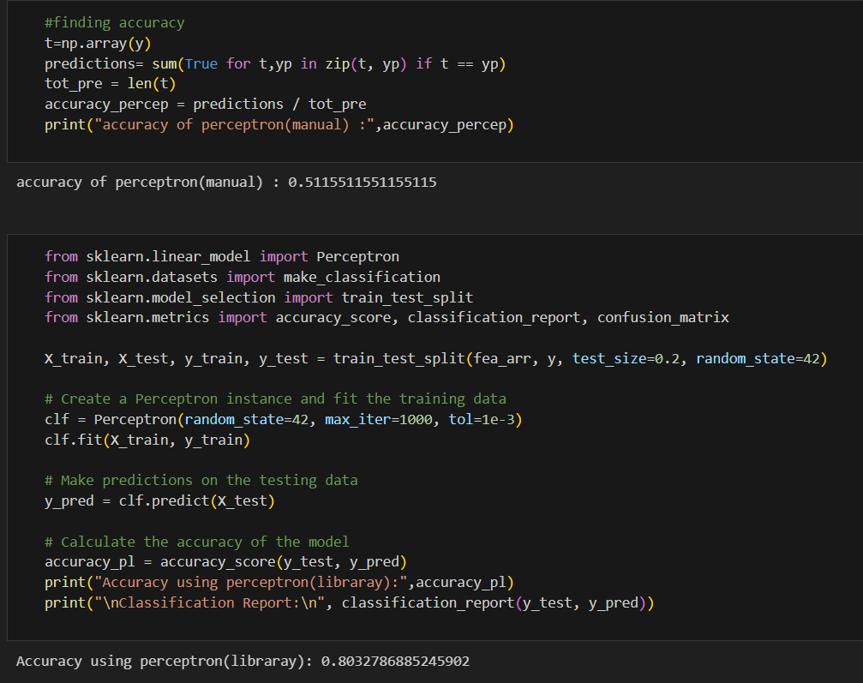
Perceptron Learning

Slide 12
KNN with Bootstrap :
K-Nearest Neighbors (KNN) with bootstrap is a technique that enhances the robustness and stability of KNN classification or regression models. By resampling the training data with replacement, multiple KNN models are trained on different subsets of the data, reducing variance and improving generalization. The ensemble of these models often results in more reliable and accurate predictions, though it comes at the cost of increased computational complexity.

Slide 13
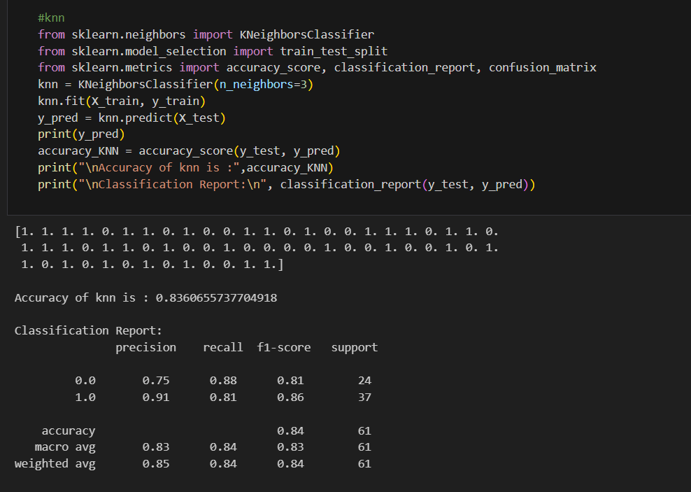
KNN

Slide 14
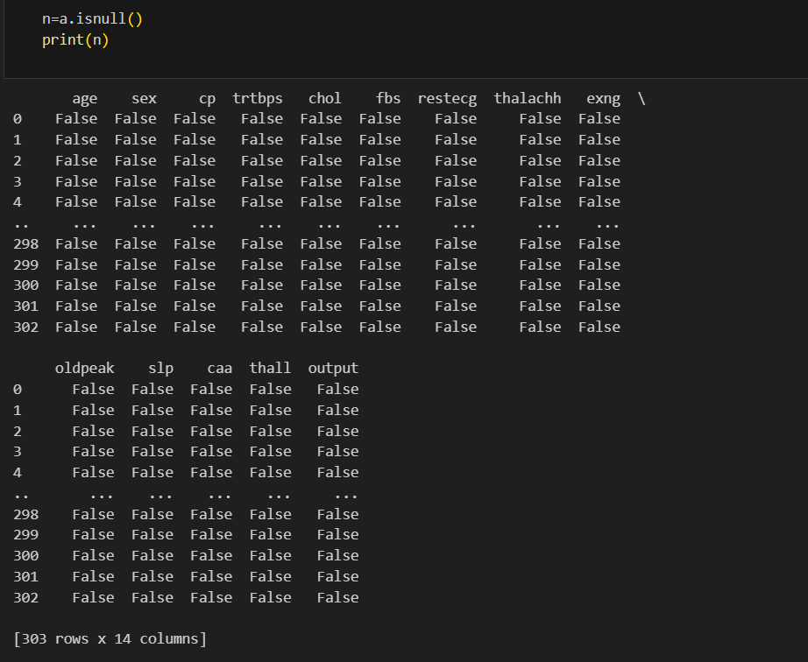
Preprocessing

Slide 15
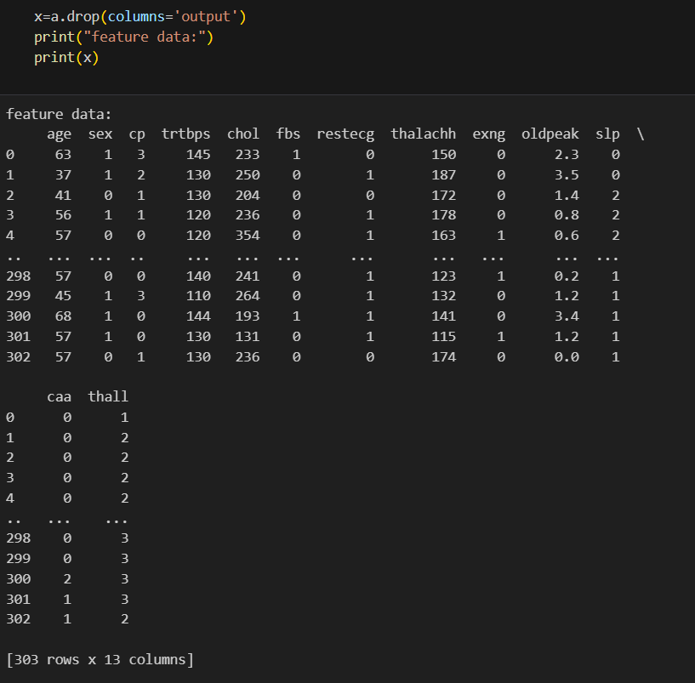
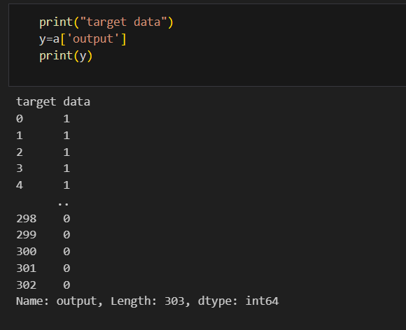
Identify Features and target variables

Slide 16
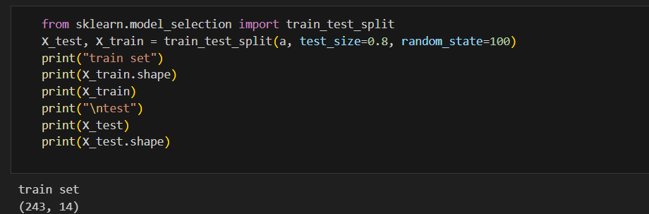
Training and Testing

Slide 17
Bootstrapping

Slide 18
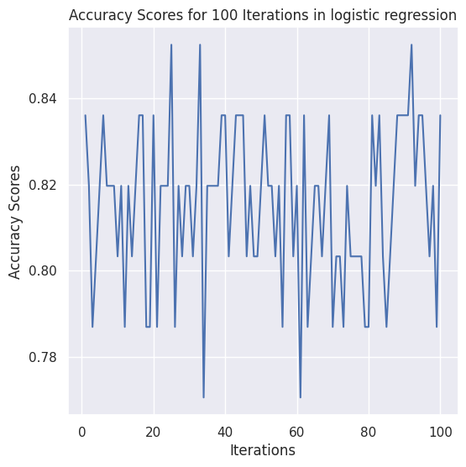
Logisitc Regression

Slide 19
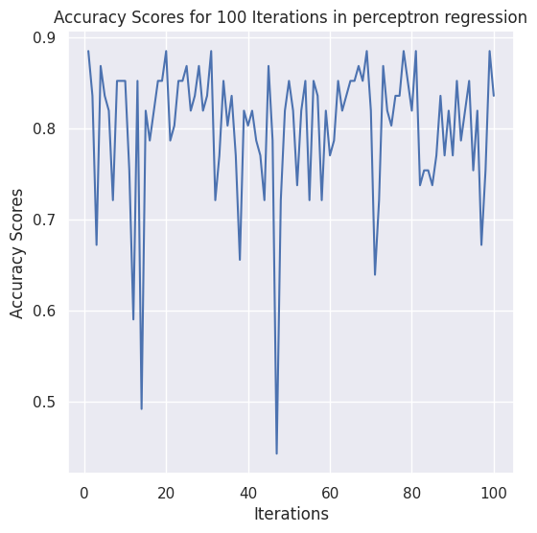
Perceptron Learning

Slide 20
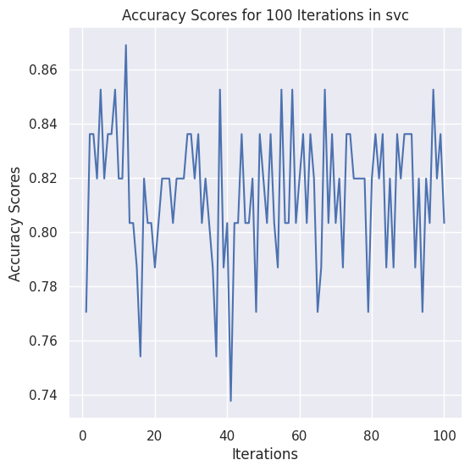
SVM

Slide 21
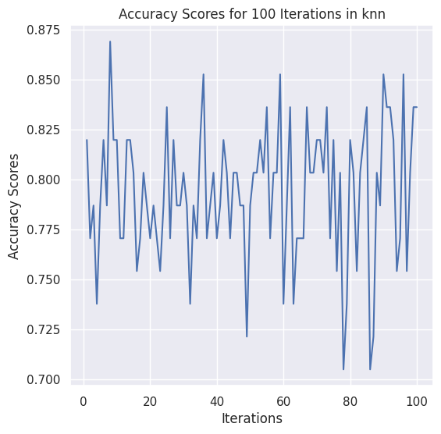
KNN

Slide 22
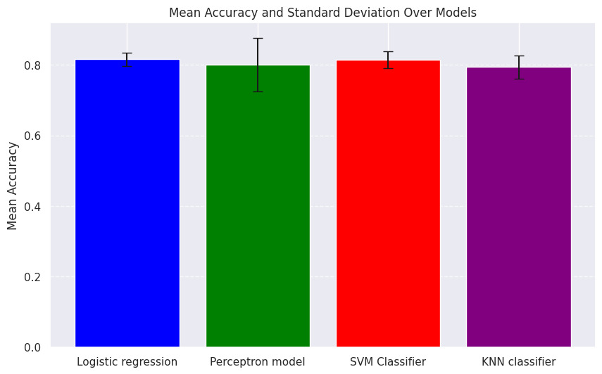
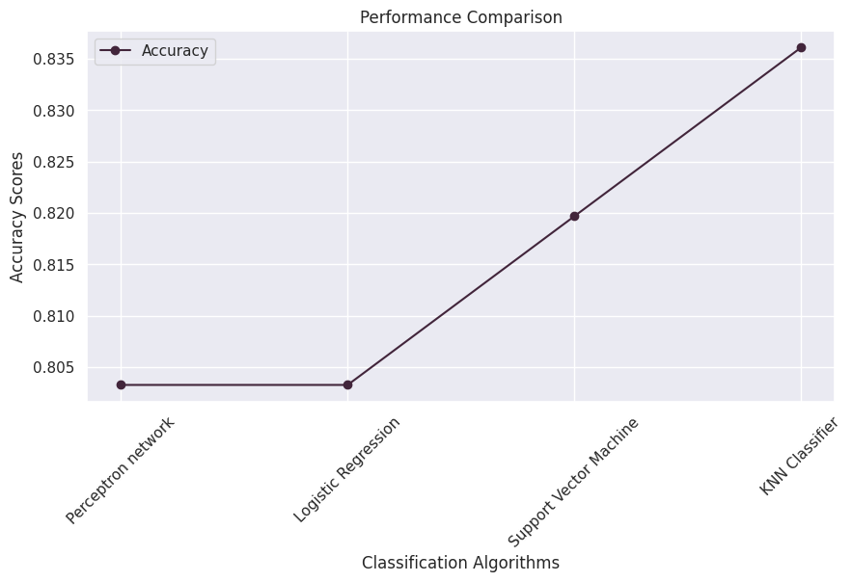
Comparison of all Bootstrapping Models
Before Bootstrap
After Bootstrap

Slide 23
Conclusion -
Perceptron stands out of all models with a good accuracy, KNN is least performed. SVM and logistic are moderate with accuracy. So Logistic regression performs well in finding out Heart attack analysis prediction

Slide 24
Summary -
This model comes under supervised learning because it has labelled data.
The target variable has categorical data
So, it comes under classification
Under classification we can do logistic regression, perceptron learning,support vector machine,K-Nearest Neighbors (KNN)
By Training & Testing data then,We find Accuracy.
We apply Bootstrapping method to all the models in order to find the performance and stability.
Finally, we conclude that from all models Logistic Regression is concluded as the best model with good accuracy

Slide 25
Thankyou!
Thank You!

