Slide 1

Evaluation of NotebookLM for Educational Use
Key Functionalities and Practical Demonstrations
Vanessa Dmello
07-11-2024

Slide 2
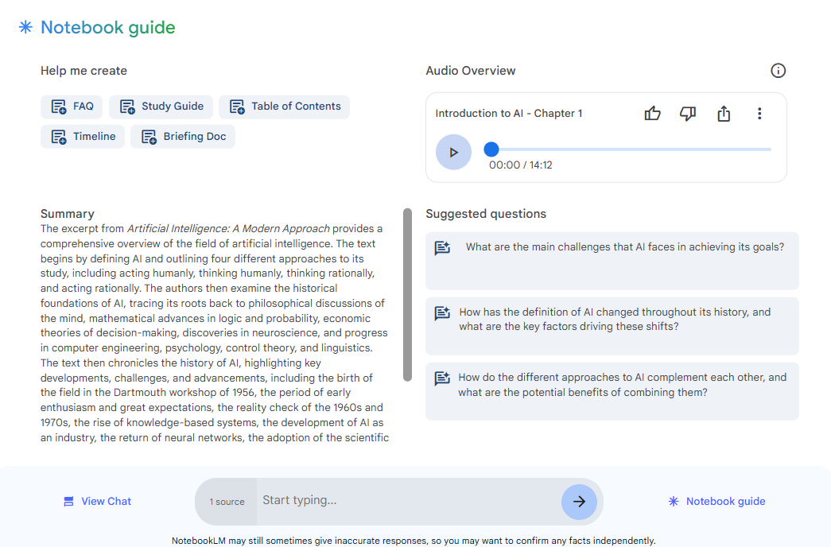
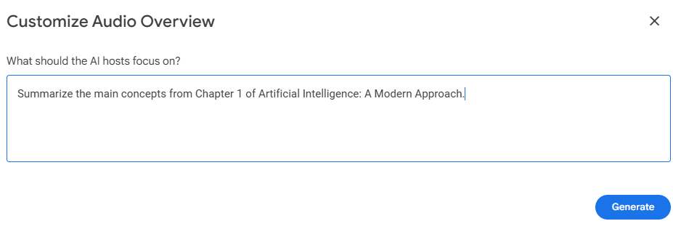
Content Summarization

Slide 3
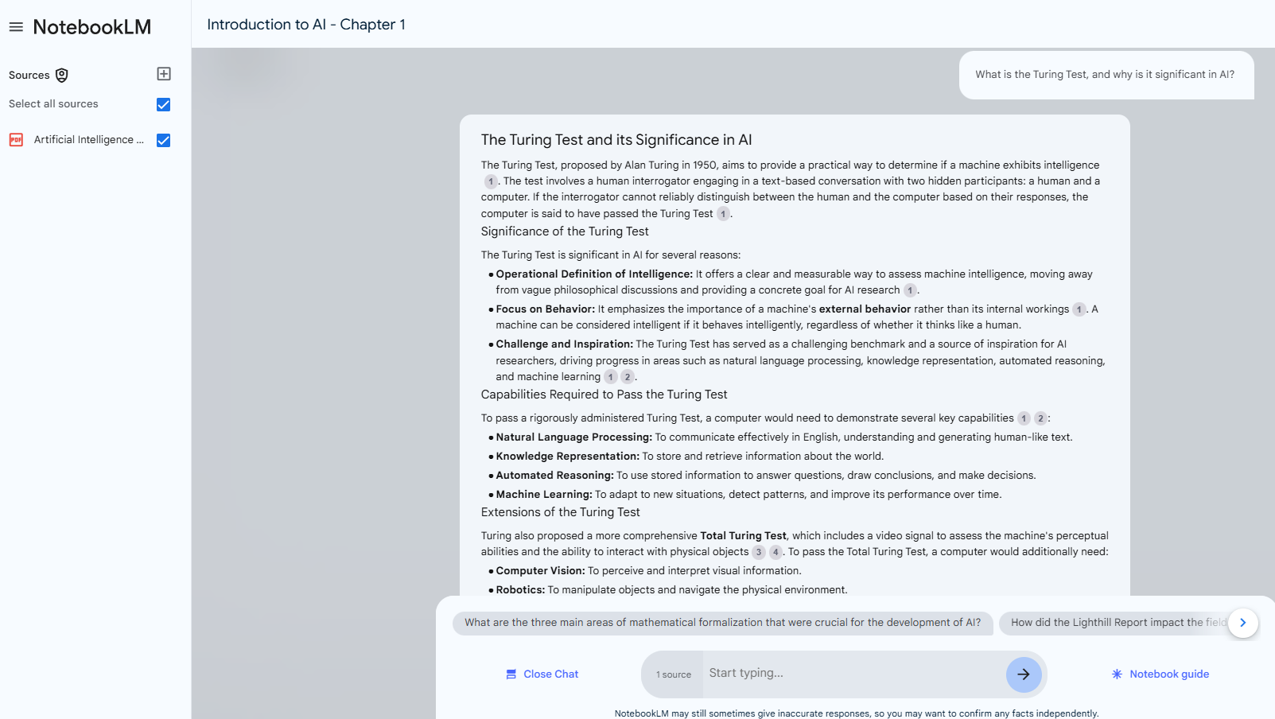
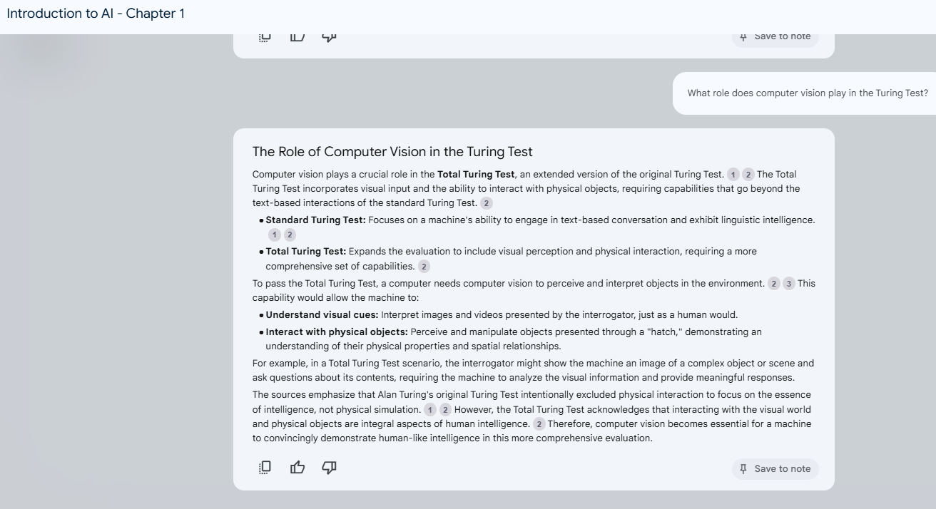
Interactive Learning (Conversational)

Slide 4
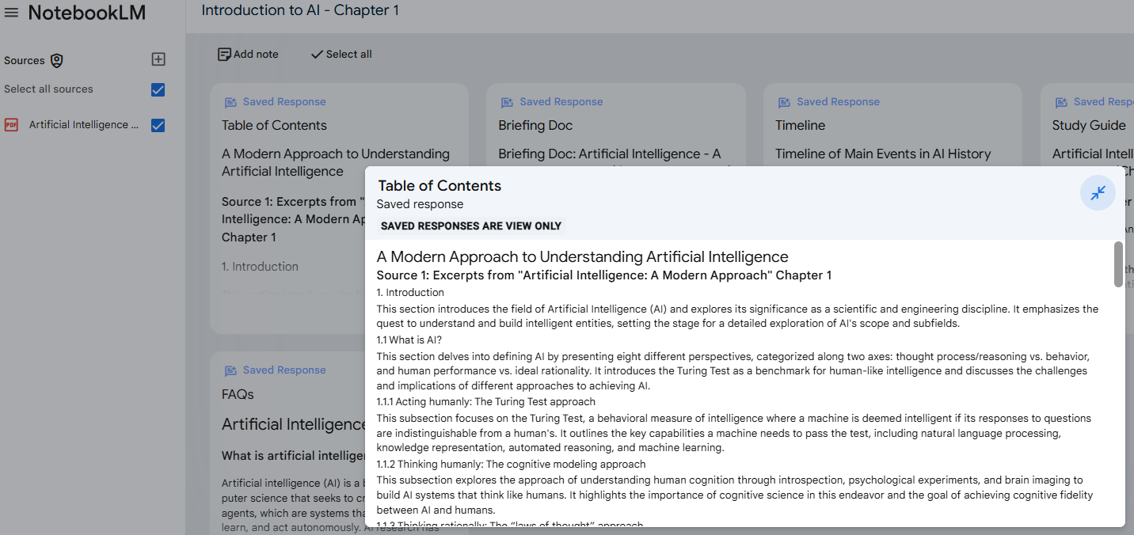
Table of Contents feature

Slide 5
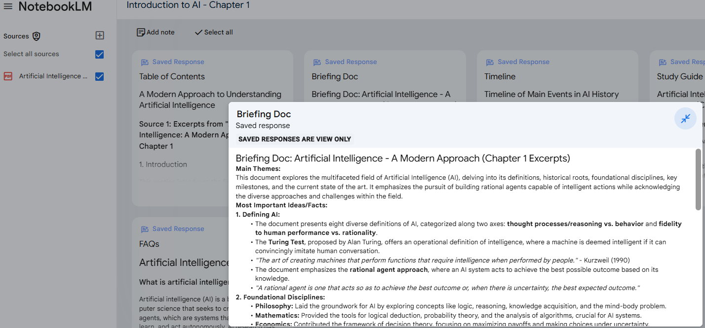
Briefing Doc Feature

Slide 6
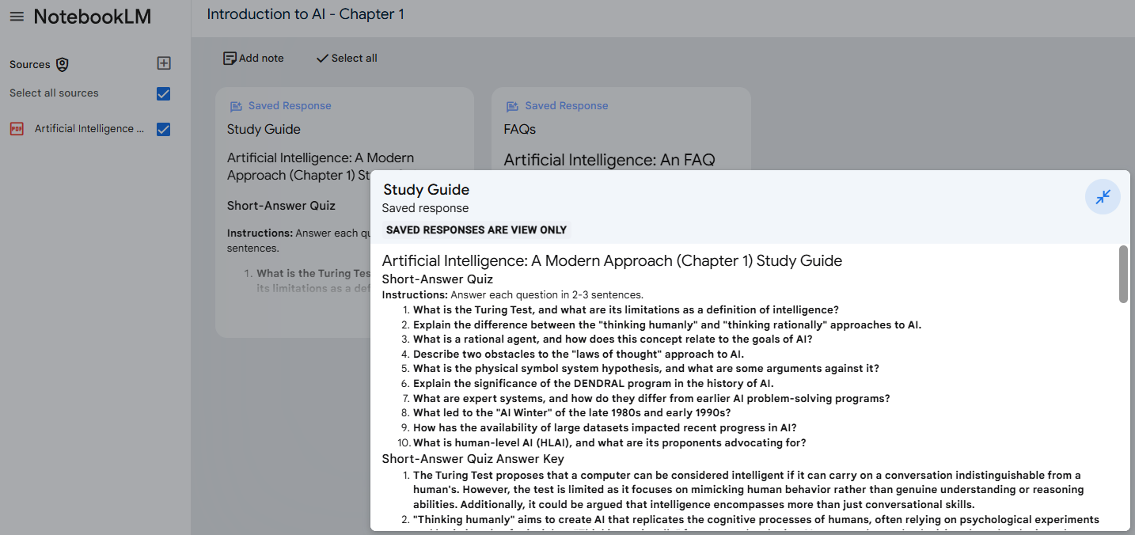
Study Guide Feature

Slide 7
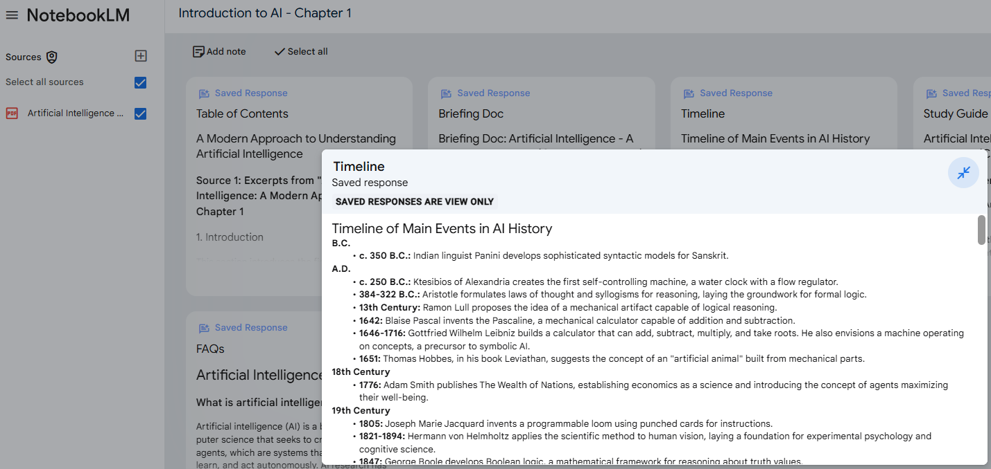
Timeline Feature

Slide 8
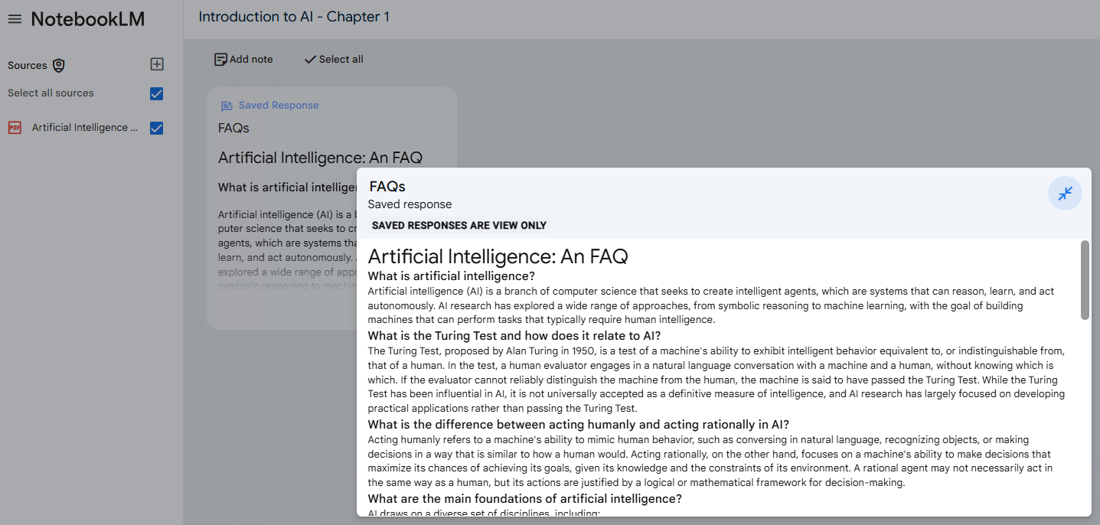
FAQ Feature

Slide 9
Thank you

