Slide 1
Sténopé: A Pet Management System
Joshua Coombs
William Cross
TC Prater

Slide 2
High Concept
Sténopé: A Pet Management System is a full-stack web application for adopting virtual pets. Focused on resource management, the application allows users to create pets and manage their inventory of items. This application uses multiple database tables to track items and pet states, as well as to enable inter-user communication.

Slide 3
Technologies Used
Java
Maven
Javalin
JDBC
Selenium/Cucumber/Gherkin
JUnit/Mockito
HTML
CSS/Bootstrap
JavaScript
AWS RDS/S3/EC2
PostgreSQL
Git/GitHub/Shellscript
REST
Notion

Slide 4
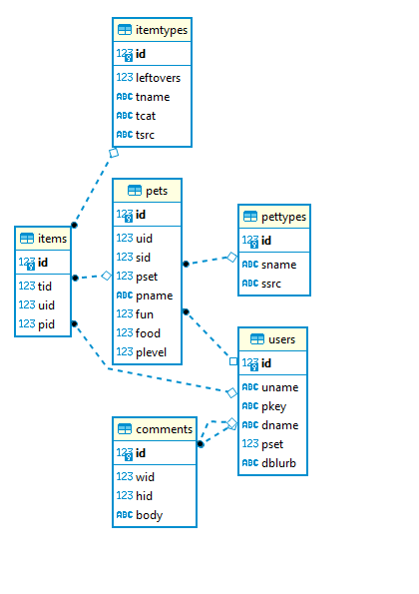
Database Structure

Slide 5
MVPs
Users can login and logout
Users can edit data fields on their account
Users can create pets
Users can change certain pet values (ex: hunger) with items
Items can be assigned to the inventory of a user or one of their pets
Item assignment drop-down auto-populates with all of a user's pets
Items can be used on pets

Slide 6
Stretch Goals
Users can add comments to user pages
Users can edit/delete their own comments
Pets can be adopted from a pound
Pets can be sent to the pound
Pet values can change over time
Users can edit pet data fields (ex: name)
Users can acquire new items
Some items disappear/change on use
S3/EC2

Slide 7
Testing
TDD using JUnit 5/Mockito
BDD using Selenium/Cucumber/Gherkin/Java
Endpoint testing using Postman

Slide 8
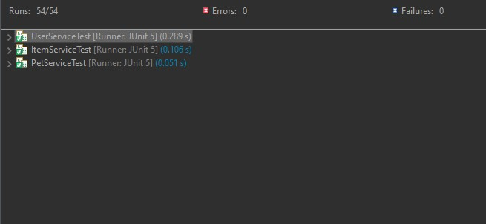
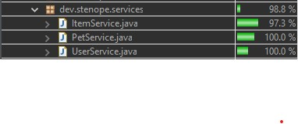
Testing
JUnit/Mockito Coverage

Slide 9
Challenges/ Works-in-progress
Challenges:
Sleep Deprivation
Testing
Works-in-Progress:
Refine comment functionality
Refine some Selenium tests
S3/EC2

