Slide 1
Employee Reimbursement System (ERS)
Robert Randolph

Slide 2
Technologies
Project Management Front-End Back-End Database
Eclipse IDE
Maven
Agile-Scrum
HTML
Bootstrap - CSS
PostgreSQL
AWS RDS
Java
Javalin
JDBC
JUnit
Mockito
Selenium
WebDriver
PostgreSQL
AWS RDS
DBeaver

Slide 3
User Stories
An Employee can login and logout
An Employee can view their requests
An Employee can create a new request
An Employee can submit a grade or cancel their request
A Manager can approve or reject a request
A Manager can change the reimbursement amount with a reason
Note: A Manager can do anything any employee can

Slide 4
User Stories - TLDL
Employee: Logout / login
Employee: View, Create, Update own requests
Manager: Approve, Reject, Change Reimbursement amount other requests
Note: Manager can do anything an employee can

Slide 5
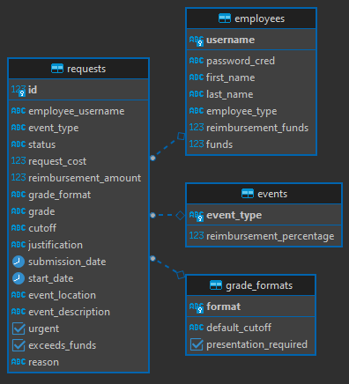
Entity Relationship Diagram

Slide 6
Endpoints
/login - - - (POST)
/logout - - - (POST)
/meta - - - (GET)
/employee/<username> - (GET)
/request - - - (GET)
/request/<username> - (POST, GET)
/request/<username>/<request id> (GET, PATCH)

Slide 7
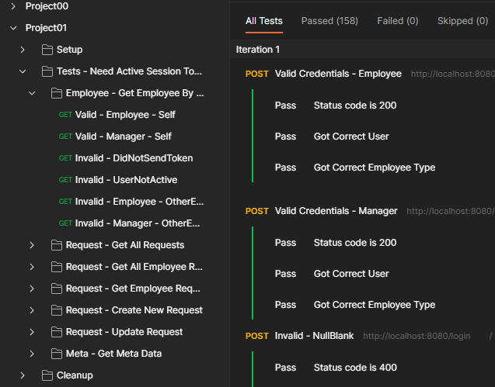
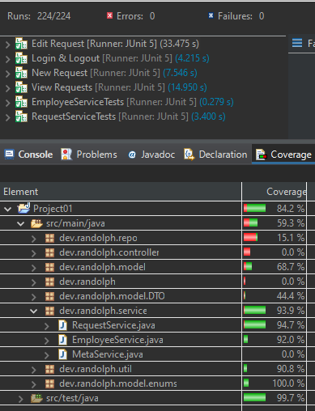
Tests
JUnit – Mockito : Service
Postman : Endpoints
Selenium Cucumber : User Behavior

Slide 8
Challenges
Selenium & Cucumber
Button – Wrong Coordinate
JUnit Suite
Bootstrap

Slide 9
Additions & Improvements
Add admin role with no restrictions on requests
Add ability to register new employees
Add ability to add new event types
Add ability to add new grade formats
Add ability to upload presentation/supporting documents to request
Add table of access rights for employees
Update client-server authentication/security
Update server to initialize enum/type data from database. (i.e. event types)
Update server to Minimize/Optimize database calls
Update better tracking of available reimbursement funds and whether current pending reimbursements exceed the amount
Improve DTOs to be more efficient

