Slide 1
Concepts of Programming PG-DAC Sept 2022
Gaurav Rajput

Slide 2
Types of Computer Programming Languages
There are basically two types of computer programming languages given below:
Low level language
High level language
Low Level Languages
The programming languages that are very close to machine code (0s and 1s) are called low-level programming languages.
The program instructions written in these languages are in binary form.
The examples of low-level languages are:
Machine language
Assembly language

Slide 3
Machine Language
The instructions in binary form, which can be directly understood by the computer (CPU) without translating them, is called a machine language or machine code.
Machine language is also known as first generation of programming language. Machine language is the fundamental language of the computer and the program instructions in this language is in the binary form (that is 0's and 1's).
Assembly Language
It is another low-level programming language because the program instructions written in this language are close to machine language. Assembly language is also known as second generation of programming language.
With assembly language, a programmer writes instructions using symbolic instruction code instead of binary codes.
Symbolic codes are meaningful abbreviations such as SUB is used for substation operation, MUL for multiply operation and so on. Therefore this language is also called the low-level symbolic language.
The set of program instructions written in assembly language are also called as mnemonic code.
Assembly language provides facilities for controlling the hardware.

Slide 4
High Level Languages
The programming languages that are close to human languages (example like English languages) are called the high-level languages.
The examples of high-level languages are:
Fortran
COBOL
Basic
Pascal
C
C++
Java
The high level languages are similar to English language. The program instructions are written using English words, for example print, input etc. But each high level language has its own rule and grammar for writing program instructions. These rules are called syntax of the language.
The program written in high level language must be translated to machine code before to run it. Each high level language has its own translator program.

Slide 5
The high level programming languages are further divided into:
Procedural languages
Non procedural languages
Object oriented programming languages
Procedural Language
Procedural languages are also known as third generation languages (3GLs). In a procedural language, a program is designed using procedures.
A procedure is a sequence of instructions having a unique name. The instructions of the procedure are executed with the reference of its name.
In procedural programming languages, the program instructions are written in a sequence or in a specific order in which they must be executed to solve a specific problem. It means that the order of program instructions is very important.
Some popular procedural languages are described below:
C language - Dennis Ritchie and Brian Karnighan developed it in 1972 at Bell Laboratories. It is a high level language but it can also support assembly language codes (low level codes

Slide 6
Non Procedural Languages
Non procedural programming languages are also known as fourth generation languages. In non procedural programming languages, the order of program instructions is not important. The importance is given only to, what is to be done.
With a non procedural language, the user/programmer writes English like instructions to retrieve data from databases. These languages are easier to use than procedural languages. These languages provide the user-friendly program development tools to write instructions. The programmers have not to spend much time for coding the program.
The most important non procedural languages and tools are discussed below:
SQL - it stands for structured query language. it is very popular database access language and is specially used to access and to manipulate the data of databases. The word query represents that this language is used to make queries (or enquiries) to perform various operations on data of database. However, SQL can also be used to create tables, add data, delete data, update data of database tables etc.

Slide 7
Object Oriented Programming Languages
The object oriented programming concept was introduced in the late 1960s, but now it has become the most popular approach to develop software.
In object oriented programming, the software is developed by using a set of interfacing object. An object is a component of program that has a set of modules and data structure. The modules are also called methods and are used to access the data from the object. The modern technique to design the program is object oriented approach. It is a very easy approach, in which program designed by using objects. Once an object for any program designed, it can be re-used in any other program.
Now-a-days, most popular and commonly used object oriented programming (OOPs) languages are C++ and Java.

Slide 8
Computer Language Translator and its Types
Translator is a computer program that translates program written in a given programming language into a functionally equivalent program in a different language.
Depending on the translator, this may involve changing or simplifying the program flow without losing the essence of the program, thereby producing a functionally equivalent program.
Types of Language Translator
There are mainly three Types of translators which are used to translate different programming languages into machine equivalent code:
Assembler
Compiler
Interpreter

Slide 9
Assembler
An assembler translates assembly language into machine code.
Assembly language consists of Mnemonics for machine Op-codes, so assemblers perform a 1:1 translation from mnemonic to a direct instruction. For example, LDA #4 converts to 0001001000100100.
Conversely, one instruction in a high level language will translate to one or more instructions at machine level
Compiler
Compiler is a computer program that translates code written in a high level language to a low level language, object/machine code.
The most common reason for translating source code is to create an executable program (converting from high level language into machine language).
Interpreter
An interpreter program execute other programs directly, running through program code and executing it line-by-line. As it analyses every line, an interpreter is slower than running compiled code but it can take less time to interpret program code than to compile and then run it. This is very useful when prototyping and testing code.
Interpreters are written for multiple platforms, this means code written once can be run immediately on different systems without having to recompile for each. Examples of this include flash based web programs that will run on your PC, Mac, games console and mobile phone.

Slide 10
Java Overview
Object-Oriented Programming
Object-oriented programming (OOP) is at the core of Java. In fact, all the Java programs are to at least some extent object oriented. OOP is thus integral to Java that it is best to understand its basic principles before you begin writing even simple Java programs.
Two Paradigms
All computer programs consist of the two elements i.e., code and data. Moreover, a program can be organized around its code or around its data in a conceptual manner i.e., some programs are written around "what's going on ?" and other programs are written about "who's being affected ?". These are the two paradigms that govern how a program is constructed. The first style is called as the process-oriented-model. This approach characterized a program as a series of one-dimensional steps i.e., code. The process-oriented model can be supposed of as code acting on data.
To manage increasing complexity, the second approach is called as object-oriented-programming, was conceived. Object-oriented programming organizes a program around its data, objects and a set of well defined interfaces to that data. An object-oriented program can be described as data controlling access to the code.

Slide 11
The Three OOP Principles
All the object-oriented programming languages provide mechanisms which helps you to implement the object-oriented model. Examples are encapsulation, inheritance, and polymorphism.
Encapsulation
Encapsulation is the process which binds together the code and the data it manipulates, and keeps both safe from the outside interference and misuse. One way to guess about encapsulation is as a protective wrapper that prevents the code and the data from being arbitrarily accessed by the other code that defined outside the wrapper. Access to the code and data inside the wrapper is tightly controlled by a well-defined interface.
Inheritance
Inheritance is the process by which one object adopts the properties of another objects. This is important because it supports the concept of hierarchical classification.
Polymorphism
Polymorphism (from Greek, meaning "many forms") is a characteristic which allows one interface to be used for a general class of actions. The particular action is decided by the exact nature of the situation.

Slide 12
A First Simple Program
Now that the basic of object-oriented support of Java has been discussed. Now let's look at the simple Java program:
/* Java Overview - Example Program */
public class JavaProgram
{
/* A Java Program Begins with a call to main() */
public static void main(String args[])
{
System.out.println("This is a Simple Java Program.");
}
}

Slide 13
Java Program Structure
Before proceed to learn Java, it is important to understand the basic structure of a Java program.
To know about the structure of a Java Program, just look at the following simple example:
/* Java Program Example - Java Program Structure
* This is a simple Java program, prints
* "Hello World" on the Screen
*/
public class JavaProgram
{
/* This
* is
* a
* multi-line
* comments
*/
public static void main(String args[])
{
// single line comments
System.out.println("Hello World");
}
}

Slide 14
Let's explain the above Java Program:
public class JavaProgram: This line of code has three parts:
public : This is an access modifier keyword, tells the compiler to access the class. Various values of access modifiers are public, protected, private or default (no value).
class : This keyword is used to declare the class. Name of the class (here JavaProgram) followed by this keyword.
JavaProgram : This is the name of the class. You can give this name according to your demand/program.
Comment Section : You can write comments in two ways:
Single Line Comments : It start with two forward slashes i.e. // and continue to the end of the current line. Line comments do not require an ending symbol.
Multi Line Comments : Also called as block comments start with a forward slash and an asterisk (/*) and end with an asterisk and a forward slash (*/).Block comments can also extend across as many lines as needed.

Slide 15
public static void main (String args[]) : This line of code has three keywords, main, and string arguments:
public : Access Modifier
static : static is reserved keyword which means that a method is accessible and usable even though no objects of the class exist.
void : This keyword declares nothing would be returned from method. Method can return any primitive or object
main : This is the main where program starts running or from here our compiler starts checking and running our java program/code.
Arguments : This is for the arguments purposes which will be included inside the curly bracket.
System.out.println("Hello World"): This line of code has also four parts:
System : It is the name of Java utility class.
out : It is an object which belongs to System class used in sending the data which is inside the bracket to the console.
println : It is print line which is utility method name which is used to send any String to console.
Hello World : It is String literal set as argument to println method

Slide 16
Java Basic Syntax
For Java programmer, it is very important to keep in mind about the following points.
Case Sensitivity - Java is a case sensitive language, which means that the identifier Hello, hello, HeLLo, hEllO, helLo, HELLO. All are different in Java.
Method Names - All the method names should start with a Lower Case letter. If several words are used to form the name of the method, then each first letter of inner word should be in Upper Case. [Lower camelCase] Example: public void employeeRecords(), public void myMethodName(), public void employeeNumber() etc.
Class Names - For all class names, the first letter should be in Uppercase If several words are used to form a name of the class, each inner word's first letter should be in Upper Case.
[Upper Camel Case ] Examples: class MyJavaProgram, class MyThirdJavaProgram, class StudentRecords etc.
public static void main(String args[]): Java program processing starts from the method main() which is a mandatory part of every Java program.

Slide 17
What is JVM?
JVM (Java Virtual Machine) is an abstract machine that enables your computer to run a Java program.
When you run the Java program, Java compiler first compiles your Java code to bytecode. Then, the JVM translates bytecode into native machine code (set of instructions that a computer's CPU executes directly).
Java is a platform-independent language. It's because when you write Java code, it's ultimately written for JVM but not your physical machine (computer). Since JVM ​executes the Java bytecode which is platform-independent, Java is platform-independent.

Slide 18
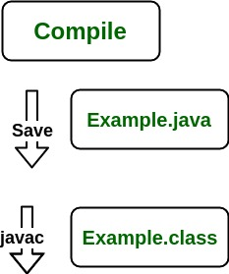

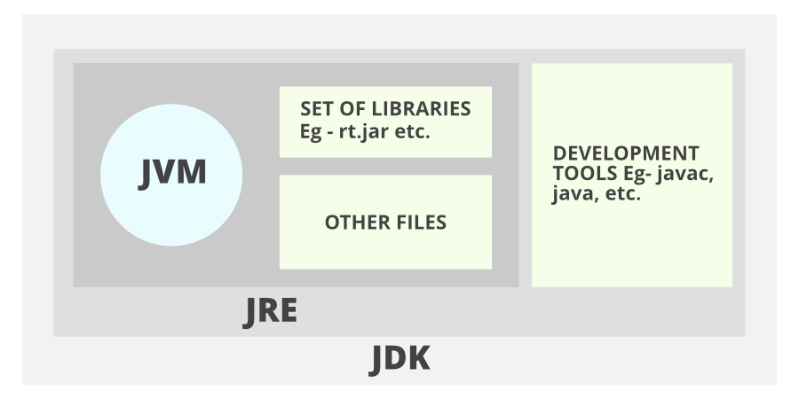
Java JDK, JRE and JVM
Working of Java Program

Slide 19
1. JDK (Java Development Kit) is a Kit that provides the environment to develop and execute(run) the Java program. JDK is a kit(or package) that includes two things
Development Tools(to provide an environment to develop your java programs)
JRE (to execute your java program).
2. JRE (Java Runtime Environment) is an installation package that provides an environment to only run(not develop) the java program(or application)onto your machine. JRE is only used by those who only want to run Java programs that are end-users of your system.
3. JVM (Java Virtual Machine) is a very important part of both JDK and JRE because it is contained or inbuilt in both. Whatever Java program you run using JRE or JDK goes into JVM and JVM is responsible for executing the java program line by line, hence it is also known as an interpreter.

Slide 20
Java Primitive Data Types
Data types specify the type of data that can be stored inside variables in Java.
Java is a statically-typed language. This means that all variables must be declared before they can be used.
Java defines the following eight primitive data types:
boolean
byte
short
int
long
Double
float
Char
The primitive data types are also commonly referred to as simple types. These can be put in the following four groups :
Integers - This group included byte, short, int, and long, which are for whole-valued signed numbers.
Floating-Point numbers - This group includes float and double, these represent the numbers with fractional precision.
Characters - This group includes char, which represents the symbols in a character set, like letters and numbers.
Booleans - This group includes boolean, which is a special type for representing the true/false values.

Slide 21
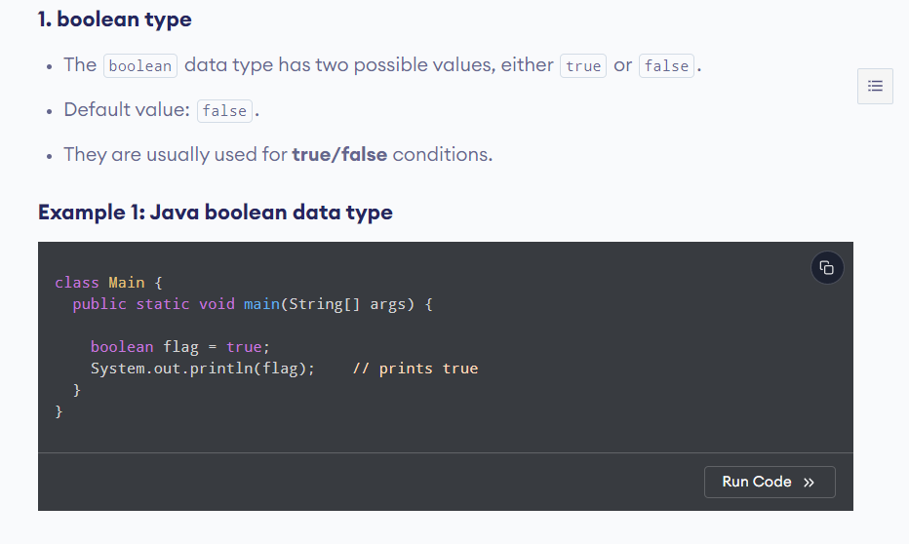

Slide 22
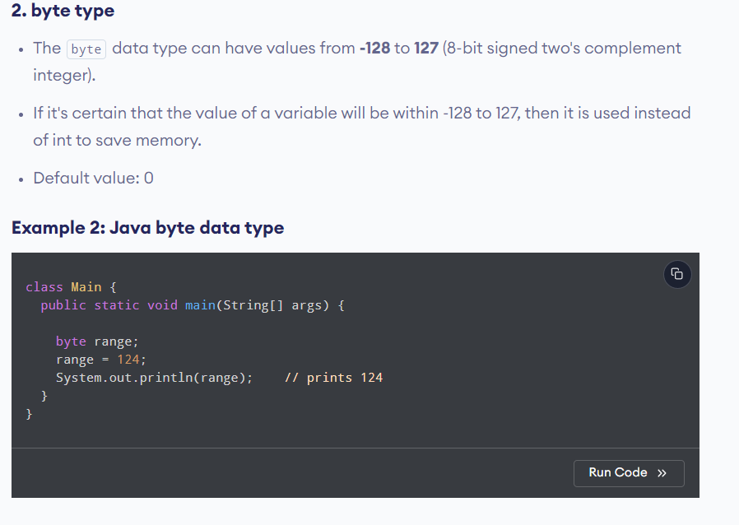

Slide 23
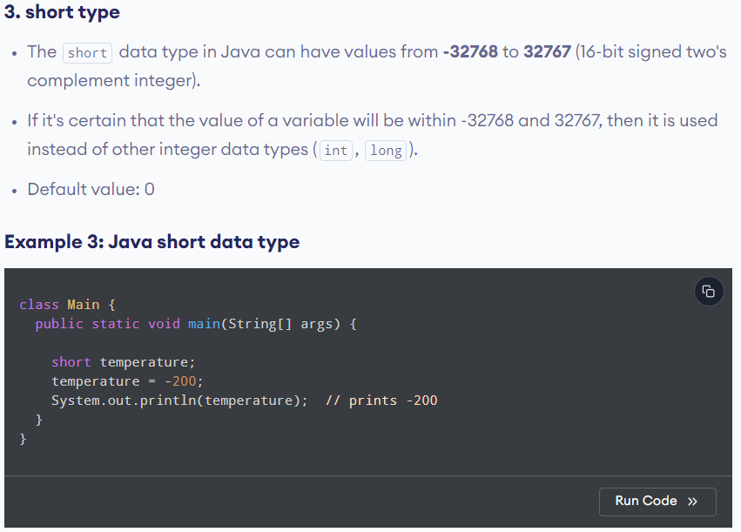

Slide 24
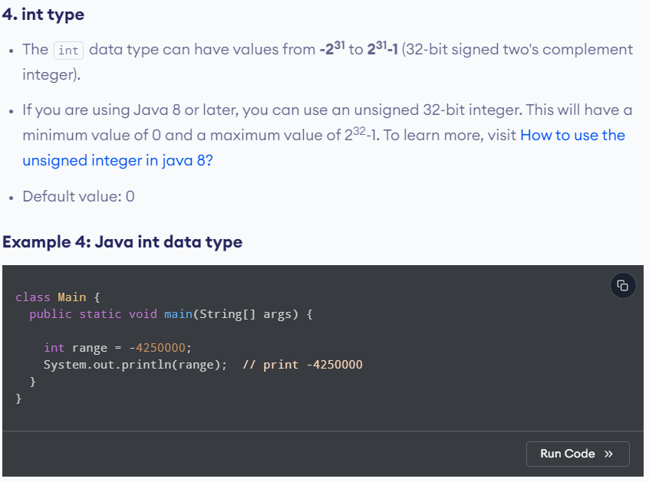

Slide 25
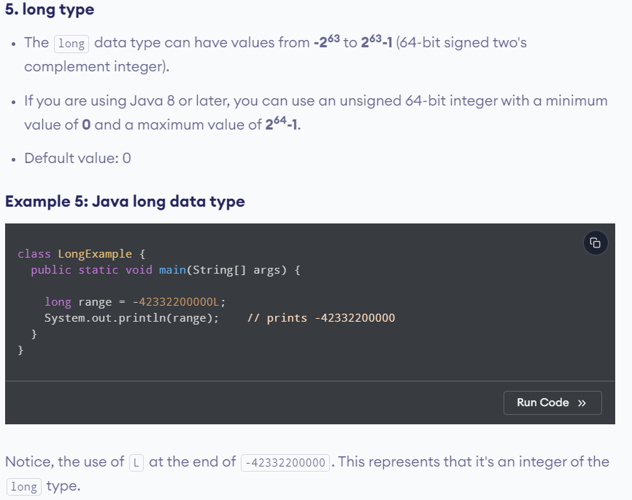

Slide 26
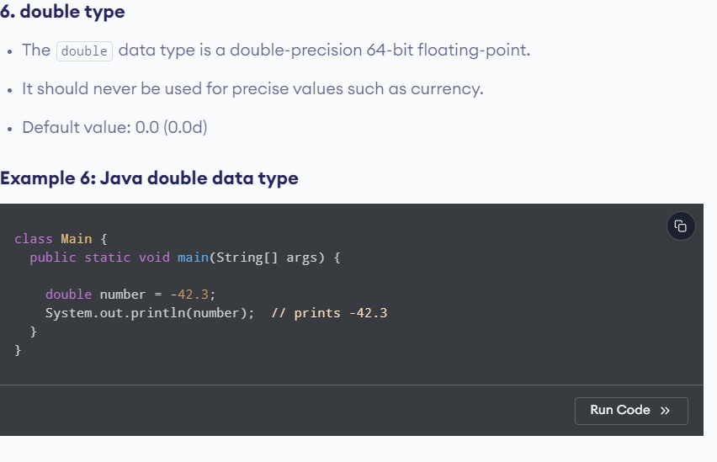

Slide 27
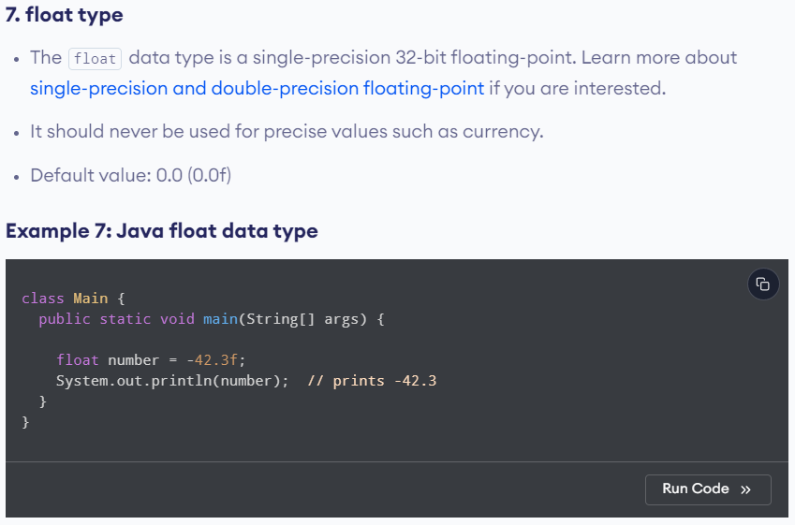

Slide 28
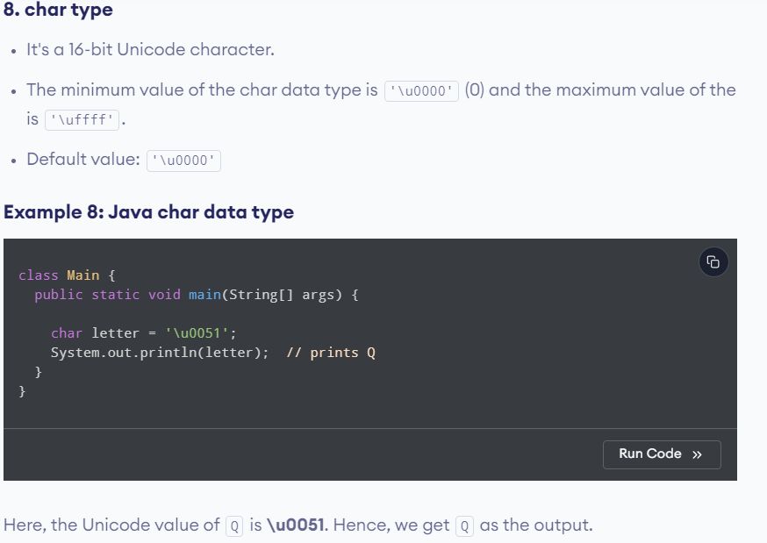

Slide 29
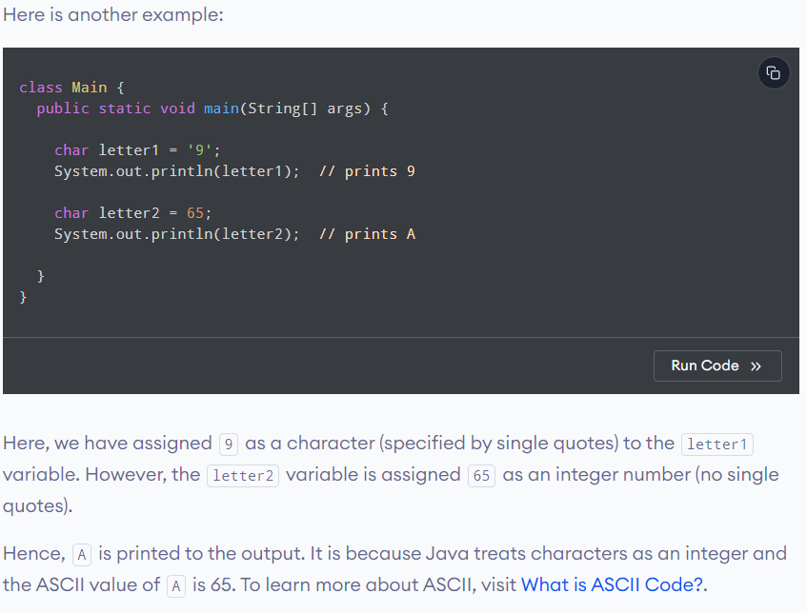

Slide 30
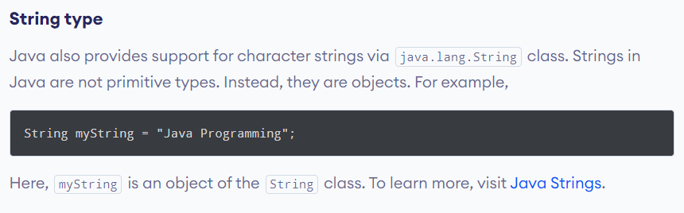

Slide 31
Java Variables and Literals:
Java Variables: A variable is a location in memory (storage area) to hold data.
To indicate the storage area, each variable should be given a unique name (identifier).
Identifiers in Java
In Java, an identifiers are used to name things, such as classes, variables, and methods.
An identifier may be any sequence of uppercase and lowercase letters, number or the underscore and dollar-sign characters. As you know, Java is case-sensitive, therefore, VALUE is a different identifier than Value.
Following are the rules to declare Identifiers in Java:
All identifiers can begin with a letter (A to Z or a to z) or dollar currency character ($) or an underscore (_).
After the first character identifiers can have any combination of characters.
Most importantly identifiers are case-sensitive.
A keyword cannot be used as an identifier since it has reserved words and have some special meaning.
Examples of illegal identifiers: 123abc, -salary etc.
Examples of legal identifiers: AvgTemp, count, a4, this_is_ok, age, $salary, _value, __1_value, customers etc

Slide 32
Java Literals
In Java, a constant value is created by using a literal representation of it. For example, below are some literals : 100 - specifies an integer literal
98.6 - specifies a floating-point literal
'X' - specifies a character constant
"This is a test" - this literal specifies a string literal
A literal can be used anywhere a value of its type is allowed.
Types of Literals
In Java, there are the following types of literals:
Boolean Literals
Integer Literals
Floating-point Literals
Character Literals
String Literals

Slide 33
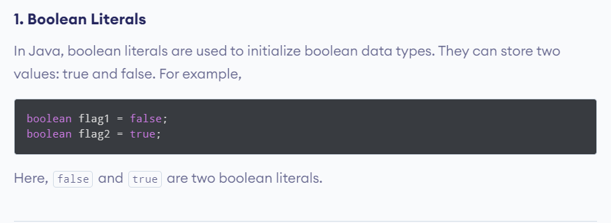

Slide 34
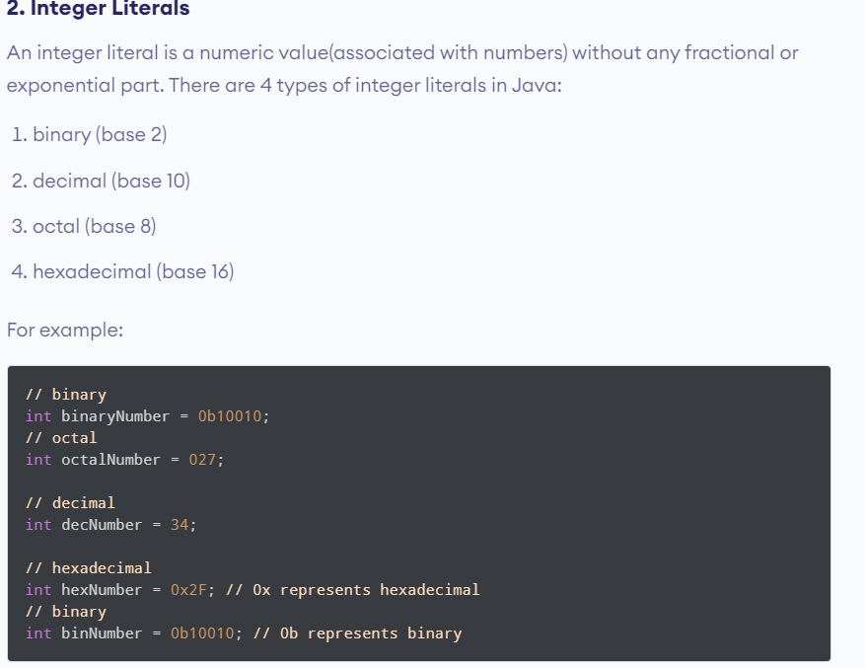

Slide 35
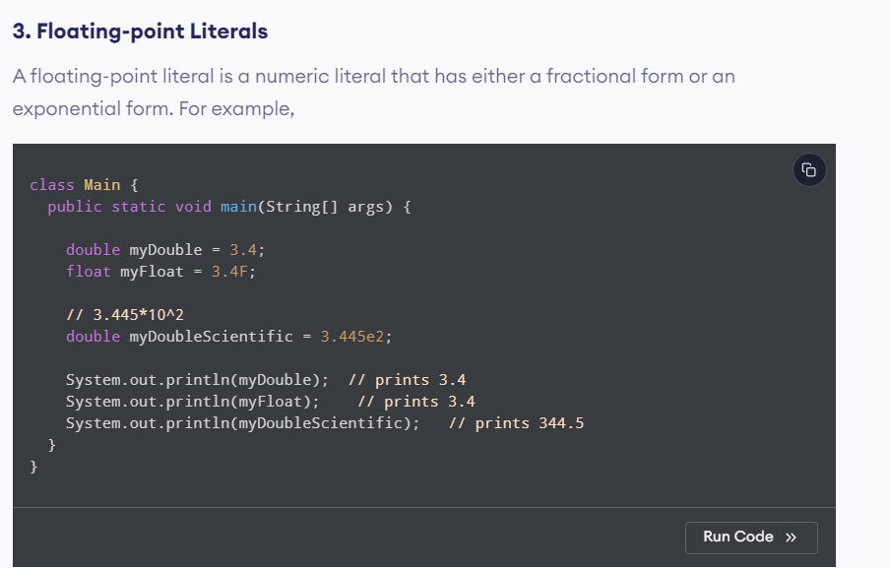

Slide 36
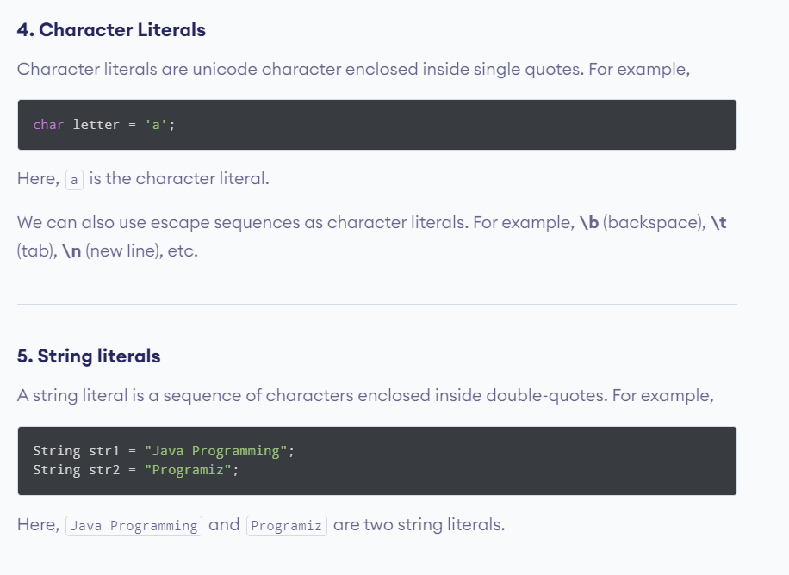

Slide 37
Java Type Casting
The process of converting the value of one data type (int, float, double, etc.) to another data type is known as typecasting.
We will only focus on the major 2 types of casting .
Widening Type Casting (Implicit Type Casting)
In the case of Widening Type Casting, the lower data type (having smaller size) is converted into the higher data type (having larger size). Hence there is no loss in data. This is why this type of conversion happens automatically.
2. Narrowing Type Casting (Explicit Type Casting)
In the case of Narrowing Type Casting, the higher data types (having larger size) are converted into lower data types (having smaller size). Hence there is the loss of data. This is why this type of conversion does not happen automatically.

Slide 38
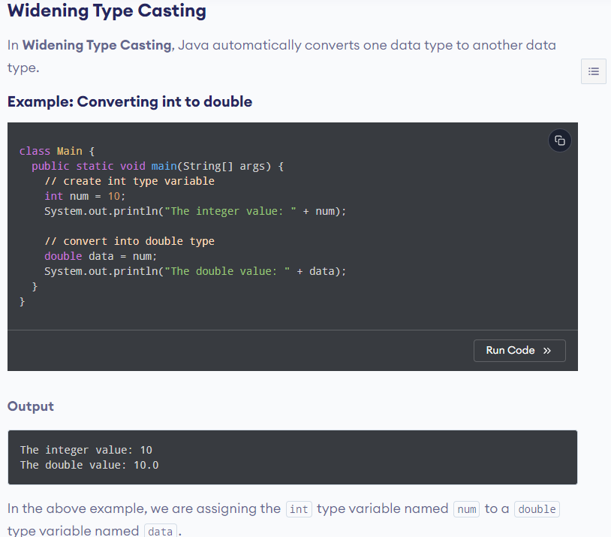

Slide 39
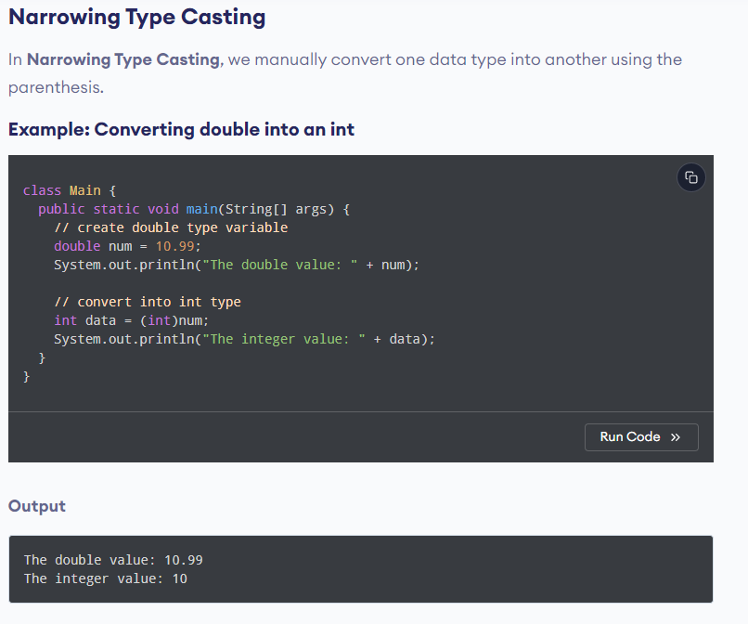

Slide 40
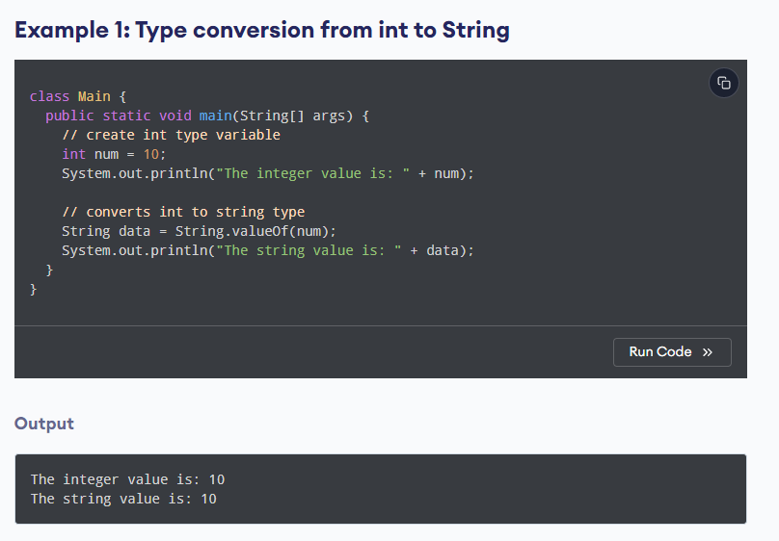

Slide 41
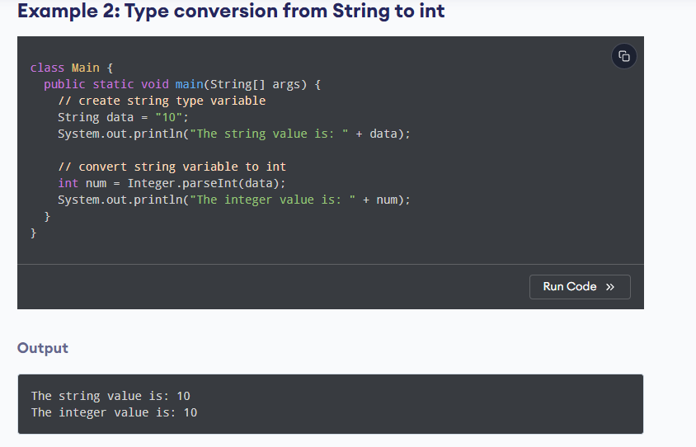

Slide 42
Java Operators
Operators are symbols that perform operations on variables and values.
For example, + is an operator used for addition, while * is also an operator used for multiplication.
Operators in Java can be classified into 5 types:
Arithmetic Operators
Assignment Operators
Relational Operators
Logical Operators
Unary Operators
Bitwise Operators

Slide 43
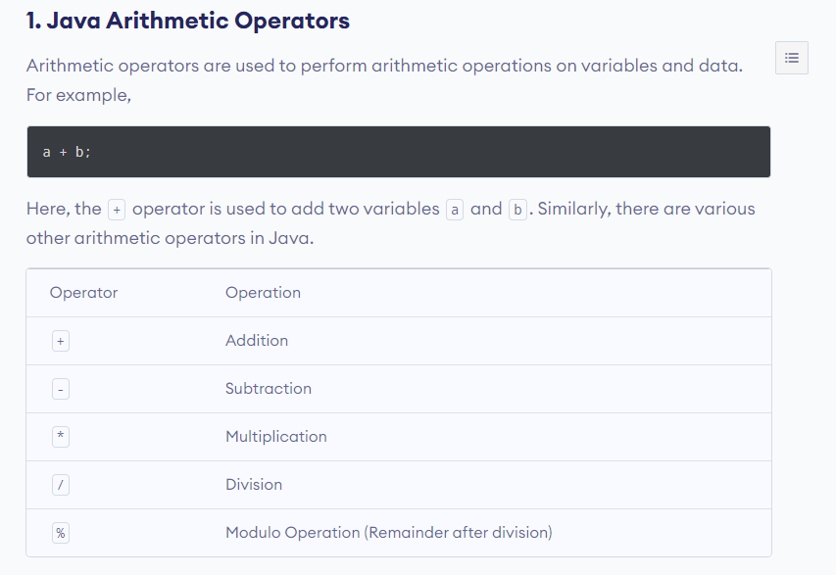

Slide 44
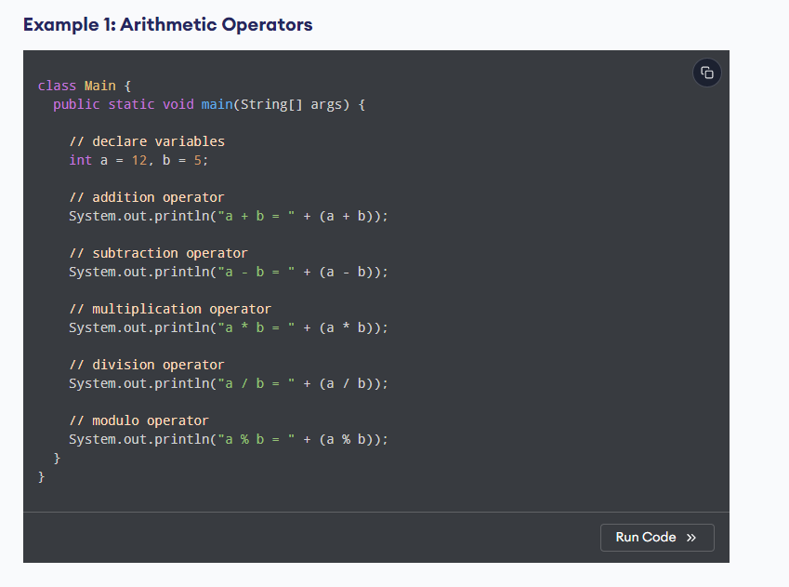

Slide 45
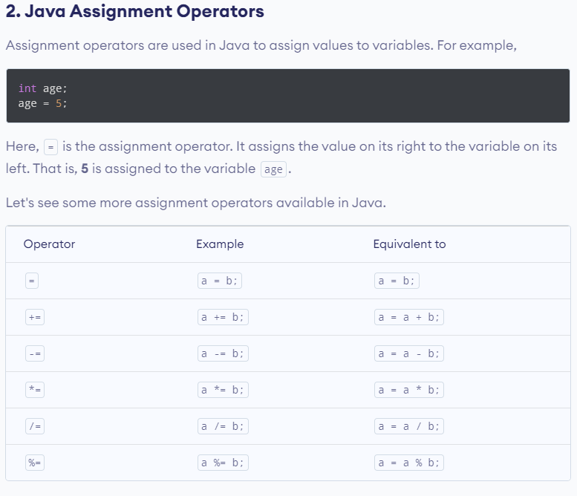

Slide 46
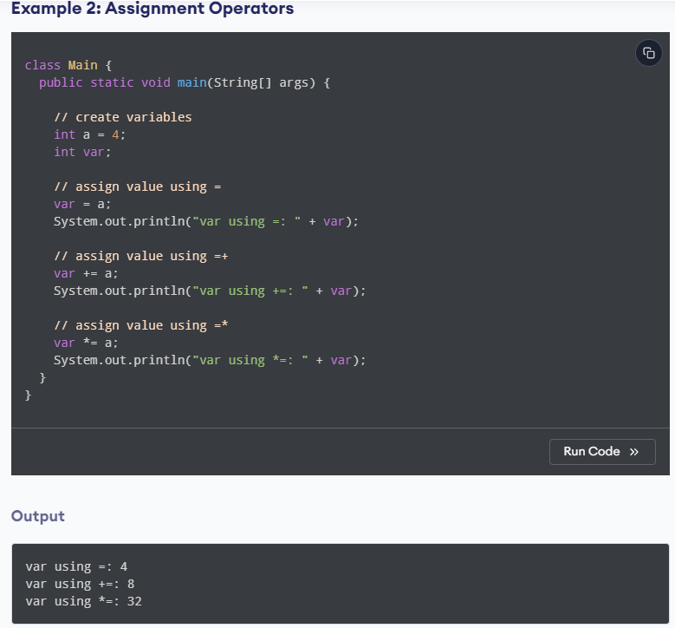

Slide 47
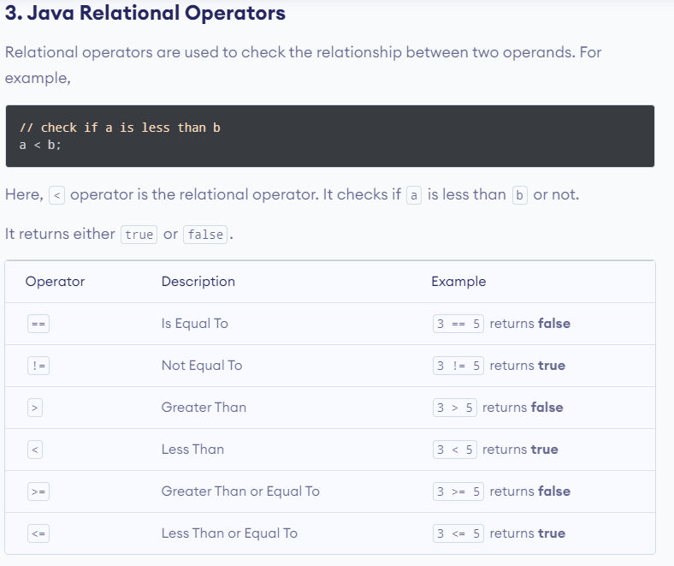

Slide 48
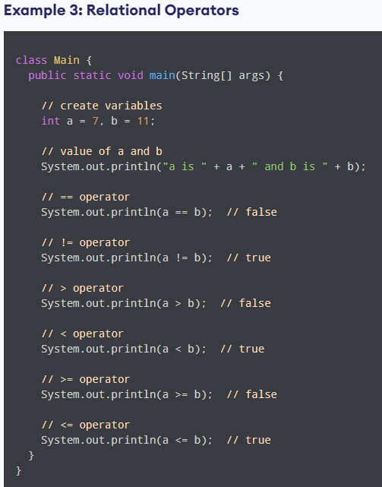

Slide 49
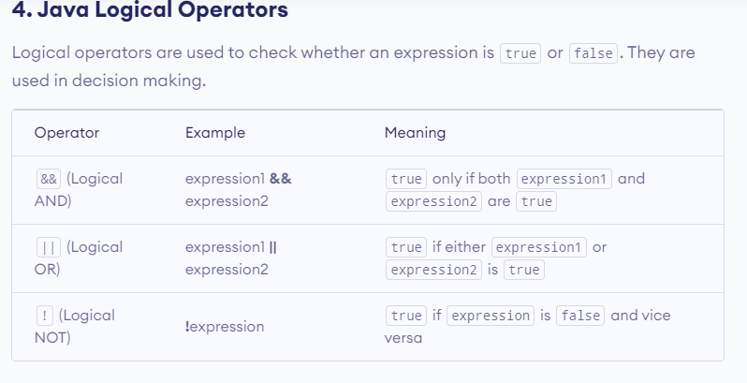

Slide 50
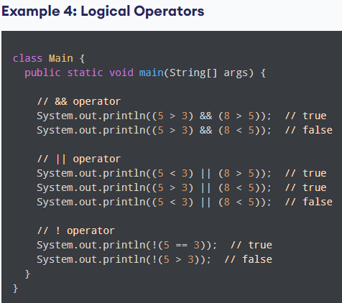

Slide 51
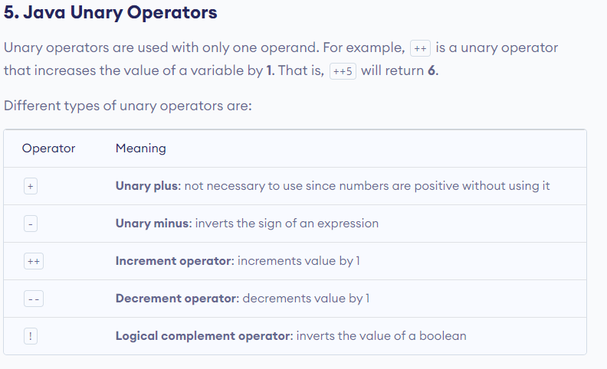

Slide 52
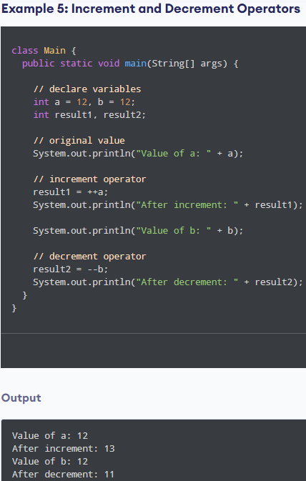

Slide 53
