Slide 1

Data Definition Language SQL Data Types
.NET

Slide 2
A software system used to maintain a relational database is called a Relational Database Management System (RDBMS). Many relational database systems use Structured Query Language (SQL) for querying and maintaining a database.
https://docs.microsoft.com/en-us/sql/t-sql/language-reference?

Slide 3

(RDBMS) Relational Database Management System – History https://en.wikipedia.org/wiki/Relational_database
Relational databases are based on the relational model of data, as proposed by E. F. Codd in 1970.
Edgar Frank "Ted" Codd (August 23, 1923 – April 18, 2003) was a British computer scientist and winner of the 1981 Turing Award.

Slide 4
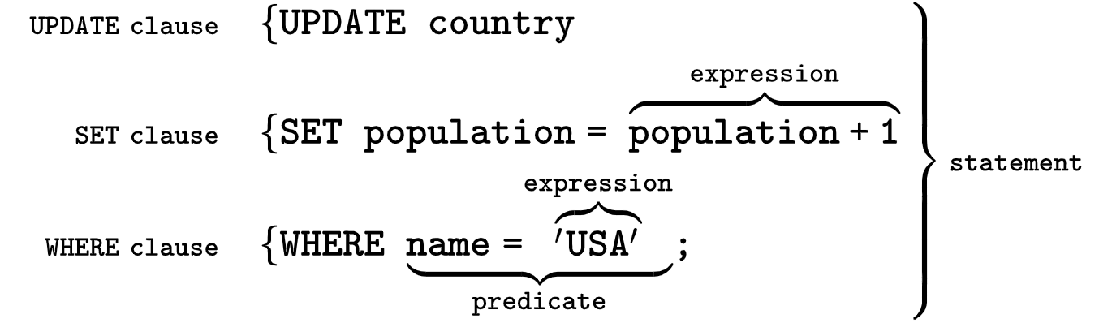
SQL (Structured Query Language) https://en.wikipedia.org/wiki/SQL
SQL was originally based upon relational algebra and tuple relational calculus. SQL is a declarative language. We say what data we want, not how to get it. We cannot manage how SQL obtains the data.
The scope of SQL includes data query, data manipulation (insert, update and delete), data definition (schema creation and modification), and data access control.
SQL consists of two main types of statements:
Data Definition Language (DDL)
Data Manipulation Language (DML).

Slide 5
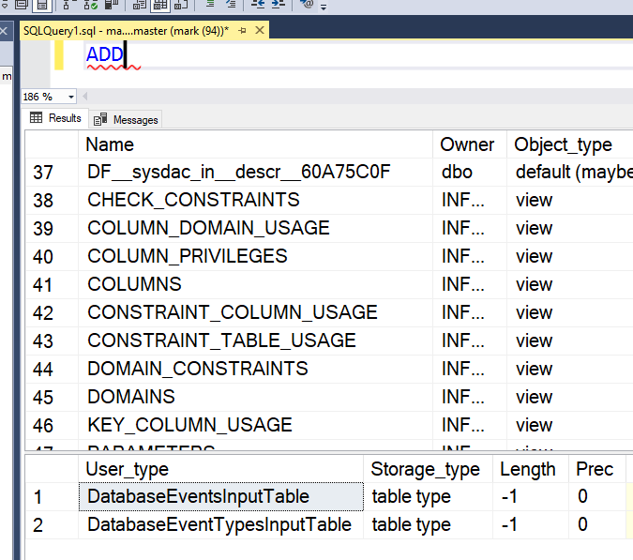
Microsoft and T-SQL https://docs.microsoft.com/en-us/sql/t-sql/language-reference?view=sql-server-ver15#tools-that-use-t-sql
T-SQL is central to using Microsoft SQL products and services. All tools that communicate with a SQL database send T-SQL commands. SQL works on top of T-SQL.
Some of the Microsoft tools that issue T-SQL commands are:
SQL Server Management Studio (SSMS)
SQL Server Data Tools (SSDT)
Azure Data Studio
*You can type a T-SQL keyword in the SSMS Query Editor window and press F1 to get data about any T-SQL Keyword.

Slide 6
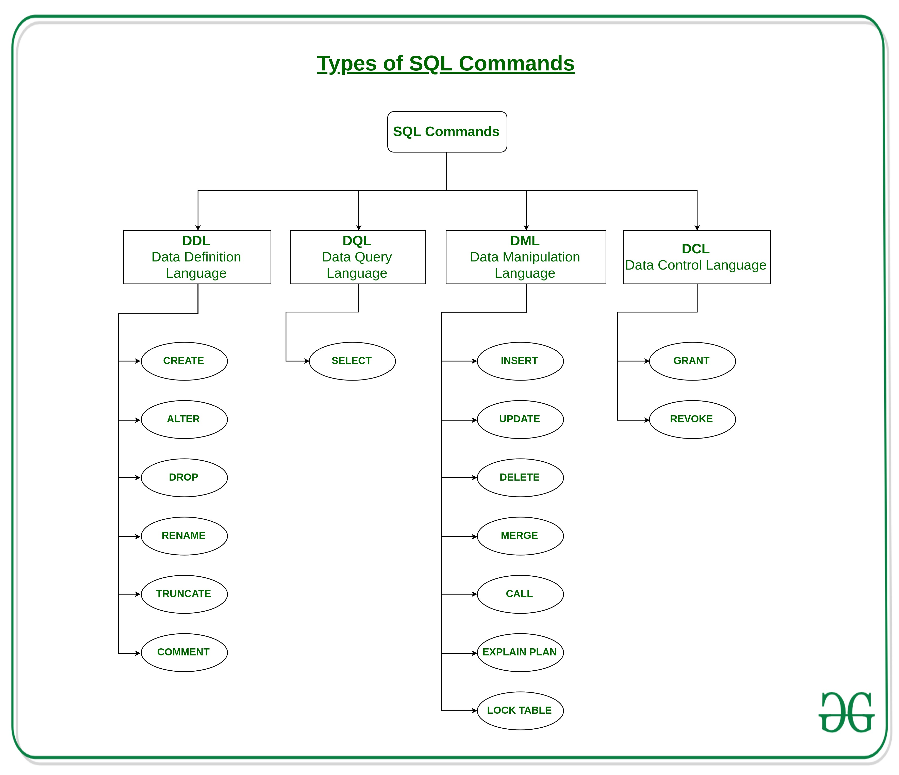

Slide 7
Data Definition Language https://docs.microsoft.com/en-us/sql/t-sql/statements/statements?view=sql-server-ver15#data-definition-language
Data Definition Language (DDL) statements define the structure of the DB. DDL statements create, alter, or drop the data structures (tables) of a database.
ALTER - Modifies a table definition by altering, adding, or dropping columns and constraints.
CREATE - creates a new database
DROP - Removes one or more table definitions and all data, indexes, triggers, constraints, and permission specifications for those tables.

Slide 8
SQL – Create and Drop an empty DB
*Deleting a database will result in complete loss of information stored in the database!

Slide 9
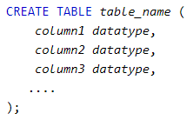
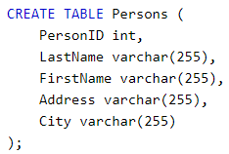
SQL – Create and Drop a table
*Deleting a table will result in complete loss of information stored in the table!

Slide 10
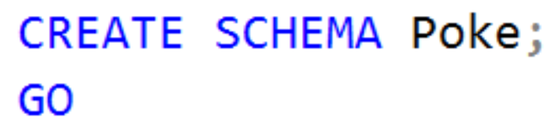
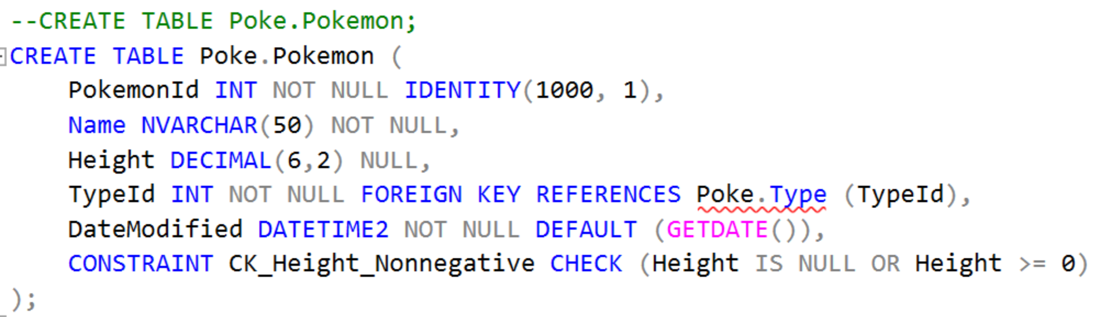
SQL with SQL Server
In SQL Server, every table must be in a schema.

Slide 11
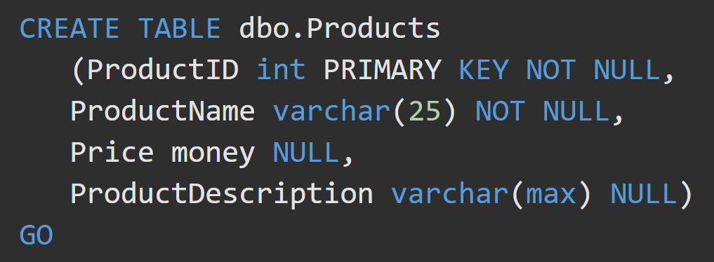
Create a Table in SQL Server https://docs.microsoft.com/en-us/sql/t-sql/lesson-1-creating-database-objects?view=sql-server-ver15#create-a-table
To create a table, you must provide:
a name for the table
name of each column
data type of each column
a unique primary key.

Slide 12
SQL – String Data Types https://docs.microsoft.com/en-us/sql/t-sql/data-types/char-and-varchar-transact-sql?view=sql-server-ver15
Data Type | Description
CHAR(n) | Fixed-length up to “n”, 0 to 255, Default 1
VARCHAR(n) | Variable length up to “n”. 0 to 65535
NCHAR(7) | Fixed-length, Unicode string
NVARCHAR(n) | variable-length Unicode string up to “n”. *Use this unless you specifically need to use something else.
There are a many functions to deal with strings:
LEN(), SUBSTRING(), CHARINDEX(), REPLACE(), LOWER(), UPPER()

Slide 13
SQL – Integer Data Types https://docs.microsoft.com/en-us/sql/t-sql/data-types/data-types-transact-sql?view=sql-server-ver15#exact-numerics
Data Type | Description
BIT | It’s a bit. Values 1 to 64. Default 1
TINYINT | Signed = -128 to 127. unsigned = 0 to 255
BOOL | Max 255 bytes. 0 = false, 1 = true
SMALLINT | Max 65535 bytes
INT | signed = -2147483648 to 2147483647. (Use this unless you need something else) unsigned = 0 to 4294967295
BIGINT | -2^63 (-9,223,372,036,854,775,808) to 2^63-1 (9,223,372,036,854,775,807)

Slide 14
SQL – Float Data Types https://docs.microsoft.com/en-us/sql/t-sql/data-types/data-types-transact-sql?view=sql-server-ver15#approximate-numerics
Data Type | Description
FLOAT(size,d) | size = total digits. d = number of digits after the decimal point
FLOAT(p) | If p is from 0 to 24, the data type becomes FLOAT(). If p is from 25 to 53, the data type becomes DOUBLE()
DOUBLE(size, d) | size = total digits. d = number of digits after the decimal point.
DECIMAL(size, d) | An exact fixed-point number. size = total digits(default 10, max 65). d = number of digits after the decimal point(default 0, max 30).

Slide 15
SQL – Date and Time Data Types https://docs.microsoft.com/en-us/sql/t-sql/data-types/date-and-time-types?view=sql-server-ver15
Data Type | Description
DATE | Format: YYYY-MM-DD. From '1000-01-01' to '9999-12-31'
DATETIME(fsp) | Format: YYYY-MM-DD hh:mm:ss. Add DEFAULT and ON UPDATE in the column definition to get automatic initialization and updating to the current date and time
TIMESTAMP(fsp) | The number of seconds since the Unix epoch. Format: YYYY-MM-DD hh:mm:ss. Automatic initialization and updating with DEFAULT CURRENT_TIMESTAMP and ON UPDATE CURRENT_TIMESTAMP in the column definition.
TIME(fsp) | hh:mm:ss. From '-838:59:59' to '838:59:59’
YEAR | 1901 to 2155, and 0000. MySQL 8.0 does not support year in two-digit format.
DATETIMEOFFSET | For storing intervals of time. Use YEAR() to extract parts of the dates/times, DATEPART(YEAR FROM '2019-01-01') or DATEPART(YEAR, '2019-01-01')

Slide 16
SQL – Currency Data Types https://docs.microsoft.com/en-us/sql/t-sql/data-types/data-types-transact-sql?view=sql-server-ver15#exact-numerics
Data Type | Description
MONEY | From -922,337,203,685,477.5808 to 922,337,203,685,477.5807 prints with ‘$’
SMALLMONEY | From -214,748.3648 to 214,748.3647 prints with ‘$’

Slide 17
SQL – Table Constraints https://docs.microsoft.com/en-us/sql/t-sql/statements/alter-table-table-constraint-transact-sql?view=sql-server-ver15
UNIQUE(columns) | Makes sure all the values in a column are unique.
REFERENCES tablename(colName) | Denotes the Primary Key that a Foreign Key column references. This is checked to maintain referential integrity when changing values.
CHECK(condition) | Enforces that some expression is true for every row in a column.
PRIMARY KEY(columns) | Allows you to define a primary key made u of multiple columns.

Slide 18
SQL – Column Constraints https://docs.microsoft.com/en-us/sql/t-sql/statements/alter-table-table-constraint-transact-sql?view=sql-server-ver15
NOT NULL | Column does not accept NULL as a value
NULL | Column accepts NULL as a value. NULL will be the default value.
PRIMARY KEY | Value must be unique within this column.
UNIQUE | NOT NULL, UNIQUE, and by default sets a CLUSTERED INDEX.
FOREIGN KEY | By default, sets a NONCLUSTERED INDEX
DEFAULT(value) | Configures a default value for that column
IDENTITY(start, inc) | Start is the first value. Inc is the amount to increment with each new row. Sets up an auto-incrementing default, AND prevents anyone from inserting their own value
EXCLUSION | Ensures that if any two rows are compared on the specified column, not all comparisons return TRUE. This is dependent on other constraints.

Slide 19
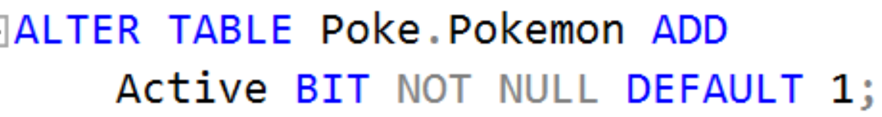
ALTER Table https://docs.microsoft.com/en-us/sql/t-sql/statements/alter-table-transact-sql?view=sql-server-ver15
ALTER TABLE
modifies a table definition by altering, adding, or dropping columns and constraints.
reassigns and rebuilds partitions or disables and enables constraints and triggers.
ALTER TABLE Addresses
DROP COLUMN ZipCode;

Slide 20
Definitions
Clustered / NonClustered Index - A clustered index defines the order in which data is physically stored in a table. Table data can be sorted in only way, therefore, there can be only one clustered index per table. In SQL Server, the primary key constraint automatically creates a clustered index on that particular column.

