Slide 1

SQL Functions
.net

Slide 2
SQL functions help simplify code. There may be a complex calculation that appears in many queries. A SQL function can be created that encapsulates the formula and uses it in each query.
https://www.sqlservertutorial.net/sql-server-user-defined-functions/sql-server-scalar-functions/

Slide 3
SQL Scalar Function https://docs.microsoft.com/en-us/sql/t-sql/statements/create-function-transact-sql?view=sql-server-ver15 https://docs.microsoft.com/en-us/sql/relational-databases/user-defined-functions/create-user-defined-functions-database-engine? https://www.sqlservertutorial.net/sql-server-user-defined-functions/sql-server-scalar-functions/
A ‘user-defined’ function:
accepts parameters,
performs an action such as a complex calculation, and
returns the result of that action as a scalar (single) value or a table.
Scalar Function – A SQL Scalar Function takes one or more parameters and returns a single value.
CREATE FUNCTION dbo.GetNetSale
( @quantity int,
@unitprice dec(10,2),
@discount dec(10,2)
)
RETURNS dec(10,2)
AS
BEGIN
return
@quantity*@unitprice*(1-@discount);
END
-- call the function
SELECT dbo.GetNetSale(10,100.00,0.1)
AS
netSale;

Slide 4
SQL Scalar Function https://docs.microsoft.com/en-us/sql/t-sql/statements/create-function-transact-sql?view=sql-server-ver15 https://docs.microsoft.com/en-us/sql/relational-databases/user-defined-functions/create-user-defined-functions-database-engine? https://www.sqlservertutorial.net/sql-server-user-defined-functions/sql-server-scalar-functions/
To create a Scalar Function:
Use the CREATE FUNCTION keywords to name the function. SQL Server may require dbo. or the schema name.
In parenthesis, specify a list of @<parameterName> <dataType>.
Use the RETURNS keyword and give the data type of the return value.
Use the AS keyword and BEGIN the function body.
RETURN the calculation.
End the body of the function with END.
To call the function,
SELECT <functionName(params)> AS <name>
CREATE FUNCTION dbo.GetNetSale
( @quantity int,
@unitprice dec(10,2),
@discount dec(10,2)
)
RETURNS dec(10,2)
AS
BEGIN
return
@quantity*@unitprice*(1-@discount);
END
-- call the function
SELECT dbo.GetNetSale(10,100.00,0.1)
AS
netSale;

Slide 5
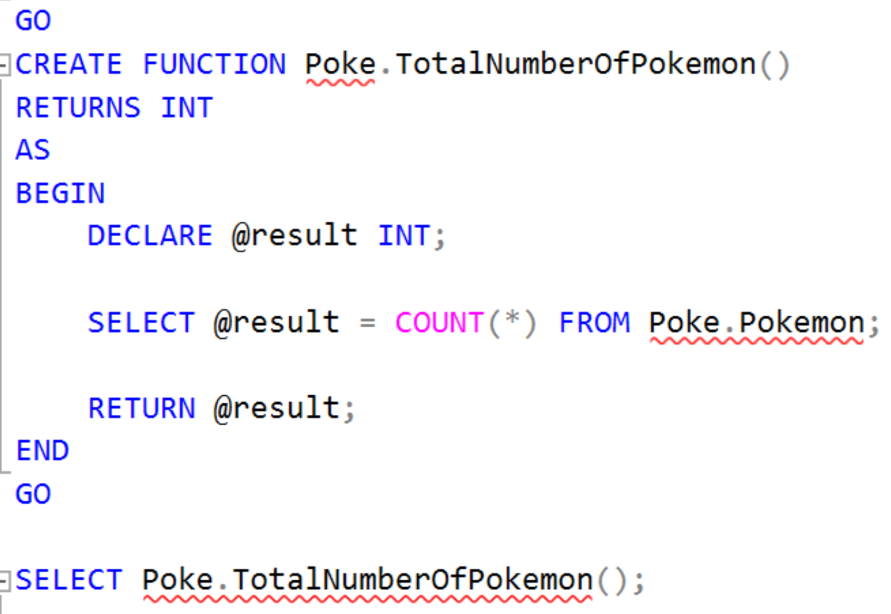
SQL – User-Defined Function
Scalar Functions operate on a single value and then return a single value.
Scalar functions can be used wherever an expression is valid.

Slide 6
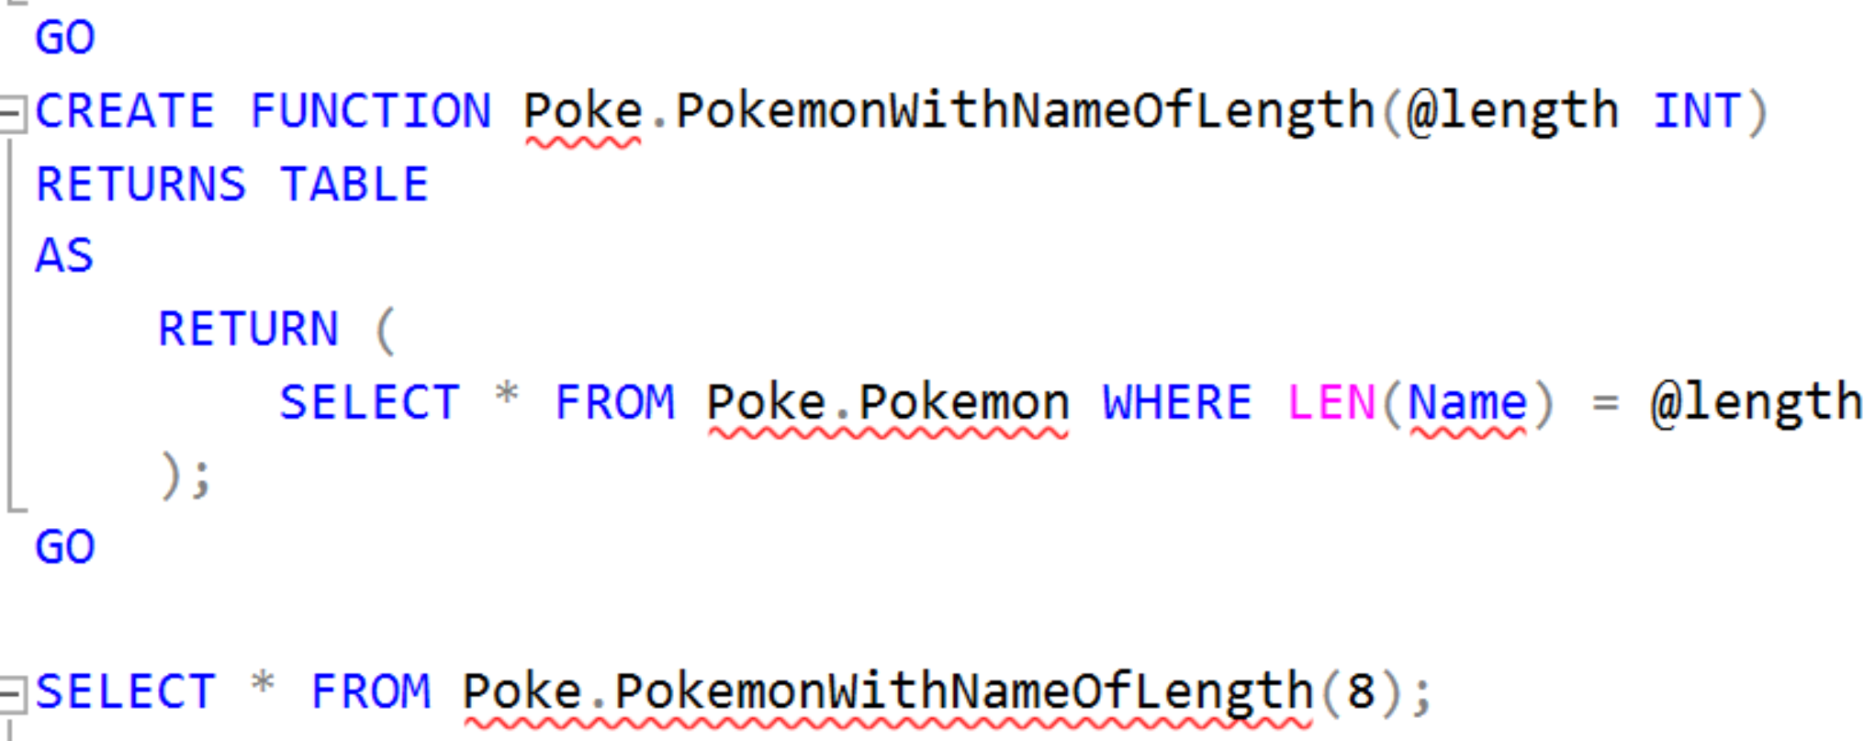
SQL – User-Defined Function
SQL Functions have "read-only" access. They cannot make changes to the database.

Slide 7
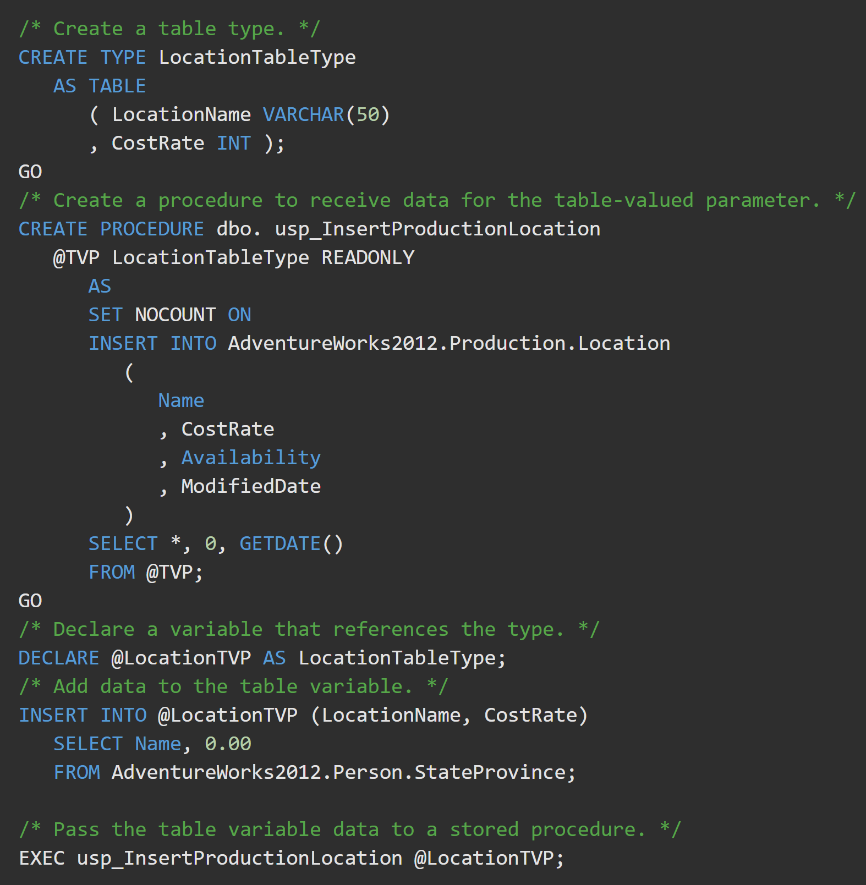
Table-Valued Parameters https://docs.microsoft.com/en-us/sql/relational-databases/tables/use-table-valued-parameters-database-engine?view=sql-server-ver15
A Table-Valued Parameter is a Function parameter that is actually a SQL table.
This example:
creates a table-valued parameter type,
declares a variable to reference it,
fills the parameter list, and
passes the values to a Stored Procedure in the AdventureWorks database.

Slide 8
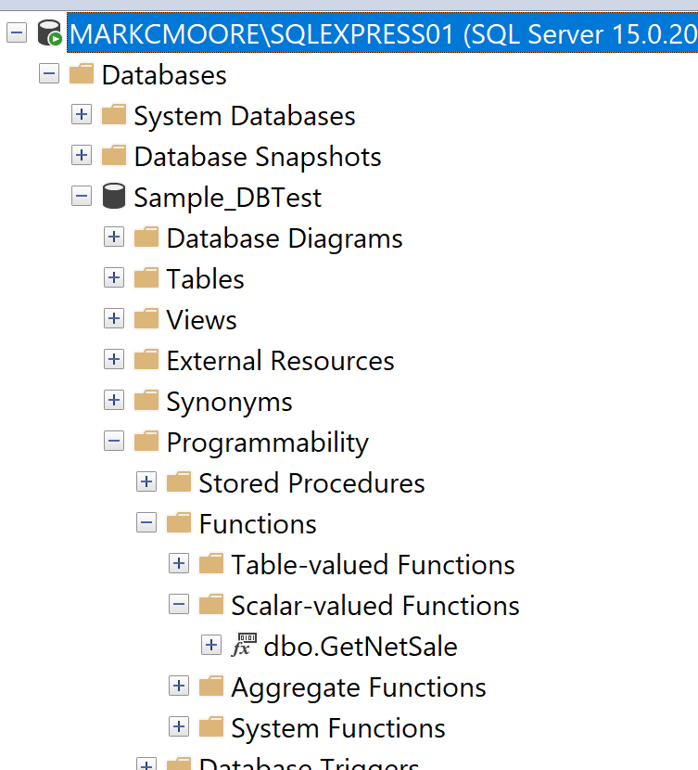
Function access
Object Explorer
>>Databases
>>[DbName]
>>Programmability
>>Functions

Slide 9
AGGREGATE Functions https://docs.microsoft.com/en-us/sql/t-sql/functions/aggregate-functions-transact-sql?view=sql-server-ver15 https://docs.microsoft.com/en-us/sql/t-sql/functions/functions?view=sql-server-ver15#aggregate-functions
Aggregate functions:
perform a calculation on a set of values and returns a single value.
ignore null values (except for COUNT() ).
are often used with the GROUP BY clause of the SELECT statement.
These are Aggregate functions
APPROX_COUNT_DISTINCT | MIN
AVG | STDEV
CHECKSUM_AGG | STDEVP
COUNT | STRING_AGG
COUNT_BIG | SUM
GROUPING | VAR
GROUPING_ID | VARP
MAX

Slide 10

AVG( ) - Average https://docs.microsoft.com/en-us/sql/t-sql/functions/avg-transact-sql?view=sql-server-ver15
AVG() computes the average of a set of values by dividing the sum of those values by the count of non-null values. If the sum exceeds the maximum value for the data type of the return value, AVG() will return an error. AVG() can have 1 or 2 arguments.
ALL – (default) Applies the aggregate function to all values.
DISTINCT - Specifies that AVG() operates only on one unique instance of each value, regardless of how many times that value occurs.
EX. SELECT AVG(ALL NumbersColumn) FROM TableName;
The above example returns the average of all numbers. Even duplicates.
This example returns the average vacation hours each Vice President has and how many total sick leave hours all Vice Presidents have together.

Slide 11

COUNT( ) https://docs.microsoft.com/en-us/sql/t-sql/functions/count-transact-sql?view=sql-server-ver15
COUNT( ) returns the number of items found in a group. COUNT( ) always returns an int.
COUNT( ) has two possible arguments:
ALL - Applies the aggregate function to all values. ALL serves as the default.
DISTINCT - Specifies that COUNT returns the number of unique nonnull values.
This example returns the number of unique job titles there are in all.

Slide 12
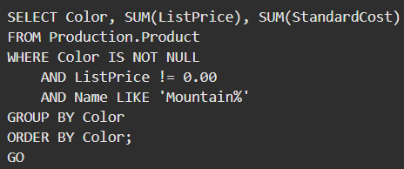
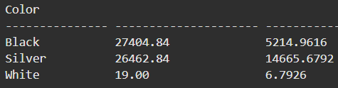
SUM( ) https://docs.microsoft.com/en-us/sql/t-sql/functions/sum-transact-sql?view=sql-server-ver15
SUM() can be used with numeric columns only. Null values are ignored.
SUM( ) has two possible arguments:
ALL – Default. Applies the aggregate function to all values.
DISTINCT - Specifies that SUM returns the sum of unique values.

