Slide 1

Design Patterns
.net

Slide 2
Conceptually, a repository encapsulates operations that can be performed on a Database. Repositories also support the purpose of separating, clearly and in one direction, the dependency between the work domain and the data allocation or mapping. - Martin Fowler
https://docs.microsoft.com/en-us/dotnet/architecture/microservices/microservice-ddd-cqrs-patterns/infrastructure-persistence-layer-design

Slide 3
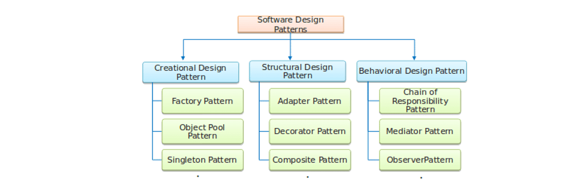
Repository vs Unit-of-Work Patterns https://docs.microsoft.com/en-us/aspnet/mvc/overview/older-versions/getting-started-with-ef-5-using-mvc-4/implementing-the-repository-and-unit-of-work-patterns-in-an-asp-net-mvc-application#:~:text=Dan%20Wahlin%27s%20blog.-,Note,-There%20are%20many
There are many ways to implement the Repository and Unit-of-Work patterns.
You can use repository classes with or without a Unit-of-Work class.
You can implement a single repository for each entity type.
When implementing one entity class for each type, separate classes, a generic base class with derived classes, or an abstract base class and derived classes can be used.
You can include business logic in your repository or restrict it to data access logic.
You can build an abstraction layer into your database context class by using IDbSet interfaces there instead of DbSet types for your entity sets.
Every approach to implementing an abstraction layer is just one option to be considered when creating an application. Choose which pattern is right for your project.

Slide 4
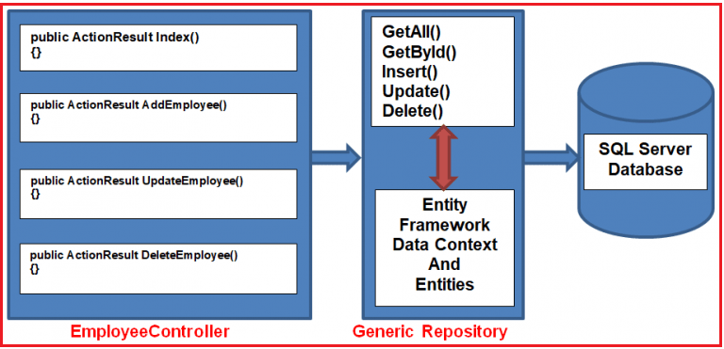
The Repository Pattern https://docs.microsoft.com/en-us/dotnet/architecture/microservices/microservice-ddd-cqrs-patterns/infrastructure-persistence-layer-design#the-repository-pattern https://docs.microsoft.com/en-us/previous-versions/msp-n-p/ff649690(v=pandp.10)?redirectedfrom=MSDN
Repositories are classes that encapsulate the logic required to access data sources. They provide better maintainability and decouple the infrastructure or technology used to access databases from the domain model layer
ADO.NET

Slide 5
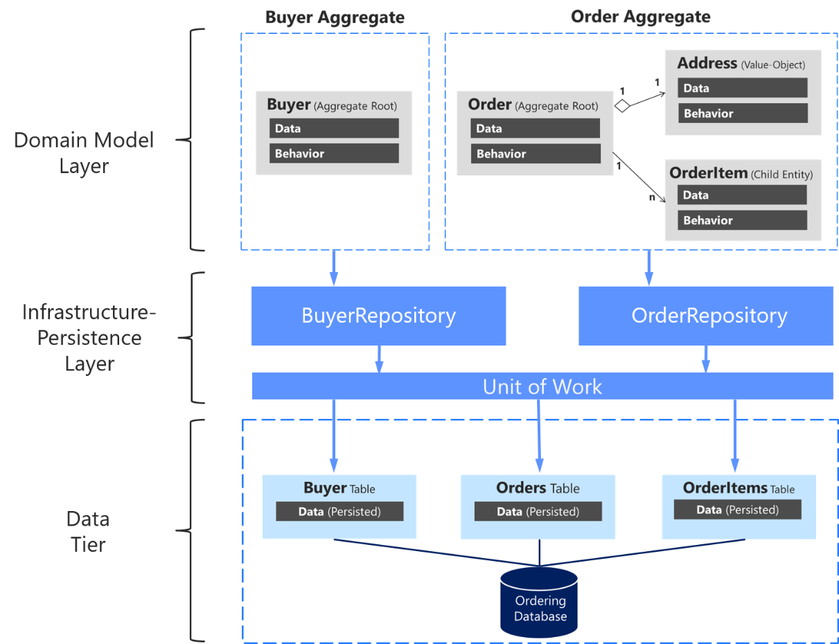
Repository Pattern Best Practices https://docs.microsoft.com/en-us/dotnet/architecture/microservices/microservice-ddd-cqrs-patterns/infrastructure-persistence-layer-design#define-one-repository-per-aggregate
EF Core forces the use of the Repository Pattern.
For each aggregate or aggregate root (a microservice or API), you should create one repository class. This is referred to as Domain-Driven Design (DDD)
The only channel you should use to update the database should be the repositories because they have a one-to-one relationship with the aggregate root.
It's okay to get data from the database through other channels because queries don't change the state of the database.
The transactional area (updates) must always be controlled by the repositories.

Slide 6
Repository Pattern Best Practices https://docs.microsoft.com/en-us/dotnet/architecture/microservices/microservice-ddd-cqrs-patterns/infrastructure-persistence-layer-design#define-one-repository-per-aggregate
A repository allows you to populate data in memory that comes from the database in the form of the domain entities. Once the entities are in memory, they can be changed and then persisted back to the database through transactions.
Data to be updated comes from the client app or presentation layer to the application layer (a WebAPI).
Use repositories to get the data you want to update from the database. Update it in memory with the data passed with the commands, and then add or update the data (domain entities) in the database through a transaction.
Only define one repository for each aggregate. To maintain transactional consistency between all the objects within the aggregate, never create a repository for each table in the database.

Slide 7
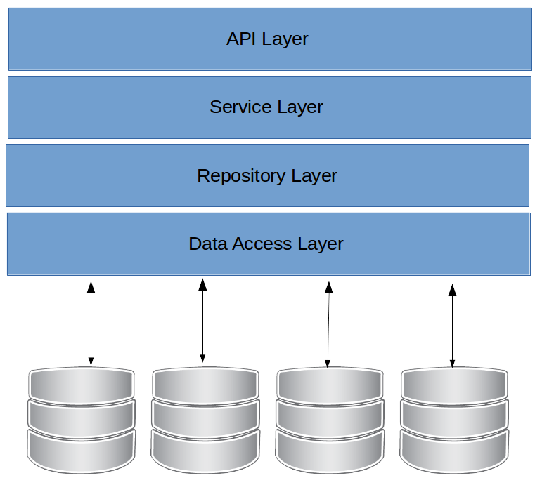
Repository Pattern Benefits https://docs.microsoft.com/en-us/dotnet/architecture/microservices/microservice-ddd-cqrs-patterns/infrastructure-persistence-layer-design#the-repository-pattern-makes-it-easier-to-test-your-application-logic
Unit tests only test code, not infrastructure, so the repository abstractions make it easier to achieve that goal.
When repository interfaces are defined and placed in the domain model layer, the application layer (API service), doesn't depend directly on the infrastructure layer.
Dependency Injection in the Controller of a Web API allows mock repositories to return mocked (staged) data instead of data from the database.
Dependency Injection in Controllers decouples the layers and allows unit tests that focus on the logic of an application without requiring connectivity to a database.

Slide 8
Repository Pattern Structure https://garywoodfine.com/generic-repository-pattern-net-core/
HTTP Call
Controllers/Actions
Business Class
Repository Class
Entity Framework
ADO.NET
Database

Slide 9
Unit of Work Design Pattern https://docs.microsoft.com/en-us/aspnet/mvc/overview/older-versions/getting-started-with-ef-5-using-mvc-4/implementing-the-repository-and-unit-of-work-patterns-in-an-asp-net-mvc-application
The Unit-of-Work Design Pattern helps to minimize redundant code and ensures that all repositories use the same database context. The Unit-of-Work Design Pattern uses a Unit-of-Work class along with a generic repository. The Unit-of-Work class instantiates the generic repository multiple times with different entities to perform the actions needed in one work action (unit of work).
The Unit-of-Work class coordinates the work of multiple repositories by first creating a single database context class. Then it instantiates the generic repo classes shared by all of them.
HTTP Call
Controller Class
Unit-of-Work Class
DataBase Context Class
Player Class
Game Class
Round Class

Slide 10
Unit of Work Design Pattern https://docs.microsoft.com/en-us/aspnet/mvc/overview/older-versions/getting-started-with-ef-5-using-mvc-4/implementing-the-repository-and-unit-of-work-patterns-in-an-asp-net-mvc-application
The unit of work class serves one purpose: to make sure that all repositories share a single database context. When a unit of work (a single action) is complete, call .SaveChanges() on the Db context instance so all related changes are persisted simultaneously.
The Unit-of-Work class needs a Save() method and a property representing an instance of each repository. Each repository property is a repository instance that has been instantiated using the same database context instance as the other repository instances.
HTTP Call
Controller Class
Unit-of-Work Class
DataBase Context Class
Player Class
Game Class
Round Class

Slide 11
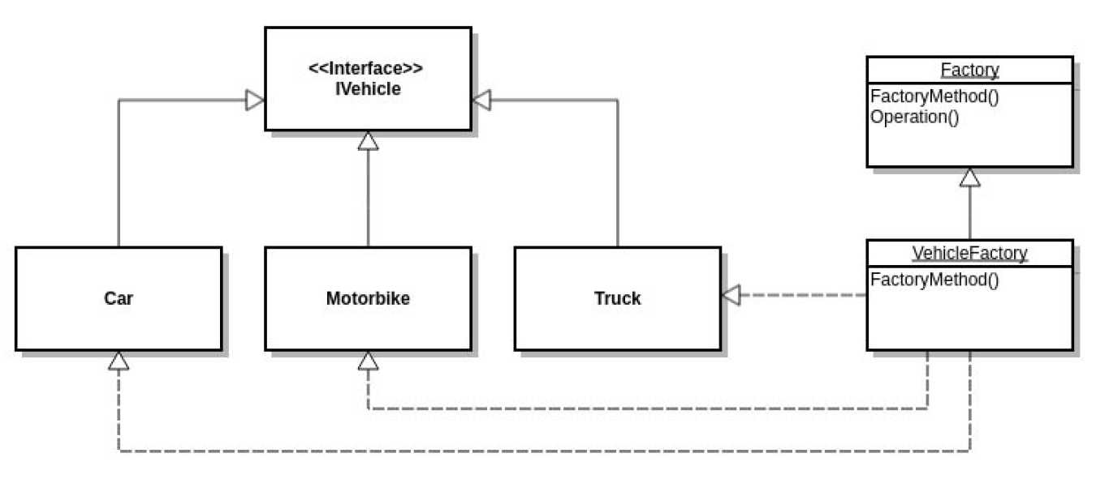
Factory Design Pattern
In Factory pattern, objects are created without exposing the creation logic to the client. The client uses the same interface (UI) to create each new type of object.
The idea is to use a static member-function (static factory method) that creates & returns instances, hiding the details of class modules from the user.
A factory pattern is one of the core design principles to create an object, allowing clients to create objects of a library(explained below) in a way such that it doesn’t have tight coupling with the class hierarchy of the library.

Slide 12
Factory Design Pattern
This class should not have logic to create the correct type of object.
The static FactoryMethod() exists to take responsibility away from the client.

Slide 13
Singleton Design Pattern https://en.wikipedia.org/wiki/Singleton_pattern
The Singleton pattern restricts the instantiation of a class to one single instance. This is useful when exactly one object is needed to coordinate actions across the system.
The singleton design pattern solves problems by allowing it to:
Ensure that a class only has one instance
Easily access the sole instance of a class
Control its instantiation
Restrict the number of instances
Access a global variable
Rock-Paper-Scissors Game
Program.cs
Gameplay Class
Game Class
Rock Class
Paper Class
Scissors Class

Slide 14









UI Layer (project)
[Public static main()]
Models (Class Library)
Business Layer(Class Library)
Repo Layer (Class Library) with ADO.NET
Database

