Slide 1

SQL Triggers
.NET

Slide 2
A Trigger is SQL code that automatically runs instead of or after an INSERT, UPDATE, or DELETE action is performed on a table.
https://docs.microsoft.com/en-us/sql/t-sql/statements/create-trigger-transact-sql?

Slide 3
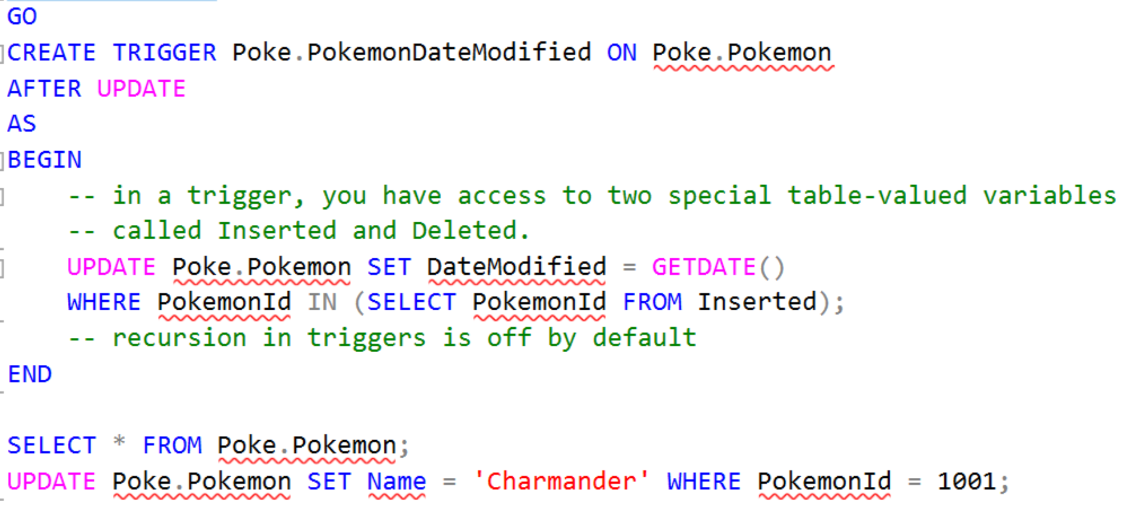
SQL – Triggers https://docs.microsoft.com/en-us/sql/t-sql/statements/create-trigger-transact-sql?view=sql-server-ver15
Code that automatically runs instead of (or after) an insert, update, or delete to a particular table.
CREATE [ OR ALTER ] TRIGGER
[ schema_name . ]trigger_name
ON { table | view }
[ WITH <dml_trigger_option> [ ,...n ] ]
{ FOR | AFTER | INSTEAD OF }
{ [ INSERT ] [ , ] [ UPDATE ] [ , ] [ DELETE ] }
[ WITH APPEND ]
[ NOT FOR REPLICATION ]
AS
{ sql_statement [ ; ] [ ,...n ] |
EXTERNAL NAME [nameOfMethod] }
<dml_trigger_option> ::=
[ ENCRYPTION ]
[ EXECUTE AS Clause ]

Slide 4
Triggers - Overview https://docs.microsoft.com/en-us/sql/relational-databases/triggers/logon-triggers?view=sql-server-ver15
A Trigger is a special type of Stored Procedure. It automatically runs when an event occurs in the database. There are three types of Triggers. DML, DDL, and Logon Triggers.
DML triggers – DML events are INSERT, UPDATE, or DELETE statements on a table or view. These triggers fire when any valid event fires, whether table rows are affected or not.
DDL triggers – These fire in response to a variety of Data Definition Language (DDL) events. These events primarily correspond to CREATE, ALTER, and DROP statements, and certain Stored Procedures that perform DDL-like operations.
Logon triggers - These fire in response to the LOGON event that's raised when a user's session is being established. You can create Triggers directly from SQL statements. SQL Server lets you create multiple triggers for any specific statement.
We will focus on DML triggers.

Slide 5
Trigger Limitations https://docs.microsoft.com/en-us/sql/t-sql/statements/create-trigger-transact-sql?view=sql-server-ver15#trigger-limitations
CREATE TRIGGER must be the first statement in the batch and can apply to only one table.
A Trigger is created only in the current database.
The same Trigger action can be defined for more than one user action (INSERT and UPDATE) in the same CREATE TRIGGER statement.
INSTEAD OF, DELETE, and UPDATE Triggers can't be defined on a table that has a Foreign Key with a cascade on DELETE/UPDATE action defined.
When a Trigger fires, results are returned to the calling application, just like with Stored Procedures.
Most DDL statements are not allowed in a DML Trigger.

Slide 6
DML Triggers - Overview https://docs.microsoft.com/en-us/sql/relational-databases/triggers/dml-triggers?view=sql-server-ver15 https://docs.microsoft.com/en-us/sql/t-sql/statements/create-trigger-transact-sql?view=sql-server-ver15
A DML Trigger is a special type of Stored Procedure that automatically takes effect when a INSERT, UPDATE, or DELETE takes place that affects the table or view defined in the trigger.
The Trigger and the statement that fires it are treated as a single transaction, which can be “rolled back” from within the trigger. If an error is detected, the entire transaction automatically rolls back.
DML triggers are frequently used for enforcing business rules and data integrity. If constraints exist on a trigger table, they're checked after the INSTEAD OF trigger runs and before the AFTER trigger runs. If the constraints are violated, the INSTEAD OF trigger actions are rolled back and the AFTER trigger isn't fired.
An AFTER trigger is run only after the triggering SQL statement has run successfully.
INSTEAD OF triggers will not run recursively. This means that if it is defined on a table and runs a statement against the same table, the trigger is prevented from being called. Instead, the statement processes as if the table had no INSTEAD OF trigger and starts the chain of constraint operations and AFTER trigger executions.

Slide 7
DML Trigger Benefits https://docs.microsoft.com/en-us/sql/relational-databases/triggers/dml-triggers?view=sql-server-ver15#dml-trigger-benefits
DML triggers:
can cascade changes through related tables in the database.
can guard against malicious or incorrect INSERT, UPDATE, and DELETE operations and enforce other restrictions that are more complex than those defined with CHECK constraints.
can reference columns in other tables
can evaluate the state of a table before and after a data modification and take actions based on that difference.
can disallow or roll back changes that violate referential integrity.

Slide 8
DML Triggers Types https://docs.microsoft.com/en-us/sql/relational-databases/triggers/dml-triggers?view=sql-server-ver15#types-of-dml-triggers
AFTER Trigger | INSTEAD OF Trigger
are executed after the action of a INSERT, UPDATE, or DELETE statement. are never executed if a constraint violation occurs. | overrides the standard actions of the triggering statement. can be used to perform error or value checking on one or more columns and perform additional actions before INSERT, UPDATE or DELETE. enables views that would not be updatable to support updates. enables you to reject parts of a batch while letting other parts of a batch succeed.

Slide 9
DML Trigger Types Syntax https://docs.microsoft.com/en-us/sql/relational-databases/triggers/dml-triggers?view=sql-server-ver15#types-of-dml-triggers
AFTER and INSTEAD OF Triggers
CREATE [ OR ALTER ] TRIGGER [ schema_name . ]trigger_name ON { table | view } [ WITH <dml_trigger_option> [ ,...n ] ] { FOR | AFTER | INSTEAD OF } { [ INSERT ] [ , ] [ UPDATE ] [ , ] [ DELETE ] } [ WITH APPEND ] [ NOT FOR REPLICATION ] AS { sql_statement | EXTERNAL NAME <method specifier [ ; ] > } <dml_trigger_option> ::= [ ENCRYPTION ] , [ EXECUTE AS Clause ] <method_specifier> ::= assembly_name.class_name.method_name

Slide 10
CREATE an ‘AFTER’ Trigger (1/3) https://docs.microsoft.com/en-us/sql/t-sql/statements/create-trigger-transact-sql?view=sql-server-ver15 https://www.sqlservertutorial.net/sql-server-triggers/sql-server-create-trigger/
IMPORTANT: When an INSERT or DELETE operation is completed, there are two internal tables populated. They are called “INSERTED” and “DELETED”.
Below, we’ll create a table that allows a record of things deleted or inserted into the Customers table to be maintained.
Create a special table (Customer_audits) to record INSERT and DELETE actions, then use the UNION ALL operator to grab that latest data from the appropriate internal (‘inserted’ or ‘deleted’) table and copy it to the ‘audit’ table.
We will place a trigger on the Customers table.
CREATE TABLE Customer_audits
(
--record a unique id of the change
ChangeId INT IDENTITY PRIMARY KEY,
CustomerId INT NOT NULL,
FirstName VARCHAR(255),
LastName VARCHAR(255),
AddressID INT,
LastOrderDate DATE,
Remarks VARCHAR(255),
--record when the operation happened
UpdatedAt DATETIME NOT NULL,
--Record what type of operation it is.
Operation CHAR(3) NOT NULL,
CHECK(operation = 'INS' or operation = 'DEL')
);

Slide 11
CREATE an ‘AFTER’ Trigger (2/3) https://www.sqlservertutorial.net/sql-server-triggers/sql-server-create-trigger/
Create a Trigger called ‘WhenCustomerAdded’.
When an INSERT or DELETE action occurs on the Customers table, the Trigger will copy the data from the deleted or inserted internal tables into the Customer_audits table using a UNION ALL statement.
CREATE TRIGGER WhenCustomerAdded
ON Customers
AFTER INSERT, DELETE
AS
BEGIN
-- to suppress the number of rows affected
-- messages from being returned (@@ROWCOUNT)
SET NOCOUNT ON;
INSERT INTO Customer_audits
(
CustomerId,FirstName,LastName,AddressID,
LastOrderDate,Remarks,UpdatedAt,Operation
)
SELECT
CustomerId,FirstName,LastName,AddressID,
LastOrderDate,Remarks,GETDATE(),'INS'
FROM
inserted
UNION ALL
SELECT
CustomerId,FirstName,LastName,AddressID,
LastOrderDate,Remarks,GETDATE(),'DEL'
FROM
deleted
END

Slide 12
CREATE an ‘AFTER’ Trigger (3/3) https://www.sqlservertutorial.net/sql-server-triggers/sql-server-create-trigger/
Now, test that the Trigger works by inserting and/or deleting something from the Customers table and then checking the Customer_audits table for any new rows.
--INSERT a new Customer
INSERT INTO Customers
(FirstName, LastName, AddressID, LastOrderDate, Remarks)
VALUES
('Test', 'Testerson', 6, '0999-12-31', 'Testing for the first millennium’);
--Look at the Customer_audits table
SELECT * FROM Customer_audits;

Slide 13
Create an ‘INSTEAD OF’ Trigger (1/3) https://docs.microsoft.com/en-us/sql/t-sql/statements/create-trigger-transact-sql?view=sql-server-ver15 https://www.sqlservertutorial.net/sql-server-triggers/sql-server-instead-of-trigger/
IMPORTANT: When an INSERT or DELETE operation is completed, there are two internal tables populated. They are called “INSERTED” and “DELETED”.
An INSTEAD OF Trigger maintain a record of changes people make and allow those changes to be approved by others.
Create a special table (Customers_pending) to record pending INSERT and DELETE actions, then use the UNION ALL operator to grab that latest data from the appropriate internal (‘inserted’ or ‘deleted’) table and copy it to the ‘audit’ table.
We will place a Trigger on the Customers table.
CREATE TABLE Customers_pending
(
--record a unique id of the change
PendingChangeId INT IDENTITY PRIMARY KEY,
FirstName VARCHAR(255),
LastName VARCHAR(255),
AddressID INT,
LastOrderDate DATE,
Remarks VARCHAR(255),
);

Slide 14
CREATE an ‘INSTEAD OF’ Trigger (2/3) https://www.sqlservertutorial.net/sql-server-triggers/sql-server-create-trigger/
This statement Creates a view, NewCustomerAdded.
When there is an INSERT action on the Customers table, it will copy the data from the inserted internal table into the Customers_pending table.
CREATE TRIGGER NewCustomerAdded
ON Customers
INSTEAD OF INSERT
AS
BEGIN
-- to suppress the number of rows affected
-- messages from being returned (@@ROWCOUNT)
SET NOCOUNT ON;
INSERT INTO Customers_pending
(
FirstName,LastName,AddressID,
LastOrderDate,Remarks
)
SELECT
FirstName,LastName,AddressID,
LastOrderDate,Remarks
FROM
inserted
END

Slide 15
CREATE an ‘INSTEAD OF’ Trigger (3/3) https://www.sqlservertutorial.net/sql-server-triggers/sql-server-create-trigger/
Now test that the Trigger works by inserting something into the Customers table and then checking the Customers_pending table for new rows.
--INSERT a new Customer
INSERT INTO Customers
(FirstName, LastName, AddressID, LastOrderDate, Remarks)
VALUES
('Testy ‘McTesterson',6, '0999-12-31', ‘Testing the Test of a test’);
--Look at the Customers_pending table
SELECT * FROM Customers_pending;

