Slide 1





Introduction to Robotic Process Automation
Entertainment rating and Recommendation Bot
Logeshwaran T
220701145
BE CSE-C

Slide 2
Abstract
The project “Entertainment Rating and Recommendation Bot” focuses on utilizing Robotic Process Automation (RPA) with UiPath to extract detailed movie information from online sources, such as IMDb. The bot retrieves data such as movie ratings, cast, release date, storyline description, and cost. Additionally, the system automates the process of recommending similar movies based on user preferences and sends these recommendations via email. The solution aims to streamline movie data retrieval and provide personalized recommendations in an efficient manner, enhancing the user experience and saving time.

Slide 3
Need for the Proposed System
The proposed solution is to build an automatede information and recommendation system using UiPath RPA. This system will streamline the process by fetching detailed movie information—such as ratings, costs, cast details, synopses, and release dates— using web scraping or APIs from movie databases. It will also analyze user preferences to generate personalized movie recommendations and deliver them directly via email .

Slide 4
Main Objective
The objective of this project is to develop an efficient, automated system using UiPath RPA to simplify the process of retrieving and analyzing movie-related information. It aims to fetch comprehensive details such as movie ratings, costs, cast members, storyline descriptions, and release dates by integrating APIs or web scraping techniques.

Slide 5
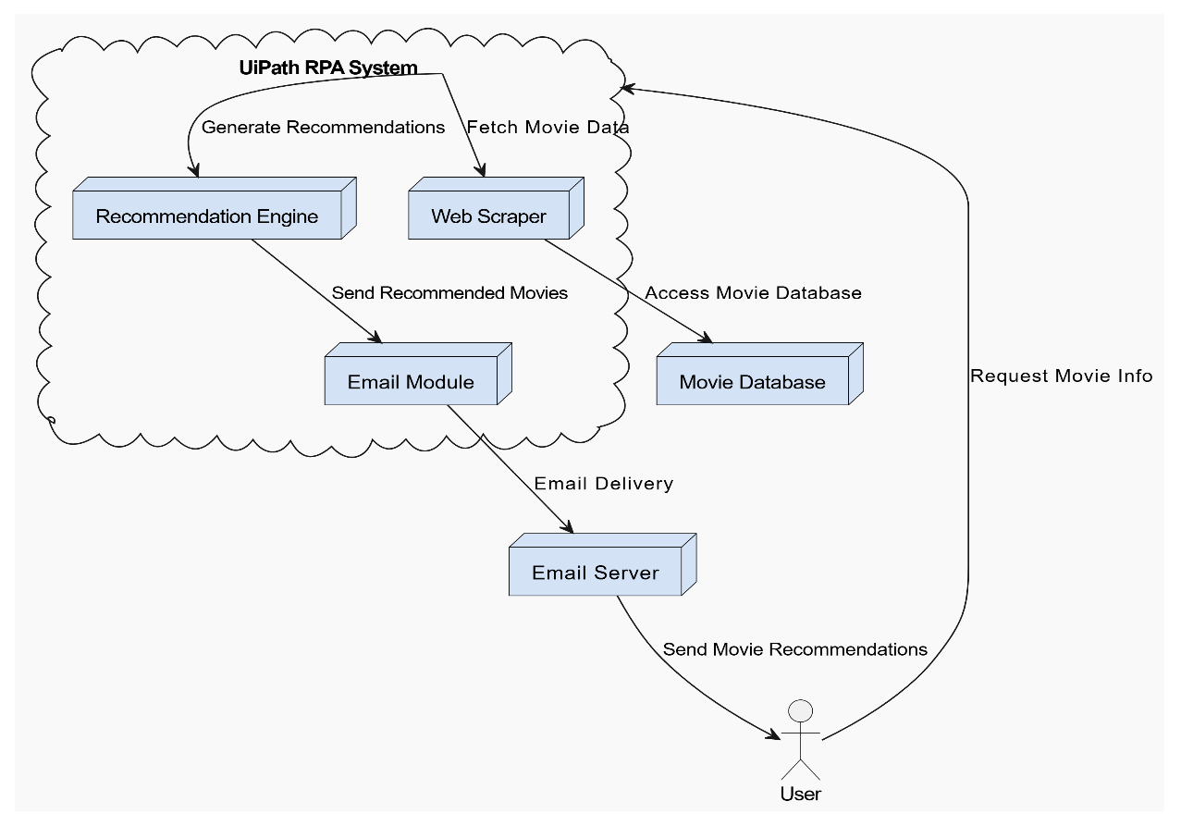
Architecture

Slide 6
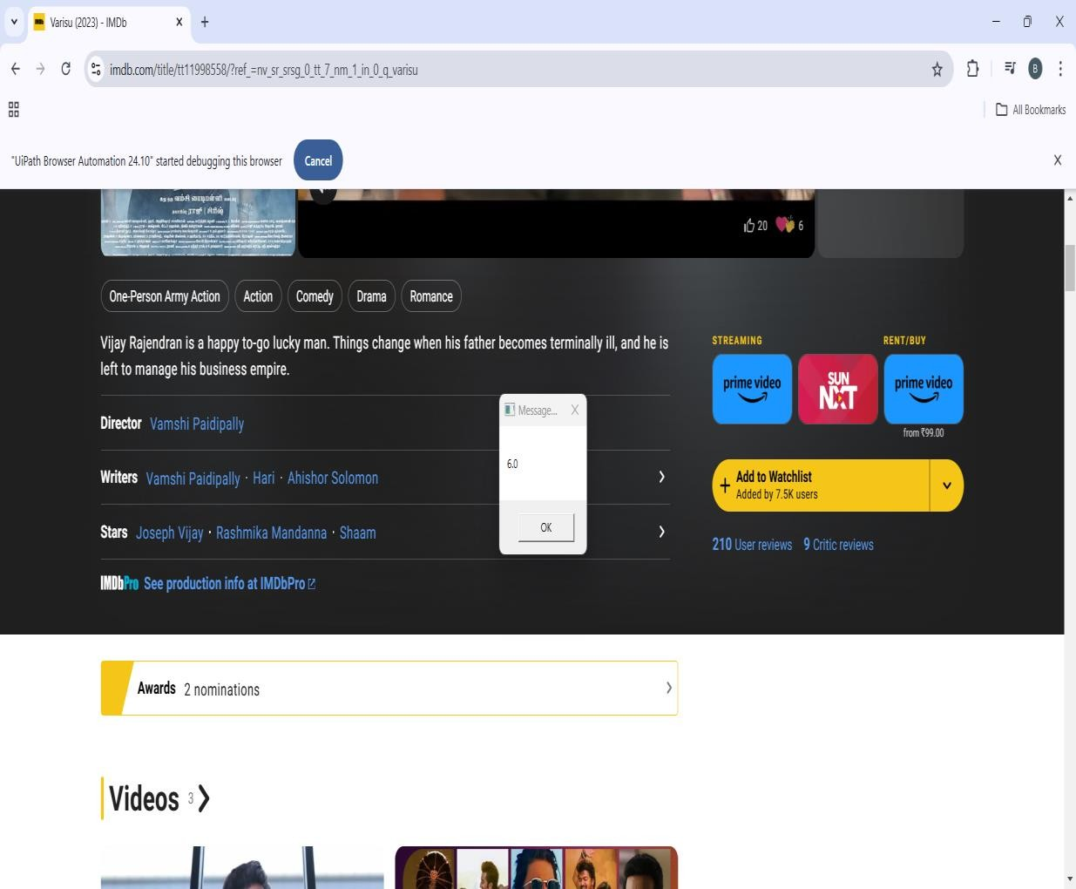
Implementation

Slide 7
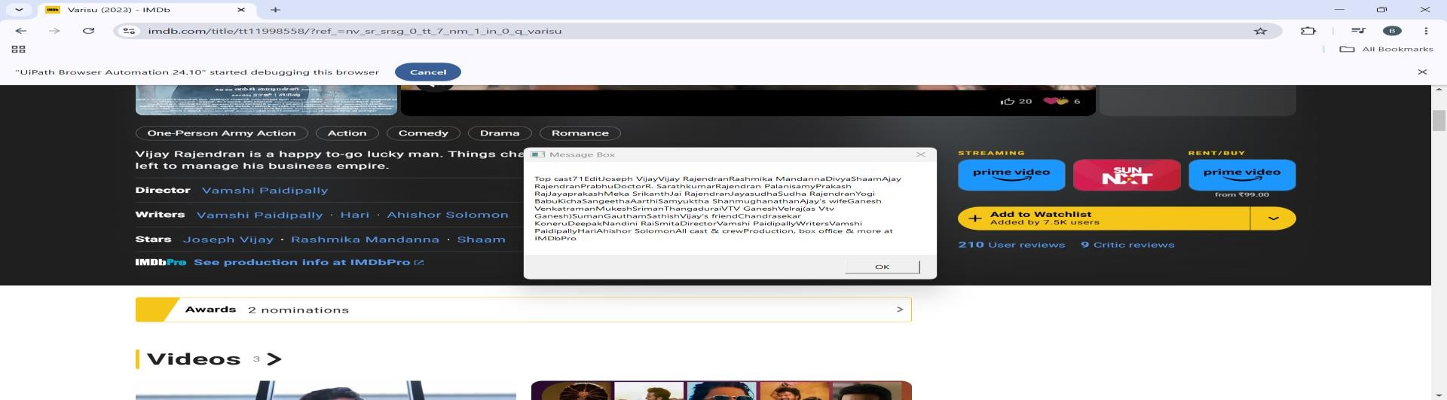

Slide 8
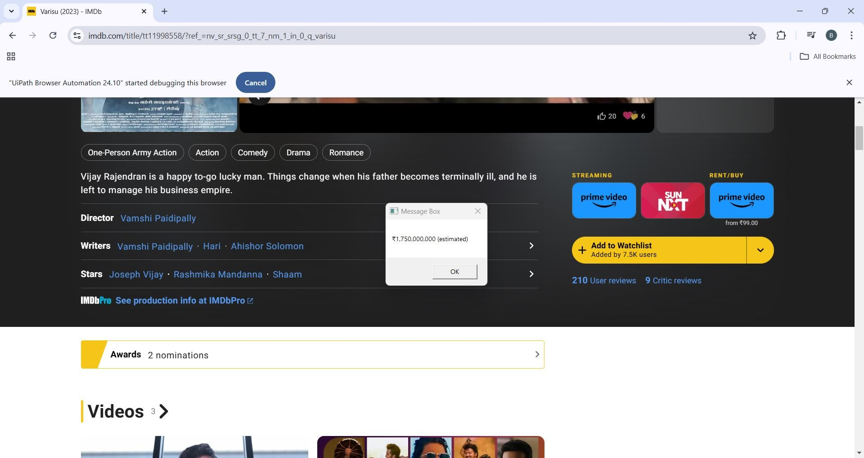

Slide 9
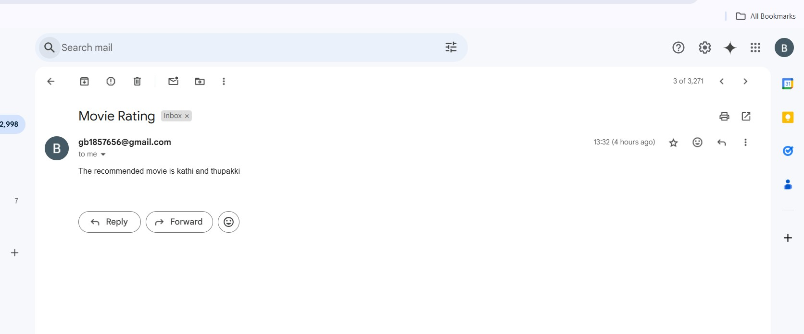

Slide 10
Conclusions
The UiPath-based RPA project designed to automate the extraction of movie information from IMDb demonstrates significant efficiency in retrieving essential details such as ratings, cost, actors, short description, and release dates. By automating the process, the bot minimizes manual efforts and enhances accuracy in gathering data from multiple movies. Additionally, the integration of email functionality to send recommended movies further optimizes the workflow, ensuring that users receive personalized content updates seamlessly. This project exemplifies how UiPath's automation capabilities can be effectively applied to data extraction tasks, saving time while maintaining precision.

Slide 11
References
[1]. UiPath Official Website – For more details on how UiPath helps automate business processes and its use in robotic process automation, visit [UiPath](https://www.uipath.com)
.
[2]. IMDb – To understand how data is retrieved from IMDb, the movie information platform, check out [IMDb](https://www.imdb.com).
These references provide the foundational understanding of UiPath's capabilities and how web data can be efficiently extracted and managed using RPA.

Slide 12
Queries

Slide 13
Thank You

