Slide 1


Department of Computer Science and Engineering
ChildSaver: AI-Powered Borewell Hazard Detection System
Dr. S. SenthilPandi., M.E., Ph.D.,
Assistant Professor
Department of Computer Science and Engineering
SIVATHANU K P (2116220701280)
VIKNESH J (2116220701321)
SASIKUMAR (2116220701525)

Slide 2
Problem Statement and Motivation
Problem: Over 1.2 million uncovered borewells in rural India cause 200+ child fatalities annually.
Limitations of Current Solutions: Manual monitoring, high costs, and lack of real-time alerts.
Motivation: Need for an affordable, automated system to detect and alert hazards proactively

Slide 3
Existing System
Relies on physical covers (often missing/stolen).
Community vigilance is inconsistent and unreliable.
Basic vibration sensors generate high false alarms.
No GPS integration for precise location tracking.
Delayed rescue ops due to lack of instant alerts.
High maintenance costs for manual inspections.

Slide 4
Objectives
Detect open borewells using multi-sensor fusion.
Classify threats (child vs. debris) with >95% accuracy.
Send real-time alerts via GSM/GPS within 5 seconds.
Ensure affordability (<₹5,000 per unit).
Minimize power usage for rural deployment.
Enable scalability across diverse terrains.

Slide 5
Abstract
ChildSaver combines ultrasonic/IR sensors, edge AI, and cellular networks to:
Automatically identify open borewells.
Classify threats (child vs. debris) with 96.5% accuracy.
Transmit alerts within 5 seconds via GSM/GPS.

Slide 6
Proposed System
Ultrasonic sensors measure borewell depth.
IR sensors detect body heat/movement.
Edge AI (Random Forest) processes data locally.
GPS pins hazard locations for rescue teams.
GSM modules transmit alerts to authorities.
Solar-powered for off-grid sustainability.

Slide 7
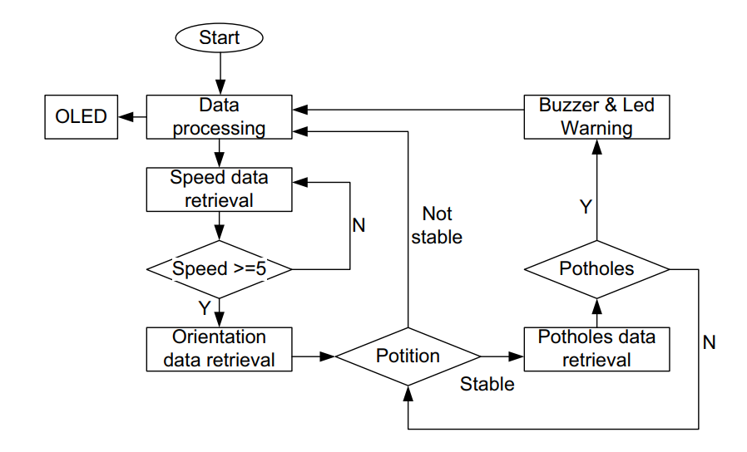
System Architecture
Sensor layer: HC-SR04 (ultrasonic) + AMG8833 (IR).
Edge layer: Raspberry Pi runs TinyML model.
Cloud layer: PostgreSQL logs incidents.
Alert layer: SIM800L GSM for SMS alerts.
UI layer: Mobile dashboards for real-time monitoring.
Fail-safe: Offline data sync when network is available.

Slide 8
List of Modules
Data Acquisition: Collects depth/thermal readings.
Signal Processing: Filters noise, normalizes data.
Threat Detection: ML model classifies hazards.
Alert System: Triggers GPS/GSM notifications.
Cloud Integration: Stores incident history.
User Interface: Displays alerts on mobile/web.

Slide 9
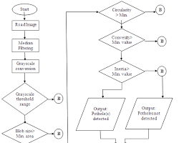
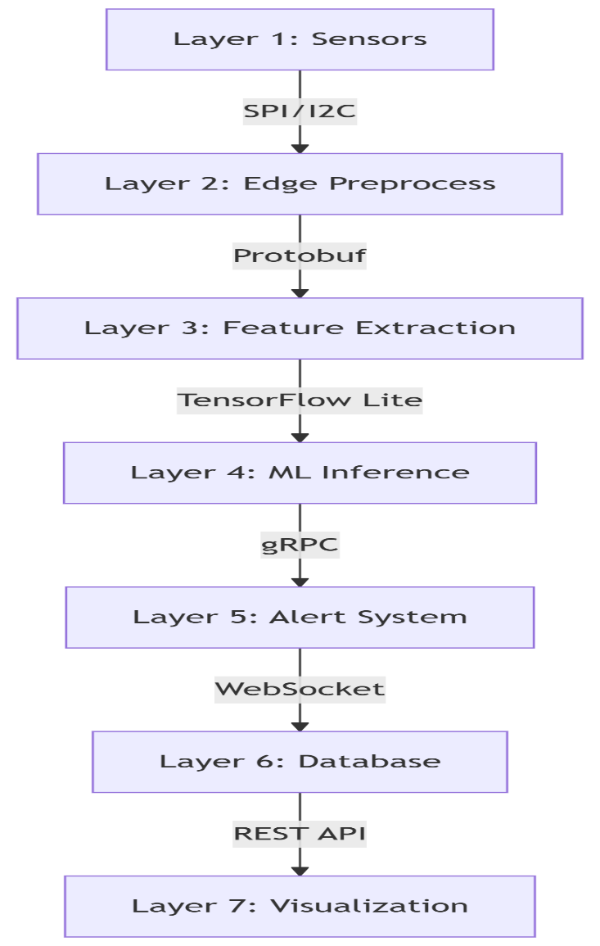
Functional Description for each modules with DFD and Activity Diagram
DFD (Fig 3.3):
Input: Sensor data → Processing: ML model → Output: Alerts.
Activity Diagram (Fig 3.2):
Continuous monitoring → Hazard detection → Alert escalation.
Fig 3.2 Fig 3.3

Slide 10
Implementation & Results of Module
96.5% accuracy in lab/field tests.
<5 sec response time from detection to alert.
₹4,800 unit cost (prototype).
Works in extreme temps (0°C–50°C).
Low power (5V battery/solar compatible).
Scalable to 10,000+ nodes via LoRaWAN

Slide 11
Conclusion & Future Work
Drone-assisted scanning for remote areas.
Robotic arms for emergency rescue.
Blockchain logs for tamper-proof records.
AI enhancements: Predict high-risk zones.
Govt. partnerships for mass deployment.
Multi-hazard adaptation (wells, manholes).

Slide 12
References
k ] S. RenugaDevi, M. Dharshini, K. Gayathri, B. Gopalakrishnan, “IoT based detection of bore-well unclosed holes using automated drone operated cameras in a remote area”, Journal of Physics: Conference Series, Vol. 1767, No. 1, 012028, 1 Feb 2021
R. Logarasu, R. Manokaran, K. Hari Krishnan, K. Gowtham, “SMART BOREWELL CHILD RESCUE SYSTEM IN WIRELESS MONITORING USING AI”, International Journal of Creative Research Thoughts (IJCRT), Vol. 12, Issue 1, January 2024
Nataraj K.B., Raghavendra C. Sappandi, Girish S.N., Priya K.M., Ravi J., “Smart Borewell Child Rescue System and Monitoring”, Journal of Emerging Technologies and Innovative Research (JETIR), Vol. 11, Issue 5, May 2024.
S. RenugaDevi, M. Dharshini, K. Gayathri, B. Gopalakrishnan, “IoT based detection of bore-well unclosed holes using automated drone operated cameras in a remote area”, Journal of Physics: Conference Series, Vol. 1767, No. 1, 012028, February 2021.
S. K. Sharma, R. K. Gupta, A. Verma, P. Singh, “An IoT-Based Smart Borewell Monitoring and Rescue System”, 2023 IEEE International Conference on Smart Technologies and Systems for Next Generation Computing (ICSTSN), Chennai, India, 2023.
A. Kumar, B. Singh, C. Patel, D. Sharma, “IoTBased Borewell Rescue System Using AI and Robotics”, 2023 IEEE International Conference on Advanced Computing and Communication Systems (ICACCS), Coimbatore, India, 2023.

Slide 13
References
T.SR.CH. Murthy, SK. Nayab Rasool, R. Ramprakash, “Smart Borewell Vehicle Monitoring System: A Microcontroller-Based GSM Informer”, International Journal for Research in Applied Science and Engineering Technology (IJRASET), Vol. 11, Issue 5, May 2023
Hadistian Muhammad Hanif, Zener Sukra Lie, Winda Astuti, Sofyan Tan, “Pothole Detection System Design with Proximity Sensor to Provide Motorcycle with Warning System and Increase Road Safety Driving,” IOP Conference Series: Earth and Environmental Science, vol. 426, Article 012039, March 2020.
Sijia Zhao,Donal O’Mahony "A Blockchain and Smart Contract Based Application for pharmaceutical Copyright Protection" 20 dec 2018.
Aravind N. Kaimal, Bijith P. B., Midhun C. Baiju, Muhammed Suhail K. S., “Borewell Child Rescue System”, International Research Journal of Engineering and Technology (IRJET), Vol. 7, Issue 9, September 2020.
T.SR.CH. Murthy, SK. Nayab Rasool, R. Ramprakash, “Smart Borewell Vehicle Monitoring System: A Microcontroller-Based GSM Informer”, International Journal for Research in Applied Science and Engineering
Chaithanya Kumar Reddy D, Charitha Sai B, Dhanuja S, Ganesh J, Aravind R, Thangarasan T, “Comprehensive Borewell Control and Sprinkler Oversight with Mobile IoT”, International Journal of Business and Management Invention (IJBMI), Vol. 13, Issue 6, pp. 69–72, June 2024.
Shriram Bhende, Samyak Meshram, Saiabhishek Turke, Prof. Hemangi Shinde, “Implementation of Child Rescue from Borewell Section Using IoT Module”, International Research Journal of Innovations in Engineering and Technology (IRJIET), Vol. 8, Issue 4, pp. 249–253, April 2024.

Slide 14
Thank You

