Slide 1
AI-POWERED MEDICAL REPORT SUMMARIZER
Presented By:
Student Name: Palak Agrawal
College Name: S.S. College of Education, Sarbahar C.G.
Department: Science
4. AICTE ID: STU6a686a9a99d481785227930

Slide 2
OUTLINE
Problem Statement (Should not include solution)
Proposed System/Solution
System Development Approach (Technology Used)
Algorithm & Deployment
Result
Conclusion
Future Scope
References

Slide 3
Problem Statement
Medical reports such as blood tests, discharge summaries, and imaging reports are often written in complex clinical language filled with technical terms, abbreviations, and numerical values. Most patients find it difficult to understand what their reports actually mean, why a particular value is high or low, or what it may imply for their health. This can lead to unnecessary anxiety, misinterpretation of medical information, and difficulty in preparing the right questions for their doctor during consultations. Therefore, there is a need for a simple and accessible tool that can instantly translate medical reports into clear, patient-friendly language while ensuring that it does not replace professional medical advice.

Slide 4
Proposed Solution
MedReport Simplifier is an AI-powered web application that converts complex medical reports into clear, patient-friendly summaries. The solution consists of the following components:
Report Upload:
  Accept medical reports in multiple formats – PDF (lab reports, discharge summaries, imaging reports), scanned images (PNG/JPG), and plain text.
  Allow the user to optionally add personal context, such as age, existing conditions, medications, or reason for the test.
Text Extraction:
  Extract raw text from the uploaded file, handling both digital documents and scanned/image-based reports.
AI-Based Analysis:
  Send the extracted text, along with a carefully engineered prompt, to Google’s Gemini 3.6 Flash model.
  The model identifies what the report is about, explains key findings in plain language, and highlights results that need attention.
Patient-Friendly Output:
  Generate a structured summary covering: what the report means, key findings explained simply, flagged results, recommended next steps, and questions to ask the doctor.
Deployment:
  Build an easy-to-use web interface using Streamlit.
  Deploy the application on Streamlit Community Cloud so it is accessible to anyone with a browser.
Output & Download:
  Let users download the simplified summary as a text (.txt) or Markdown (.md) file for future reference or to share with their doctor.

Slide 5
System Approach
The System Approach outlines the overall strategy and technology stack used to build and run the MedReport Simplifier application:
System Requirements
  Python 3.x runtime with internet access for API calls
  A valid Google Gemini API key for report analysis
  Web browser to access the deployed Streamlit application
Libraries & Tools Used
  Streamlit – for building the interactive web interface
  google-genai – Python SDK to call the Gemini 3.6 Flash model
  PDF and image handling libraries to read uploaded reports
  Git & GitHub for version control and code hosting

Slide 6
Algorithm & Deployment
The application relies on prompt-engineered generative AI rather than a traditionally trained ML model. Here is how it works:
Model Selection:
  Uses Google’s Gemini 3.6 Flash, a fast multimodal large language model, chosen for its strong language understanding and low latency – ideal for real-time report summarization.
Data Input:
  Text extracted from the uploaded report (PDF, image, or plain text), along with optional patient context such as age, existing conditions, and medications.
Prompt Engineering (in place of Training):
  A structured system prompt instructs the model to act as a compassionate medical communication specialist and to always follow a fixed response format: What This Report Is About, Key Findings, Findings That Need Attention, Recommended Next Steps, Questions to Ask the Doctor, and Reassurance & Summary.
Prediction / Generation Process:
  The extracted text and prompt are sent to the Gemini API, which returns a plain-language, structured summary that is rendered directly in the app.
Deployment:
  Built with Streamlit and deployed on Streamlit Community Cloud, with the source code hosted and version-controlled on GitHub.

Slide 7
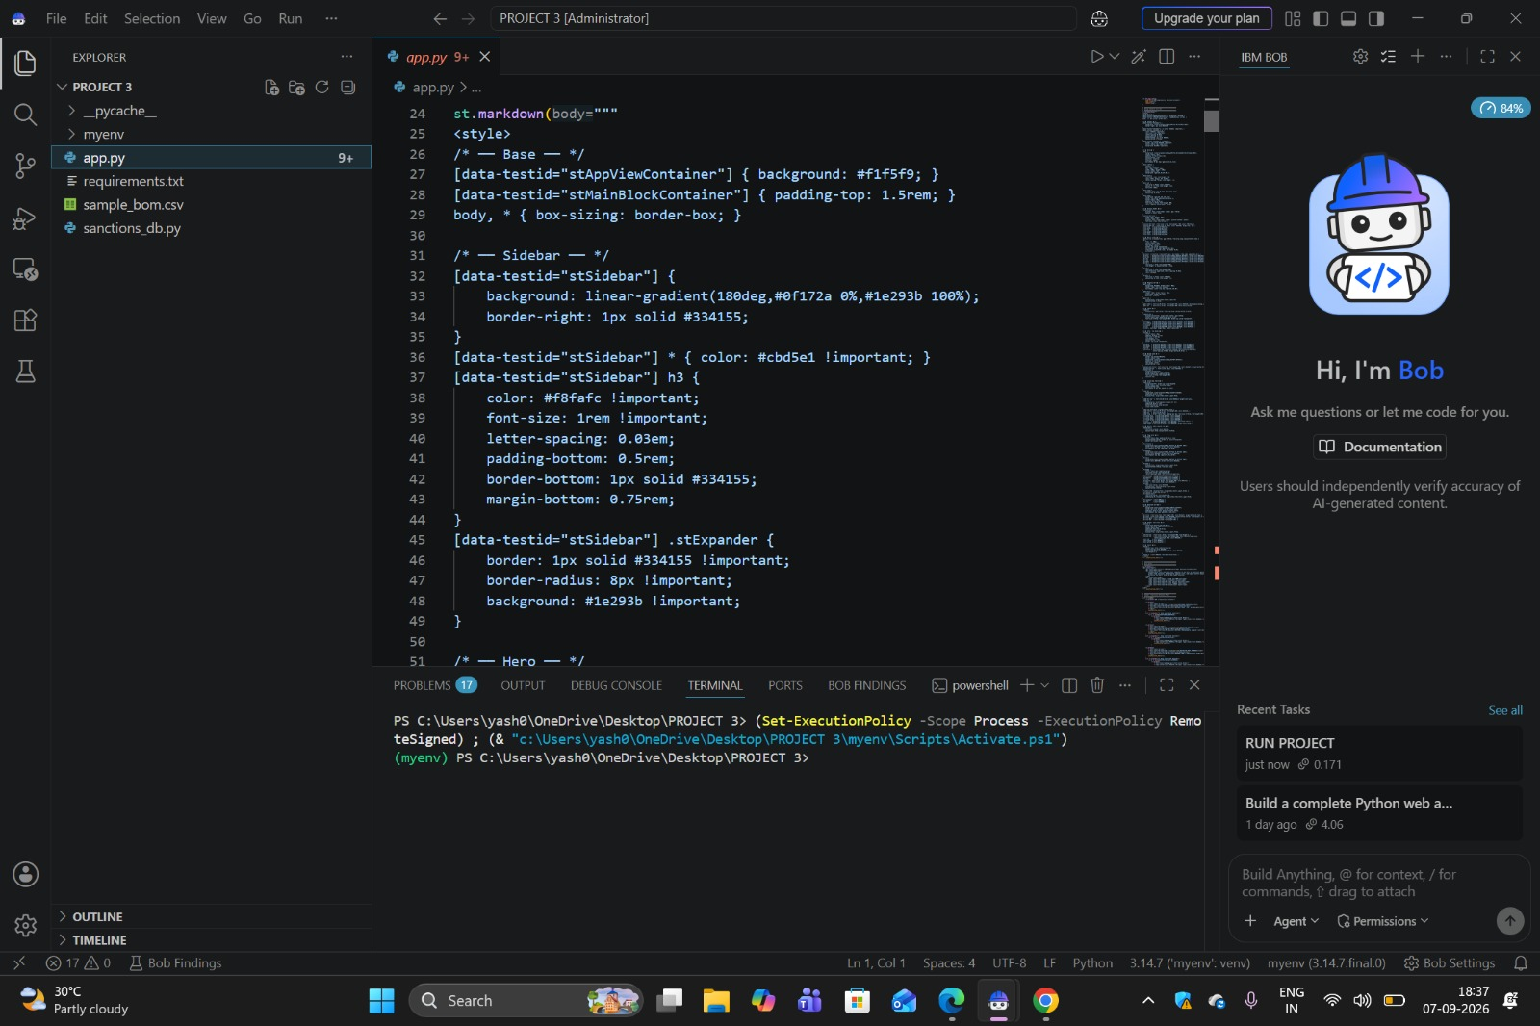
Result
The app was tested with a sample blood report. It correctly extracted the data and generated an accurate, well-structured, plain-language summary, as shown below:
IBM BOB CODE

Slide 8
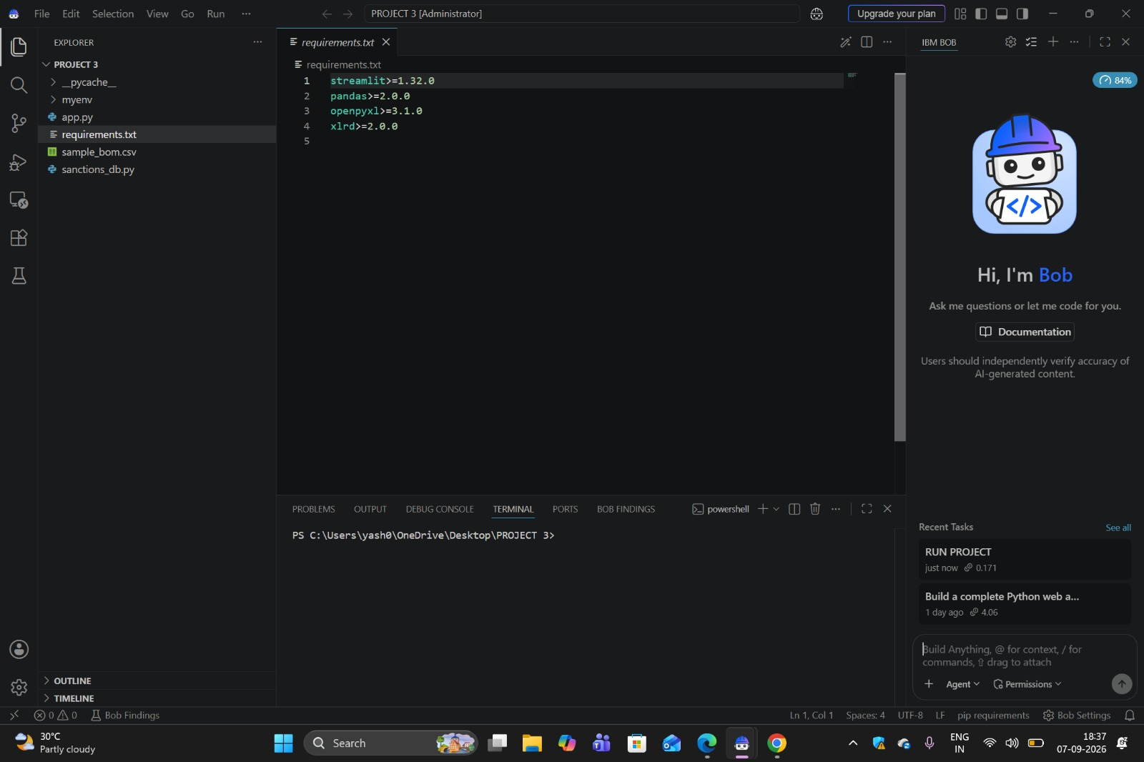
Result
Requirement File(BOB)

Slide 9
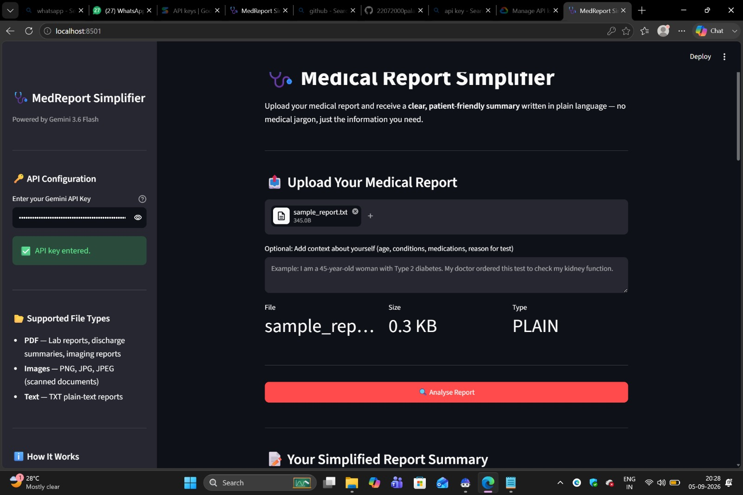
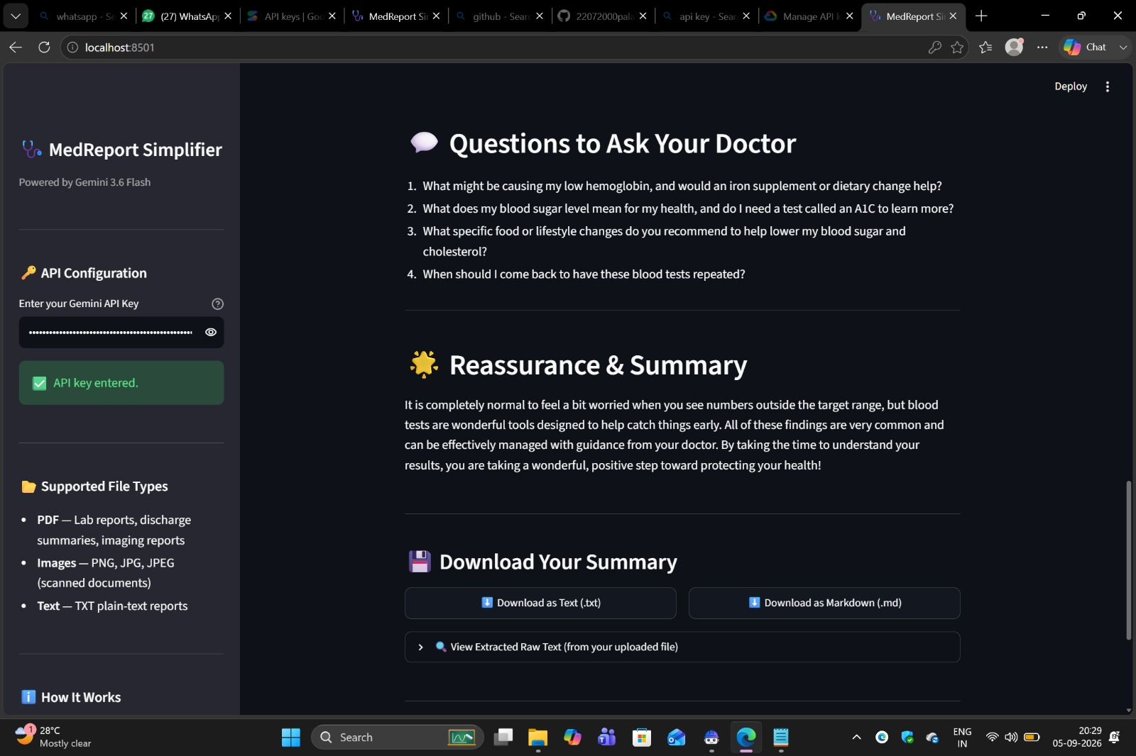
Result
Upload Report(Local host)

Slide 10
Result
Question to Ask Doctor

Slide 11
Conclusion
MedReport Simplifier successfully converts complex medical reports into clear, patient-friendly summaries using Gemini 3.6 Flash and a well-structured prompt. The app correctly identifies key findings, flags results needing attention, and suggests relevant follow-up questions, making medical reports easier to understand for non-medical users. Challenges included handling varied report formats and ensuring the AI's output stays consistent, structured, and medically responsible. The current version provides a solid, working foundation for a genuinely useful patient-support tool.

Slide 12
Future scope
Add support for more languages so non-English speaking patients can also benefit. Improve OCR accuracy for handwritten and low-quality scanned reports. Allow users to securely save report history and track health trends over time. Integrate with hospital or lab systems (EHR) for direct report import. Build a mobile app version for easier access on the go. Add voice-based summaries for visually impaired or elderly users.

Slide 13
References
Sources and documentation referred to while building MedReport Simplifier:
Project GitHub Repository
Google Gemini API Documentation
Streamlit Documentation

Slide 14
Deployment link / github link
GitHub Link: github.com/22072000palak-boop/Medical-Agent
Deployment Platform: https://streamlit.io
Live App Link: medical-agent-qwhjbmvr8ncrrmhvticiuo.streamlit.app

Slide 15
THANK YOU

