Slide 1
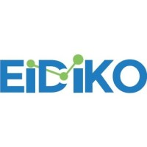
Eidiko - Leading digital and integration service provider

Slide 2



INTRODUCTION
Name: EIDIKO Systems Integrators Private Limited.
Founded: December 10, 2010, Maggari Srinivas
Nature of Business: EIDIKO is a private IT services and consulting company.
it delivers secure, scalable solutions across cloud,
security, and content management domains.

Slide 3
COMPANY PRESENCE
In India
City | State | Details
Mumbai | Maharashtra | Regional Office
Hyderabad | Telangana | Headquarters – Gachibowli, MJR Magnifique
International Offices
City | Country | Details
Charlotte, NC | United States | US Operations
London | United Kingdom | UK Presence
Dubai | United Arab Emirates | Middle East Operations

Slide 4


Slide 6
Key Projects.
🔗 Connecting Systems (Integration)
They make different apps and systems talk to each other.
🚀 Automating Work (DevOps & Cloud)
They set up tools that automatically test and launch software.
🌐 Managing APIs (Digital Gateways)
They build secure “digital doors” (called APIs) so apps can share data safely.
🔒 Keeping Data Safe (Security)
They help protect sensitive info like customer details and passwords.
📁 Handling Documents (Content Management)
They create systems to store, search, and manage documents easily.
📱 Mobile & Team Tools
They build mobile apps and tools that help teams work together better.

Slide 7
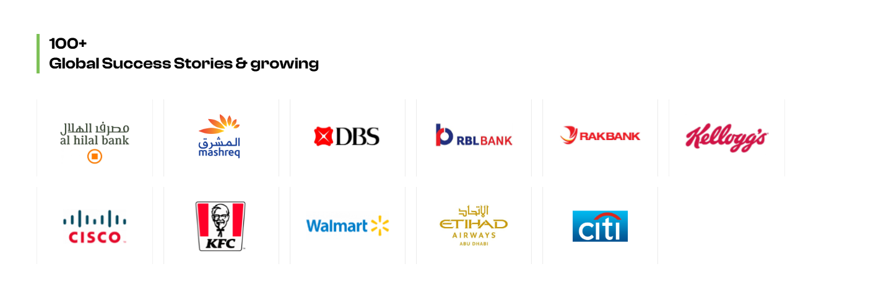

Slide 8




THANKS

