Slide 1
Sample code of RDI generation
Load raw data
Initial and Parameters
Load phase compensate value
Fast FFT
Phase compensate
Main Code
Slow FFT
RDI

Slide 2
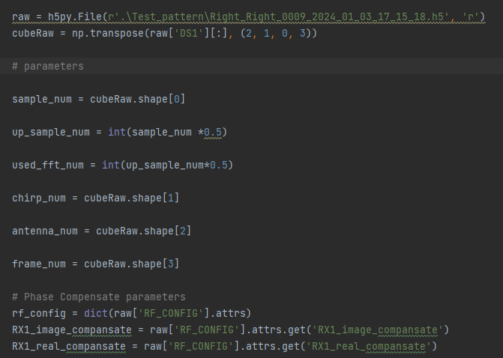
Load raw data
Parameters
Get Phase Compensate Value

Slide 3
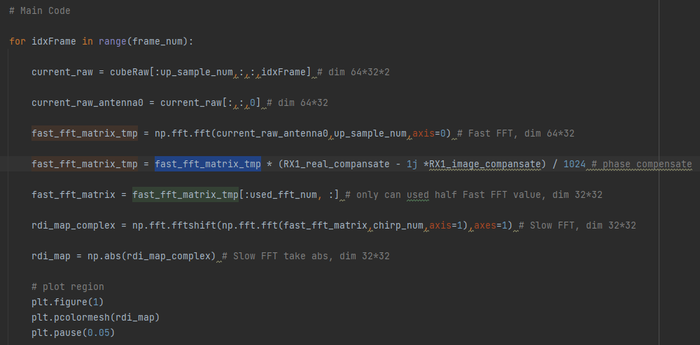
Fast FFT
Phase Compensate
Slow FFT
RDI & Plot

