Slide 1

Serversless recognition using AWS rekognition
Hasritha Reddy Cheruku 2210030012
Under the esteemed guidance of
Ms. P. Sree Lakshmi
Assistant Professor,
Department of Computer Science and Engineering

Slide 2
Project Overview
In today's digital world, the volume of images and videos being generated and stored in the cloud is growing rapidly. Many organizations need to analyze this visual data for security, automation, content moderation, and business intelligence. However, setting up traditional servers for image recognition can be expensive, time-consuming, and difficult to scale.
This presents an opportunity to use serverless technologies combined with AWS Rekognition, a powerful image and video analysis service. By leveraging AWS's serverless architecture, we can build a highly scalable, cost-effective, and maintenance-free solution for automating visual recognition tasks such as facial analysis, object detection, and text extraction.
The main objective of this project is to develop a serverless image analysis system using AWS Rekognition. The system will automatically analyze images stored in an AWS S3 bucket, extract meaningful data (such as detected objects, faces, or text), and store the results for further use.

Slide 3
Services Used
This project leverages several powerful AWS services that work together seamlessly to provide a serverless image analysis system. These services handle everything from storing images to processing and analyzing them. Here’s a closer look at each AWS service used in the project:
Amazon S3 (Simple Storage Service)
Amazon S3 is used to store images in this project. S3 is a scalable and highly durable object storage service that allows users to store any amount of data. In this project, when an image is uploaded to the designated S3 bucket, it automatically triggers a series of actions in the system. S3 is the starting point of the workflow, where images are stored and event notifications are sent to initiate processing by the Lambda function.
S3 provides several benefits such as built-in redundancy, ease of integration with other AWS services, and minimal cost, making it a perfect choice for storing large volumes of data like images.

Slide 4
AWS Lambda
AWS Lambda is at the heart of the serverless architecture in this project. Lambda runs code in response to events, such as the upload of an image to an S3 bucket. The Lambda function is responsible for processing the image and calling the Amazon Rekognition service to analyze the image’s content. With Lambda, there is no need to provision or manage servers, as the service automatically scales based on the workload.Lambda allows the code to run only when triggered, which is cost-effective since users only pay for the time the function is running, rather than keeping a server running continuously.
Amazon Rekognition
Amazon Rekognition is the main service for image and video analysis in this project. It leverages deep learning models to detect objects, scenes, text, faces, and other elements within an image. When an image is uploaded to the S3 bucket, the Lambda function calls Rekognition to perform analysis on the image. The Rekognition API returns detailed results, such as labels for objects found in the image or facial analysis results, which are then logged in Amazon CloudWatch.
Rekognition provides a fully managed, highly accurate service that requires no machine learning expertise to use. It is ideal for quickly adding advanced image analysis features to applications.

Slide 5
Amazon CloudWatch
Amazon CloudWatch is used for monitoring and logging Lambda execution. Every time the Lambda function processes an image, the results (such as detected labels or facial analysis data) are logged in CloudWatch. This service helps track function performance, debug issues, and maintain system health by providing logs and metrics in real-time.
CloudWatch allows developers to monitor the entire flow of the application, providing insight into Lambda function executions and Rekognition API responses. It also facilitates easy troubleshooting by displaying detailed logs of what happens during each Lambda invocation.
AWS IAM (Identity and Access Management)
AWS IAM plays a crucial role in securing the communication between services. In this project, an IAM role is created and assigned to the Lambda function. This role grants the necessary permissions for Lambda to interact with other AWS services, such as S3, Rekognition, and CloudWatch. IAM roles ensure that each service only has access to the resources it needs, improving security and reducing the risk of unauthorized access.

Slide 6
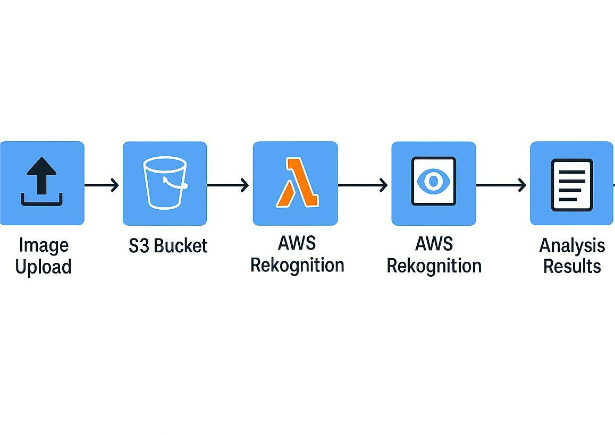
Flow Diagram

Slide 7
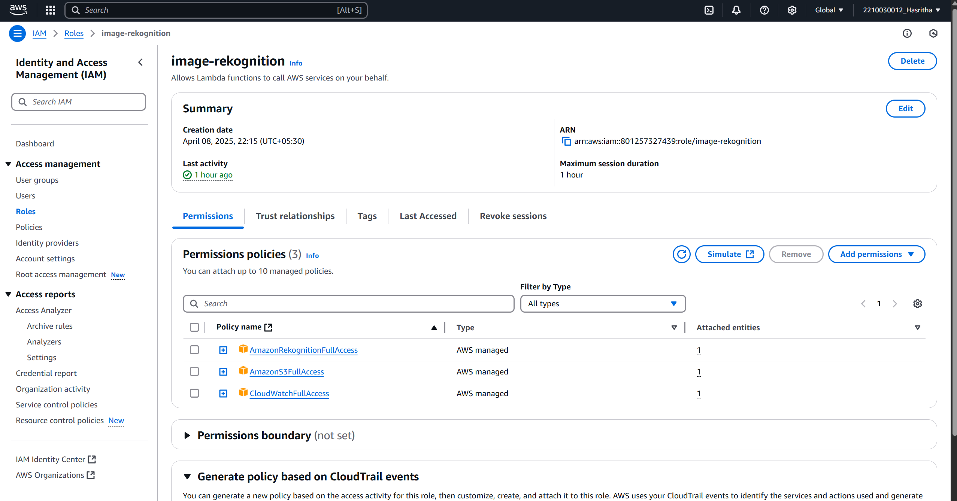
Implementation Process

Slide 8
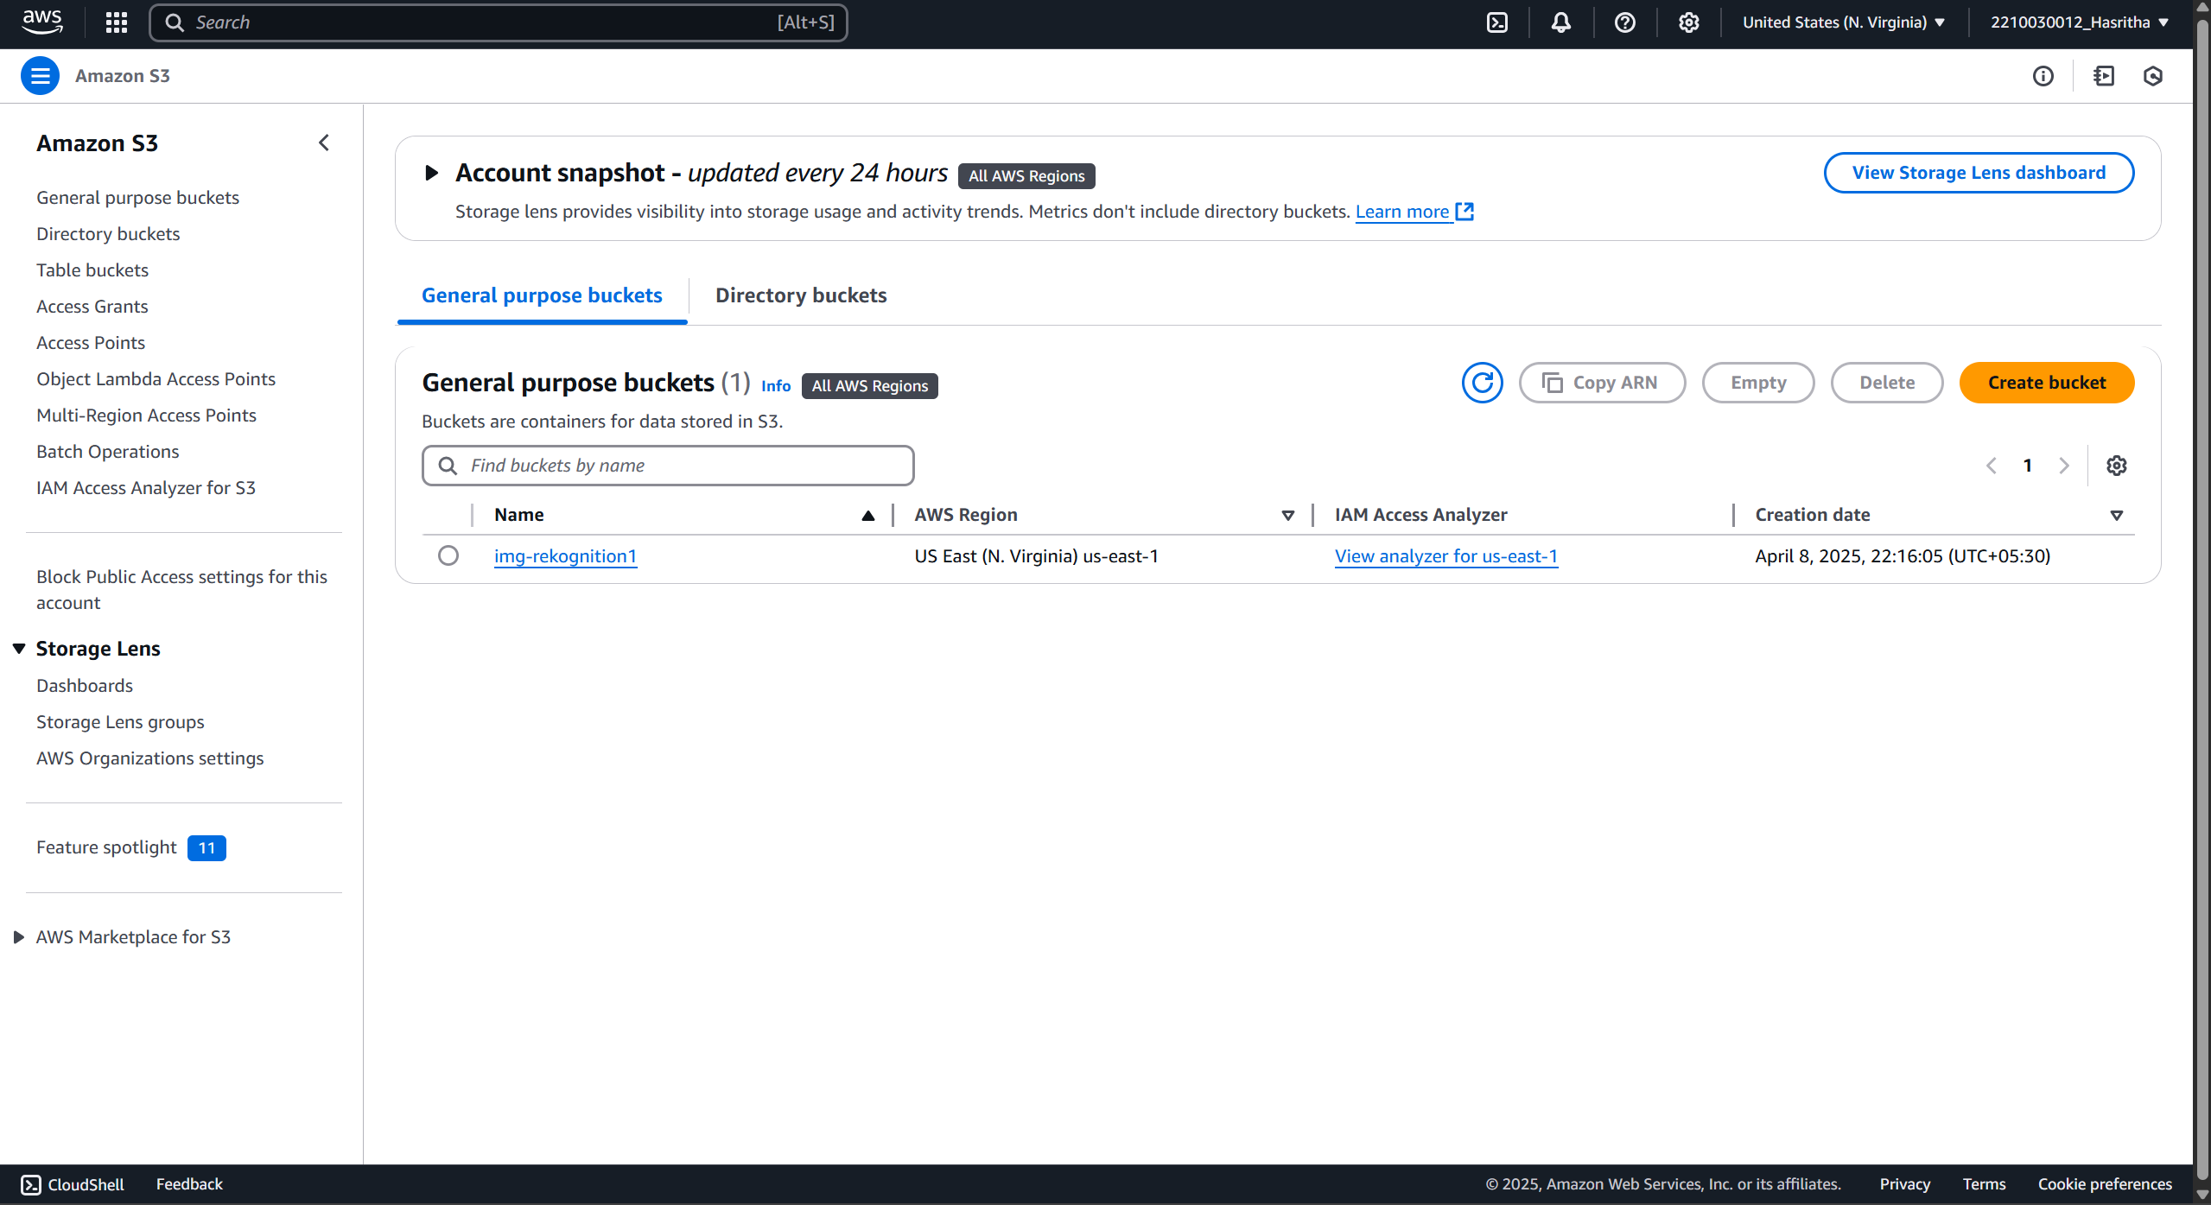

Slide 9
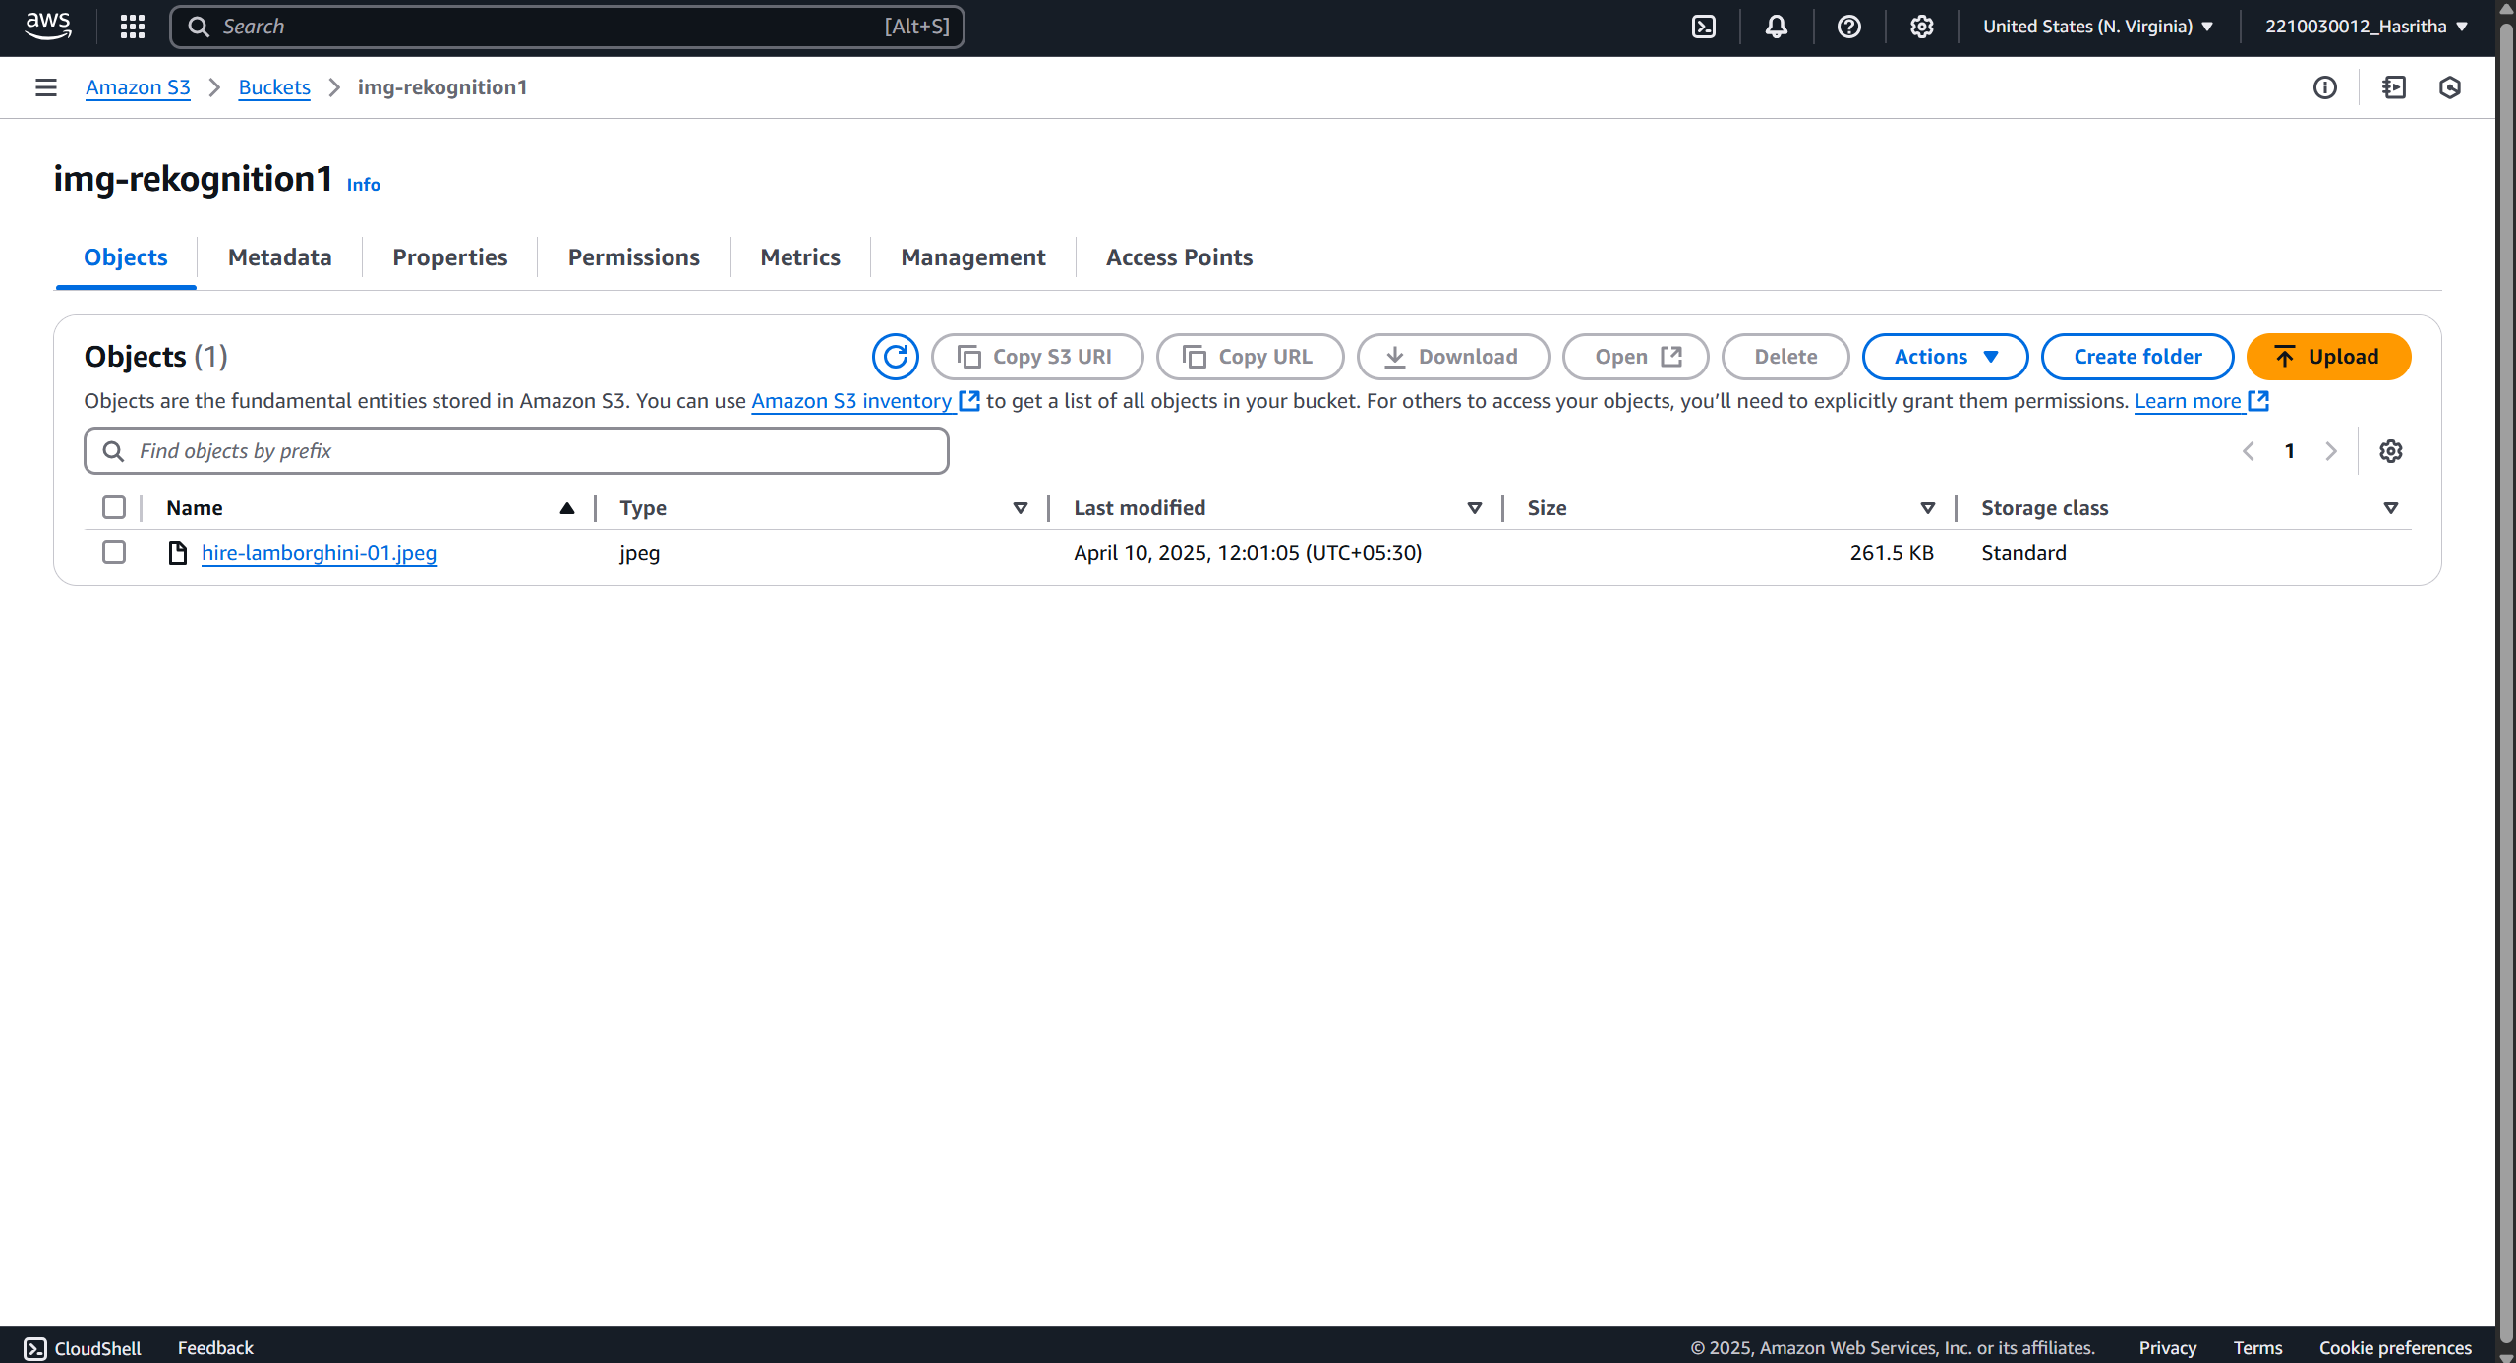

Slide 10
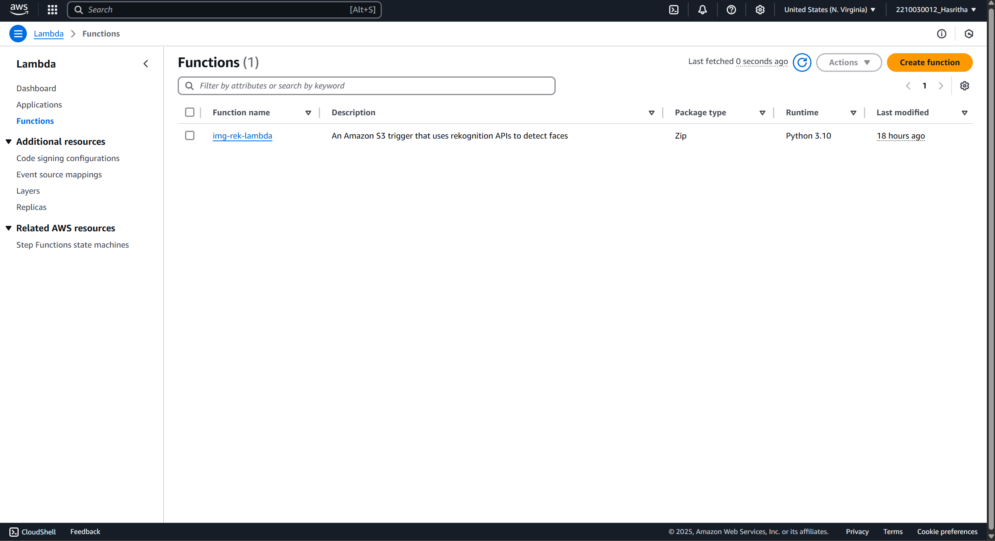

Slide 11
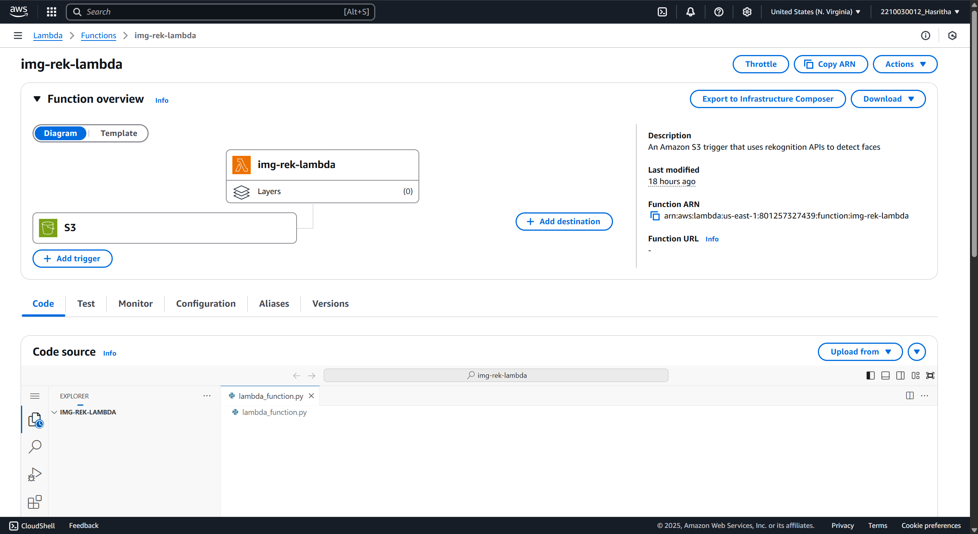

Slide 12
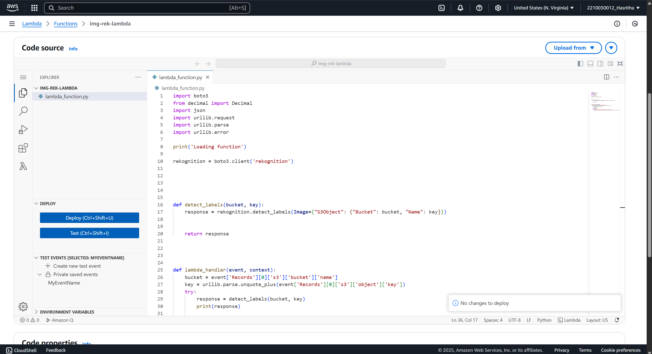

Slide 13
Key Features and Functionality
Key Features
Automatic Image Processing:
As soon as an image is uploaded to the S3 bucket, it is automatically processed without any manual steps. The system uses S3 event triggers to initiate the workflow.
Serverless Architecture:
By leveraging AWS Lambda, the project eliminates the need for managing any servers. The code is executed only when triggered, reducing operational overhead and cost.
Scalable and Real-Time:
The architecture is designed to scale based on usage. Whether it’s one image or hundreds, the system handles each upload individually and processes them in real time.

Slide 14
Integration with Amazon Rekognition:
Amazon Rekognition provides powerful image analysis capabilities such as label detection, face detection, and text recognition. The integration with Lambda allows these features to be used dynamically.
Secure Role-Based Access:
IAM roles are configured to ensure that each AWS service has the exact permissions required. This improves security by applying the principle of least privilege.
Centralized Logging and Monitoring:
All analysis results and Lambda execution logs are stored in Amazon CloudWatch. This allows for centralized monitoring of system activity, performance, and error tracking.
Cost-Effective:
Since the services used are pay-per-use, the overall cost of running this system remains low. There are no upfront infrastructure costs, and users only pay for what they use.
The system can be extended to include notifications (using SNS), save results to databases (like DynamoDB), or even integrate with front-end applications for real-time feedback.

Slide 15
Functionality
The core functionality of this project is to automatically analyze images uploaded to a cloud storage bucket and extract meaningful information from them using machine learning. The system uses AWS Rekognition to perform various image analysis tasks, such as detecting objects, faces, or text within an image, all without human intervention.
When an image is uploaded to the Amazon S3 bucket, an event is triggered that invokes an AWS Lambda function. This Lambda function then calls the Amazon Rekognition API and passes the uploaded image for analysis. The results returned by Rekognition — including labels, confidence scores, and detected features — are then logged to Amazon CloudWatch for monitoring and review.
The entire process is fully automated and serverless, which means it does not require any backend infrastructure to be managed manually. It is designed to be scalable and responsive, handling image uploads in real-time and processing them instantly through AWS services.

Slide 16
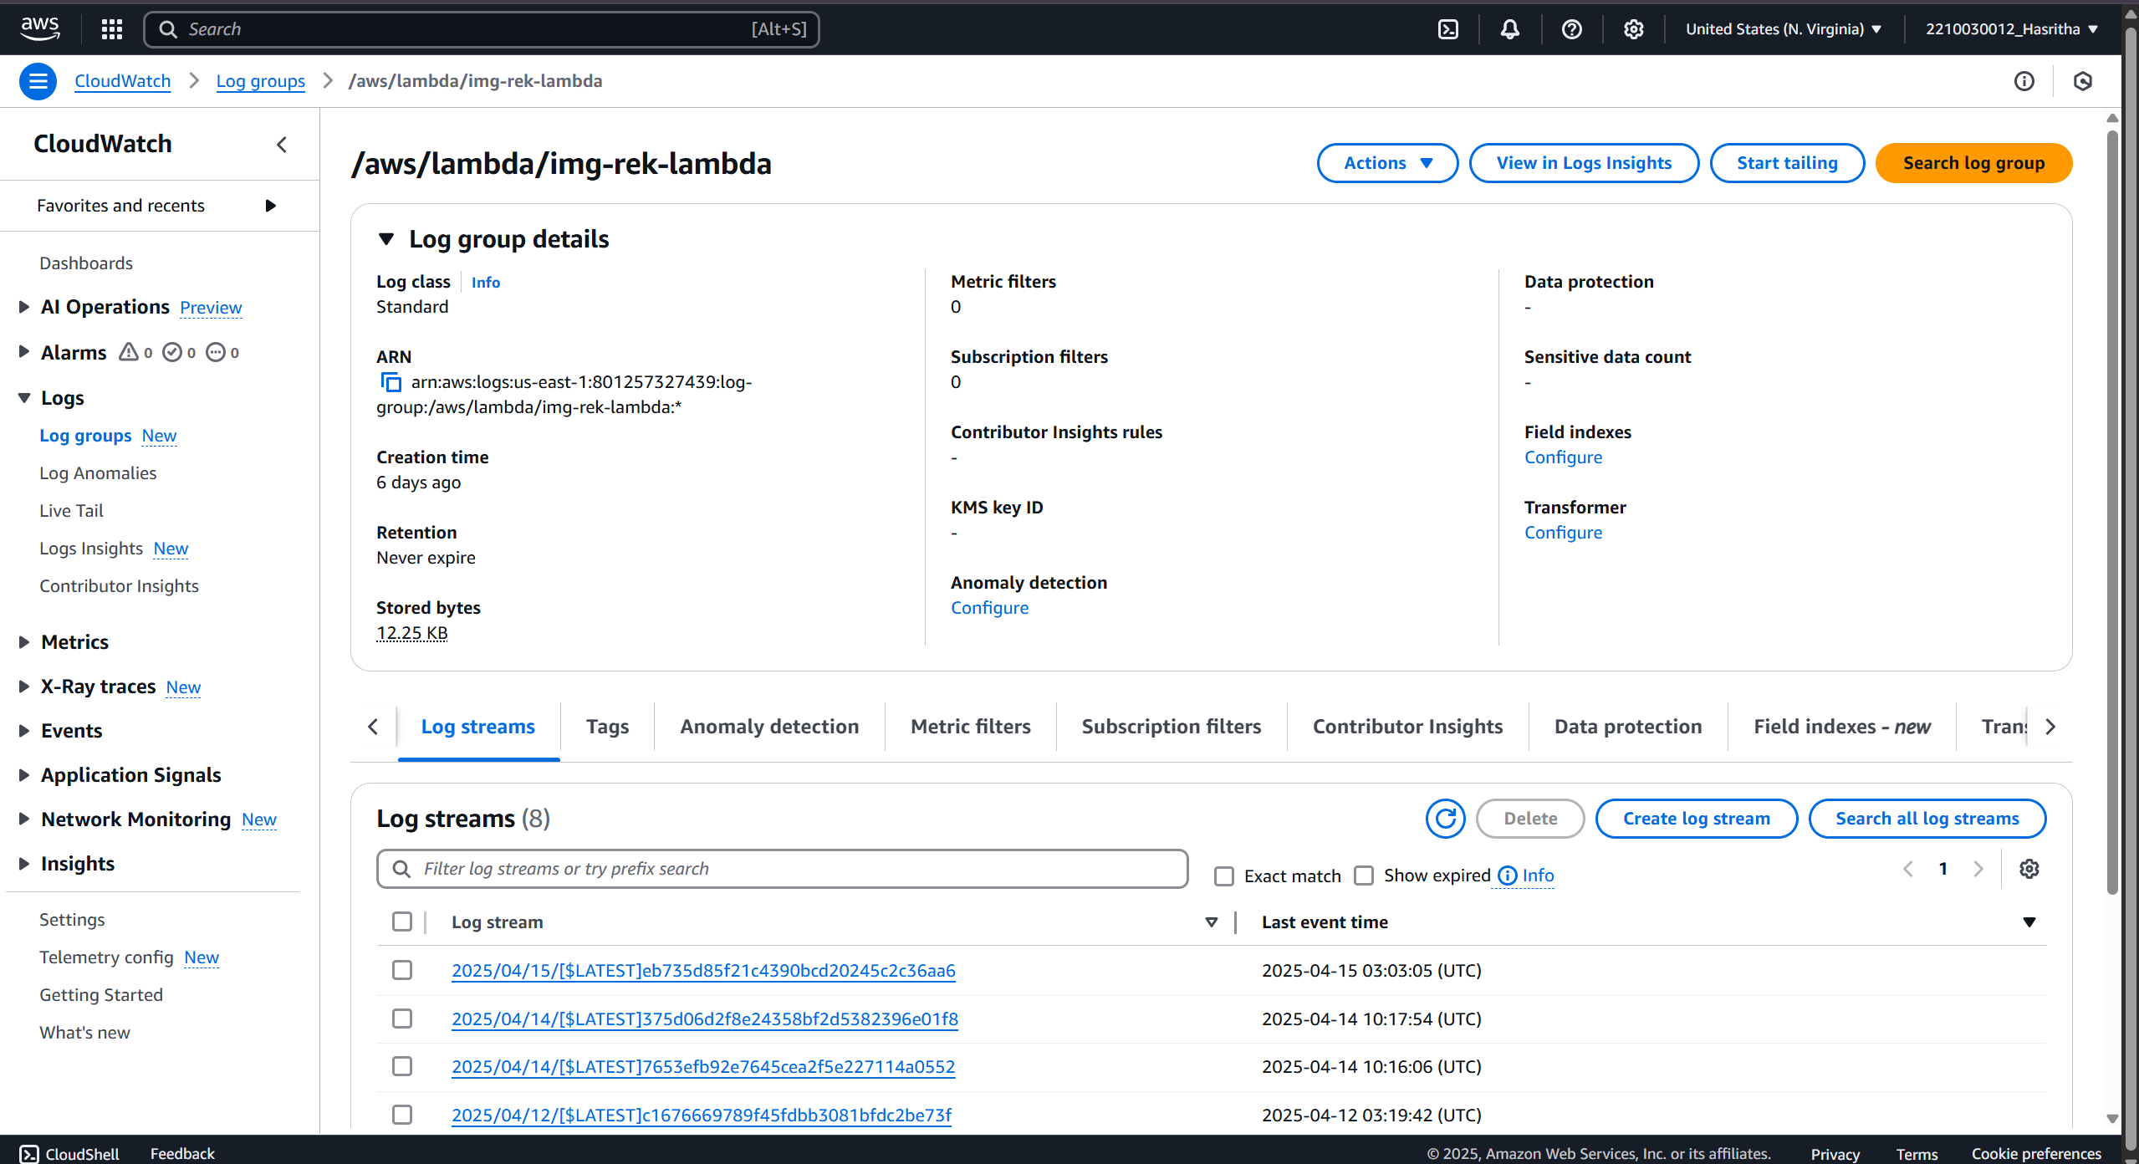
Results and Outputs

Slide 17
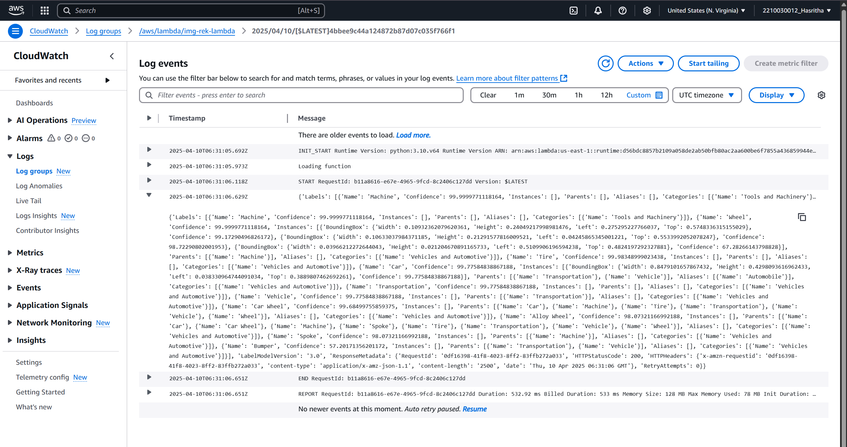

Slide 18
Learnings & Takeaways
This project offered significant insights into cloud computing and serverless architecture by utilizing various AWS services. A major takeaway was understanding how serverless computing works, particularly through AWS Lambda. It became clear how Lambda functions can be triggered automatically without the need to manage any servers, making application development more efficient and scalable.
Additionally, working with AWS services such as Amazon S3, Rekognition, IAM, and CloudWatch provided hands-on experience in setting up a complete cloud-based workflow. The use of Amazon Rekognition introduced the process of image analysis using pre-trained machine learning models accessible via API. This exposure is valuable for developing applications involving facial recognition, object detection, or text extraction from images.

Slide 19
The implementation of CloudWatch for logging and monitoring helped reinforce the importance of observability in cloud applications. By tracking logs and metrics in real-time, it becomes easier to debug and optimize performance. Furthermore, configuring IAM roles and permissions ensured that each AWS service had only the necessary access, emphasizing best practices in cloud security.
Finally, the project highlighted the cost-effective nature of serverless services. Since billing is based only on usage, this architecture is suitable for both small-scale and large-scale applications. The flexibility and automation of AWS services allowed for the development of a fully functional image analysis system without requiring extensive infrastructure or manual maintenance.

Slide 20
Future Scope
This project lays the foundation for several real-world applications that can be expanded upon using the same architecture. By leveraging AWS Rekognition's capabilities along with serverless computing, the system can be adapted for more advanced and practical use cases across various industries.
One major future use is in security and surveillance systems. By using Rekognition’s face detection and facial analysis features, the system can be integrated into smart surveillance platforms to automatically identify people entering restricted areas or detect unusual activities in real-time.
Another potential use case lies in e-commerce and content moderation. Online platforms can use this system to automatically tag product images, detect inappropriate content, or verify user-uploaded media before it goes live. This reduces the need for manual moderation and speeds up content approval workflows.

Slide 21
In the healthcare industry, similar architecture can be used to analyze medical images for early detection of diseases, such as identifying anomalies in X-rays or CT scans. While Rekognition itself is not a medical tool, integrating this architecture with other specialized ML models could lead to efficient diagnostic tools.
The system can also support smart attendance systems in educational institutions and offices by recognizing faces from uploaded images or video frames. This can automate attendance tracking and increase accuracy without human intervention.
Lastly, this project can evolve into a real-time analytics dashboard where results from Rekognition are stored in a database like DynamoDB or RDS, and visualized using services like AWS QuickSight. This allows organizations to track and analyze image content trends over time.

Slide 22
References
1.What is Amazon Rekognition?. https://docs.aws.amazon.com/rekognition/latest/dg/what-is.html
2. AWS Lambda Developer Guide. https://docs.aws.amazon.com/lambda/latest/dg/welcome.html
3. Amazon S3 Documentation. https://docs.aws.amazon.com/s3/index.html
4. Amazon CloudWatch Documentation. https://docs.aws.amazon.com/cloudwatch/
5. IAM Roles and Policies. https://docs.aws.amazon.com/IAM/latest/UserGuide/introduction.html

Slide 23
THANK YOU

