Slide 1
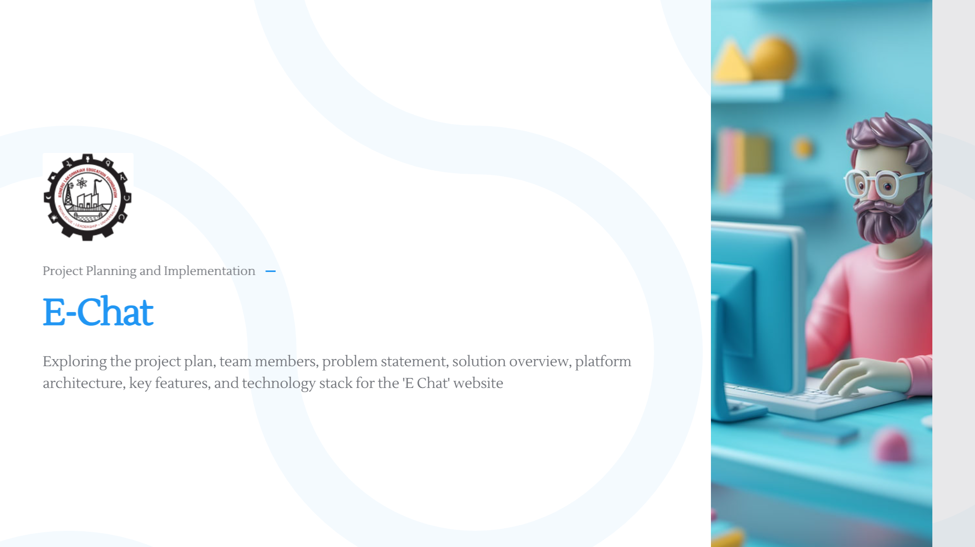

Slide 2
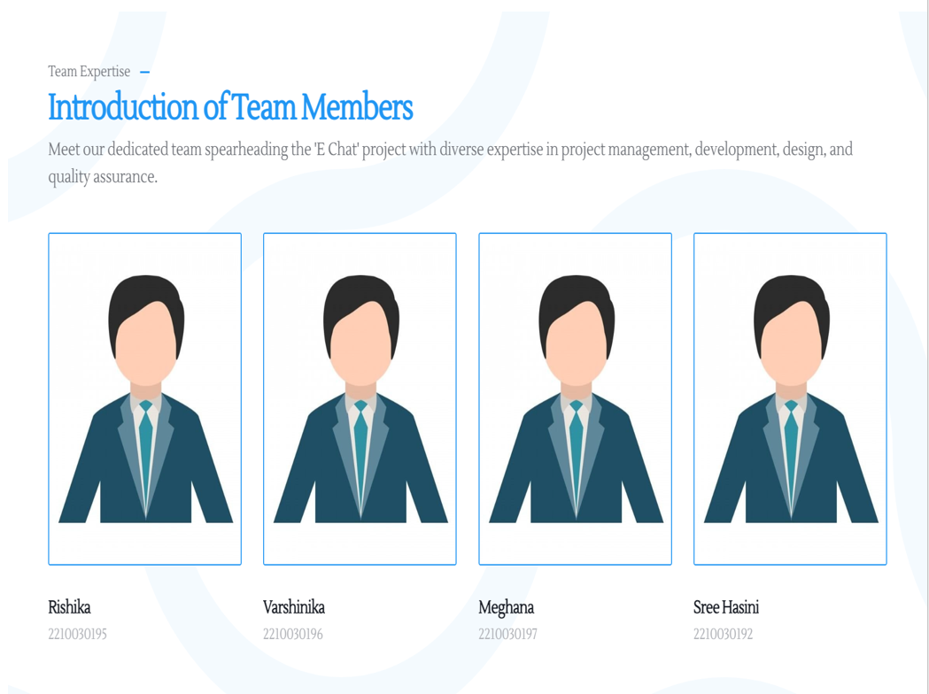

Slide 3
PROBLEM STATEMENT
Time-consuming Group Creation
Dependency on External Platforms
Need for Automation
To avoid Confusion for Searching for a particular group
To avoid Students from missing to join a particular group.

Slide 4

FEATURES OF OUR PROJECT:
Creates and adds students and faculties to their respective groups without manually doing it .
Groups are Systematically arranged according to semesters to avoid the chaos in searching for a particular subject group.

Slide 5
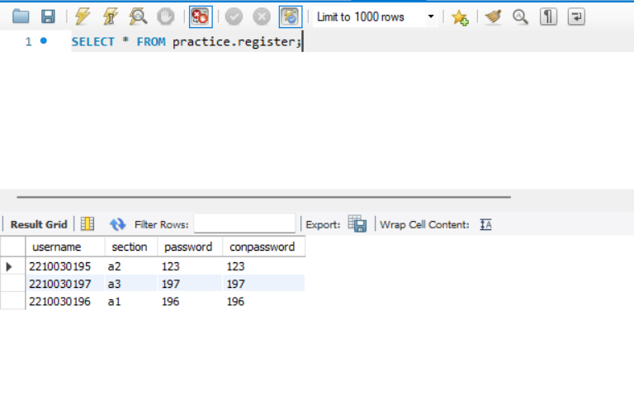
FEW SAMPLE DATABASE TABLES:

Slide 6
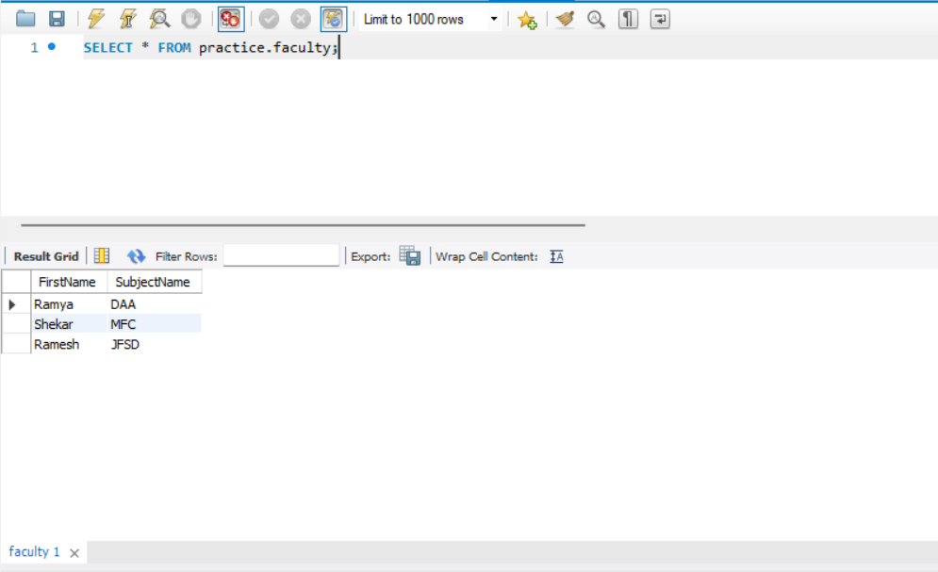
FEW SAMPLE DATABASE TABLES:

Slide 7
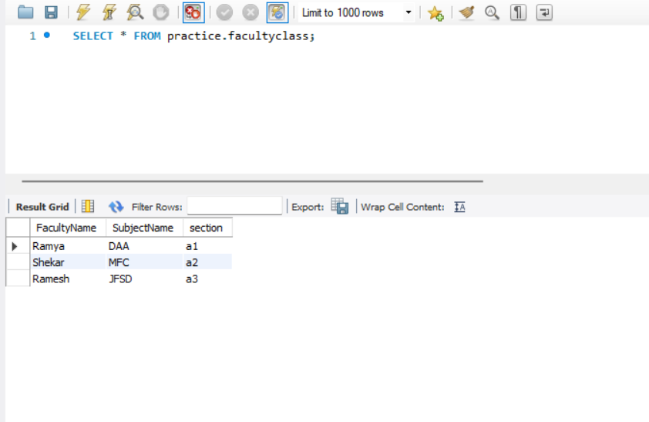
FEW SAMPLE DATABASE TABLES:

Slide 8
THANKYOU!!!

