Slide 1


IntelliChat
Team – 14-A4

Slide 2


CONTENT
TECHNOLOGY USED
ACCOUNT CREATION
LOGIN FLOW
USE CASE DIAGRAM
ARCHITECTURE
MAIN FEATURES

Slide 3
TECHNOLOGY USED
MERN Stack(MongoDB, Express.js, React.js, node.js)
Socket io
Heroku(Cloud deployment)

Slide 4
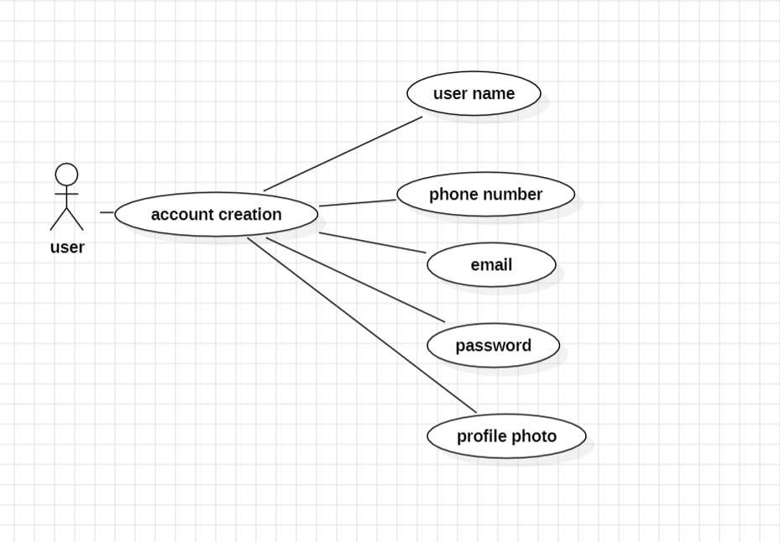
ACCOUNT CREATION

Slide 5
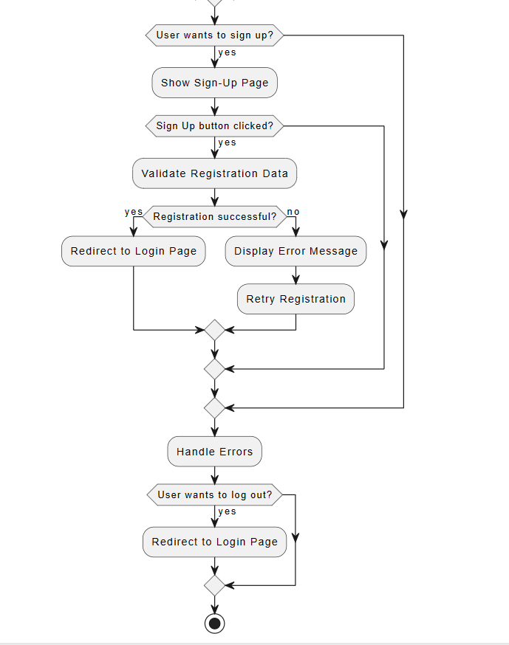
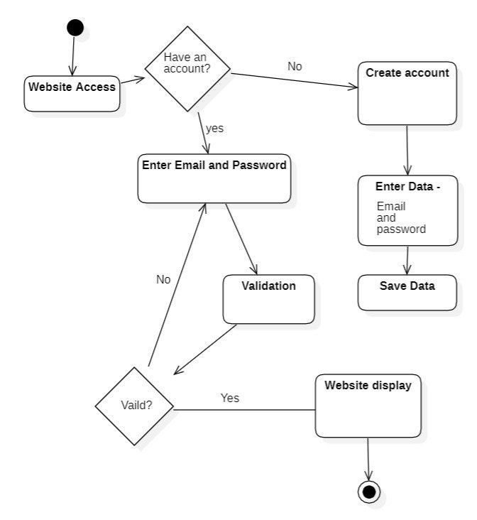
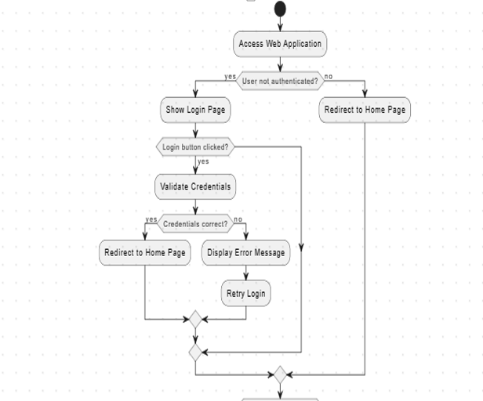
LOGIN FLOW

Slide 6
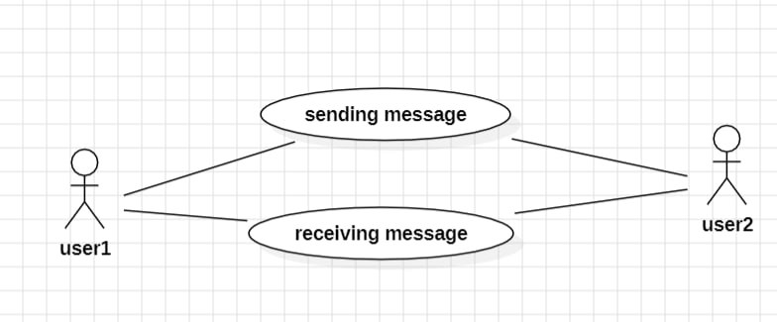
USE CASE DIAGRAM

Slide 7
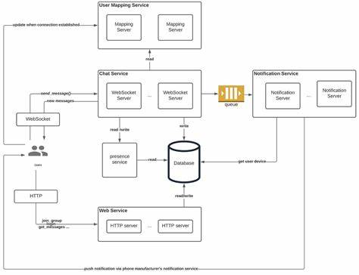
ARCHITECTURE

Slide 8
MAIN FEATURES
Send message
Create Groups for group chat
Authentication is based on mail so multiple accounts can be created.
For example: One account can be created for personal other can be a professional or
for organization.

