Slide 1
Week 2 Day 4
JDBC

Slide 2

Java: Maven
Java dependency manager and build automation tool
Project configuration handled in the pom.xml
Maven Project Coordinates:
What identify the project itself
group-id
artifact-id
version

Slide 3
Maven: Project Object Model
The POM (Project object Model) contains:
Project Coordinates
Project specific properties
Dependencies
Dependencies come from the Maven Repository
Project will look first locally for preloaded dependencies
Project will download any missing dependencies from the Maven Repository

Slide 4
Maven: LifeCycles
Building a project takes your java code and packages it into a jar/war
When building the developer can choose one of three built in lifecyles
Default
Clean
Site

Slide 5
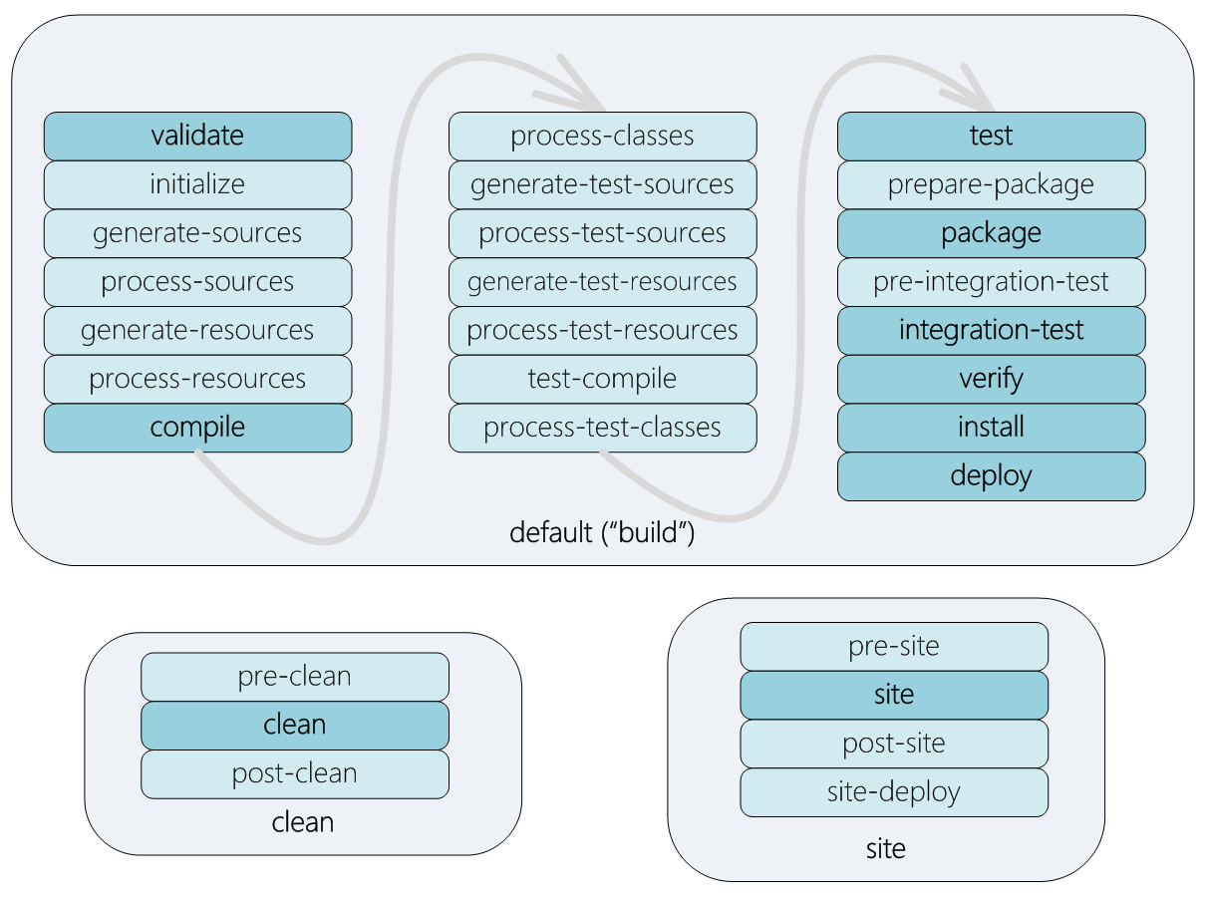
Maven: Life Cycle Phases
When building your project, the default build life cycle goes through these phases
Validate
Compile
Test
Package
Integration
Verify
Install
Deploy
Source: https://i.stack.imgur.com/yg0mZ.png

Slide 6
JDBC
Java Database Conectivity

Slide 7
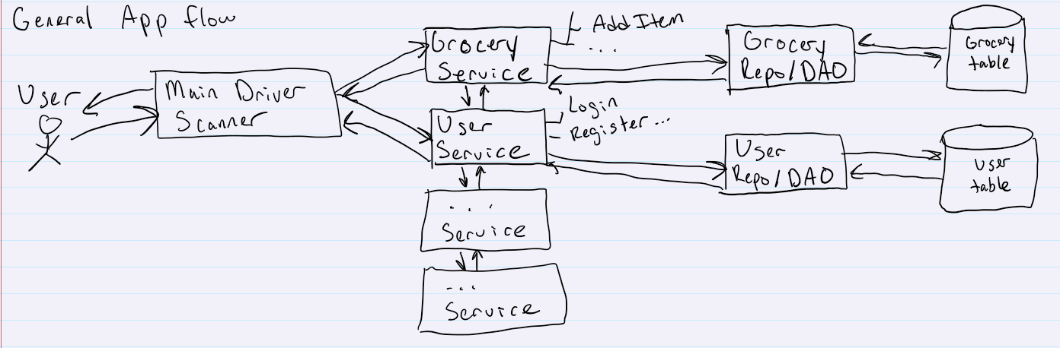
Design Pattern: Data Access Object
Separates your business logic from your database connectivity
More reusable code
Cleaner project structure

Slide 8
JDBC: Overview
Java Database Connectivity
Allows java code to interact with RDBMS
Important Interfaces of the API
DriverManager<I>
DataSource<I>
Connection<I>
SQLException<C>
Statement<I>
PreparedStatement<I>
CallableStatement<I>
ResultSet<I>

Slide 9
JDBC: Configuration
Must include the Driver dependency
https://mvnrepository.com/artifact/org.postgresql/postgresql/42.5.0
Must provide the following to the Connection Manager
URL to the database (jdbc:postgresql://hostname:port/database)
username
password

Slide 10
JDBC: Statement and ResultSet
Statement interface allows you to perform static SQL queries
Use the .createStatement() method of the Connection object
Include the SQL string to executed
ResultSet objects are returned from the execution of a query
Contain all the results in rows
Must loop through every result and convert to an object

Slide 11
Configure JDBC and create Statements

Slide 12
JDBC: PreparedStatements
Interface which executes pre-compiled SQL statements
Protects against SQL Injection attacks
Allows for parameterized SQL queries
Also returns a ResultSet object

Slide 13
Continued JDBC Demo

