Slide 1
ECOMMERCE APPLICATION
BY TEAM-4
13-12-2022

Slide 2
TEAM STRUCTURE
Each team member worked on the front-end and the back-end for each feature.
Andrew was responsible for the user profile, and admin page
Andy was responsible for the reset password, and diagrams
Rin was responsible for cart, checkout and quantity select
Firas was responsible for the login, register, display products, search for products, sales/deals/featured, Dark mode, and notifications.

Slide 3
AGILE SCRUM IMPLEMENTATION
One week sprint duration.
On Mondays we did a spring planning, we defined the goals and metrics for the sprint.
We had daily meetings where everyone told what they are working on, what they are stuck on, and their goals for the day
On Fridays we reviewed what was accomplished, also we did sprint retrospective to review the metrics, and to plan to make improvement.

Slide 4
GITFLOW AND BRANCHING STRATEGIES
Each team member created a branch
Each team member pulled the main branch from the GitHub
Each team member worked on the feature on his branch.
Once the feature completed, we merged it to the local main branch
Then we pushed to the remote main branch.

Slide 5
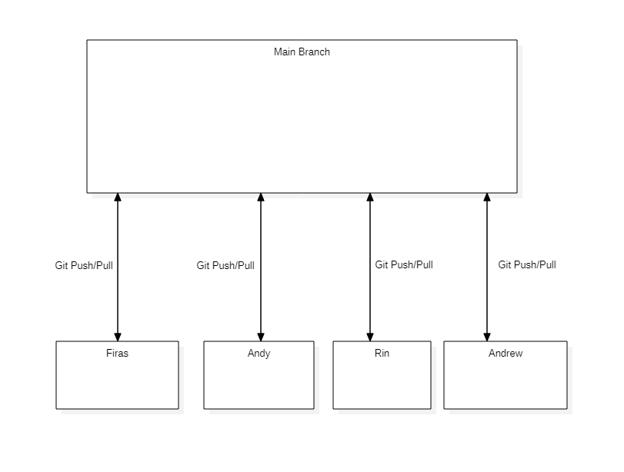
GITFLOW AND BRANCHING STRATEGIES. CONTINUE

Slide 6
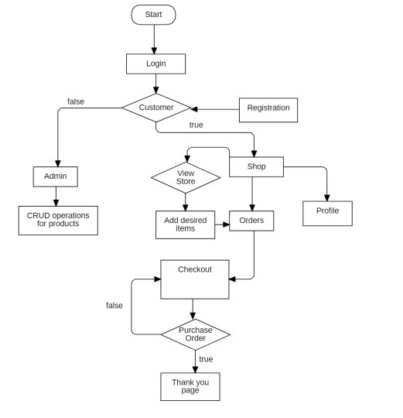
FLOW CHART DIAGRAM

Slide 7
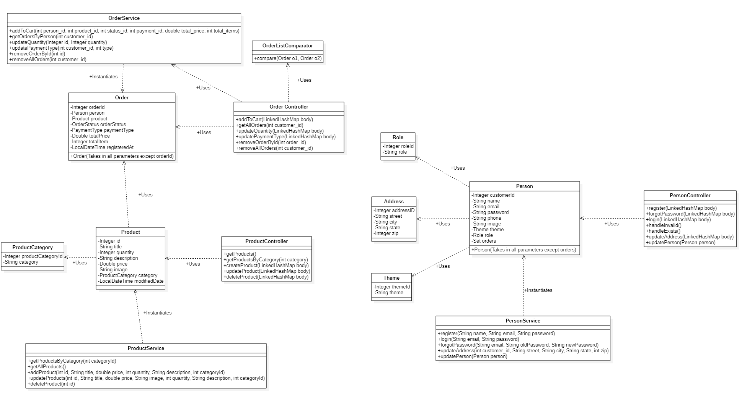
CLASS DIAGRAM

Slide 8
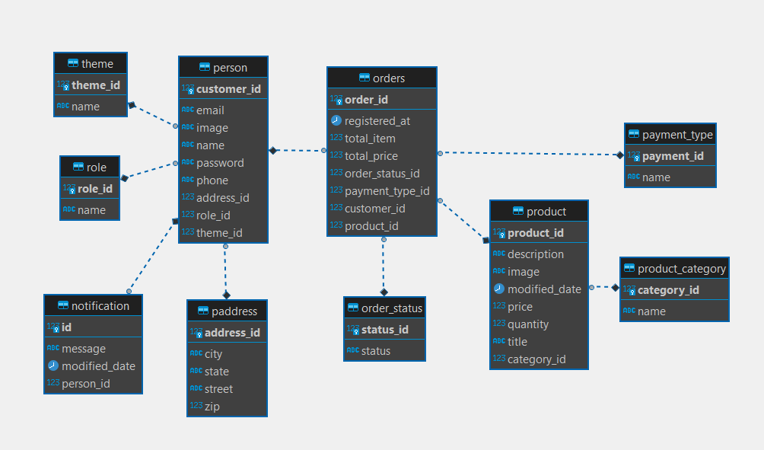
ERD DIAGRAM

Slide 9

TECHNOLOGIES UTILIZED

Slide 10
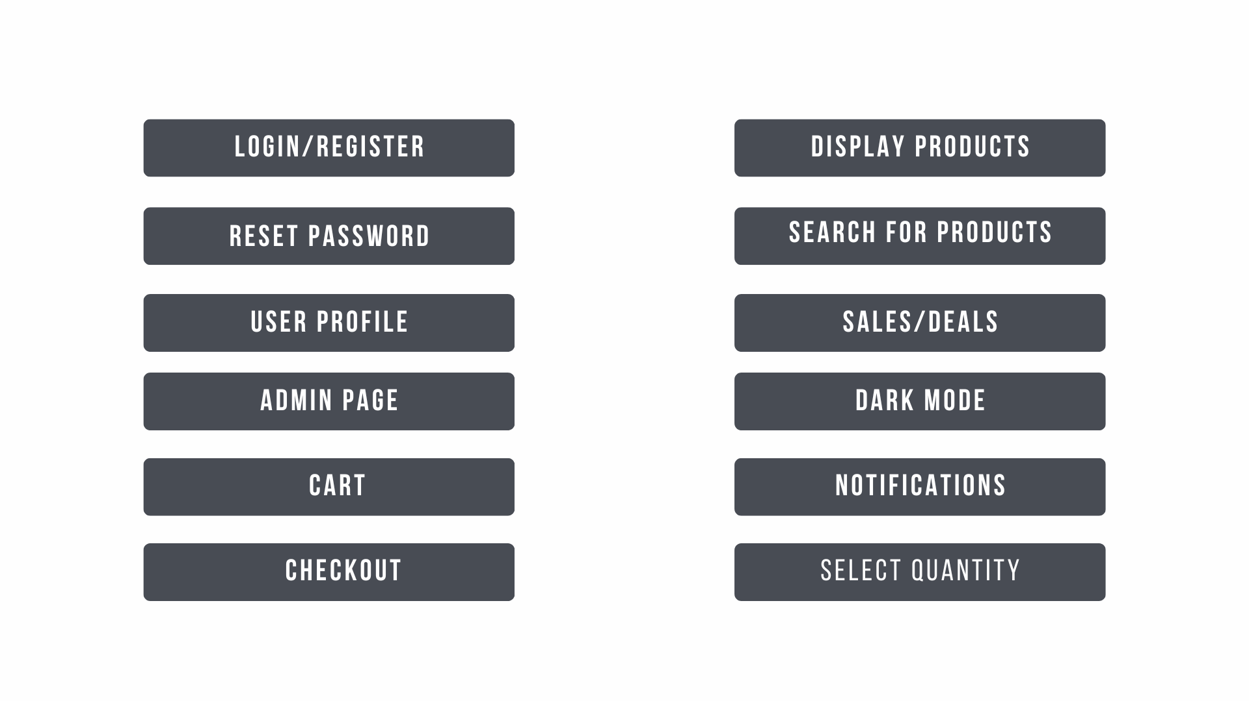
LIST OF FEATURES IMPLEMENTED

Slide 11
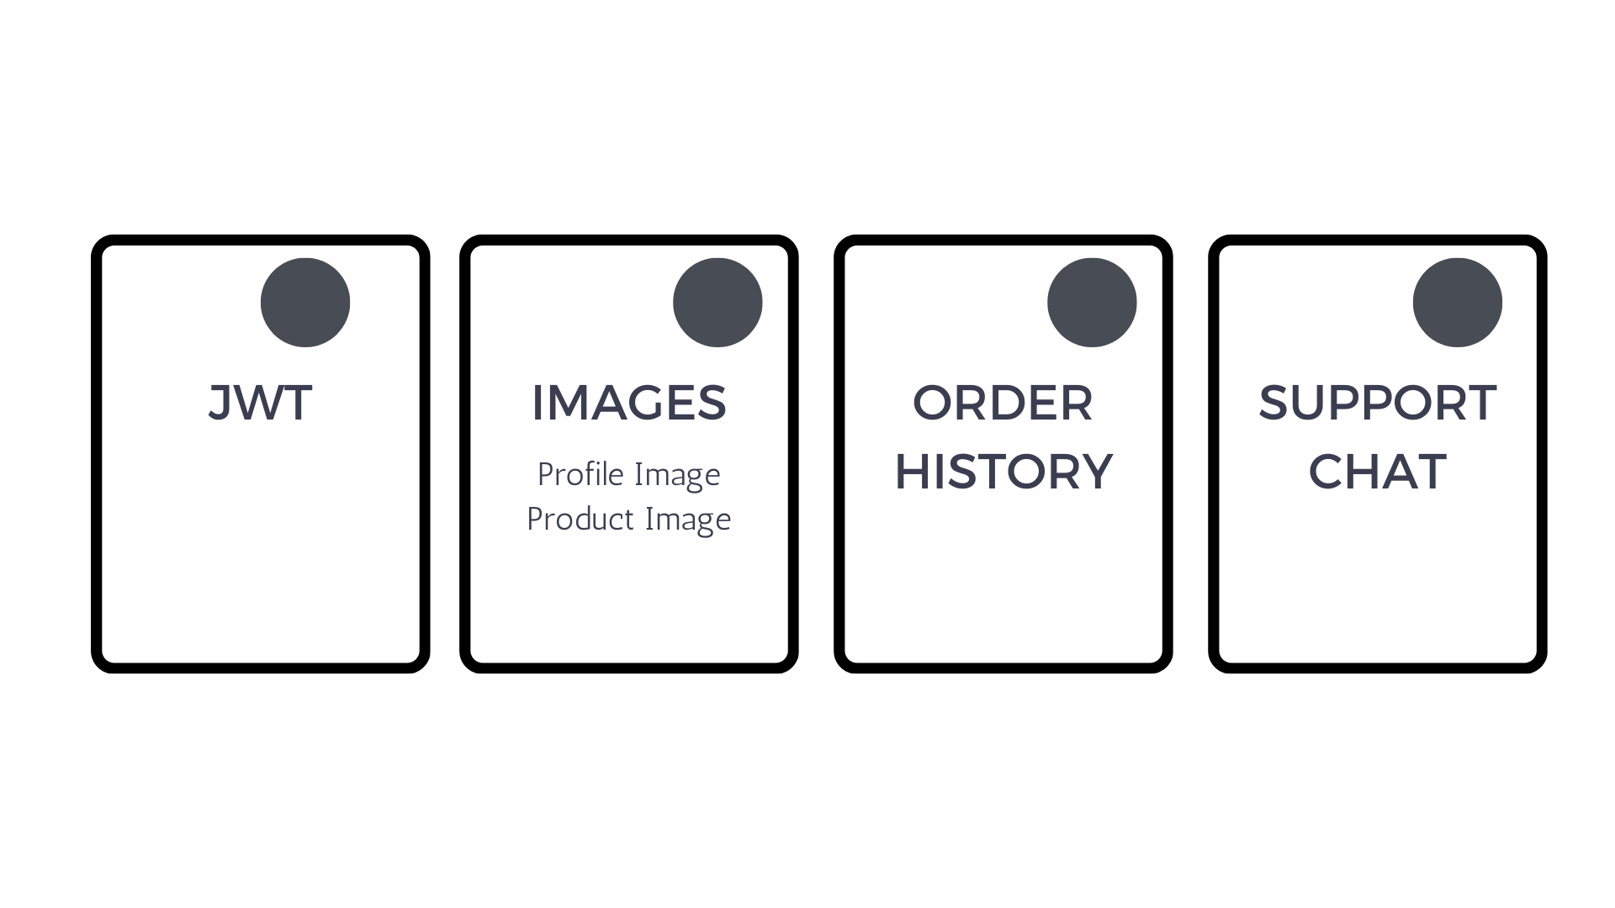
OUTSTANDING DEFECTS & ISSUES

Slide 12
CHALLENGES FACED
Merging the code to the main branch without losing any work.
Sending and receiving data from frontend to the backend and vice versa.
Managing the state.
Creating custom JPA methods.

Slide 13
DEMO

