Slide 1
SMS SPAM CLASSIFIER
Team No: 18
Team Member and Roll No:
Monalika (2210990582)
Navpreet (2210990601)
Navya (2210990602)
Neharika (2210990605)

Slide 2
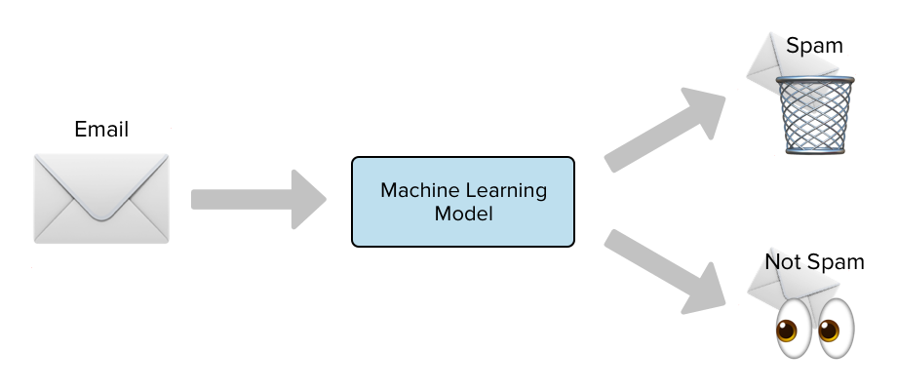
INDEX
Introduction
Objective
Methodology and Approach
Source Code
Result
Conclusion
Reference

Slide 3
INTRODUCTION
With the increasing use of mobile phones, spam messages have become a common annoyance. An SMS Spam Classifier is a tool that detects unwanted spam messages, ensuring that users only receive legitimate texts.
The main goal of this project is to create a machine learning model that can accurately classify incoming SMS messages as either "spam" or "ham" (not spam). By doing so, it helps improve user experience and security.

Slide 4
OBJECTIVE
Develop a Spam Detection System:
To create a model that can reliably distinguish between spam and non- spam messages with high accuracy.
2. Enhance User Experience:
To reduce the amount of harmful messages that users receive, thereby improving their overall communication experience.
3. Improve Security and Privacy:
To protect users from scams, and other malicious activities often associated with spam messages.

Slide 5
METHODOLOGY & APPROACH
DATA CLEANING: In the data cleaning process, we removed unnecessary columns, converted categorical data to numeric formats, identified and removed missing and duplicate values. This ensures the dataset is accurate, consistent, and ready for effective model training.
EDA: We analyzed the data by counting the number of characters, words, and tokenizing the SMS messages. We compared ham and spam messages, discovering that spam messages generally contain more characters, words, and sentences. For better clarity, we visualized these findings through plots and examined the relationships between columns to understand collinearity.
DATA PREPROCESSING: In the data preprocessing stage, we converted all text to lowercase, tokenized the messages into individual words, and removed special characters and stop words. We also removed punctuation and applied stemming to convert words into their root form. These steps ensure the text data is clean and uniform for model training.

Slide 6
METHODOLOGY & APPROACH
MODEL BUILDING:
TF-IDF Vectorizer: Transform text data into numerical features for machine learning models.
2. Logistic Regression: Predict binary outcomes (e.g., yes/no, spam/ham).
3. Support Vector Machine (SVM) : Classify data by finding the optimal separating hyperplane.
4. Decision Tree: Model decisions and their possible consequences. It is a Tree-like model with nodes representing decisions, branches representing outcomes.

Slide 7
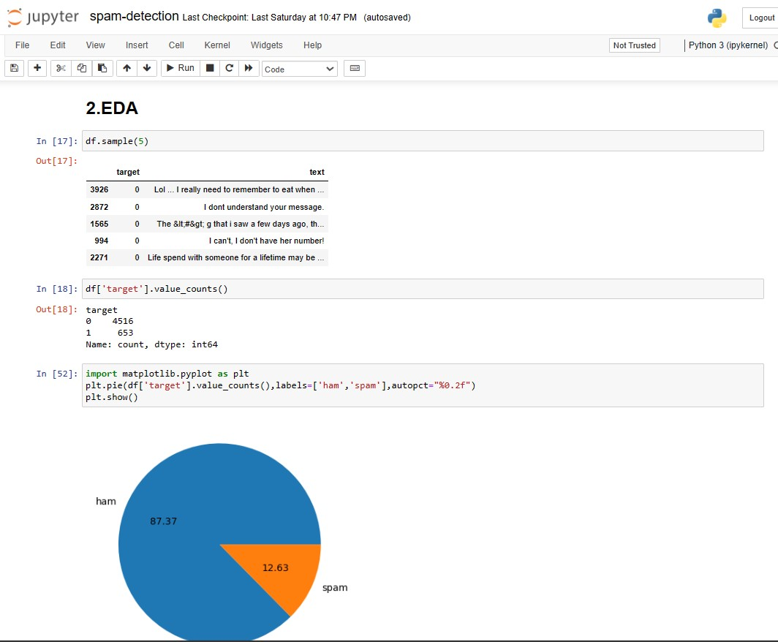
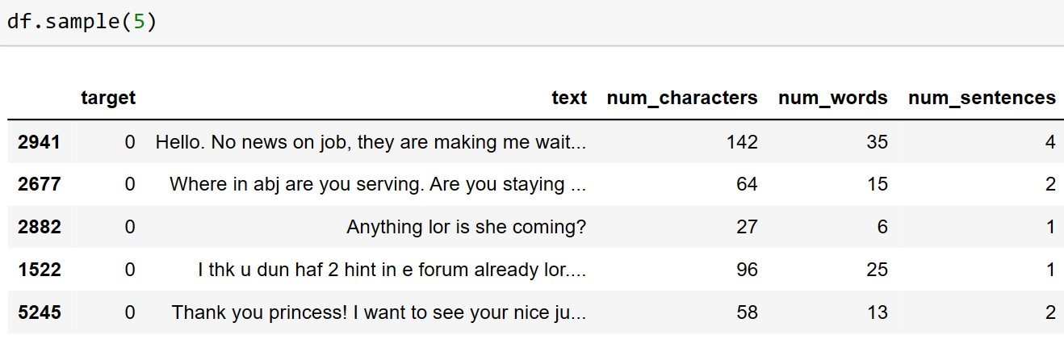
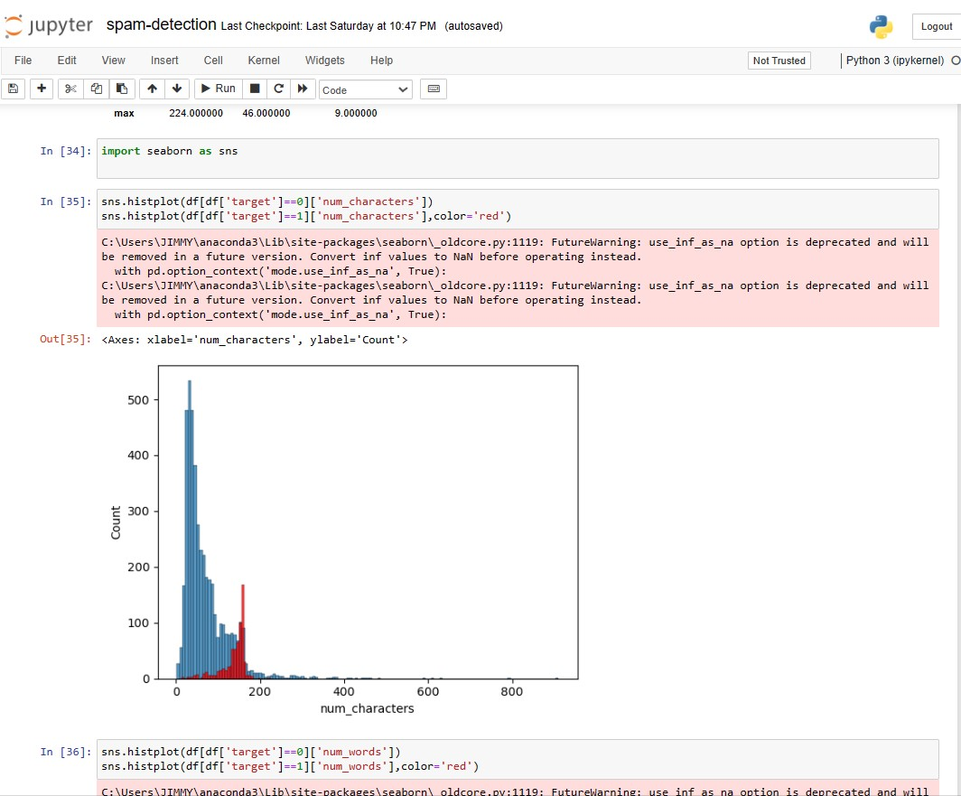
SOURCE CODE

Slide 8
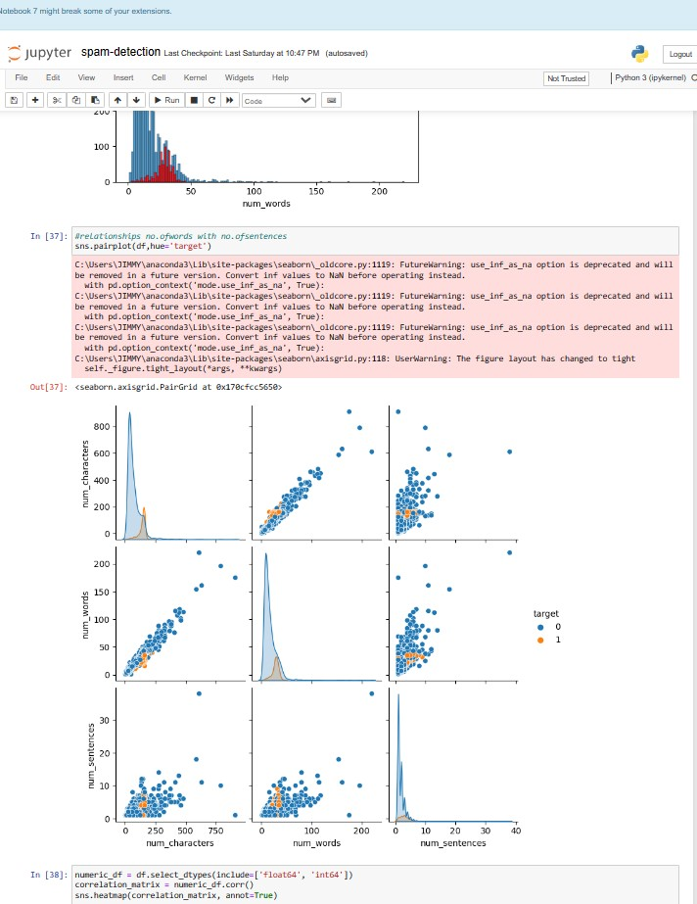
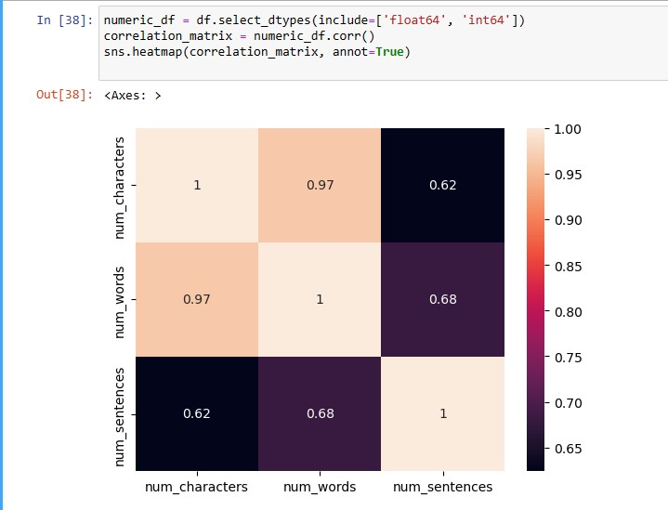
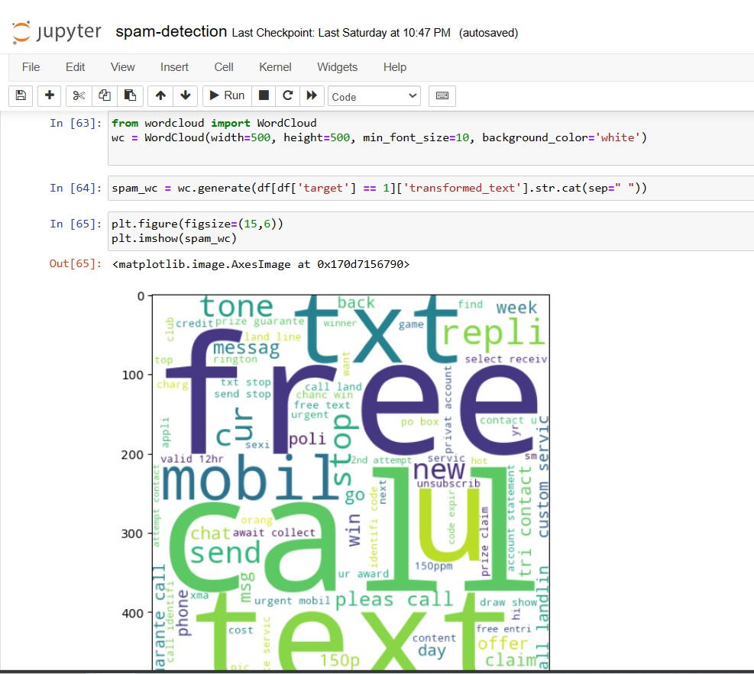
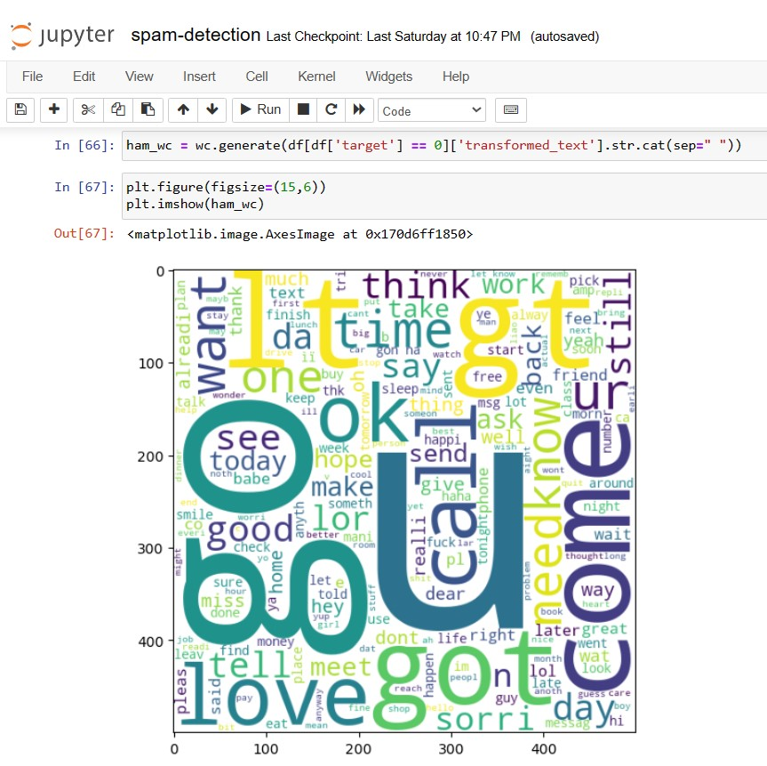
SOURCE CODE

Slide 9
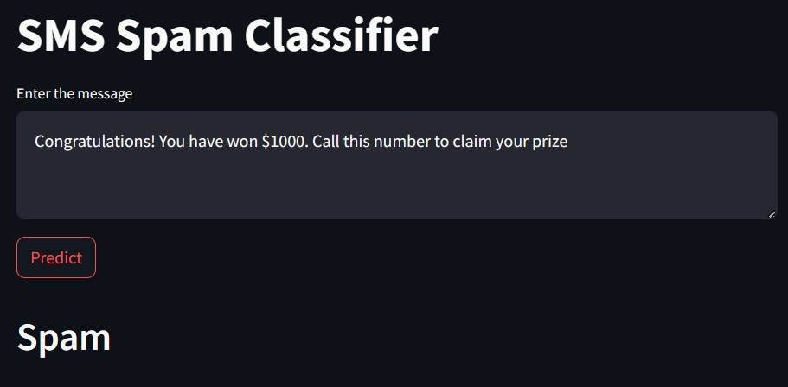
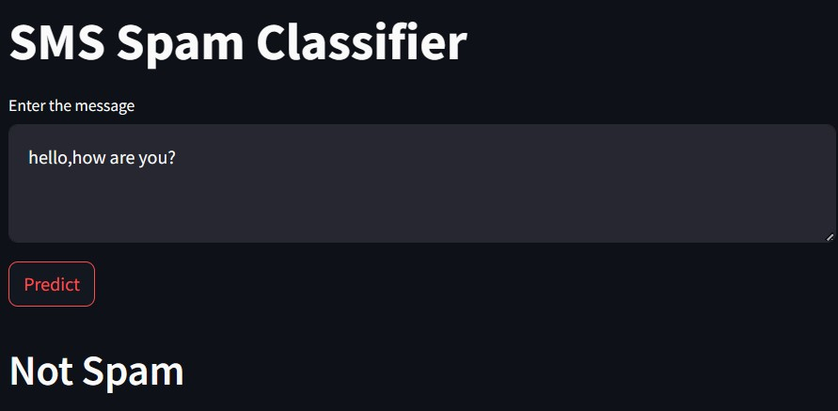
RESULT

Slide 10
CONCLUSION
In conclusion, the SMS Spam Classifier is a valuable application of AI technology that offers practical benefits. It showcases how machine learning can be used to solve real-world problems, making our digital interactions safer and more efficient. As technology continues to evolve, such intelligent systems will become increasingly important in managing and securing our communications.

Slide 11
REFERENCE
https://www.youtube.com/watch?v=FkF2jhaRJIs
https://www.kaggle.com/datasets/uciml/sms-spam-collection-dataset

Slide 12
THANK YOU

