Slide 1
Marks Drawrings
#tribute

Slide 2











Merge conflict explanation

Slide 3
Stack vs heap
Stack – value types
D1
d2
d3
d4
d2
heap | Re | Fe | Re | Nc | eT | Yp | es
1n |  |  |  |  |  | 3n
 |  |  | 2n
4n

Slide 4
Singley-Linked List
1st Node
It’s an object
3rd Node
It’s an object
2nd Node
It’s an object

Slide 5
Doubley-Linked List
1st Node
It’s an object
-Next
- previous
2nd Node
It’s an object
3rd Node
It’s an object
3rd Node
It’s an object

Slide 6
Circular-Singley-Linked List
2nd Node
It’s an object
1st Node
It’s an object
3rd Node
It’s an object
5th Node
It’s an object
^{4th} Node
It’s an object

Slide 7
Stack explanation (Stacko)
A stack is a LIFO construction. So the first thing that you pushed onto the stack is the last thing that you can take off of the stack.
Functionality of a stack:
push() – put a new obj on the stack
Pop() - return and delete the top obj
Peek() – get the data from the top obj.
Size prop – returns the size of the stack currently
Stack Class
Person3
Person4
Person2
Person1

Slide 8
P1 api application program structure “Repository Pattern”
API Project - Entrypoint
Has ‘controllers’ that contain ‘action methods’ that call methods on the business layer
ProjectReference
Data
Models
This holds all our various objects necessary in the app.
Business Layer Project
This is where business logic happens. Calls methods on the Repo layer to insert, etc data to the Db.
ProjectReference
ProjectReference
Repository Layer Project
Makes calls to the Db.

Slide 9






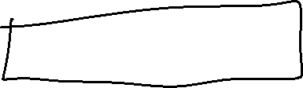


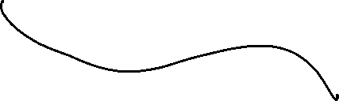

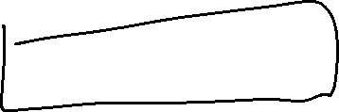




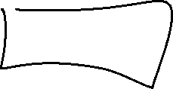








Dependency Inversion

Slide 10
Liskov substitution
Class c (IclassA x, IClassB y)
c1
C2
X.A1()
X.A2()
X.A3()
X.B1() //this fails
Y.B1()
Y.B2()
IClass A
A1
A2
A3
Class B : IclassA, Iclassb
A1
A2
A3
B1
B2
IClass B
B1
B2

Slide 11
Azure Portal structure
Subscription (AKA. Tenant)
Resource Group1 is a logical grouping of related resources (like a namespace in C# programs)
Resource Group2 is a logical grouping of related resources (like a namespace in C# programs)
Azure Db
Web App2
Web App1
Blob Storage
Azure Db
Blob Storage
Web App1
Web App2
AKS (Azure Kubernetes Service)
AKS (Azure Kubernetes Service)

Slide 12
Marks Db Structure
Customer/Address Junction
Customers
Addresses
It I want to see all the orders of Customer 1 and where they were delivered to….
Inner join customers / orders…
Orders

