Slide 1
Marks Drawrings
#tribute

Slide 2

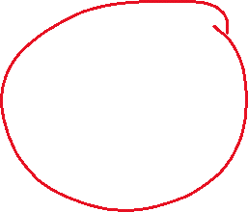









Merge conflict explanation

Slide 3
Stack vs heap
Stack – value types
D1
d2
d3
d4
d2
heap | Re | Fe | Re | Nc | eT | Yp | es

